Slide 1
Construction and Application of Small Portable Low Field MR Device
Devin Morin
University of New Brunswick

Slide 2
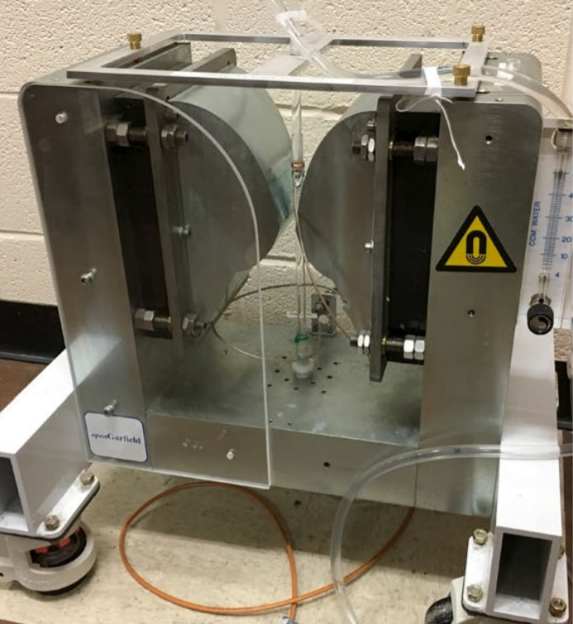
Introduction (What are we doing?)
Building a magnetic resonance device that can measure flow velocities.
Things like this have been done in the past with really large magnets of which can be hazardous a quite expensive. (Actually in our lab! Sebastian!)
How does one measure flow velocity with NMR?

Slide 3



Basic Introduction to NMR
$$Magnetic Field$$
$$Hydrogen$$
nuclei
Nuclear magnetic resonance is possible as nuclei posses angular momentum.
These nuclei can be thought of a miniature dipoles that will forced to point the direction of the applied magnetic field.
By the conservation of angular momentum, these spins will precess about the direction of the applied magnetic field.
$$ω=γB_{0}$$

Slide 4
Pulse NMR / Use of RF Coil
A Radio Frequency (RF) coil is used to flip the magnetization of sample into the transverse plane.
These nuclei decay back to the background magnetic field and induce current in the RF coil at the larmor frequency.
*Image of RF Coil and Magnet Setup

Slide 5
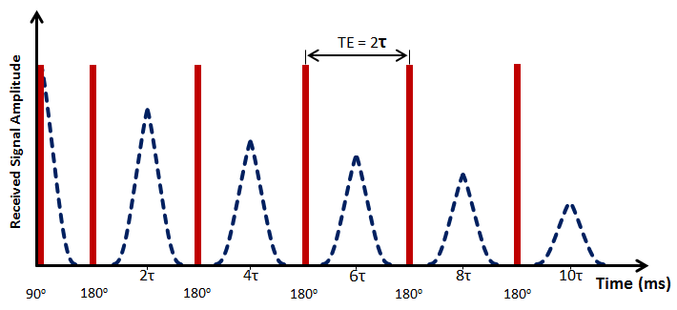
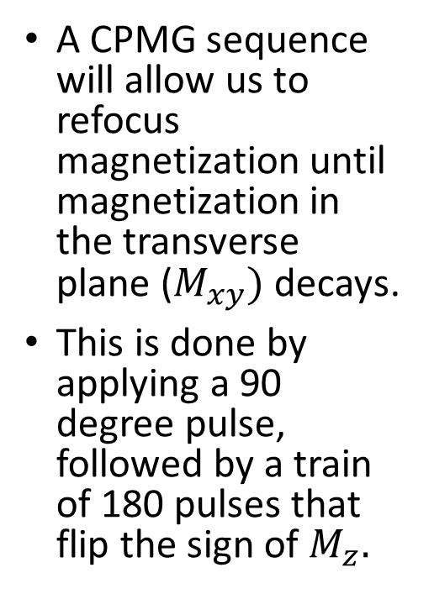
Use of CPMG for Flow Measurements
A CPMG sequence will allow us to refocus magnetization until magnetization in the transverse plane ($M_{xy})$ decays.
This is done by applying a 90 degree pulse, followed by a train of 180 pulses that flip the sign of $M_{z}.$

Slide 6
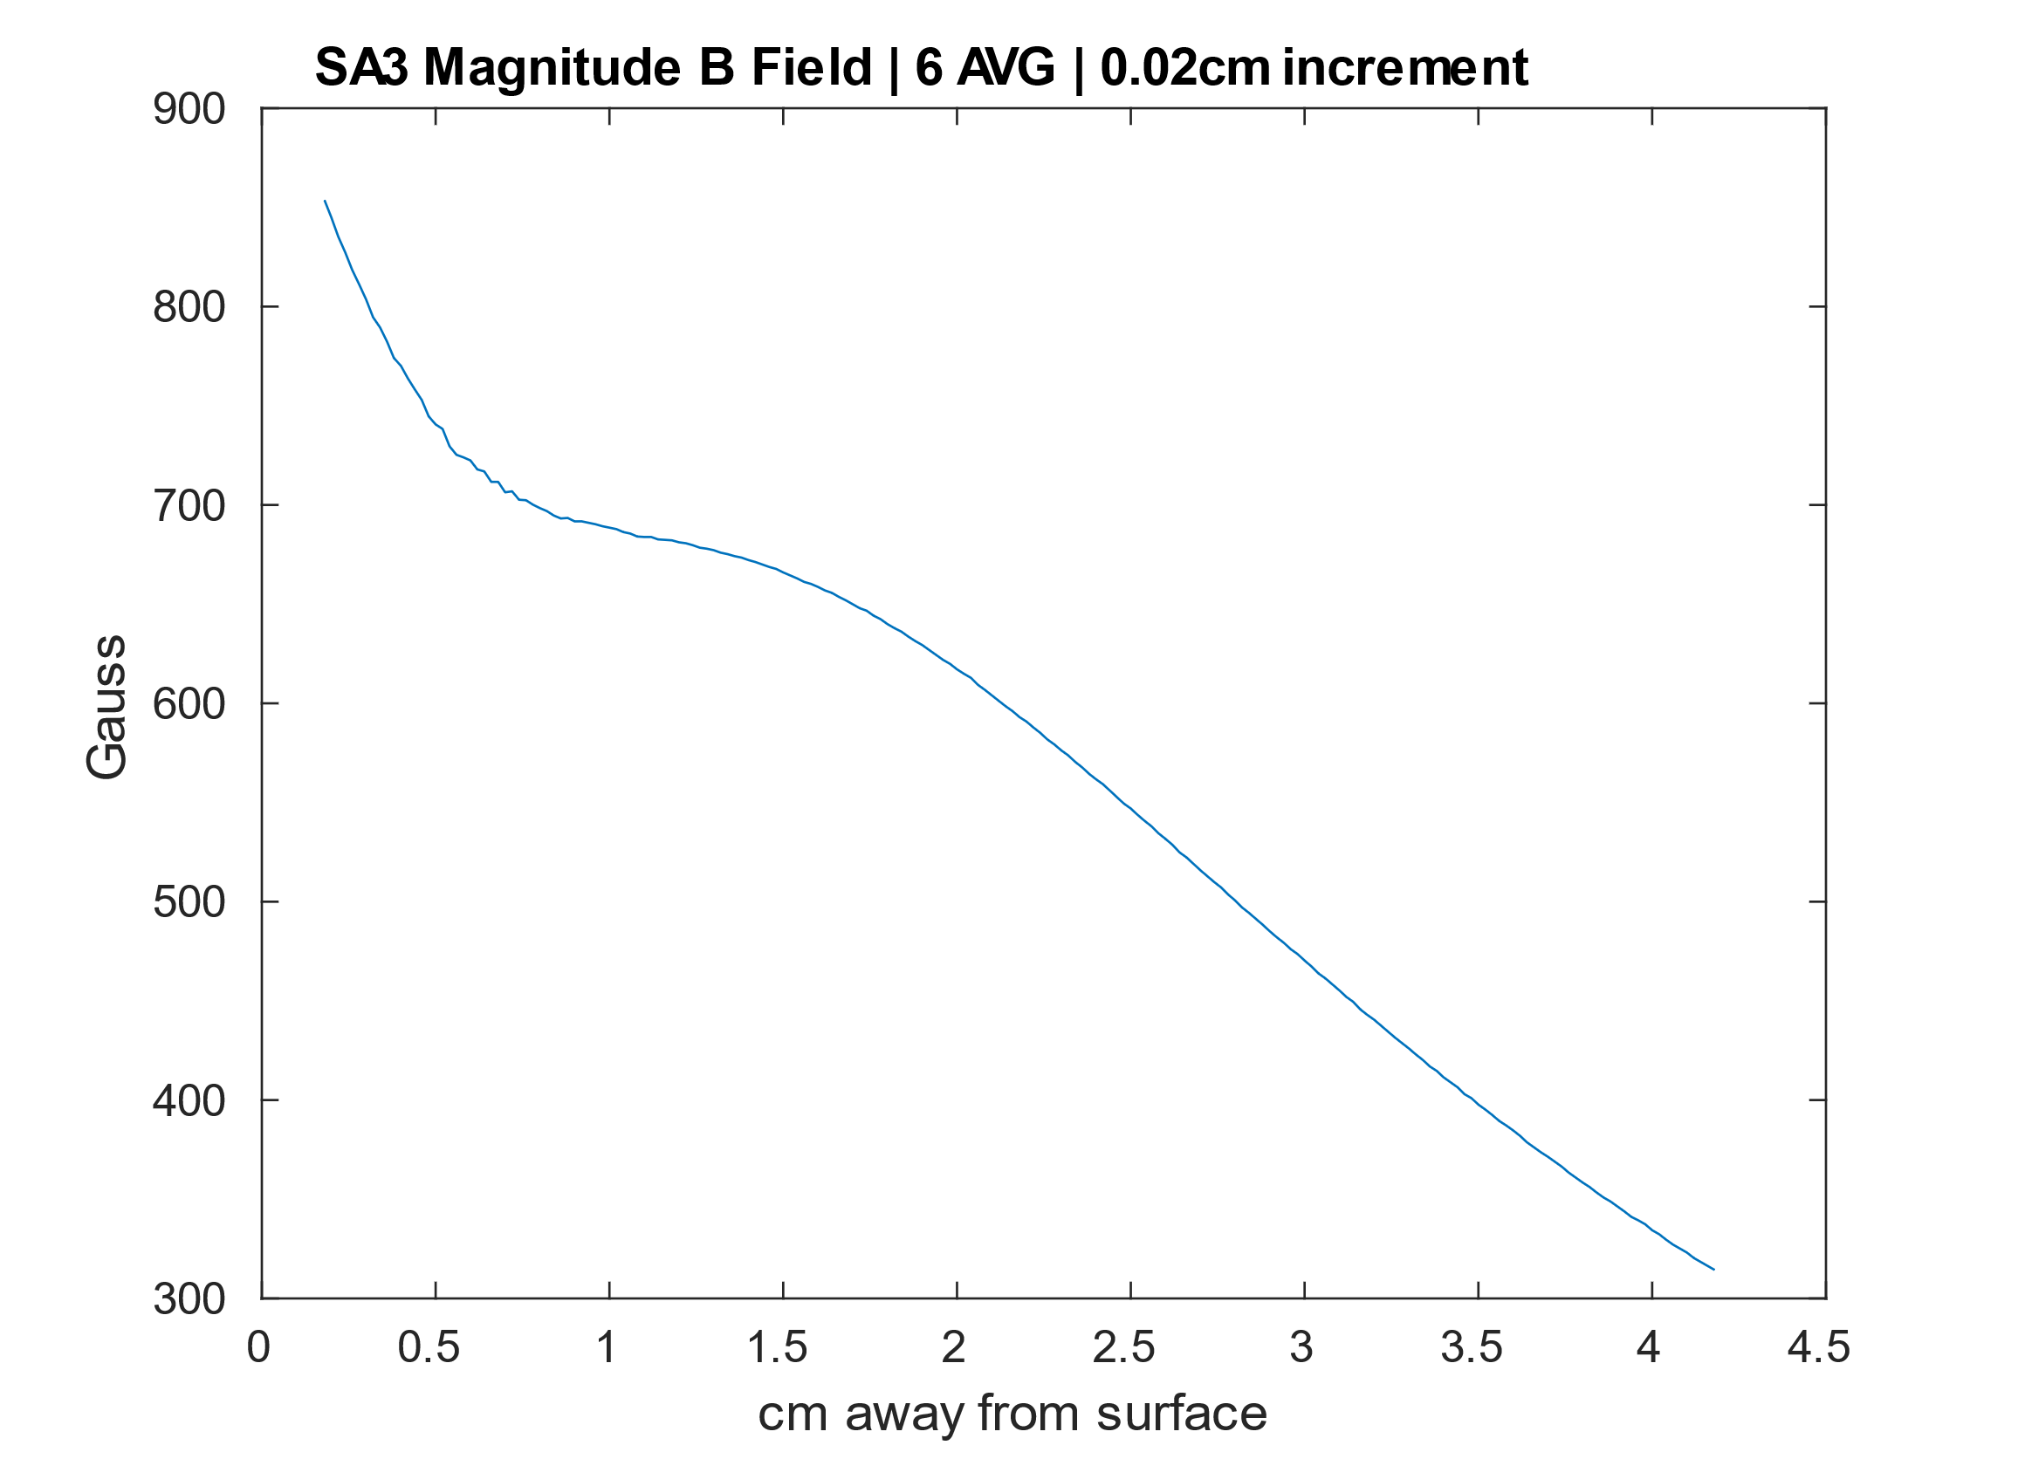
Handheld Unilateral Magnet
Cross Section of Unilateral
Magnet 1
Magnet 2
Magnet 3

Slide 7
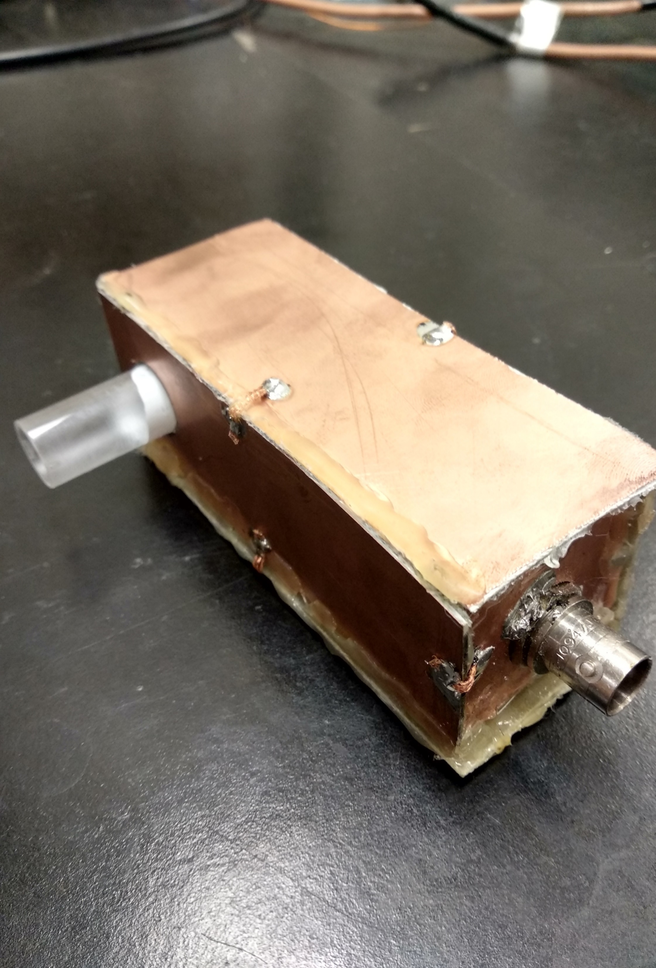
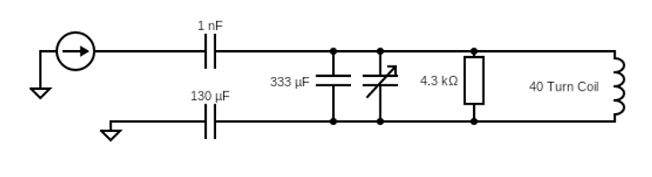
RF Probe Construction
A coil is wrapped around the glass former, such that a secondary tube could be placed into the opening in the RF probe.
To reduce noise, a Faraday cage is housed around the circuitry.
Combination of both capacitively and inductively matched to 50Ω.

Slide 8
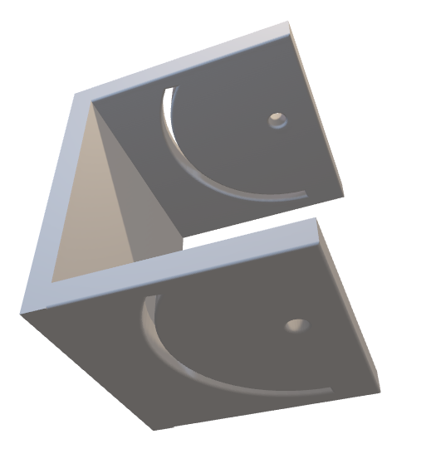
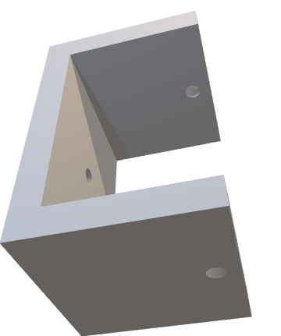
Unilateral Magnet & Cradle System
The magnet of choice is a small, handheld unilateral magnet with a constant gradient region at (2-2.5cm).
500 gauss (2.26MHz for Hydrogen) at 2.25cm above the surface.
A cradle system was 3D printed in order to change the relative angle of the magnet to allow for varying gradient strength which will change our slice thickness.
*Insert image of B0 of SA3*

Slide 9
How to Measure Flow for CPMG
The early odd echoes will roughly decay linearly. A relationship that can be shown mathematically.
Even echoes are not used as their intensity is drastically decreased due to a phenomena termed ‘Even Echo Rephasing’.
The relationship between –B/A and flow velocity is linear. Where B is the slope of the linear fit, and A is the y-intercept.

Slide 10
Methods
Doped water with MnSO4 to decrease delay time.
Used pump to direct flow through the RF probe.
Gathered data for a range of flow velocities (500CCM-1400CCM).
Also, gathered data for 0,5,10, and 15 degrees which will vary the slice thickness
*insert image of flow setup*

Slide 11
Results 1 – 0 Degree

Slide 12
Results 2
*Statistics*

Slide 13
How to Improve the System
Better Faraday cage to reduce noise
Lower delay time by doping the water more
Filters that cut out as much noise as possible (Currently using 30MHz low pass)
MORE SCANS, MORE SCANS AND MORE SCANS
Circuitry could be made much smaller and decrease size of RF probe overall.
Functionally best at 0 deg; Get that sample as close as possible to the magnet! Increase magnetic field and increase signal.

Slide 14
Conclusion
We have been able to show that measurements by fellow researchers in the lab are reproduceable with at low field.
We have constructed a small magnetic resonance that can measure flow velocities.
This was done with the use of a cradle system to allow for a variable slice thickness.

Slide 15
Acknowledgements
Ben Newling ; Supervisor
Bruce ; Director of UNB MRI Centre
Adres ; Research Scientist

