Slide 1
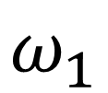
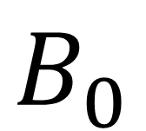
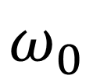
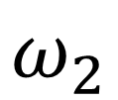
$$B_{0}$$
$$ω_{1}$$
$$ω_{2}$$
$$ω_{0}$$

Slide 2
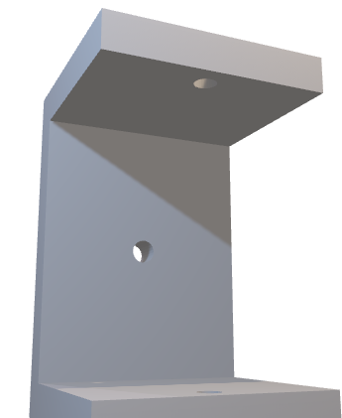




$$0^{°}$$
$${10}^{°}$$

Slide 3
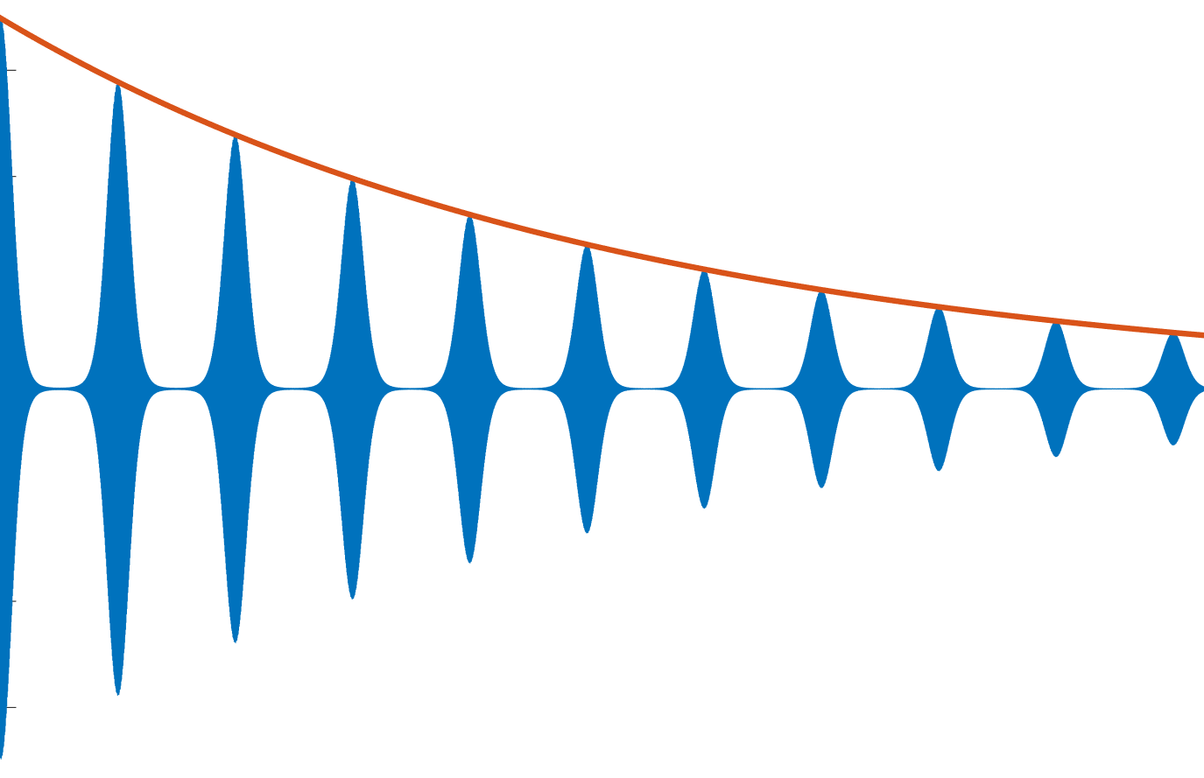


$$exp⁡(−\frac{t}{T_{2}^{∗}})$$
$$exp⁡(−\frac{t}{T_{2}})$$

Slide 4
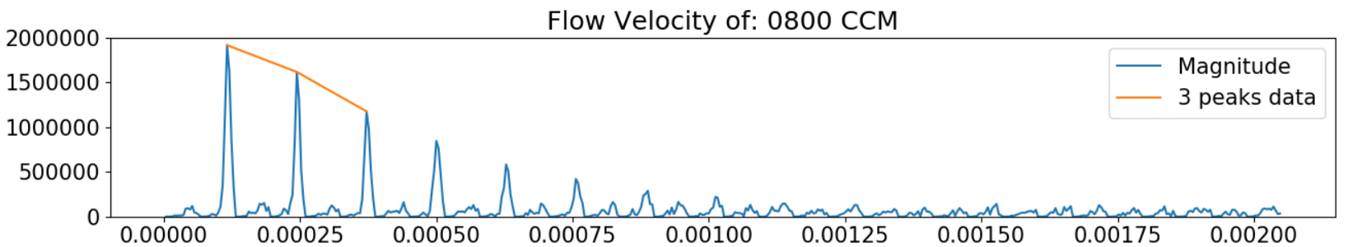
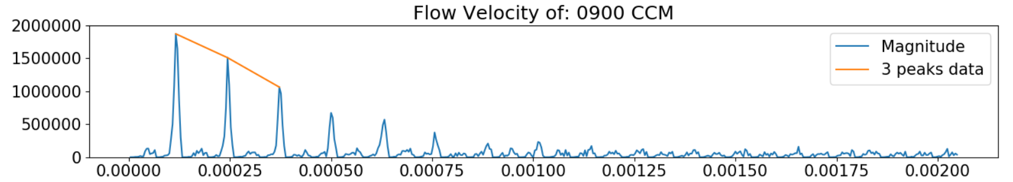
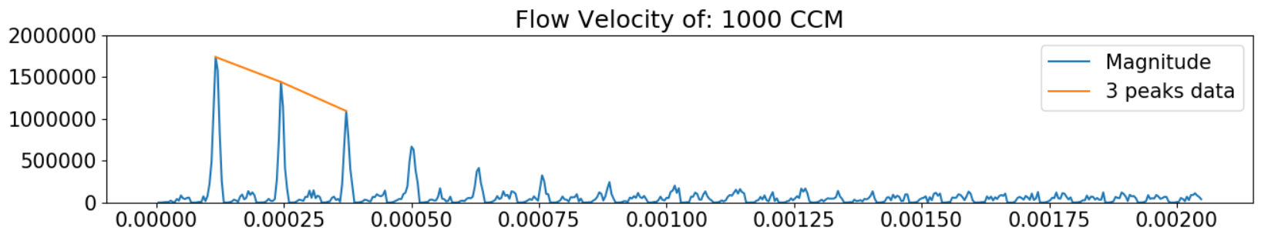

Slide 5
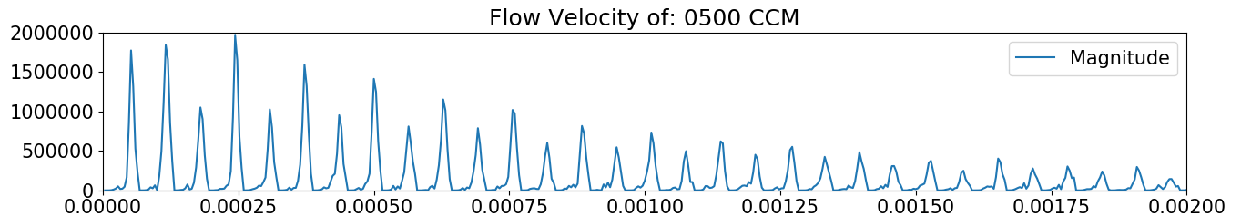
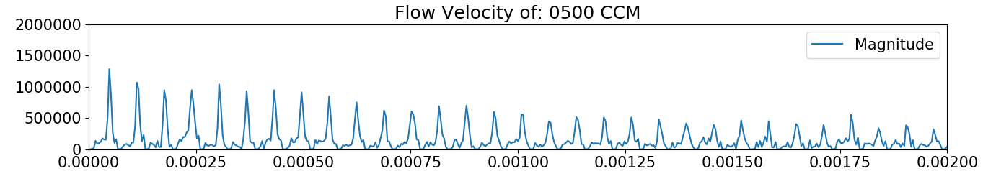




$$0^{°}$$
$$Time (s)$$
$${15}^{°}$$
$$Time (s)$$

Slide 6
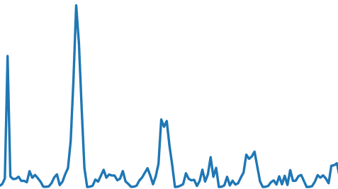


Peak splitting
$$Signal$$
$$Time$$

Slide 7



$$G_{z}=150 G/m$$
Length of coil
22mm
c
Flow
$$G_{z}=150G/cm$$
$${10}^{°}$$

Slide 8


Magnet
Magnet
Pipe

Slide 9








$$y$$
$$z$$
$$4.76mm$$
$$x$$
$$2mm$$
$$3cm$$
$$3cm$$
$$2cm$$

Slide 10
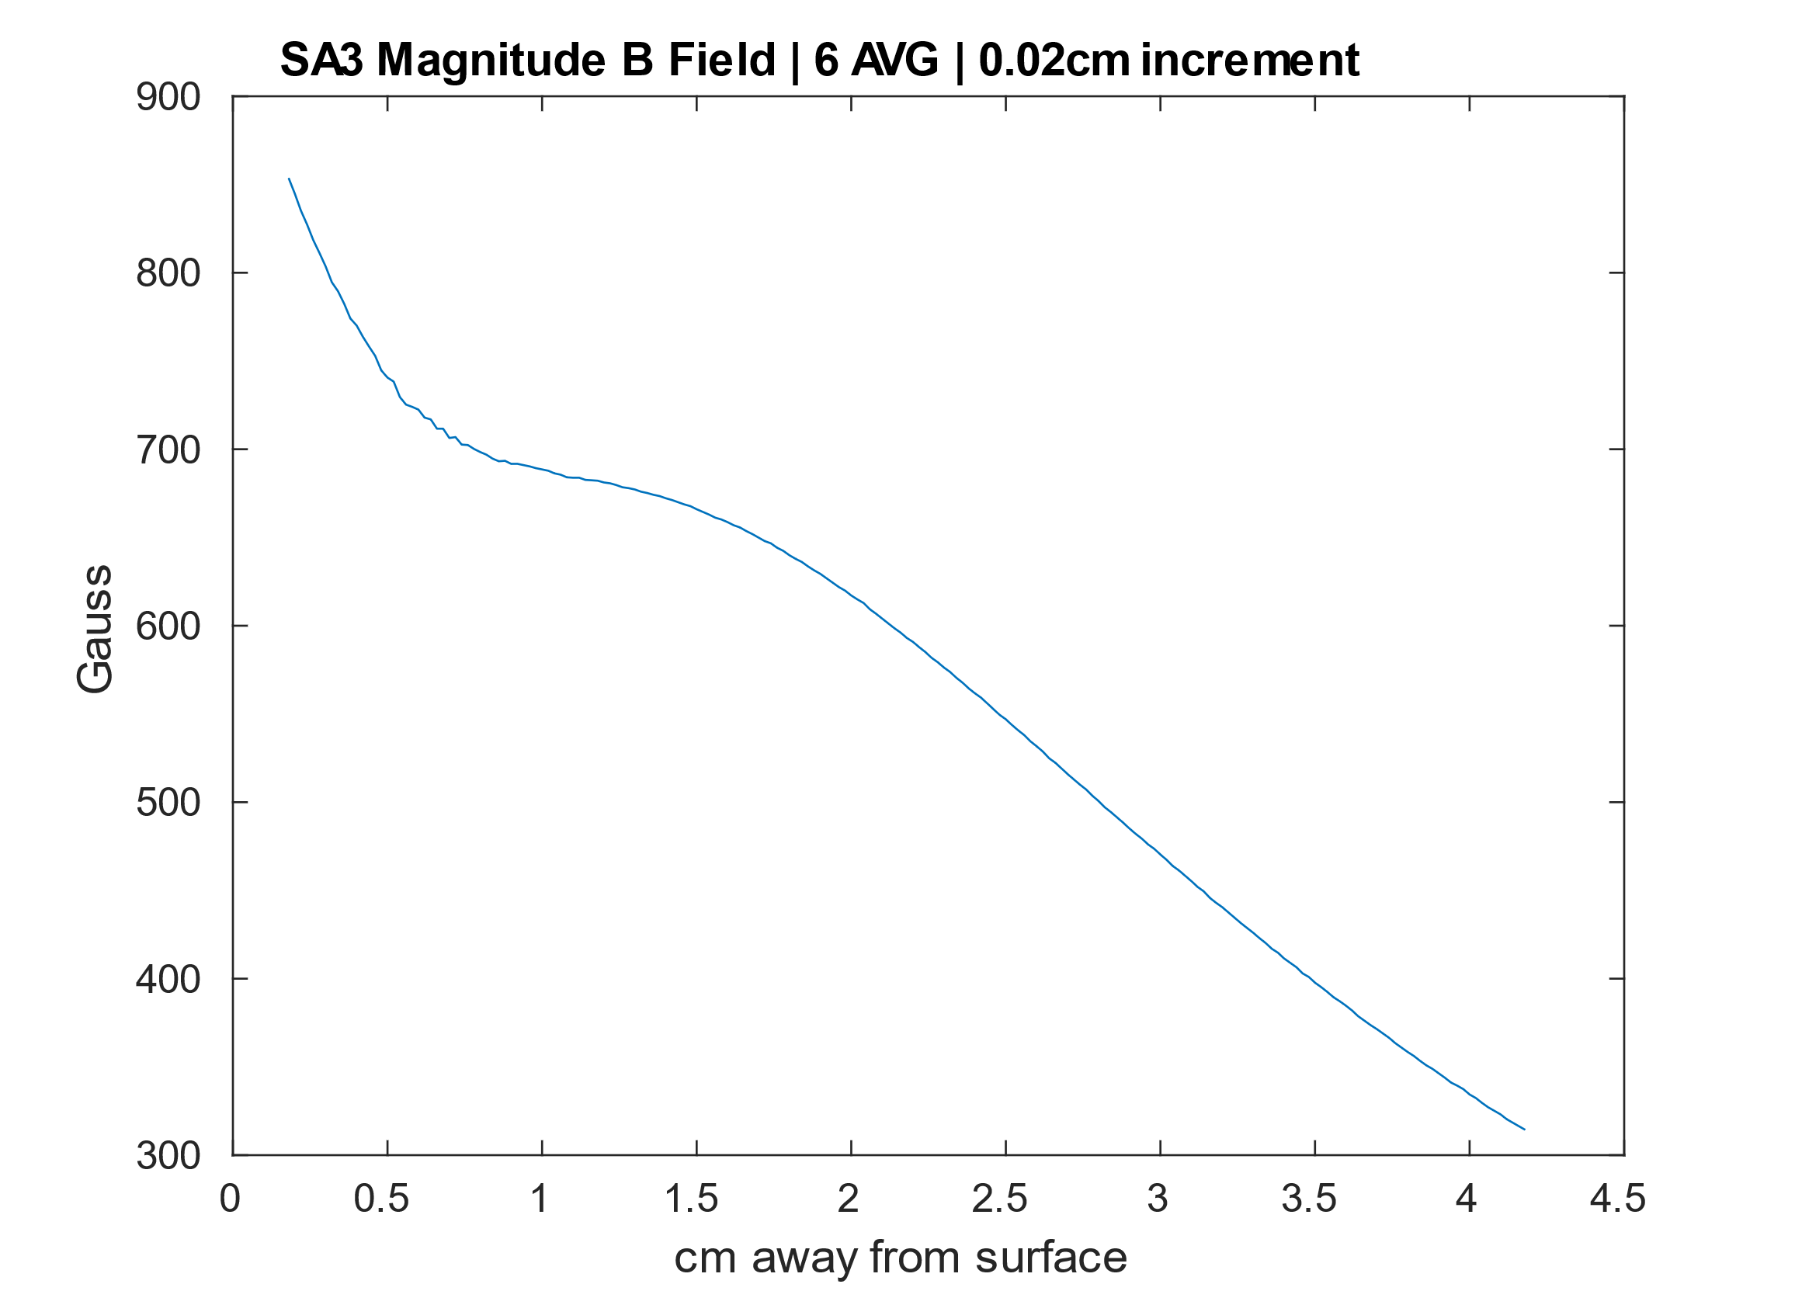

$$Y (cm from surface)$$
YX

