Slide 1
Handheld Unilateral Magnet for Flow Measurements using a Large Constant Gradient
Devin Morin
April 2020

Slide 2
Summary
Theory
Intro to Magnetic Resonance
Theory for Flow Measurements
Materials and Methods
Unilateral Magnet
Cradle
Probe Construction
Code
Results & Discussion
Conclusion

Slide 3
Theory
Introduction to Magnetic Resonance - FID

Slide 4
Theory
Theory for Flow Measurements

Slide 5
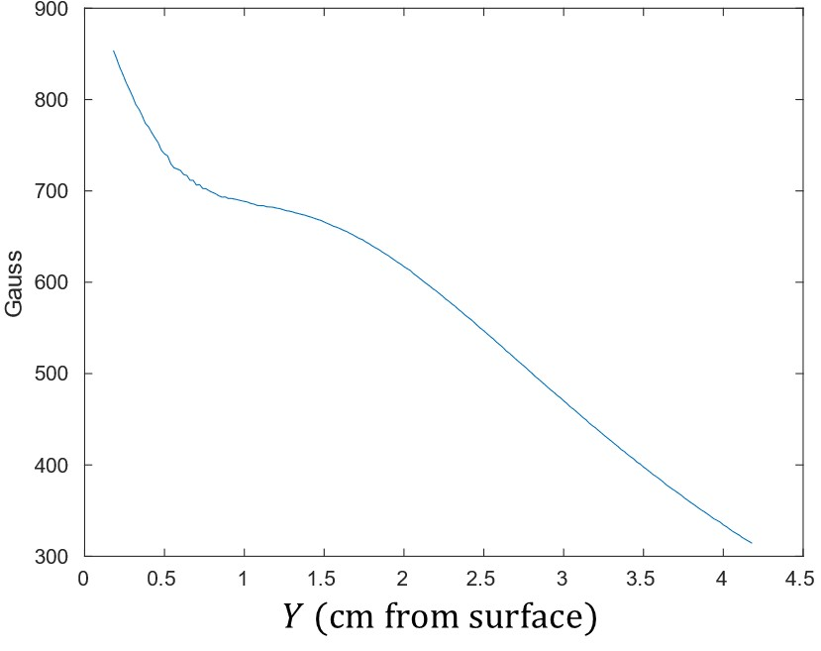
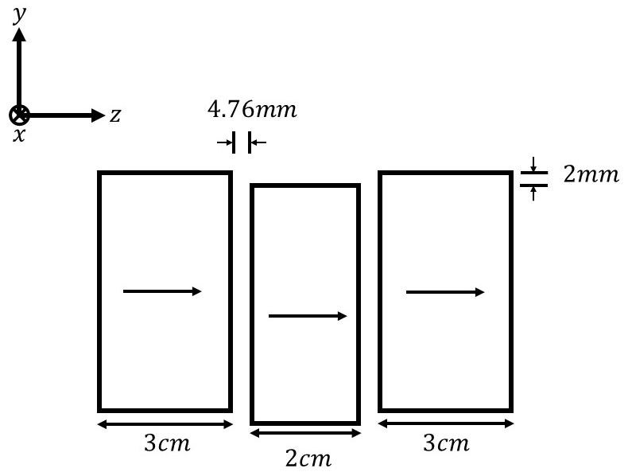
Materials and Methods
Unilateral Magnet
Small handheld unilateral magnet with a constant gradient region perpendicular to the surface (y direction). Three magnet array with B0 along the z direction.

Slide 6
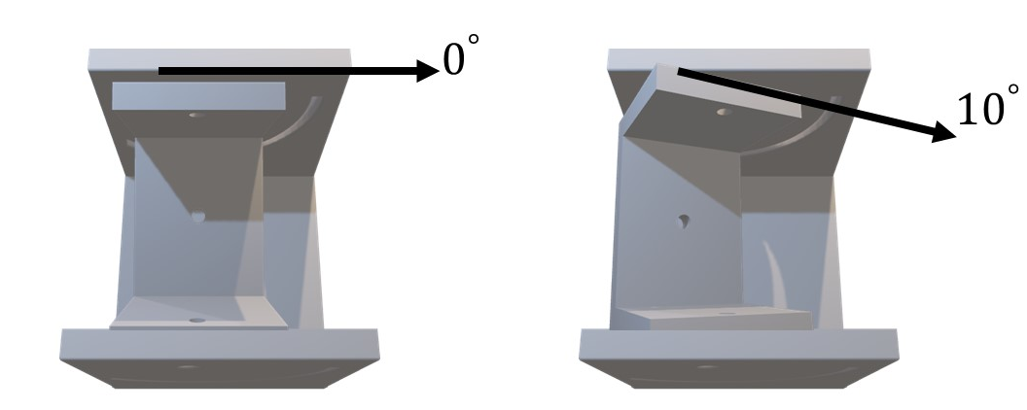
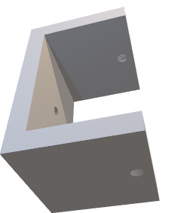
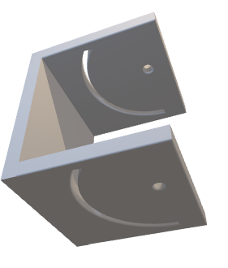
Materials and Methods
Cradle System
A cradle was 3D printed to allow for the magnet to be suspended at different angles.
This was a quick and effective solution to securely suspending the magnet.

Slide 7
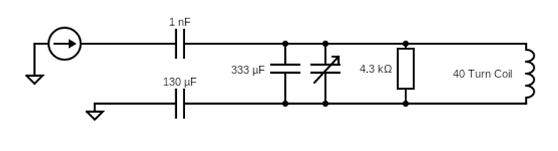
Materials and Methods
RF Probe
The 2.26 MHz RF probe was constructed with a 40 turn coil, wrapped about a Plexiglass former. The RF probe is enclosed about a PCB board connected at all sides to act as a Faraday cage.
Problems with probe dead time required a resistor to be in series with the coil.

Slide 8
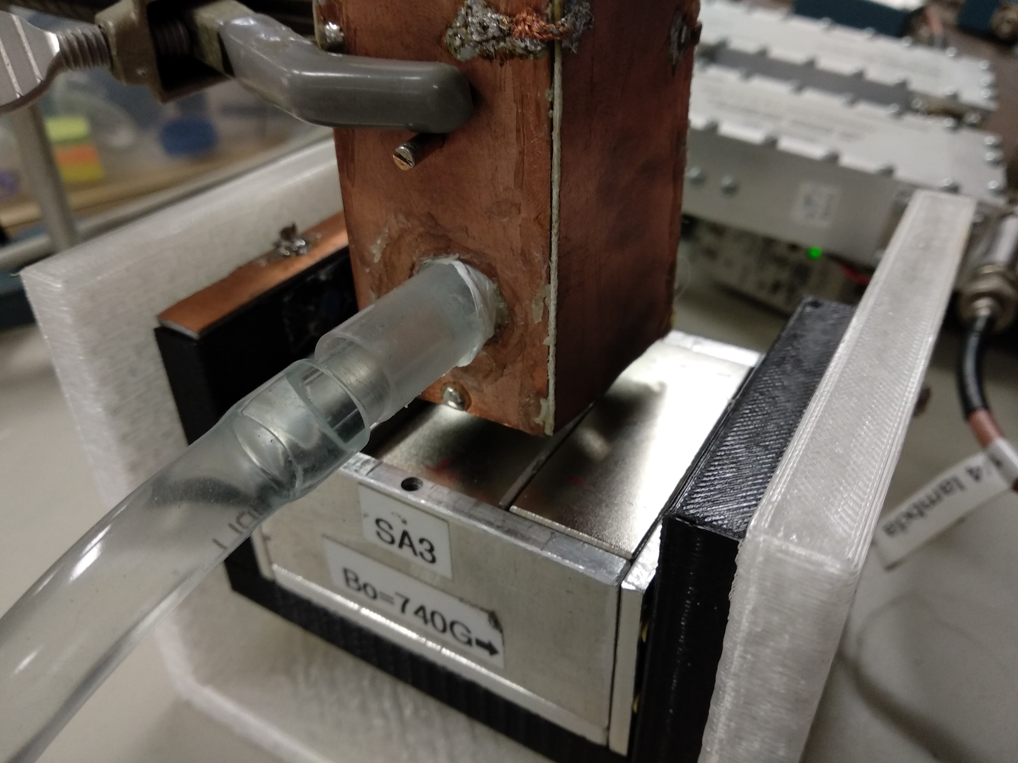
Materials and Methods
Setup
To decrease total acquisition time, the water sample used is doped with CuSO4. 14g of CuSO4 was added to 3102g of distilled water to reduce T1. (74.8ms T1 at 7T)
The doped water sample is pumped through a hose that feeds into the RF coil. The flow rate can be adjusted and documented to then be compared to MR flow data.
Pump outputs flow in CCM to an oscilloscope (frequency must be multiplied by 7.5) which has uncertainty of +/-3Hz (22.5CCM).

Slide 9
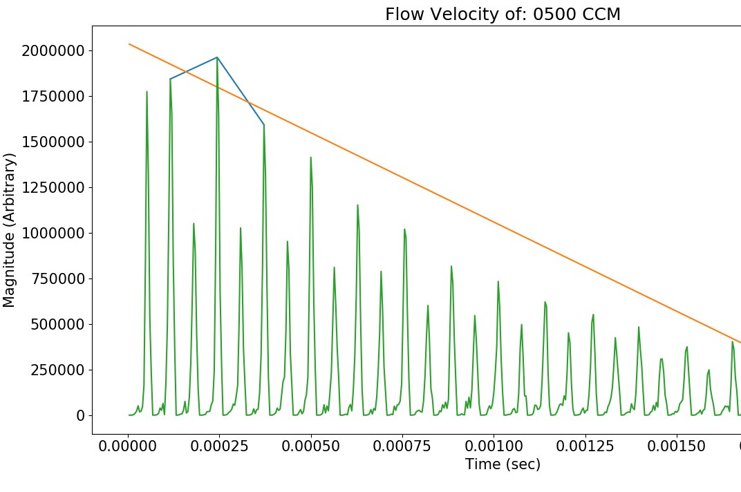

Materials and Methods
Code
Python code was used to analyse the bulk of the data generated by TNMR. The associated –B/A values are collected for the MR flow data.
A line is fitted to the first 3 even peaks. Then, the –B/A is calculated and stored in an array. In the case of three sets of data for each flow velocity, this approach is repeated, but will take the average of the –B/A
Vertical uncertainties are calculated with the standard deviation of the three –B/A values given the three data sets for a flow velocity.
$$y=B∗\left(time\right)+A$$

Slide 10
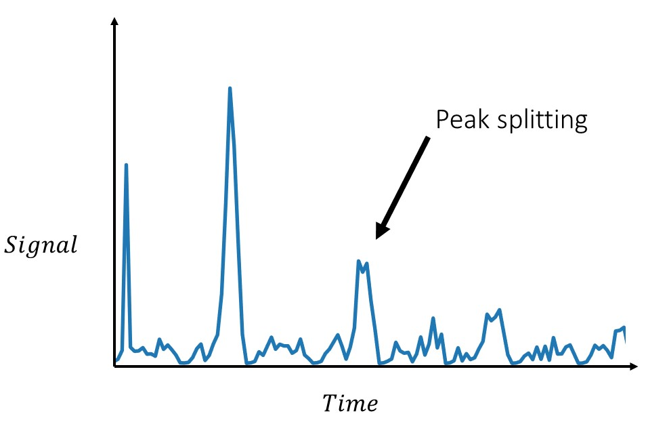
Materials and Methods
Code continued
Low signal to noise ratio caused some of the echo amplitude to split across multiple data points. Because of this, the code will sum over three data points (middle data point is the expected echo peak) and take the average to be considered in the final linear fit.
These problems came and went, possibly due to unstable equipment.

Slide 11
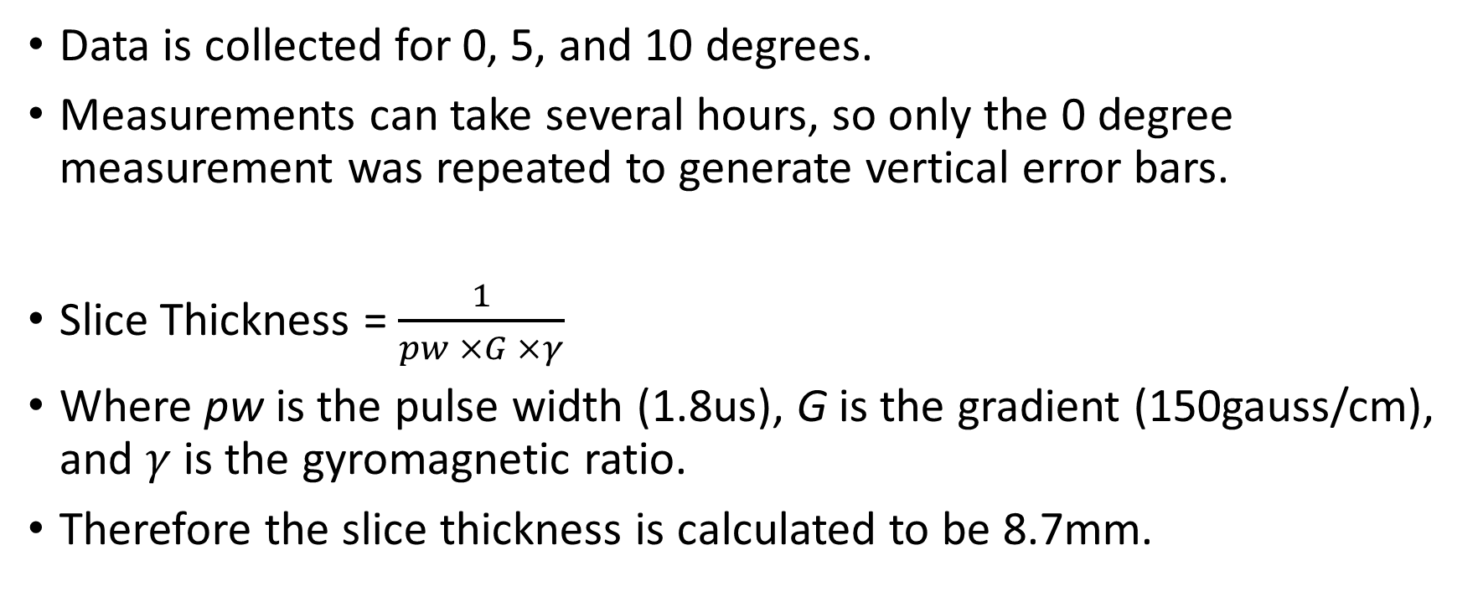
Results
Data is collected for 0, 5, and 10 degrees.
Measurements can take several hours, so only the 0 degree measurement was repeated to generate vertical error bars.
Slice Thickness = $\frac{1}{pw ×G ×γ}$
Where pw is the pulse width (1.8us), G is the gradient (150gauss/cm), and $γ$ is the gyromagnetic ratio.
Therefore the slice thickness is calculated to be 8.7mm.

Slide 12
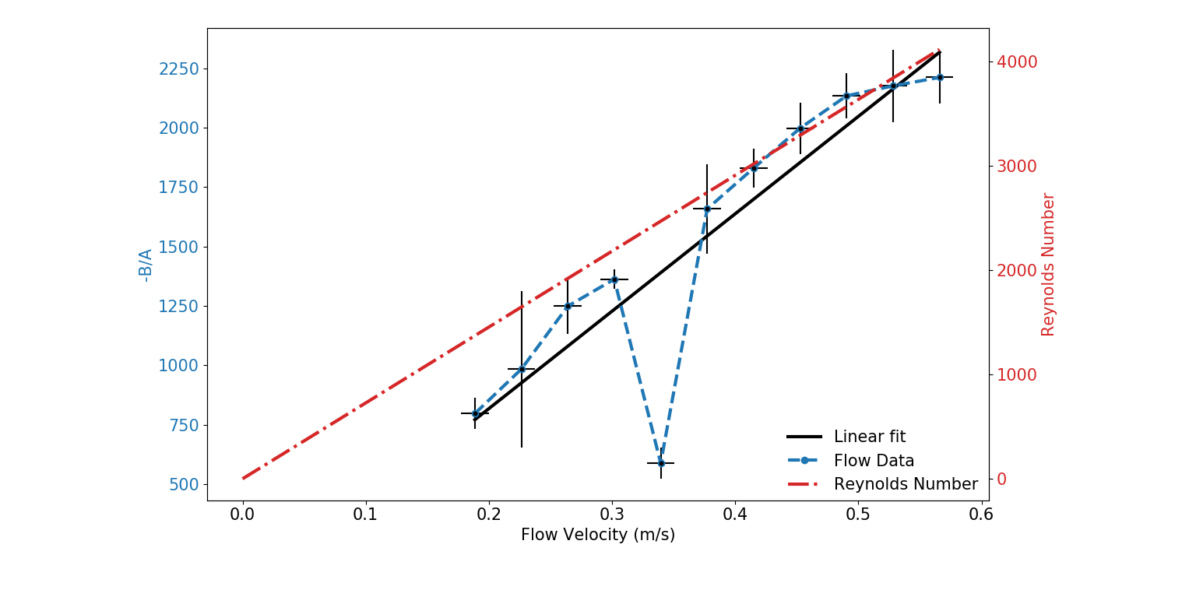
Results
0 degree

Slide 13
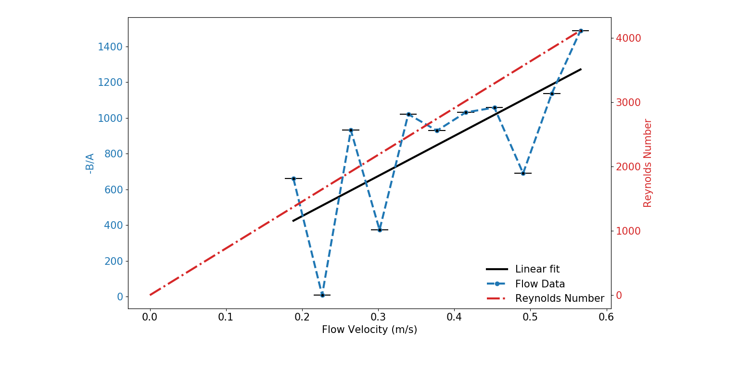
Results
5 degree

Slide 14
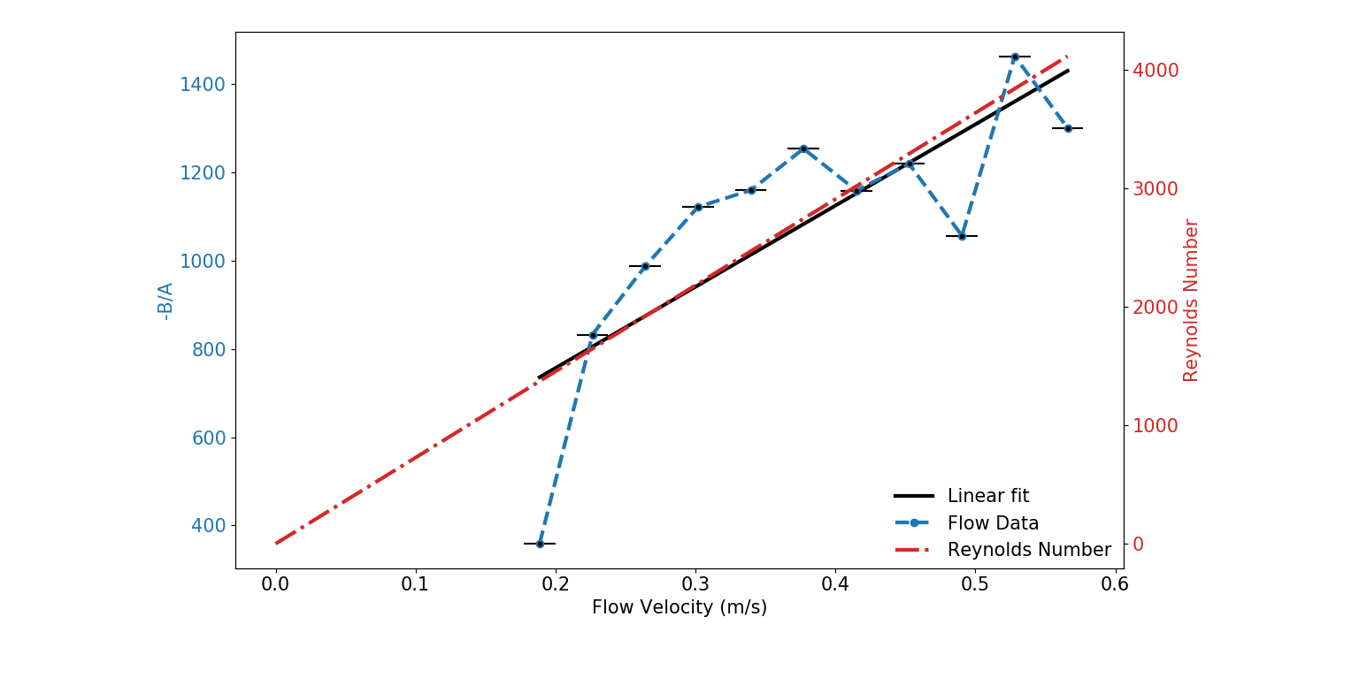
Results
10 degree

Slide 16
References
[1] Andrew E. Marble, Igor V. Mastikhin, Bruce G. Colpitts, and Bruce J. Balcom. “A Compact Permanent Magnet Array With a Remote Homogeneous Field”. Journal of Magnetic Resonance, 186:100–104, 2007.
[2] Eiichi Fukushima and Stephen B.W. Roeder. ”Experimental Pulse NMR A Nuts and Bolts Approach”. CRC Press, Florida, USA, 1981.
[3] J.J. Helmus and C.P. Jaroniec. “Nmrglue: An open source Python package for the analysis of multidimensional NMR data”. Journal of Biomolecular NMR, 55:355–367, 2013.
[4] Juan C. Garc´ıa-Naranjo, Igor V. Mastikhin, Bruce G. Colpitts, and Bruce J. Balcom. “A Unilateral Magnet with an Extended Constant Magnetic Field Gradient”. Journal of Magnetic Resonance, 207:337– 344, 2010.
[5] Os`an T.M., J. M Oll´e, M. Carpinella, L. M. C. Cerioni, D. J Pusiol, M. Appel, J. Freeman, I. Espejo. “Fast measurements of average flow velocity by Low-Field 1H NMR”. Journal of Magnetic Resonance, 209:116– 122, 2011.
[6] R. Bryon Bird, Warren E. Stewart, and Edwin N. Lightfoot. “Transport Phenomena”. John Wiley & Sons Inc., NJ, USA, 2007.
[7] Sebastian Richard and Ben Newling. “Measuring Flow Using a Permanent Magnet with a Large Constant Gradient”. Applied Magnetic Resonance, 50:627–635, 2019.
[8] United States Geological Survey. “Water Density”. https: //www.usgs.gov/special-topic/water-science-school/science/ water-density?qt-science_center_objects=0#qt-science_ center_objects. [Online; accessed April-2020].
[9] Waluch, V. and G.B, William. “NMR Even Echo Rephasing in Slow Laminar Flow”. Journal of Computer Assisted Tomography, 8(4):594– 598, 1984.
[10] Zhi-Phei Liang and Paul .C Lauterbur. “Principles of Magnetic Resonance Imaging - A Signal Processing Perspective”. The International Society for Optical Engineering, Bellingham, Washington USA, 1991.

