Slide 1
Handheld Unilateral Magnet for Flow Measurements Using a Large Constant Gradient
Devin Morin
June 2020

Slide 2
Introduction
Aim to measure flow velocity using a small handheld unilateral magnet. The magnet contains a large constant gradient perpendicular to the surface.
Variable magnet orientation to change our effective probe coil length and vertical gradient.
Magnetic resonance is employed throughout many fields (biomedicine, material characterization, food science, agriculture), and it could be of great benefit to have a device that preserves a non-invasive technique, while being portable and low hazard.
These methods are based on the work done by Osàn T.M. et al and Sebastian Richard. Sebastian had done similar measurements of flow velocity using the GARField magnet.
Notes:
The goal of this project is to measure flow velocity using a small unilateral magnet. This project is largely based off of the work done by Osan and Sebastian Richard. We’ve been able to measure flow velocity in the past with much larger magnets, at high field, so this project aims to explore using a much smaller, low field device. The benefit to a small device is that it’s maneuverable, and as such we will explore changing the angle of the magnet relative to the direction of flow. Low field brings more problems, like a decreased signal to noise ratio. However, I think all of the possible benefits of unilateral magnetic resonance (UMR) inspire this kind of research. A small UMR device could potentially have a big impact in biomedicine, agriculture, or wherever a magnetic resonance presence already exists.

Slide 3
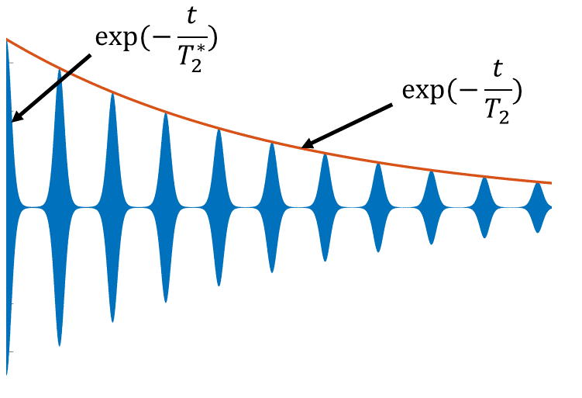
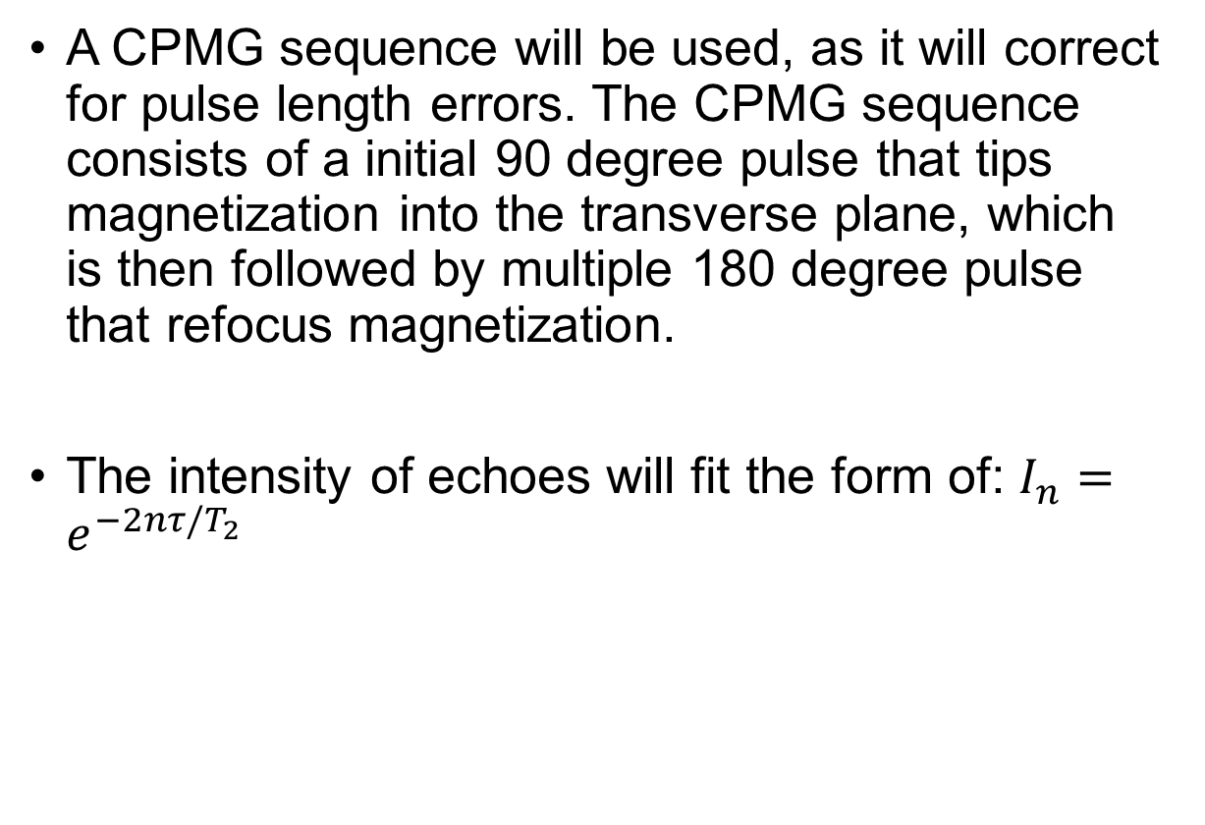
Theory
A CPMG sequence will be used, as it will correct for pulse length errors. The CPMG sequence consists of a initial 90 degree pulse that tips magnetization into the transverse plane, which is then followed by multiple 180 degree pulse that refocus magnetization.
The intensity of echoes will fit the form of: $I_{n}=e^{−2nτ/T_{2}}$
180y RF pulse applied
Notes:
I used a CPMG sequence to obtain the magnetic resonance signal, as it corrects for pulse length errors. The unilateral magnet of choice, has a very inhomogeneous magnetic field. As such, transverse components of magnetization will cancel due to a dephasing of spins, and with the application of a 180 degree pulse, these spins will come together to form an echo.

Slide 4
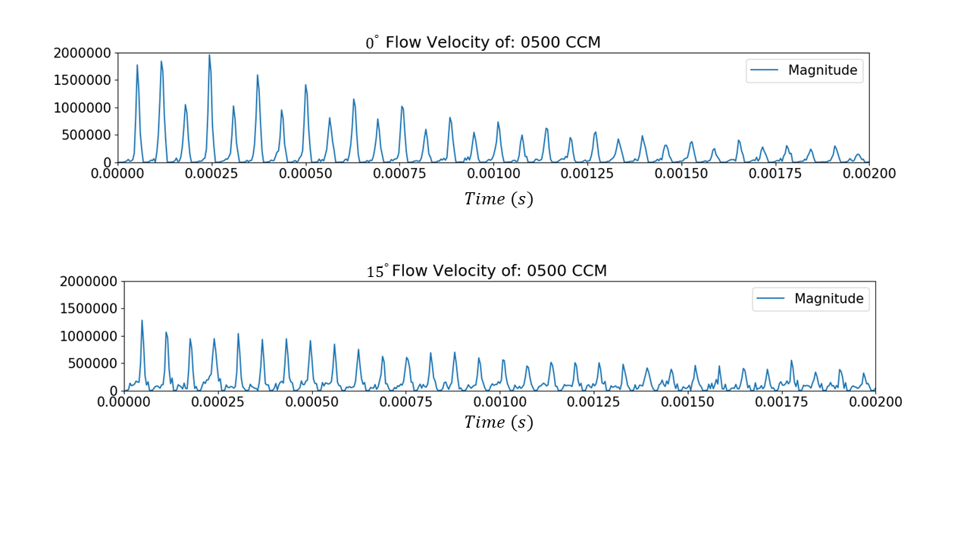
Theory
A characteristic of flow in a CPMG is the decrease signal on odd peaks. A relationship between the gradient and velocity of the water causes complete rephasing of spins on even peaks, and therefore an increased signal.
We use even peaks only, as the odd peaks have decreased magnitude.
The means by which we gather flow data, is due to the polarized spins, leaving the sensitive region of the probe.
Notes:
When employing a CPMG, a characteristic of flow within the signal is this alternating peak height. This characteristic is called even echo rephasing. This effect occurs due to a relationship between the velocity of the fluid and gradient. The mathematics are quite involved, so I will not discuss them here, but if you’re interested they are discussed in my honors thesis, and Osan’s paper. We will only use even peaks in our determination of flow velocity, as the odd peaks have a greatly decreased magnitude. In this method, we gather a flow velocity information due to the polarized spins leaving the sensitive region of the probe.

Slide 5
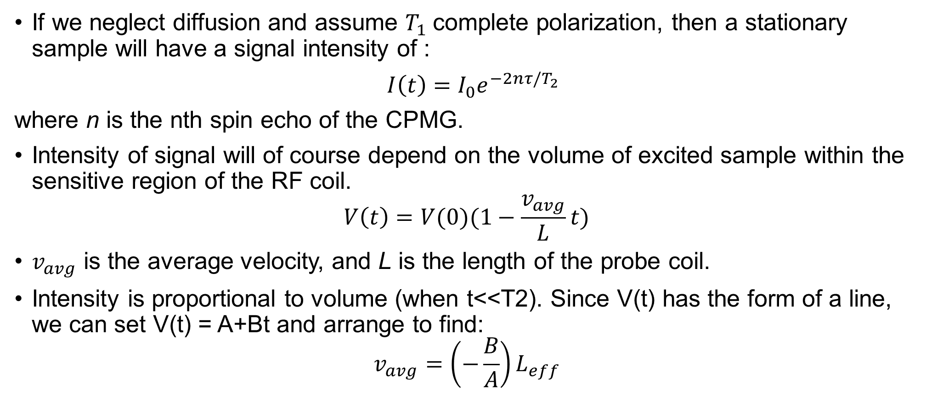
Theory
If we neglect diffusion and assume $T_{1}$complete polarization, then a stationary sample will have a signal intensity of :
$I\left(t\right)=I_{0}e^{−2nτ/T_{2}}$
where n is the nth spin echo of the CPMG.
Intensity of signal will of course depend on the volume of excited sample within the sensitive region of the RF coil.
$$V\left(t\right)=V(0)(1−\frac{v_{avg}}{L}t)$$
$v_{avg}$ is the average velocity, and L is the length of the probe coil.
Intensity is proportional to volume (when t<<T2). Since V(t) has the form of a line, we can set V(t) = A+Bt and arrange to find:
$$v_{avg}=\left(−\frac{B}{A}\right)L_{eff}$$
Notes:
To measure flow with a CPMG, we start by neglecting diffusion, and assume complete polarized of the sample due to T1. The intensity of signal is therefore given by the first expression I have at the top. Of course the intensity of our signal depends on the volume of sample within the sensitive region of the RF coil. Since this fluid is moving at some average velocity, we may write the volume occupied in time as the second expression, where v_avg is the average velocity of the fluid, and L is the probe coil length.
Two important things to note, is that we assume the fluid moves at one averaged velocity, which is course is not true. This is an approximation which will function best for the turbulent regime, where the flow profile drops off steeply towards the edges of the pipe. Also, the probe coil length L, once measured with the flow data, will be smaller than the true coil length. This is because magnetic field inhomogeneity of B0, cause the probe to be sensitive to a much smaller length, than the true length of the coil.
The signal intensity if proportional to volume, and by fitting the equation for a line to the first few even peaks of the CPMG, we can find the average velocity to be the bottom equation. By using the first few peaks, we are also approximating t<<T2, neglect the exponential term in the signal intensity. So, B is the slope of the line, and A in the y-intercept. In my case, I used the first three even echo points when fitting my line to the CPMG data.

Slide 6
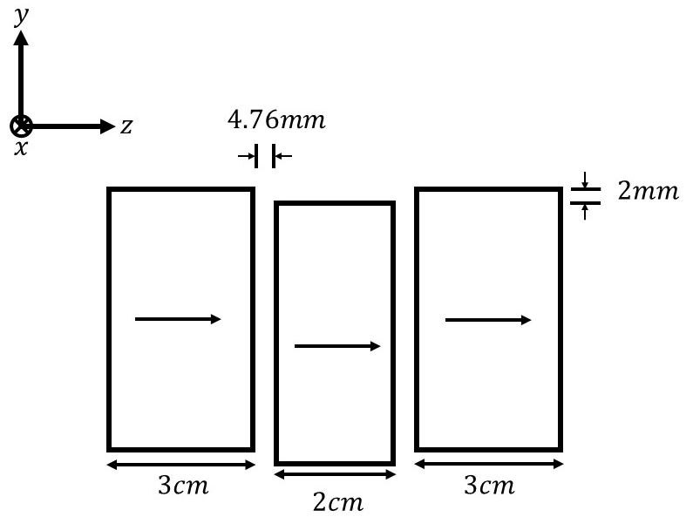
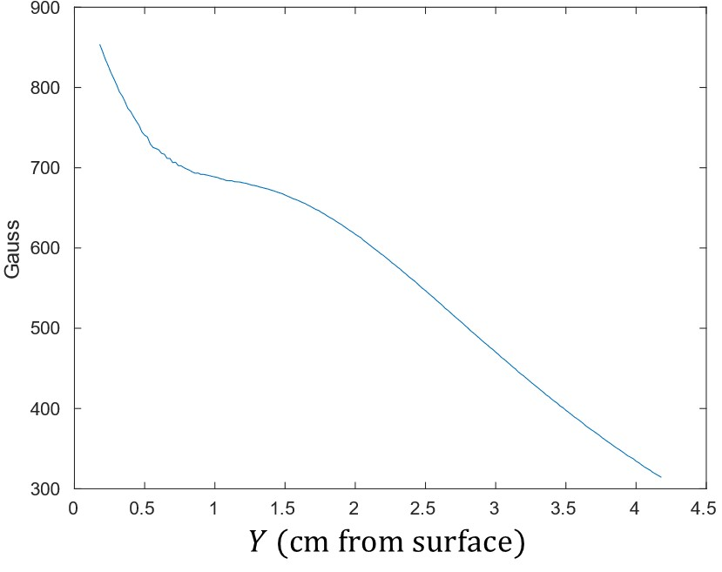
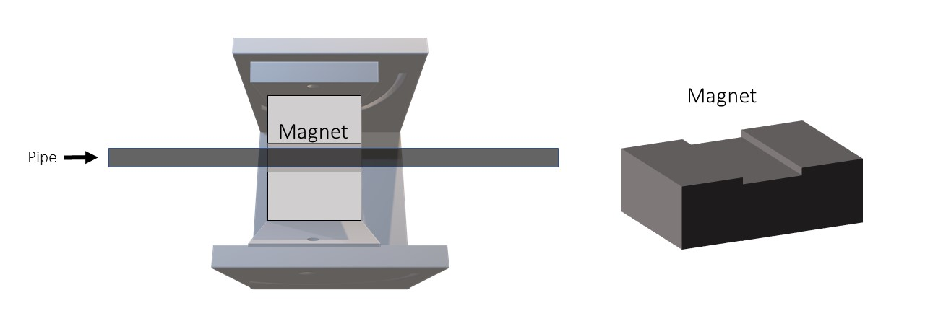
Materials
Using a small handheld unilateral magnet with a constant gradient region perpendicular to the surface. A cradle system was used to suspend the magnet at different angles.
$$z$$
$$x$$
$$y$$
Notes:
The unilateral magnet is housed in a cradle system that will allow us to easily change the angle of the magnet relative to the pipe.
To the right, we can see field profile of the magnet. This would be magnitude of magnetic field as a function of distance from the surface. To do this the 3D magnetic field plotter was used. The gaussmeter is simply placed in the center of the magnet, and then moved away, normal to the surface. From this we can see the gradient (of 150gauss/cm) exists between 2-3.5 cm above the surface.

Slide 7
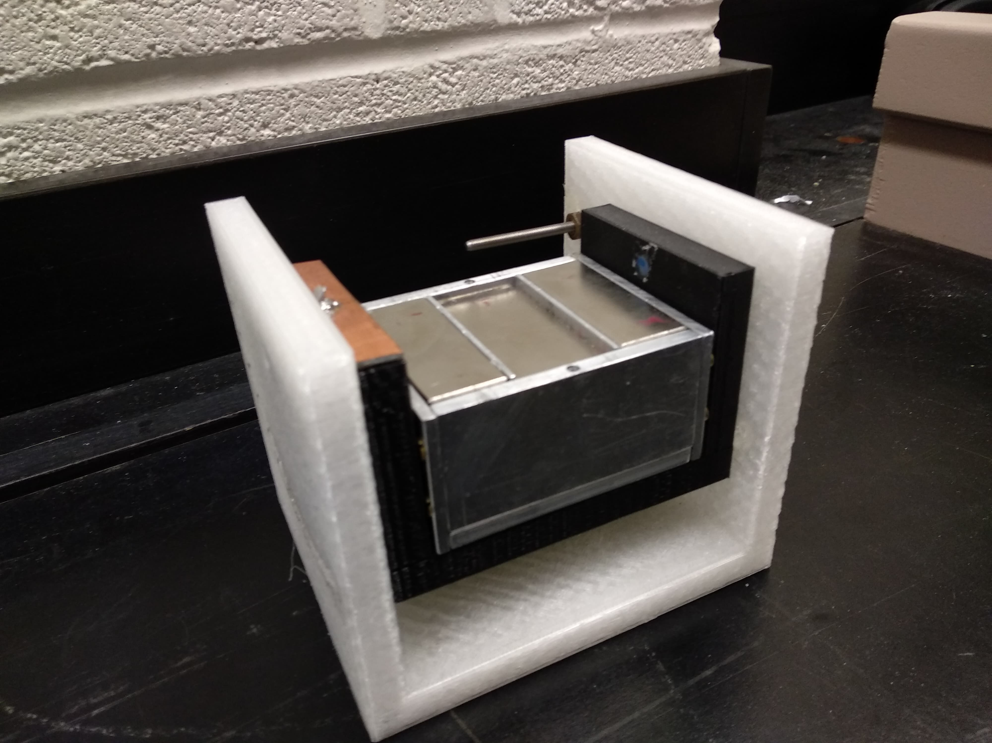
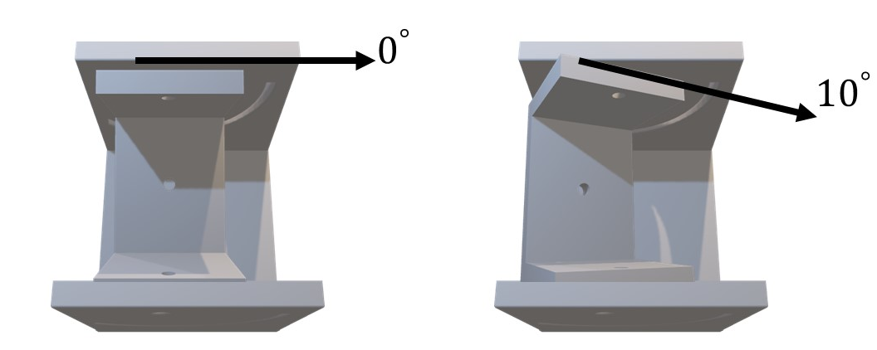
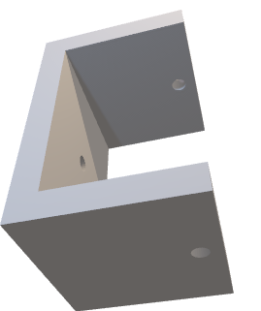
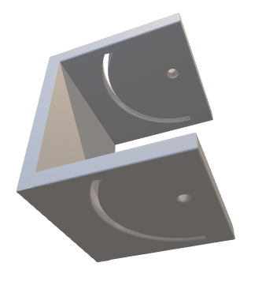
Materials
A cradle was 3D printed to allow for the magnet to be suspended at different angles.
This was a quick and effective solution to securely suspending the magnet.
Notes:
A cradle system was 3D printed to allow for the magnet to be easily repositioned at different angles. The center piece is allowed to change angle about a point, and two screws on both sides are inserted into the curved opening to secure the cradle in place.
This was maybe not the most robust solution, but it was quick, easy, and if anything broke it wouldn’t be difficult to reprint another piece we needed.

Slide 8
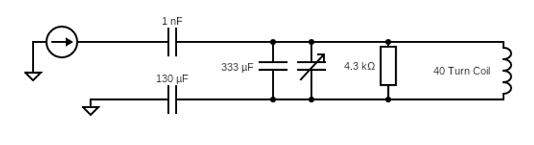
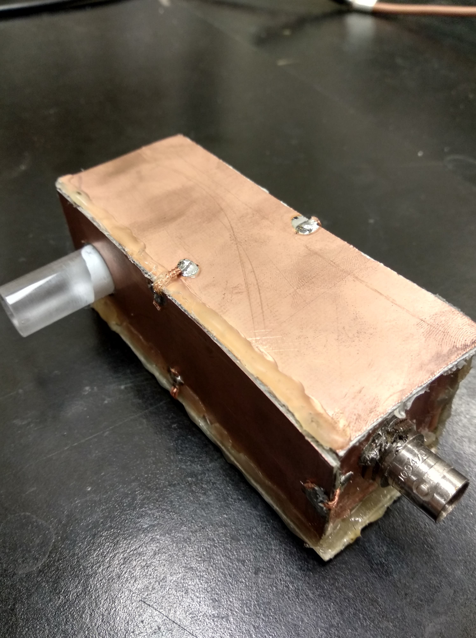
Materials
The RF probe was tuned to 2.26MHz and matched to 50 ohms.
40 turn coil, wrapped about a plexiglass former.
To reduce noise, a Faraday cage was constructed out of PCB circuit board to surround the circuitry.
Problems with probe dead time required a resistor to be added in parallel with the coil.
Notes:
The RF probe was constructed with an arrangement of capacitors and a resistor. It was matched to 50 ohms and tuned to 2.26 MHz (560 gauss at 2.25cm above the surface of the magnet).
A resistor was added in parallel with the coil to help probe dead time.
Also, to reduce noise, a Faraday cage was constructed out of PCB circuit board, which was soldered on all sides, and connected to ground.

Slide 9
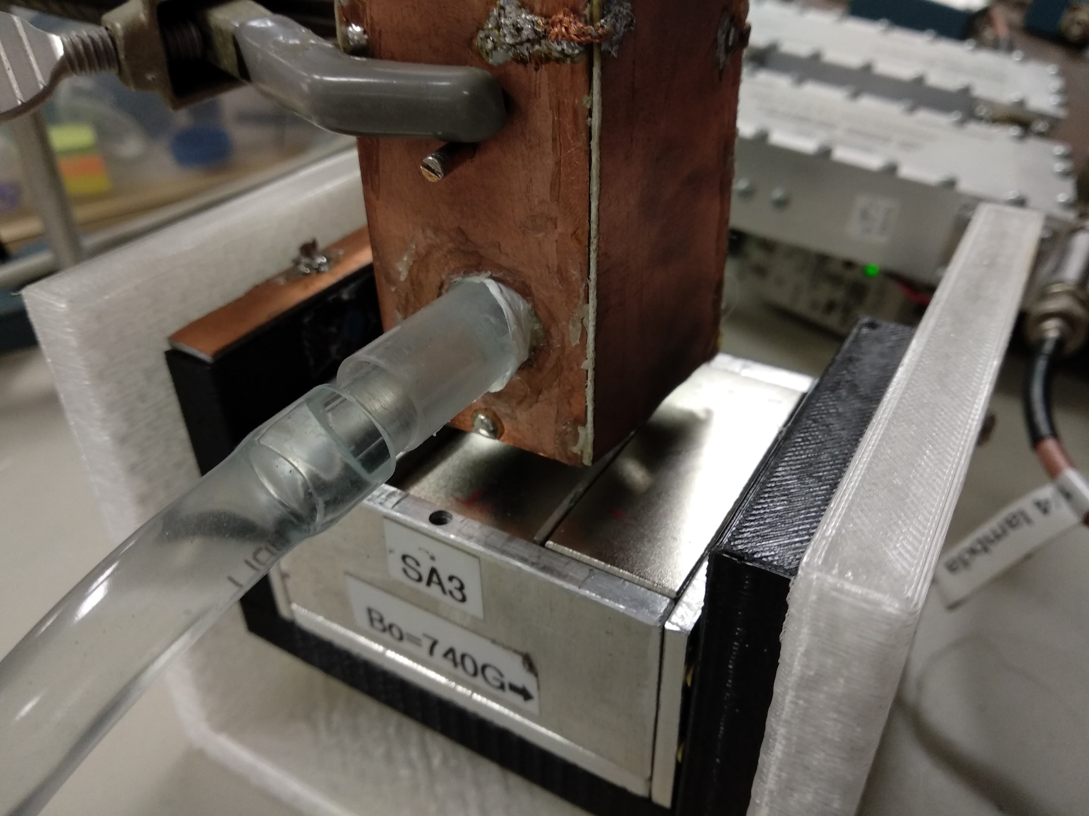
Methods
A doped water sample was pumped through a hose that feeds into the RF coil. Flow rate can be adjusted by the pump. This flow rate is taken as the true flow rate, which will be used on the final plot.
Pump outputs flow in CCM to an oscilloscope. Uncertainty in flow rate given by the pump is +/- 22.5 CCM.
Pulse length was determined by considering the probe geometry, and power supplied to the coil.
Notes:
To perform the experiment, a pump was connected to a hose which fed into the RF coil, through a glass pipe. The flow rate in CCM can be adjusted through the pump. The uncertainty in the flow volume rate given by the pump is +/-22.5 CCM. This uncertainty is what will be used for the horizontal error bars in the final flow plot.
The pulse length was determined by considering the probe geometry and power supplied to the coil.

Slide 10
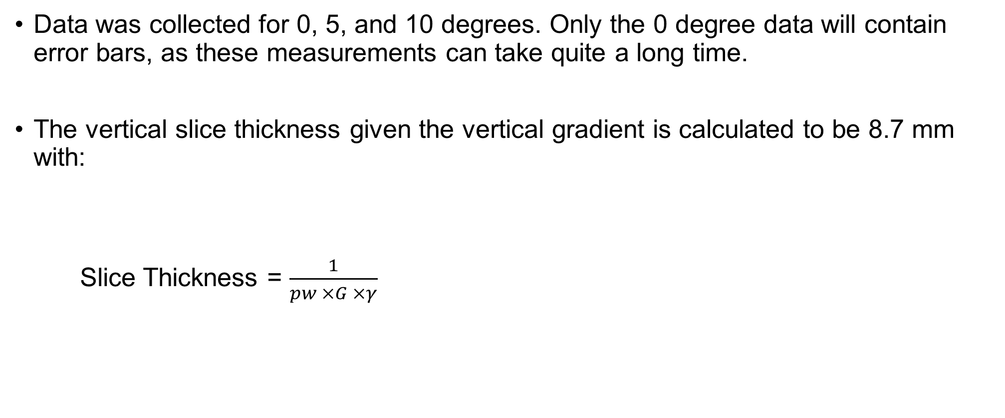
Results
Data was collected for 0, 5, and 10 degrees. Only the 0 degree data will contain error bars, as these measurements can take quite a long time.
The vertical slice thickness given the vertical gradient is calculated to be 8.7 mm with:
Slice Thickness = $\frac{1}{pw ×G ×γ}$
pw | 1.8 us
Gradient (G) | 150 gauss/cm
Aqc. Time | 64 us
Dwell Time | 4 us
# Scans | 3000
Total Acq. Time | ~6.4 mins
Notes:
Data was collected for a 0, 5, and 10 degree tilt of the cradle system. As measurements can take several hours, only the 0 degree measurement has error bars. Error bars are obtained by gathering three sets of flow data, and then looking at the standard deviation between each flow velocity data point. As mentioned before, horizontal error bars are obtained from the uncertainty in the flow pump.
The slice thickness is calculated to be 8.7 mm, given the vertical gradient, pulse width and gyromagnetic ratio.

Slide 11
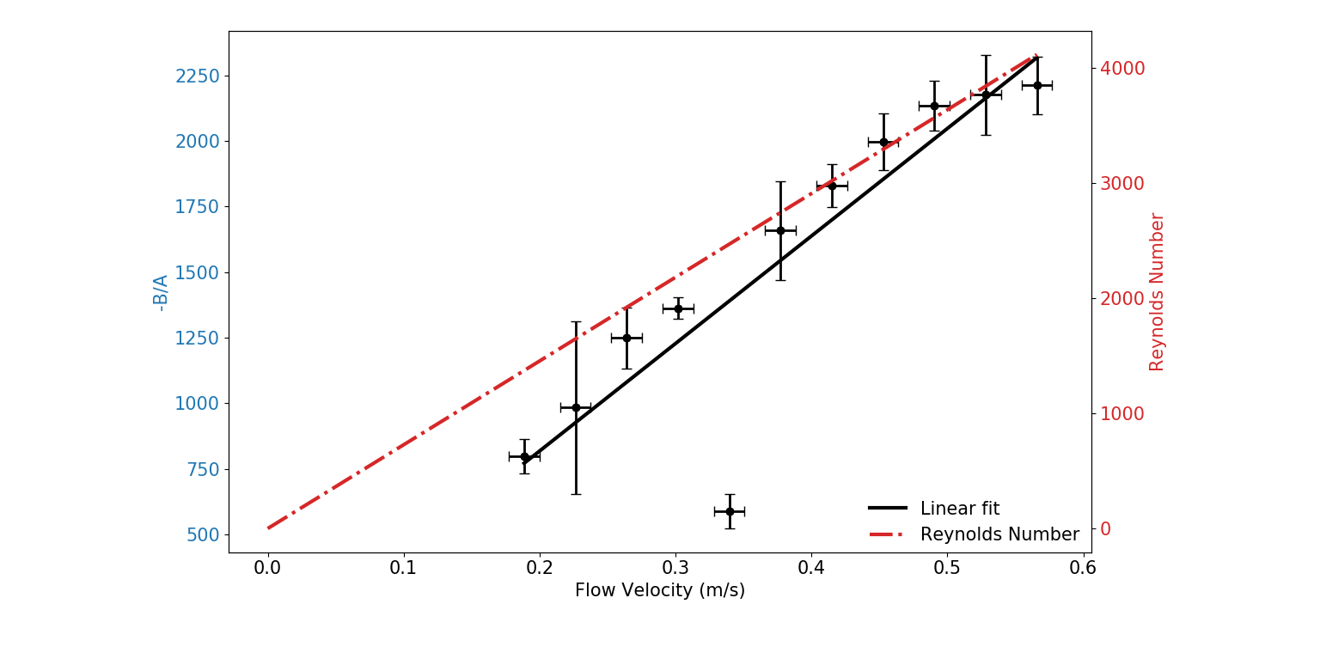

0 degree
$$R^{2}=0.88$$
Notes:
This is the 0 degree plot. The vertical axis is labeled –B/A, and the horizontal axis shows the flow velocity in m/s. The flow velocity is roughly linear. Although, there is a noticeable artifact on the 5th data point. When I originally took these measurements, I had repeated that data point multiple times and found that it did not change that much, so I concluded that it must be a real feature of the measurement.
A similar artifact had been noted in Sebastian paper, using the GARField magnet to make similar flow measurements. This had been hinted at being possibly caused due to a transition from laminar to turbulent. Much more exploration needs to be done. This artifact could be something different than what Sebastian had seen, and it could also be something that has nothing to do with a transition from laminar to turbulent. We have an R squared of 0.88, and by omitting the 5th data point, the R^2 is 0.99

Slide 12
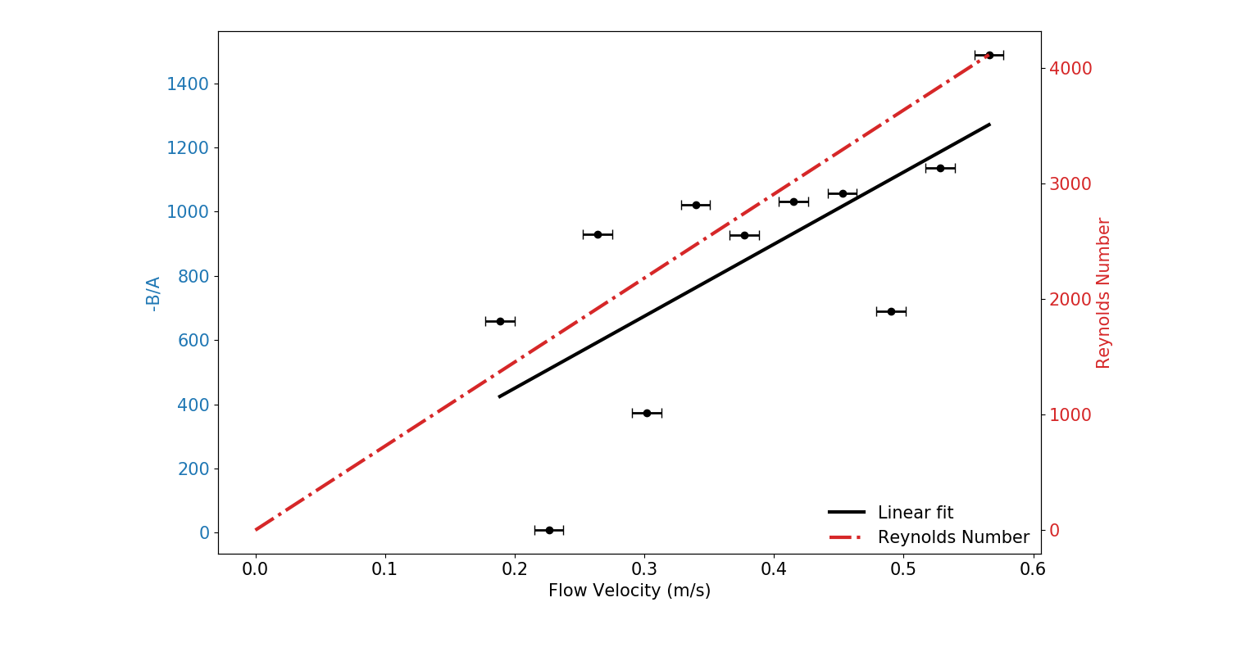

5 degree
$$R^{2}=0.70$$
Notes:
The 5 degree data is not as good, with an R squared of 0.70. Vertical error bars are not present on 5 and 10 degrees as these measurements take a long time and it’s difficult to get multiple data sets.

Slide 13
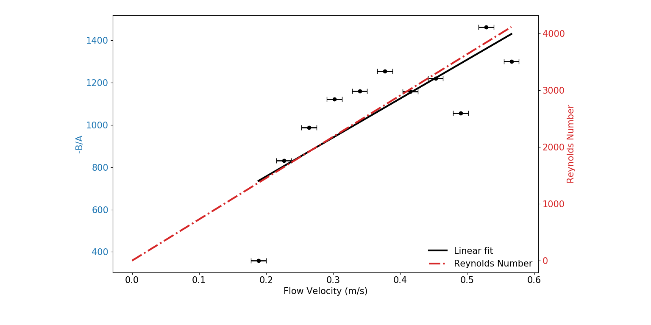

10 degree
$$R^{2}=0.79$$
Notes:
The 10 degree plot is also similar to 5 degrees, in how it’s difficult to say anything conclusively with data that does not fit to the trend.

Slide 14
Discussion
0 degree data appears to be the best result. It contains an artifact where the data point deviates greatly from the trend.
SNR decreases as the angle increases.
SNR for 0 degrees is 22.9, 5 degrees is 9.2, and 10 degrees is 8.2.
Notes:
The 0 degree appears to be the best result. Through research by Sebastian, we’ve been able to hint at the artifact being possibly caused due to a transition from laminar to turbulent. More work needs to be done to characterize the artifact. It’s also seems that by increasing the angle of the magnet, the overall signal amplitude is decreased. This can be seen in the comparison between 0 and 15 degree tilt of the magnet, for the same flow rate.
The SNR was calculated for 0,5, and 10 degrees by adding up all flow data for a particular angle, and then dividing by the total number of files used, to generate an averaged plot. Then, the highest magnitude point in that plot is divided by the average of the last 10 data points. The SNR for 0 degrees is 22.9, for 5 degrees is 9.2, and 10 degrees is 8.2. This decreasing SNR with increasing angle is what we would expect given the comparison between the 0, 5, and 10 degree plots.

Slide 15


Discussion
Effective slice thickness is calculated with :
$$v_{avg}=\left(−\frac{B}{A}\right)L_{eff}$$
$L_{eff}=4.9 mm$ given 0 degree data.
Effective probe coil length will change with a change in magnet orientation.
We would expect $L_{eff}$ to be different for 0, 5, and 10 degrees.
Slope of this line is $L_{eff}$
Notes:
For the 0 degree data set, we can use our average velocity equation, with –B/A to find our effective probe coil length. The effective probe coil length ends up being the slope of the line. For 0 degrees, the effective probe coil length is measured to be 4.9mm
Because the effective probe coil length is determined by magnetic field inhomogeneity, as we change the orientation of our magnet, we change the orientation of the magnetic field inhomogeneities. This would cause Leff to change. So in essence, the cradle system could not only be used to change the vertical gradient, but also the horizontal sensitive slice length.
Also, to revisit an earlier assumption we made. I said that we neglect T1 complete polarization of our sample. To put some things into perspective, at the highest velocity (0.56m/s), it takes 39 ms to move through the 22mm long coil. The T1 of this doped water, is approximately 75ms (although that T1 was measured at 7T). So we’re approaching the limit of that approximation with increasing flow velocity. As flow rate increases we have to worry more and more about T1 polarization of our sample.

Slide 16
Conclusion
We’ve been able to show that with these methods, flow measurements can be made with a small unilateral magnet.
The method works best at 0 degrees, as SNR decreases with an increase in magnet angle.
Overall, the project is encouraging of unilateral magnetic resonance, and shows that there is potential for a device like this to be one day used in the field.
Notes:
From my results, we can see that flow measurements can be made with a small handheld unilateral magnet. There are obvious problems with noise. By changing the orientation of the magnet with respect to flow velocity, we can see that the signal to noise decreases, and gives poor flow results. More exploration needs to be done in that regard.
I’ve also been able to show that with this particular magnet, at 0 degrees there’s a prominent artifact at roughly a Reynolds number of 2000. Once again, more exploration needs to be done to say whether or not the artifact is caused by a transition from laminar to turbulent.
Overall, the design and methods used show that unilateral magnetic resonance has potential. Hopefully work in this field motivates further research such that some day portable magnetic resonance devices can be used for a broad range of environments.

Slide 17
Acknowledgements
I would like to thank Ben and Bruce for their guidance throughout the project.

