Slide 1

UFC HISTORY 1994 - 2021

Slide 2
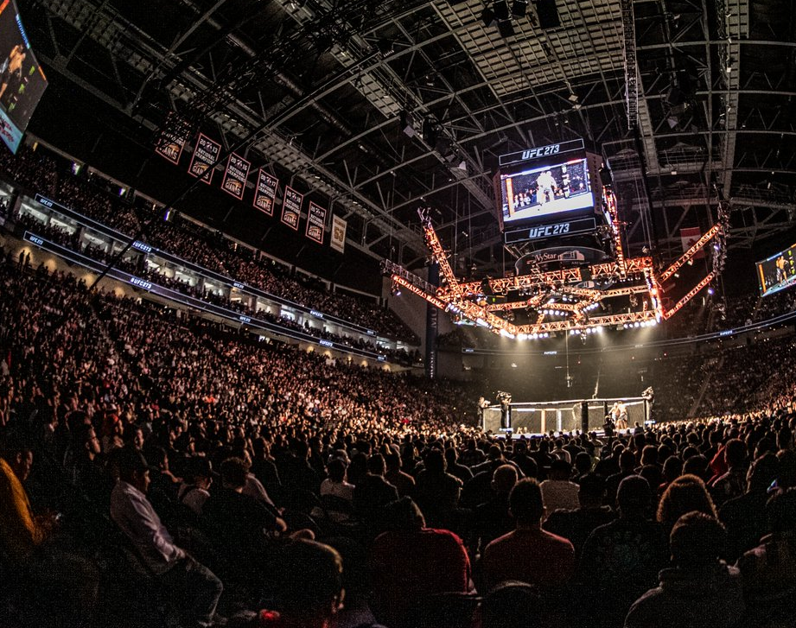
UFC quick summary
Number of fighters: 2124
The oldest fighter age: 51
Number of events: 556
The biggest event numer (152): Las Vegas

Slide 3
How many fights took place in each division?

Slide 4
What is the most common way to win a fight…

Slide 5
… and who is the best fighter?

Slide 6
The most dangerous STRIKERS in UFC

Slide 7
TO BE CONTIUNED…

