Slide 1
TypeScript
Slides by
Anders Hejlsberg
Technical Fellow

Slide 2
Large scale JavaScript development is hard.

Slide 3
TypeScript: A language for large scale JavaScript development.

Slide 4
TypeScript: A typed superset of JavaScript that compiles to plain JavaScript.

Slide 5
Any browser. Any host. Any OS.

Slide 6
Open Source.

Slide 7
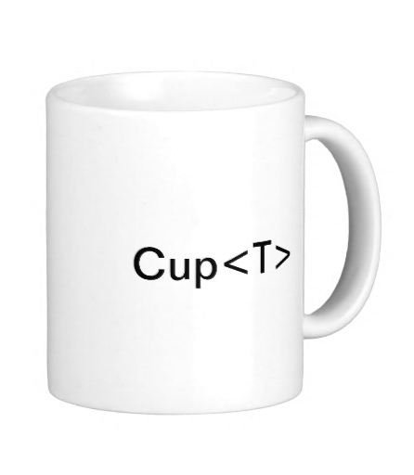


+
+

Slide 8
+
+

Slide 9


Announcing: TypeScript 1.0

Slide 10
Type System
An accurate static representation of JavaScript’s dynamic run-time type system
Structural typing and type inference
In practice very few type annotations are necessary
Generics, union types, tuple types
Increases accuracy and expressiveness of type system
Works with existing JavaScript libraries
Declaration files can be written and maintained separately
Types enable tooling
Provide verification and assistance, but not hard guarantees

Slide 11
Classes, Interfaces, Modules
An accurate static representation of JavaScript’s dynamic run-time type system
Scalable application structuring
Classes, interfaces, and modules enable clear contracts in code
Aligned with emerging standards
Class and lambda syntax aligns with ECMAScript 6 proposals
Supports popular module systems
CommonJS and AMD modules in any ECMAScript 3 environment

Slide 12
TypeScript Ecosystem
An Open Source language for large scale JavaScript development.
Community
https://github.com/Microsoft/Typescipt - OPEN SOURCE!!!
Over 3000 StackOverflow questions
Mozilla Shumway, Turbulenz, doppio, Away3D, WinJS, ...
Frameworks
Over 700 .d.ts library definitions on Definitely Typed repository covering more than 90% of popular JavaScript frameworks
Tool support
IDEs: VS, Monaco, Eclipse, IntelliJ, Resharper, Sublime Text, Brackets, …
Build: Heroku, Ruby, grunt, ASP.NET, node.js, compile-in-client
Testing: Chutzpah, tsUnit + TSD + GRUNT-TS

Slide 13
TypeScript Roadmap
An Open Source language for large scale JavaScript development.
TypeScript 1.3 available now!
New 5x faster compiler, new language service, tuple types, protected
TypeScript 1.4
Union types, const enums, let and const, template string, symbols
Available in master branch of repo (not jet released)
TypeScript 1.5
More ES6: Destructuring, spread operator, for...of, generators
TypeScript 2.0
ECMAScript 6 parity, downlevel support where feasible
Additional features, e.g. Asynchronous Functions (async/await)
https://github.com/Microsoft/TypeScript/wiki/Roadmap

Slide 14
http://typescriptlang.org

