Slide 1
.NET Conf 2024 Novità in C# 13
Daniele Morosinotto

Slide 2
Agenda – What’s new C#13
New params Collections → new types NOT ONLY Array[]
+ method overload Resolution → choose «best» Collection type
Partial «everywhere» → methods & props
New Lock object → optimized lock meccanism
Other features:
field keyword (in preview → WARN break-change use @field / this.field )
Escape sequence \x1b or \u001b → ‘\e’
Index FromEnd [^1]
Generics :allow ref struct
extensions (probably next year… C# 14)
Reference & Contacts

Slide 3
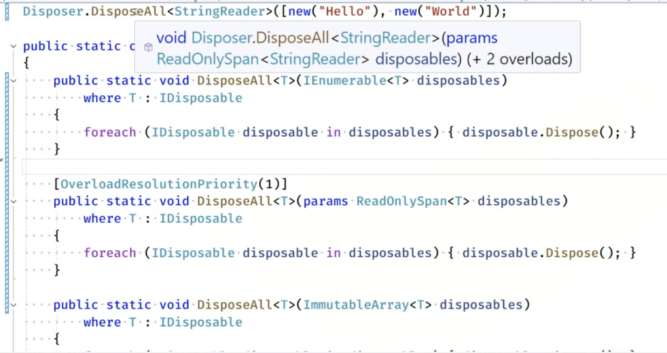
DEMO params collections + overload resolution

Slide 4
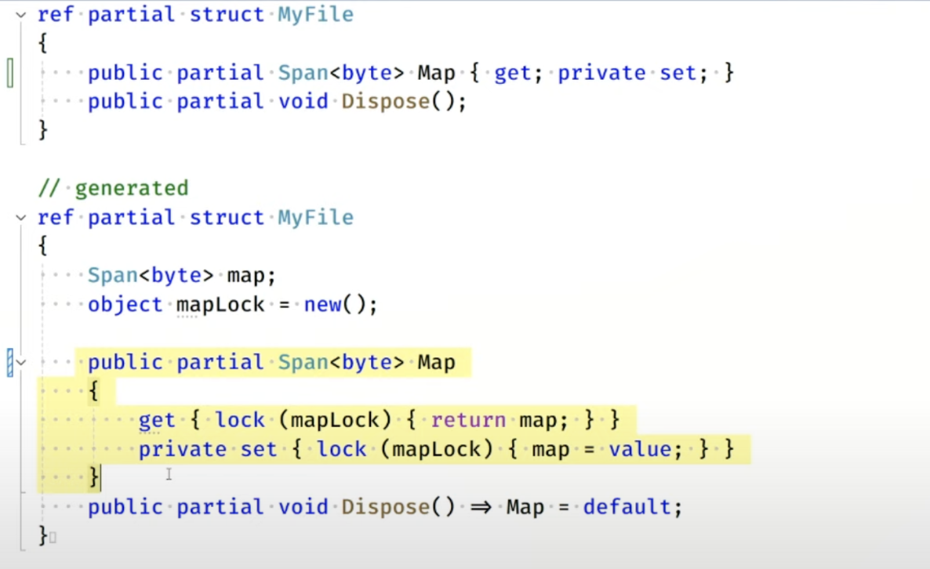
DEMO: partial «everywhere» methods & props

Slide 5
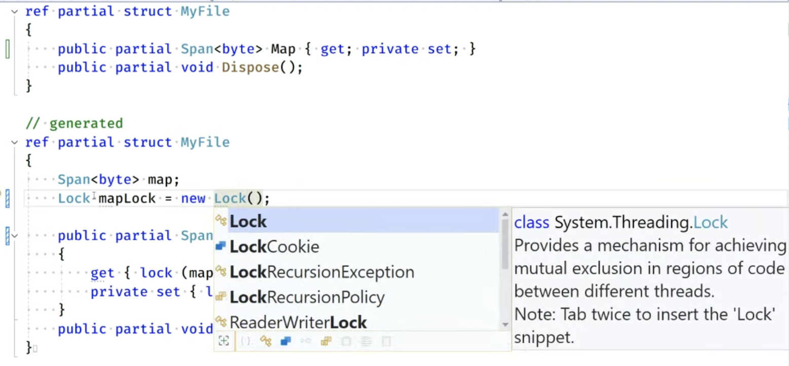
DEMO: Lock object ← optimize lock(…)

Slide 6
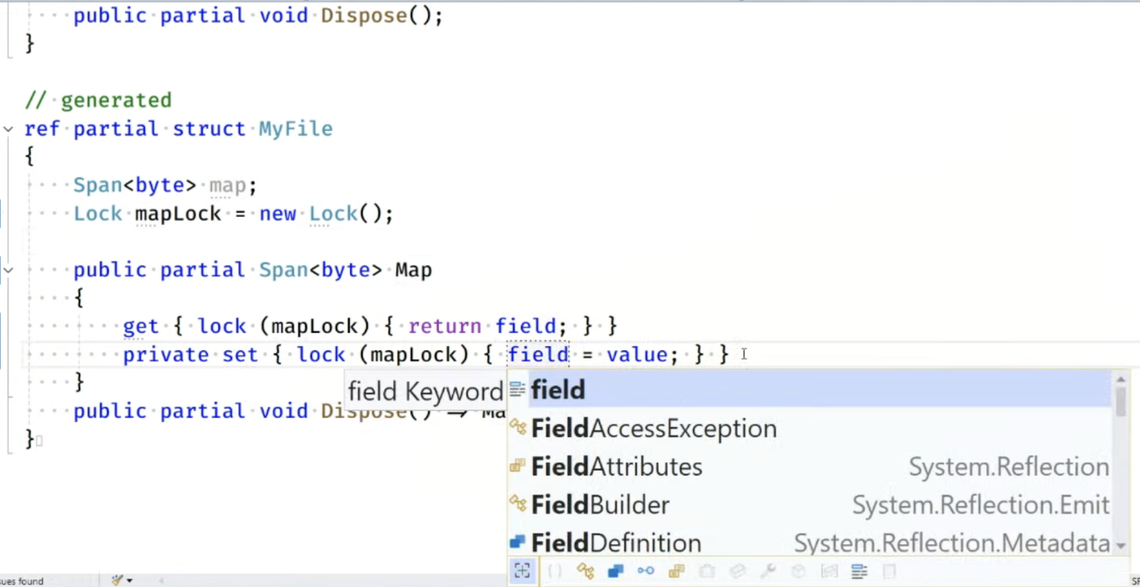
DEMO: field keyword «preview» – WARN break-change

Slide 7
Reference C# 13
[VIDEO] What’s New in C# 13? – .NETConf https://youtu.be/japXYFS9YPQ
+ Preview extensions @Build 2023 with Mads & Dustin https://youtu.be/O3hx6oPWzX8?si=cshHjRKFbIT-pYWz
[ARTICLE] Explore C# 13 Preview Features https://devblogs.microsoft.com/dotnet/csharp-13-explore-preview-features/
[DOCS] What's NEW in C# 13 https://learn.microsoft.com/en-us/dotnet/csharp/whats-new/csharp-13
[WIKI] C# Feature Status https://github.com/dotnet/roslyn/blob/main/docs/Language%20Feature%20Status.md
[REPO] C# compliler meeting notes https://github.com/dotnet/csharplang

Slide 8
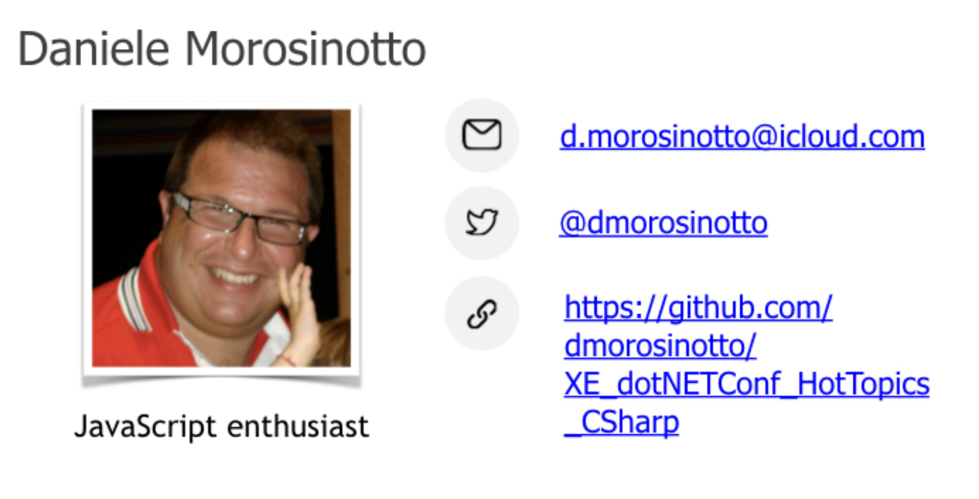
Contacts

