Slide 1
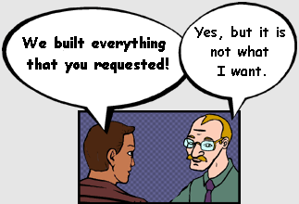
Keeping Business Dreams From Becoming Software Delivery Nightmares
Matt Holitza, Change and Configuration Management
Daniel Moul, Requirements Management
Notes:
Introductions: Daniel first, then Matt
Background
What we are working on now
Tell them what you’re going to tell them: Objectives of the webcast (common nightmares; learn more about how Rational can provide you with solutions and capabilities to make your lives easier; how our platform can help you avoid common pitfalls) – Matt ☺

Slide 2

Business dreams…
Exceed Expectations
Fast Time to Market
Profit
Success
Happy Customers, Employees and Shareholders
Revenue
High Quality Products
Notes:
Daniel
Ahh, the dreams of business. No matter what industry or business you are in, the dreams are very similar: it’s all about finding innovative ways and methods to deliver on particular a customer need, while at the same time generating revenue and turn a profit.
More specifically in the world of IT, those big picture dreams and goals revolve around the need to get your product or application to market as quickly as possible, while also producing a solution that is of high quality. And finding a way to achieve the perfect balance between the two. The end result is of course in a perfect world we want to find ways of exceeding the expectations of our stakeholders, and generating a loyal customer base, happy employees, and satisfied shareholders.

Slide 3
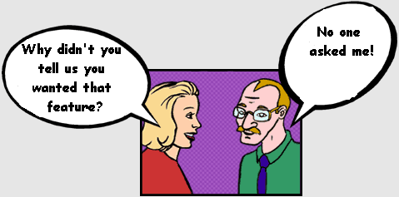
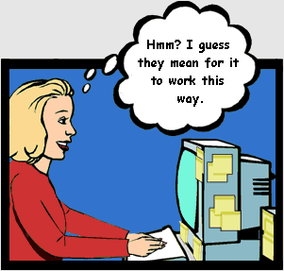
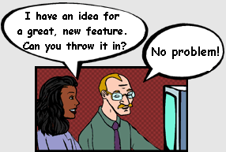
Some familiar situations…
Notes:
Daniel
The four cartoons show symptoms of common project problems:
Top left cartoon: Skipped analyzing the problem or understanding their stakeholders’ needs.
Top right cartoon: Poor elicitation of requirements, lack of stakeholder involvement.
Bottom left: Developers think they know best, requirements not kept formally, no formal change management.
Bottom right: Failure to manage scope.

Slide 4
… But, there are barriers
IT
Business
Silos of People, Processes and Tools
Notes:
Matt
However, as you know this is all easier said than done.
There are barriers to realizing the dreams…
Silos of people, processes and tools (even with business and IT, communication issues, organization politics, inconsistent tooling infrastructure, loose integrations)

Slide 5




… But, there are barriers
IT
Business
Silos of People, Processes and Tools
Business Analyst
Tester
Developer
Distributed/Virtual Teams
Notes:
Matt
This is exacerbated by distributed and virtual or matrixed teams, where collaboration and communication is more difficult, email, spreadsheets and conference calls become less effective.

Slide 6

… But, there are barriers
IT
Business
Poor Visibility
Silos of People, Processes and Tools
Business Analyst
Tester
Developer
Distributed/Virtual Teams
Notes:
Matt
And leads to poor visibility, it’s very difficult with no standard collaboration infrastructure to effectively understand project or program status, how an organization is performing with regards to KPIs.

Slide 7
How can IBM Rational help make your business dreams a reality?
Notes:
Daniel

Slide 8












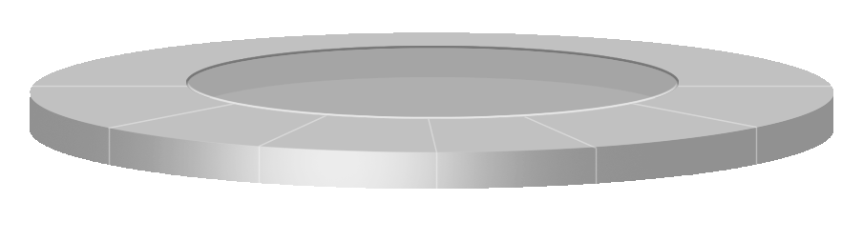





An open ALM platform can break down organizational, functional and geographic barriers
Real-time, transparent access to project data, risks and progress
TEST TEAM
PROJECT A
Open
Source
Solutions
Product
A
Product
B
Product
C
Third-party
products
Product
D
Process Workflow
HTTP/REST
Shared Platform Services
Integrated, loosely coupled
Logic, User Interfaces
Data Models, Workflow
Administration
ARCHITECTURE
PROJECT B
Notes:
Daniel/Matt Discuss
We at IBM believe that what's needed is a fresh approach to solving the core problem of tool integration across the software lifecycle -- a software development platform.
The KEY to a platform is that it replaces one vendor's view of the world (even our own view) with an open and extensible view that enables any vendor to participate. And that delivers real-time, transparent access to project data, risks and progress across the preferred environment that YOU choose -- including tools from IBM, competitors and open-source alternatives.
Matt’s question: “Daniel, hasn’t this been done before?” Talk about how Rational is different… tee up the idea of tool integration / jazz collaboration.

Slide 9
Tool integration - the old way
Traceability links
Model concepts
Payment
service
Pay
service
Settlement
service
Payment
service
Cash
service
Payment
service
Ent Arch
Require-
ments
Bus Proc Model
Software & Solution Architecture
Development
Test
Payment
process
Pay
process
Settlement
process
Payment
process
Cash
process
Payment
process
Similar silos for repositories, including links to products
Notes:
Daniel
One of the big challenges for organizations deploying ALM solutions is that the integrations between tools have introduced a lot of constraints. At root, these are often caused by the need of one tool to understand the data model of a second tool as well as business logic of the second tool. The result are tightly coupled products and product releases – with integrations that are expensive to develop and test, and data that is synchronized between the tools (and which must then be kept in sync).
We can do better.

Slide 10
Tools – the new way: “www linked data”
Taking integration to a new level
http://acme.com/paymentProcess
http://acme.com/paymentService
about
about
about
about
HTTP/REST
Ent Arch
Require-
ments
Bus Proc Model
Software & Solution Architecture
Development
Test
Similar fix for repositories
Notes:
Daniel
We can learn from the loosely coupled nature of the Internet.
We can take principles from service-oriented architectures
We can define common interfaces and offer them in a REST style
Jazz technology has enabled Rational to take integration to the next level. This is not about passing data from one tool to the other, but rather how to stay in your own tool but yet access vital, related information from others tools – all without ever leaving your own environment or tracking down the right contact to provide that information.
We are doing all the above in the Jazz platform and Open Services for Lifecycle Collaboration

Slide 11
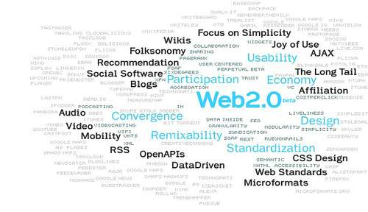

Designed to integrate both partner and competitor resources
Simplifying collaboration across the software delivery lifecycle
An open invitation to collaborate on a common integration architecture for software delivery
© Markus Angermeier@aperto.de
Open Services for
Lifecycle Collaboration
Barriers to sharing resources and assets across the software lifecycle
  Multiple vendors, open source projects, and in-house tools
  Private vocabularies, formats and stores
  A proposed architecture for sharing lifecycle resources
    Described on Jazz.net through illustrative resource definitions, service implementations, and use cases
  Inspired by Internet architecture
    Loosely coupled integration with “just enough” standardization
    Common resource formats and services
  Innovation from the Jazz technology platform
Notes:
Daniel
We understand that organizations have existing products that need to integrate into the ALM backbone, which is why we are sponsors of the OSLC project.
Key Points:
Focus is on lifecycle collaboration
Ability for organizations to use disparate tools and share lifecycle resources
Loosely coupled approach
Relying on standard internet protocols (http, xml, …)
Not requiring intensive vendor interactions/agreements
We’re at early stages of thinking
Learning through Jazz (JRS) incubator
Early usage of this style of architecture in some new 2008 products
Decision to incorporate into future of Jazz technology platform
We see possibilities for industry-wide benefits, and want to test and develop these ideas with the broader community
Bringing this to the community at this early stage is just another example of the transparent nature of Jazz
Publishing our thinking on jazz.net – background, suggested protocols, code illustrations of how to use the protocols, sample resource definitions
Cross community/ecosystem initiative
The ideas, architecture, and protocols are the key here – the code implementations are not if high importance, it’s agreement on protocols that matters
FAQs
What is IBM announcing?
IBM is introducing an initiative, called Open Services for Lifecycle Collaboration, aimed at simplifying collaboration across the software delivery lifecycle. Our goal is to enable teams to use disparate tools and share lifecycle resources in delivering software, whether the tools are from IBM, other vendors, open source projects, or in-house development. We aim to do so in a way that is open and non-proprietary and that will encourage all industry members to collaborate.
Specifically, we're publishing several things at Jazz.net, including an initial set of descriptions for lifecycle resources such as requirements and test cases, as well as protocols and services for accessing these resources. We're also providing code that illustrates usage of these protocols. We hope that by openly sharing our ideas and sample code, our efforts will promote cross-industry collaboration that will lead to agreement on a common architecture and to both commercial products and open source projects that implement these protocols.
What problem are you trying to solve?
The software delivery tools marketplace of today grew organically from point tools aimed at solving specific narrow needs in the software delivery lifecycle. Teams and organizations who are concerned with all aspects of software delivery have historically had to rely on multiple point-to-point integrations between tools. Consequently, this has created barriers for teams to collaborate and have made cross-lifecycle processes and cross-tool integrations expensive to create, complex to manage, and difficult to change over time, despite the best efforts of tools vendors to integrate their own tools or create alliances with complementary vendors.
The increasing focus in software delivery on governance and business alignment make it imperative that the industry move to solve the closely-related problems of tool interoperability and lifecycle collaboration. Our goal is to find a means for allowing tools to readily share lifecycle resources, enabling organizations to more easily integrate, manage, and evolve lifecycle tools and processes for software delivery in response to new business demands.
What fresh approach does IBM bring to the solution of this challenge?
First, IBM’s experience has identified three degrees of interoperability that are relevant to this challenge: (1) fundamental services that allow different tools to share and exchange the data that they produce; (2) common understanding of relationships between lifecycle resources, such as test cases and requirements; and (3) detailed agreement on the information in an resource, such as a Use Case. A successful solution to this challenge must allow for any and all of these degrees of integration, without forcing tools to agree at the most detailed level where that isn’t necessary.
Second, we recognize that the interoperability mechanisms must be robust and flexible allowing companies to easily upgrade individual tools without breaking tool integrations or process flows. A successful solution to this challenge cannot be dependent on close cooperation or continuous coordination between vendors. That’s why our proposal relies heavily on the architecture of the web, which robustly integrates disparate providers of information and services. Similarly, we model our approach on Web 2.0 concepts such as mashups, exploiting document formats, metadata and services rather than traditional brittle APIs.
Third, any eventual solution must be recognized as being independent of one vendor’s control. To that end, in the future we’d like to explore the role that open standards and open source projects might play in ensuring that agreed-to protocols and resource descriptions will be freely and equitably available and evolve under independent governance. To promote discussion and help people to understand the ideas being proposed, we are also making illustrative code available under an open source license.
What are you making available on Jazz.net?
We are making available documents outlining the Open Services for Lifecycle Collaboration initiative as well as sample implementations of the services and resource descriptions. The documents (1) outline IBM’s motivations for this initiative and discuss the architectural principles and technical underpinnings for the proposed resource descriptions and services; (2) suggest a topology of lifecycle resource types and initial descriptions for a core set of resource types, including requirements and test cases; and (3) describe an initial set of protocols and services for accessing resources, including services for retrieving and updating resources, for collecting resources into projects, and for controlling access to resources. Additionally, we’ve published sample implementations for the resource descriptions and for the services.
What do you expect people to do with what you’ve published on Jazz.net? What are the next steps?
The documents and sample code published on Jazz.net are intended to start the discussion by illustrating our ideas. We encourage other vendors and members of the community to examine these resources and begin the dialog with us and each other that can lead to a common approach for achieving lifecycle collaboration.
Image licensed with attribution per following: http://en.wikipedia.org/wiki/Image:Web_2.0_Map.svg

Slide 12


The Jazz Project: Transforming software delivery
A continuing investment by IBM to create a scalable, extensible, and collaborative lifecycle management platform.
IBM’s vision of the future of software delivery–globally distributed, fluid and dynamic.
An evolution of the Rational portfolio, which will evolve to support Jazz technology over time.
A community at Jazz.net –where you can see Jazz-based products being built.
Jazz is a project and platform for transforming how people work together to deliver greater value and performance from their software investments.
Notes:
Matt
The Jazz platform
Platform
Collaborative ALM
There is a repository
Technical architecture…

Slide 13



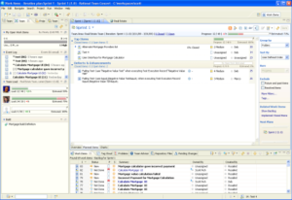

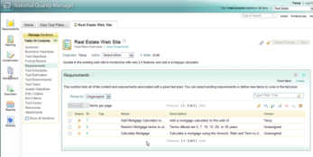
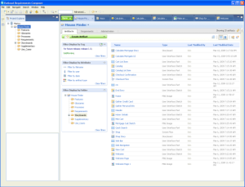



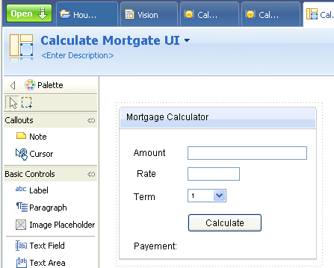
Align technical teams with business drivers
Integrated workflows foster clarity of requirements
Developer
Rational Team Concert
Analyst
Tester
Rational Requirements Composer
Rational Quality Manager
2. Developer reviews requirements associated with work-items
3. Tester ensures requirements coverage in test plans and test cases.
1. Analyst defines, analyzes, and validates requirements.
Notes:
Matt to pass over to Daniel – “Daniel, can you talk about the flow here starting with requirements?”
We focused on accelerating the core workflows that integrate and automate software delivery teams, such as the requirements workflow that you see here...

Slide 14
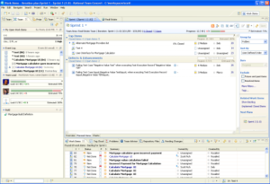
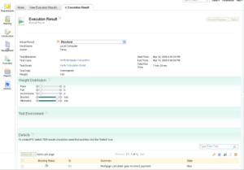

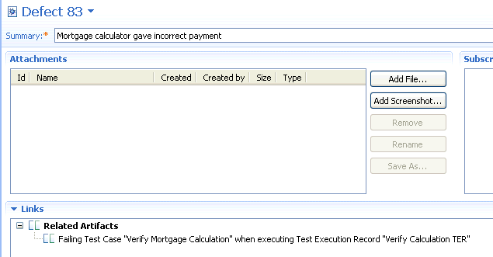
Accelerate the build-test-debug cycle
Integrated workflows speed defect time-to-resolution
Developer
Tester
Analyst
Rational Quality Manager
Rational Requirements Composer
Rational Team Concert
1. Tester captures test execution results and logs defect as a work-item.
3. At any time, developers and testers can link to associated requirements, sketches or storyboards.
2. Developers see defect in their "To Do" list, and can link to detailed defect information.
Notes:
Matt
And the core workflow of developing, building and validating software.
Last minute showstopper scenario – Speeding time to defect resolution

Slide 15

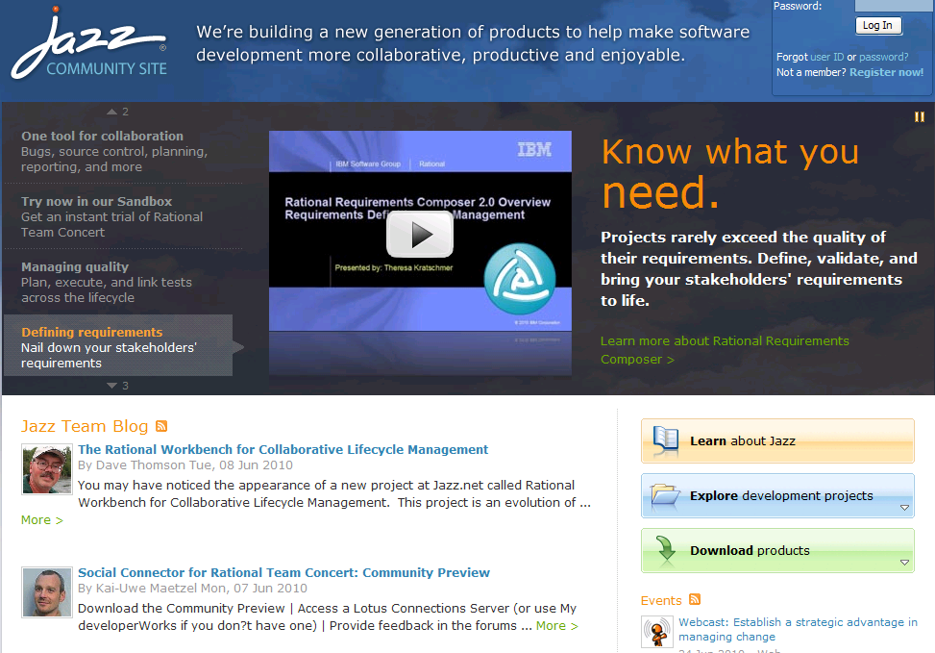
We invite you to join the Jazz community on jazz.net
Suppose we did our development out on the Internet?
A transparent software delivery laboratory where you can...
  Communicate with the development team
  Track the progress of builds and milestones
  Get the latest product trials and betas
  Join developers and product managers in discussion groups
  Submit defect and enhancement requests
Try Rational Requirements Composer, Rational Team Concert and other jazz offerings at no charge:
jazz.net/downloads
Notes:
Daniel
The Jazz project started as an joint project between IBM Rational -- in fact, many of the same folks who brought you the Eclipse project now work on and drive Jazz technology --

Slide 16

Notes:
Back to Angelique

Slide 17


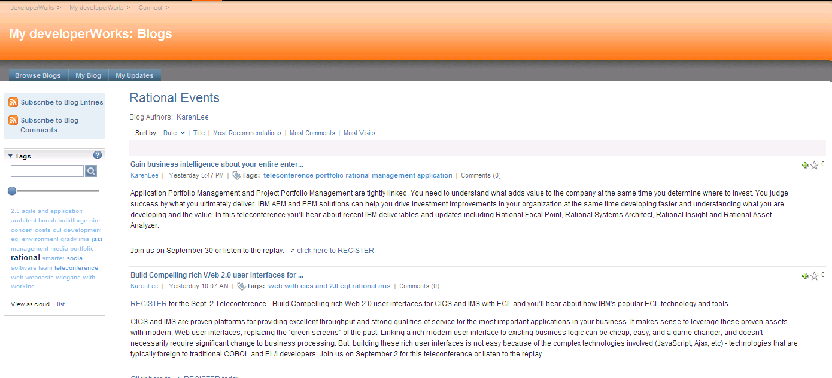
Rational events blog
Check out the brand new Rational events blog
https://www.ibm.com/developerworks/mydeveloperworks/blogs/rationalevents/
We’ll be blogging about Webcasts, Teleconferences, Podcasts, Videos, Face to Face events, etc….. and don’t forget to subscribe to the RSS Feed
Come visit the blog and provide us with feedback and comments on the webcast you just attended.…or ideas and recommendation for future events.

Slide 18
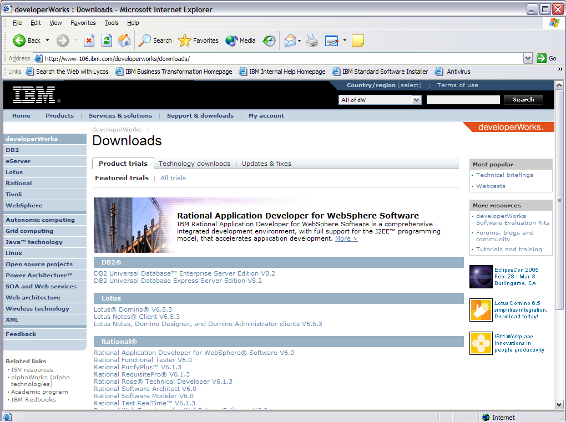
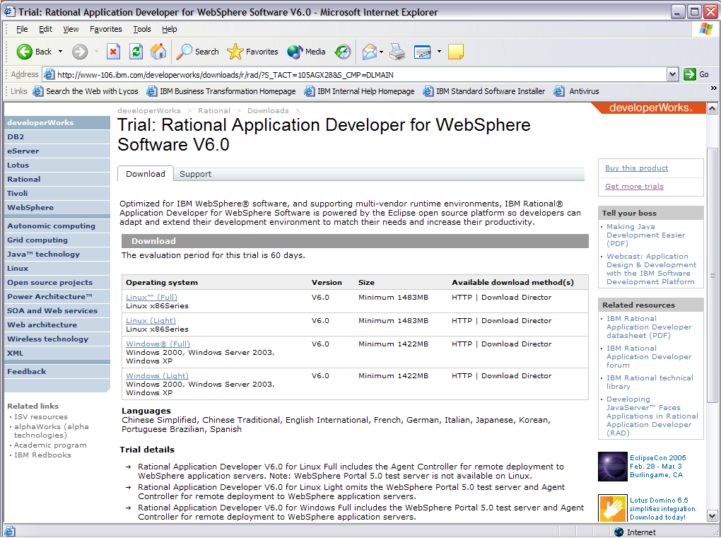
Free trial downloads and demos of IBM solutions
one stop shopping for IBM’s most popular trial code downloads
Provides easy access to IBM’s most popular trial software including:
  IBM Rational Requirements Composer
  IBM Rational Team Concert
  SEK available if you prefer DVD to download
Provide a collection of supporting resources for each trial that is easy to find on the web:
  Complimentary tech support*
  Forums
  Installation Guides
  Demos & tutorials
  ROI materials
  Pricing information from the IBM online catalog
  ibm.com/developerWorks/downloads
Actual product download page
Notes:
developerWorks has created an area on the site dedicated to IBM’s most popular trial code downloads. If you visit ibm.com/developerworks/downloads, you’ll find a menu of trials to chose from on multiple platforms. In addition to quick access to the free code, we’ve collected product specific material to help downloaders get up and running with the products. There are several trials available of the products we covered today such as Rational Software Architect, Rational Software Modeler and Rational Application Developer. These materials include technical tutorials, demos and ROI materials if you are interested in learning how these tools can help your business. For those who prefer a DVD to download, we have a Software Evaluation kit available. [Turn to next chart about SEK].
*support not available for all trials. See Web site for specifics.

Slide 19
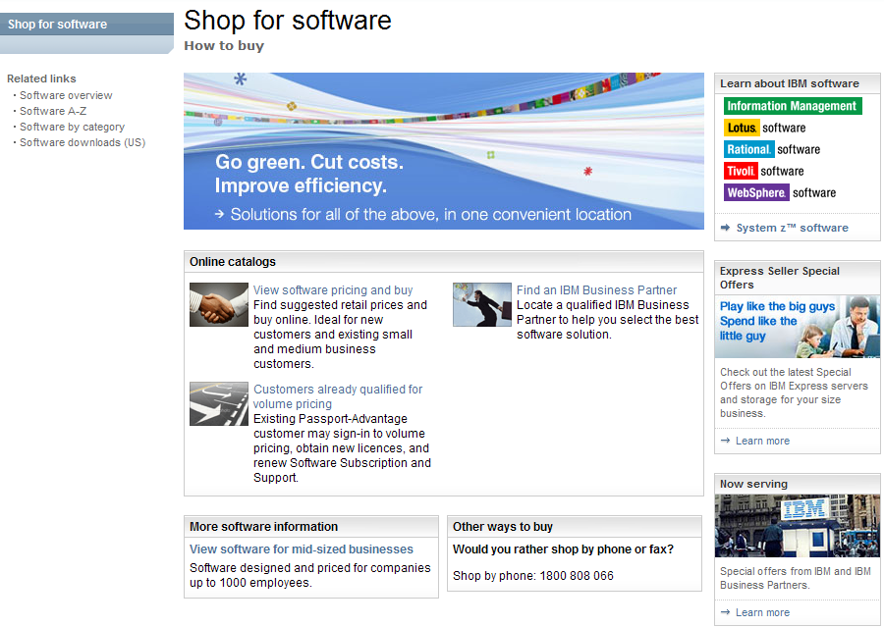
Want to buy what you’ve seen today?
The IBM Software online Catalog makes it easy to shop for IBM software.
Quickly find the products you need by name, part # or by category
Obtain up-to-date translated product and SRP* pricing information
Have questions? Ready to move to the next step? You can place your order by phone or online
Learn, Shop and Buy the way that works best for you!
ibm.com/software/ecatalog
IBM SW online Catalog
Or you can call 1-877-426-3774
Phone number for other countries on website
*Suggested Retail Price (SRP) shown. For volume pricing, simply create cart and input existing Web Identity user name and password
Notes:
For internal audience – Sales Reps get

Slide 20

Already purchased an IBM Rational software product?
Customer Ratings and Reviews now available for Rational products. This easy-to-use review capability allows your voice to be heard. When you rate a product and write a review you are sharing your valuable experiences and opinions with other people who are considering Rational products.
Write a review today and share your thoughts with the Rational community.
http://www.ibm.com/software/rational/info/review

Slide 21

Take Action
  Visit IBM Rational
  http://www.ibm.com/rational
© Copyright IBM Corporation 2009. All rights reserved.
The information contained in these materials is provided for informational purposes only, and is provided AS IS without warranty of any kind, express or implied. IBM shall not be responsible
for any damages arising out of the use of, or otherwise related to, these materials. Nothing contained in these materials is intended to, nor shall have the effect of, creating any warranties or representations from IBM or its suppliers or licensors, or altering the terms and conditions of the applicable license agreement governing the use of IBM software. References in these materials
to IBM products, programs, or services do not imply that they will be available in all countries in which IBM operates. Product release dates and/or capabilities referenced in these materials may change at any time at IBM’s sole discretion based on market opportunities or other factors, and are not intended to be a commitment to future product or feature availability in any way.
IBM, the IBM logo, the on-demand business logo, Rational, the Rational logo, and other IBM Rational products and services are trademarks or registered trademarks of the International Business Machines Corporation, in the United States, other countries or both. Other company, product, or service names may be trademarks or service marks of others.

