Slide 1
Session CEE-1905 The End of Cloning: Strategic Reuse and Product Line Engineering With the IBM Rational Platform
Daniel Moul
Senior Product Manager
IBM Rational Product Management
dmoul@us.ibm.com
Barclay Brown
Global Solution Executive
IBM Rational
barclayb@us.ibm.com
Notes:
0

Slide 2
Please note
IBM’s statements regarding its plans, directions, and intent are subject to change or withdrawal without notice at IBM’s sole discretion.
Information regarding potential future products is intended to outline our general product direction and it should not be relied on in making a purchasing decision.
The information mentioned regarding potential future products is not a commitment, promise, or legal obligation to deliver any material, code or functionality. Information about potential future products may not be incorporated into any contract. The development, release, and timing of any future features or functionality described for our products remains at our sole discretion.
Performance is based on measurements and projections using standard IBM benchmarks in a controlled environment. The actual throughput or performance that any user will experience will vary depending upon many factors, including considerations such as the amount of multiprogramming in the user’s job stream, the I/O configuration, the storage configuration, and the workload processed. Therefore, no assurance can be given that an individual user will achieve results similar to those stated here.
Notes:
IBM IOD 2011
9/9/2014
Prensenter name here.ppt
9/9/2014 1:02 AM
1

Slide 3
Abstract
Customers are demanding increasing levels of specialization and customization in everything from automobiles to military satellites. Custom-engineering each configuration is expensive and time-consuming, especially when many products have a high degree of commonality, and only small variations. Producing a new product for a new customer or market by copying all engineering artifacts and then modifying the copies—the “clone and own” approach—is not a complete answer because it multiplies the requirements, design, implementation and testing effort. In this session, you learn about how the engineering and manufacturing of complex products and systems is undergoing a revolution and how to prepare and manage it.

Slide 4
Outline
Background: The need for Reuse
Approach: The need for Product Line Engineering
Concepts of PLE
Solution: Federated Platform for PLE

Slide 5
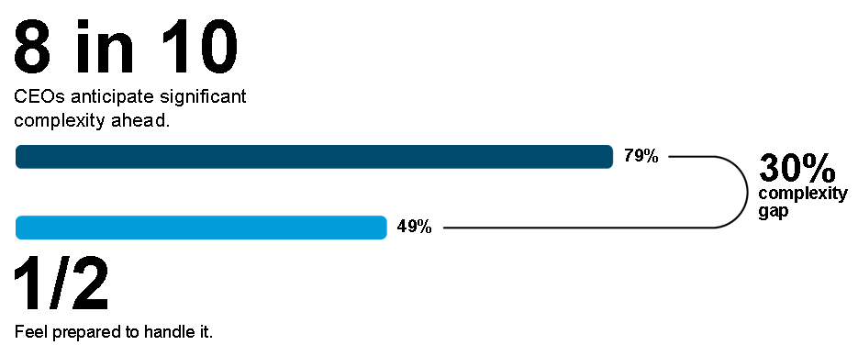
As products and systems become more complex, engineering effort multiplies.
source, HBR, June 2010
Notes:
We all know about the rise in the complexity of systems. In part, it’s this complexity that is causing us to look for new ways of engineering more efficiently.

Slide 6
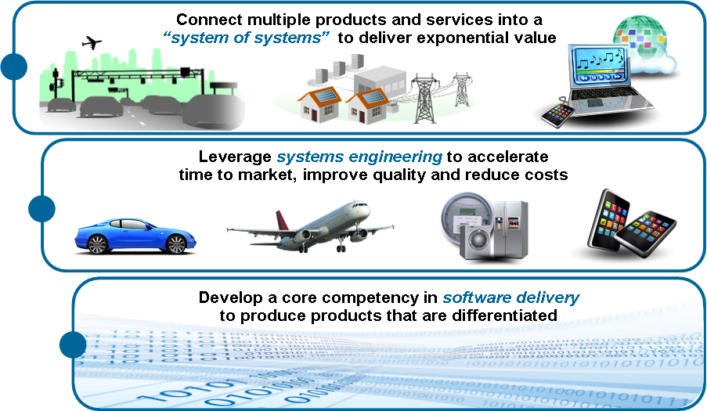
Companies are embracing new techniques and methods to better engineering complex products.
… but good engineering on its own isn’t enough
5
Notes:
There are a number of approaches to better engineering and we are fully behind all of these. They seek to improve engineering itself. But addressing the escalating levels of complexity is going to require something more…. Good engineering on it’s own isn’t enough.

Slide 7
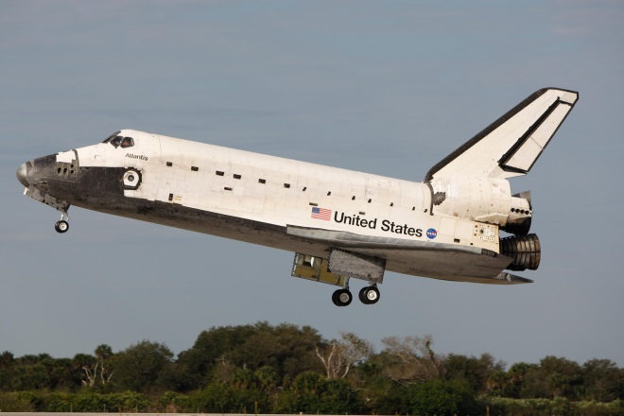
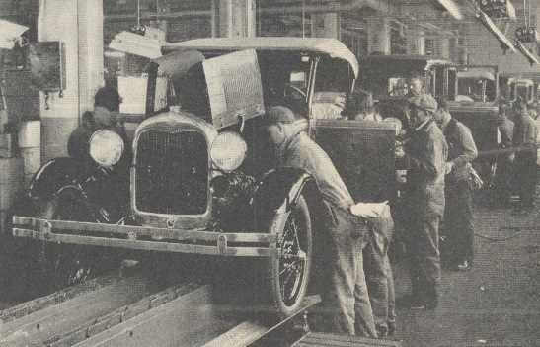
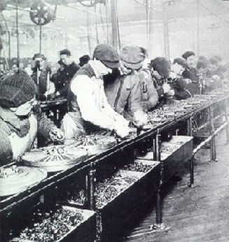



In the beginning …
…we just made them all alike
(efficient, but it didn’t meet all customers’ needs)
…or we built them one-by-one for each new customer
(it met the needs, but was very expensive)
Now customers demand increasingly specialized and customized products and costs are going through the roof!
Notes:
Let’s consider a historical perspective. When we made things all alike, like the original assembly lines, it was efficient, but customers had to be satisified with only one things—”any color, as long as it’s black,” as Henry Ford used to say. Or, we built custom systems for very demanding customers, engineering each from the ground up. It was expensive. But now customers require the best of both worlds—customized products and mass production prices!
Auto assembly line: http://en.wikipedia.org/wiki/Fordism
Ford Assembly line: http://commons.wikimedia.org/wiki/File:Ford_assembly_line_-_1913.jpg
Satellite: http://en.wikipedia.org/wiki/Solar_Maximum_Mission
Space Shuttle: http://commons.wikimedia.org/wiki/File:Space_Shuttle_Atlantis_approaching_the_Kennedy_Space_Center_to_land_following_STS-122.jpg

Slide 8

In reality …
… many products have a high degree of commonality with just small variations…
1
2
3
3a
4
4c
1
2013 XL
2014 XLT
Notes:
The good news is, many of the customizations customers need are small compared to the engineering of the entire product. The difference between the American and British fighter jet is small, compared to the entire aircraft. Car models and model years generally bring only incremental changes. A smartphone platform can endure for many evolutionary models without fundamental change.

Slide 9
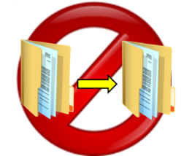
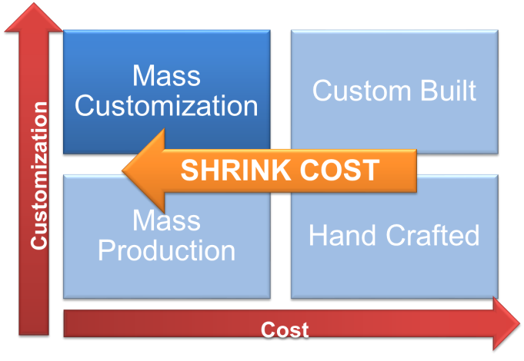
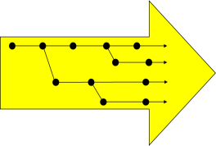
We need a new approach
Strategic reuse of engineering artifacts (without just copying)
Engineering from sets of features with dozens, hundreds or even thousands of product variants
Management of product component versions and their combinations
Strategic management of product family evolution
Result: More customization and variation to meet customer needs, but at a lower cost.
Notes:
The bad news, though is that our engineering systems are generally not engineered this way. What I mean is, the engineers THINK this way, but the systems they use often don’t support this way of working. What we need is a system that can meet several key needs. It must support strategic reuse of all kinds of engineering work products—and here I mean reuse without just making copies. We call that “clone and own” and as you probably know, this is only a partially effective strategy for reuse, since it disconnects the copy from the original. We also need a system that can create and manage product variants (like the US vs. British jet) based on sets of required features. These variants and all of their engineering information—requirements, designs, changes, tests—must be managed systematically and traceability relationships within this body of information maintained.
The result? We are able to shrink the cost at the same level of customization. Reducing this cost can make us more competitive or help us maintain profitability.

Slide 10

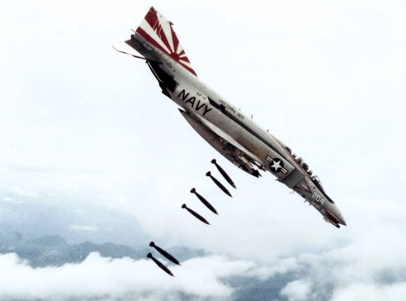

A scenario on the timeline…
A problem is found and change applied
Fix delivered from Program B Base variant, then to other family variants
A
B
Program B identifies and issue and fixes it
C
Parallel development …
Propagation of changes …
Notes:
It’s one thing to create product variants, and another to manage them effectively throughout the development process. For example, as changes occur in the product from which you created the variant (we’ll call this the base product), these changes should potentially be applied to the variants you’ve created. This is there some of the benefit of strategic reuse is seen—we didn’t have to discover this change four different times!
F4 Fighter:
http://en.wikipedia.org/wiki/McDonnell_Douglas_F-4_Phantom_II
http://en.wikipedia.org/wiki/McDonnell_Douglas_F-4_Phantom_II
http://en.wikipedia.org/wiki/Japan_Air_Self-Defense_Force

Slide 11
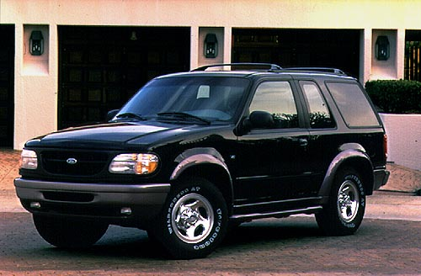
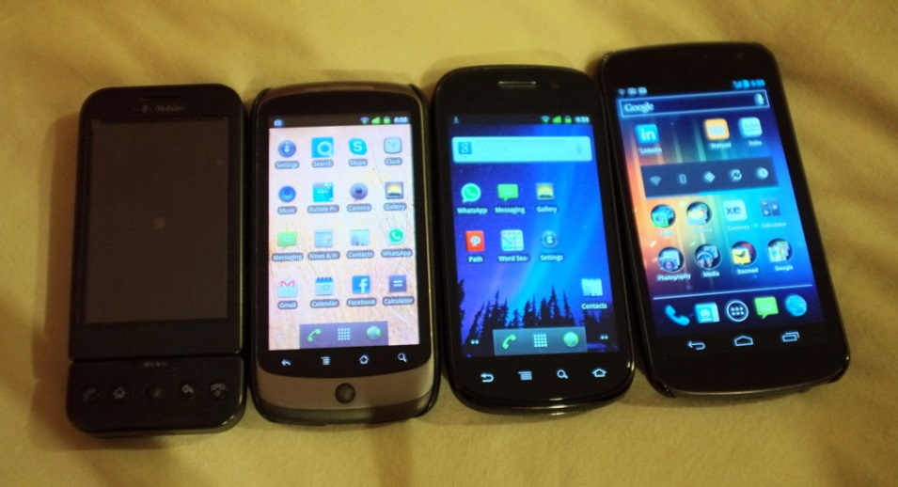
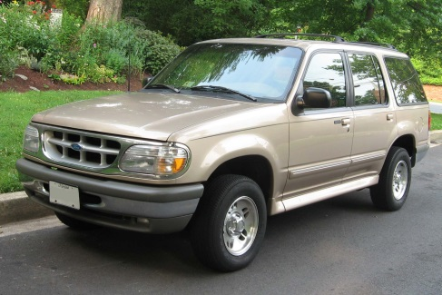
Product Line Engineering (PLE): The Path to Engineering Efficiency
The goal: Product Lines with high degree of reuse
Better reuse & variation management
Reach more market segments
Reduce development costs
Reduce time to market
Improve engineer productivity
Notes:
What we are talking about is a style, a philosophy of development that allows for reuse, and ultimately allows for the creation of product lines that enable us to reach new market segments more efficiently by exploiting the commonality between products.
Smart Phones: http://en.wikipedia.org/wiki/Google_Nexus
Ford Explorer: http://www.cargurus.com/Cars/2001-Ford-Explorer-Overview-c161
http://en.wikipedia.org/wiki/Sport_utility_vehicle

Slide 12
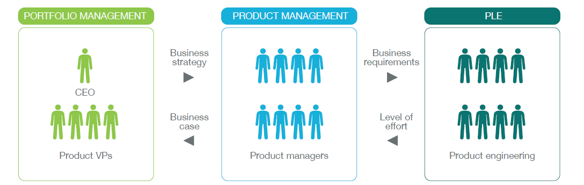
Product Line Engineering is becoming a key component of business strategy, along with portfolio and product management
PRODUCT LINE ENGINEERING
PRODUCT LINE ENGINEERING
Build those products right
Now build them as product lines
Lower Cost
Engineering Efficiency
Reuse
Time to Market
Pick the right products to build
11
Notes:
Product line engineering is growing beyond just the engineering organization, to take it’s place alongside strategic business functions like portfolio management, where we decide what products to build, and product management, where we figure out how to build those products efficiently and effectively. Product Line Engineering becomes even more advantageous when we harmonize our product strategy with our engineering strategy.

Slide 13
Needs Driving Toward a Product Line Engineering Strategy
Strategic Reuse of Requirements and Designs… with Variations
Product Line Strategy
Complex
Configuration Management
Product Line Engineering
MBSE and Modular Architectures
Complex Impact Analysis
Software Product Lines
Notes:
With these needs in mind, let’s look more closely at the strategic reuse and product line engineering approach. There three main aspects to this approach.

Slide 14




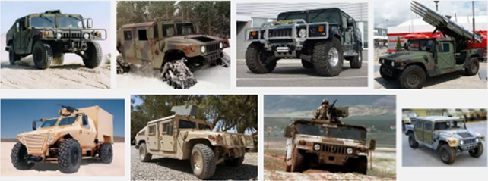




Needs Driving Toward a Product Line Engineering Strategy
Product Line Strategy
“Our products are presented to the market in product lines already—now we want to better develop and engineer that way”
Notes:
Some industries, notably automotive and consumer electronics position their products as evolving product lines to the market. Unfortunately this doesn’t always mean that their engineering processes and systems are set up this way.

Slide 15
Needs Driving Toward a Product Line Engineering Strategy
Strategic Reuse of Requirements and Designs… with Variations
“This new system has much in common with the last one we built so we want to reuse requirements, designs, components, etc… without just making copies”
Avoiding “Clone and Own”
Notes:
Other industries are aiming, not so much for a complete product line strategy, but for increased ability to reuse from one development program to another, without just making copies.

Slide 16
Needs Driving Toward a Product Line Engineering Strategy
Complex
Configuration Management
“We manage versions, variants, branching and configuration at a low level but want to do this at all levels of our product and systems engineering”
Notes:
Through configuration management, variants in low level engineering components, like software modules, can be managed. The goal may be to extend this to handle all aspects of the product, including hardware and higher level assembly and architecture.

Slide 17
Needs Driving Toward a Product Line Engineering Strategy
Complex Impact Analysis
“Analyzing the impact of change across our complex set of interrelated products and systems is a challenge for us”
Notes:
Changes, especially sets of changes or block changes can be incredibly disruptive to an engineering process. Being able to manage the impact of change by seeing how change affects related product variants can shrink the time needed to absorb and respond to changes.

Slide 18
Needs Driving Toward a Product Line Engineering Strategy
Software Product Lines
“My software is developed in product lines and I want to extend this to my products and systems development”
Notes:
The discipline of product line engineering has been applied to software successfully for years. The same concepts can be applied to the entire product, but must be embraced in the other engineering disciplines and at higher levels of engineering strategy.

Slide 19
Needs Driving Toward a Product Line Engineering Strategy
MBSE and Modular Architectures
“We are pursuing a model-based systems engineering approach and want to build product line variations into our models”
Notes:
Many organizations are embracing a model-based approach to systems engineering and it is sensible to try to build product variations into the model. That way, the same model can be developed and used to cover multiple variations of the same product.

Slide 20
Needs Driving Toward a Product Line Engineering Strategy
Strategic Reuse of Requirements and Designs… with Variations
Product Line Strategy
Complex
Configuration Management
Product Line Engineering
MBSE and Modular Architectures
Complex Impact Analysis
Software Product Lines
Notes:
With these needs in mind, let’s look more closely at the strategic reuse and product line engineering approach. There three main aspects to this approach.

Slide 21


Consider the economic determinants
I cannot afford to engineer for reuse
I cannot afford NOT to engineer for reuse

Slide 22
Consider the economic determinants
We only reuse the same components a couple of times
We don’t have executive support to create a platform engineering team
Each program is funded separately. The client won’t pay for benefits that others will get
The 2nd and 3rd programs wanting to reuse something have to bear the cost.
It’s the only practical approach
I cannot afford to engineer for reuse

Slide 23
Consider the economic determinants
It’s the only way we can meet our development cost and time-to-market challenges
Our executive team recognizes this and sponsors our strategic reuse transformation
Our field servicing costs are way down too!
I cannot afford NOT to engineer for reuse

Slide 24
On the road to more effective and pervasive reuse
Example: Automotive
3) System-level PLE
Holistic reuse strategy across engineering domains
System & feature level modeling
Reuse of electrical and software with common logical architecture
2) Mechanical Platform and/or Software PLE
Reuse of mechanical platforms and modular architectures
Reuse of software through software PLE
Disjointed reuse initiatives
1) Documents and Components
Copy and paste
Limited traceability

Slide 25
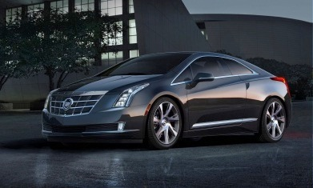

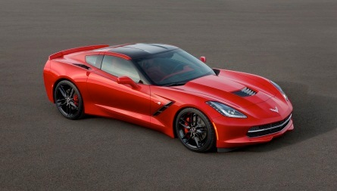
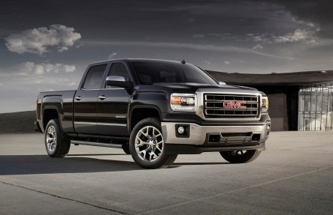
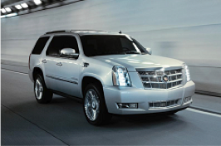

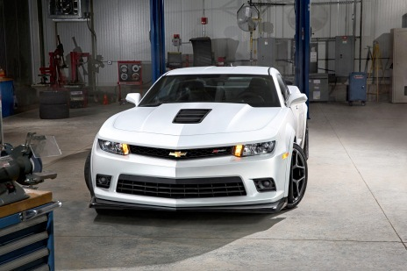
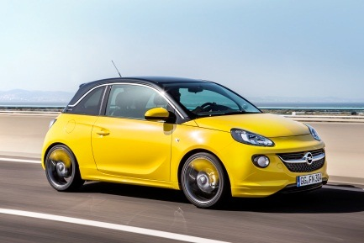

General Motors
Mega-scale Product Line Engineering
Largest product line and one of the most complex systems and software product line engineering challenges in the world.
3000 product line engineers
300 hierarchical subsystems
Thousands of variant features
Millions of product instances
Tens of thousands of unique product variants
Product line and feature set evolves annually
15 concurrent temporal development streams
Dramatic increase in product line variation and subsystem interactions due to new propulsion systems, active safety, infotainment, and more
Notes:
GM is by far one of the most complex product line engineering implementation and they are constantly innovating to push the envelope of PLE methods and best practices.
GM has been building product lines for decades
The new approach for GM is that they now consider everything as part of the single product line: by that I literally mean that a Corvette and delivery truck are considered part of one product line
Dramatic increase in product line variation and subsystem interactions due to new propulsion systems, active safety, infotainment, etc. have introduced a new set of complexities much further up in the product development lifecycle … at the feature definition phase.
For example; yesterdays car was build with a focus was on a passive safety feature that kicks in after accident happens. Todays cares are designed with significant focus on active safety features to keep you out of an accident.
This means increased complexity for example in that breaking and steering needs to work together - old ways will no longer allow to manage that complexity - and that is precisely where Gears comes into play

Slide 26
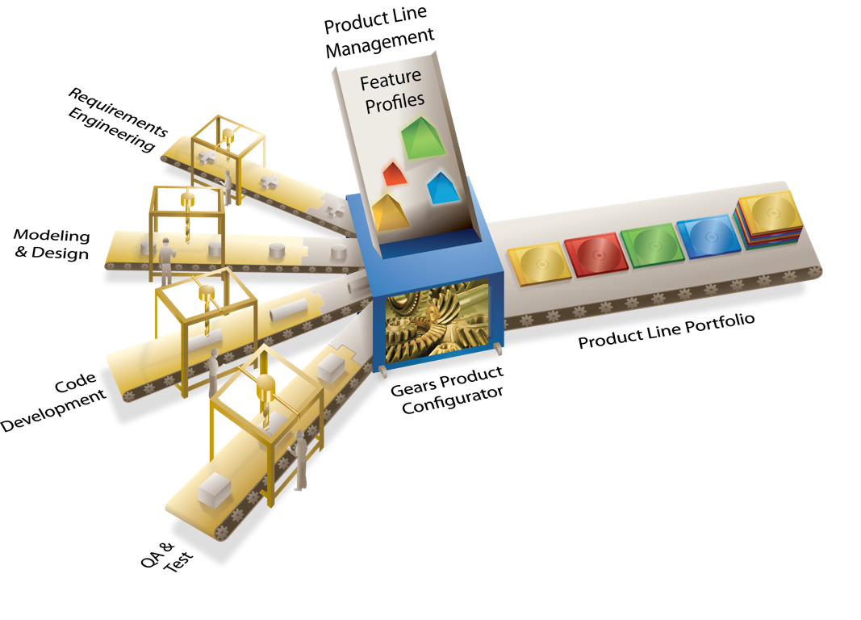
An Efficient Means of Production
for Systems and Software Product Lines
Notes:
So the question begs … How are today’s most successful product companies implementing PLE? And What do they have in common?
In the next session by IBM partner BigLever Software, we will take a closer look at their 2nd generation PLE approach and the transformation to an efficient means of Producing systems and software product lines that has resulted within these companies.
With the BigLever PLE Framework and IBM systems and software engineering tools, our customers’ product line development organization has a common set of PLE concepts and constructs for all tools and assets, which allows their development processes to flow cleanly and efficiently from one stage to another across the full lifecycle
Please join John Carrillo from BigLever Software as provides an in-depth overview of their complete solutions.

Slide 27
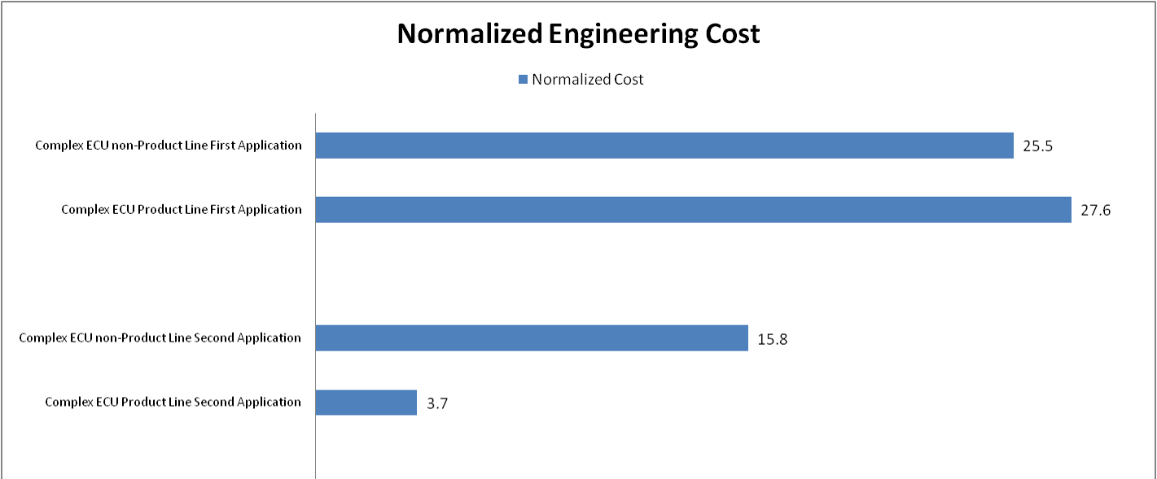
GM started a reuse approach (PLE) in software engineering with astounding results:
1st Application of Complex
Non-PLE ECU
1st Application of Complex
PLE ECU
-38%
2nd Application of Complex
Non-PLE ECU
2nd Application of Complex
PLE ECU
-87%
Notes:
The first application of a PLE ECU does cost more, it is harder to do.
But the following applications can be created at 75% of the cost!

Slide 28
IBM Solution for Continuous Engineering Integrated modular cross-discipline engineering solution
Information Integration
Requirements Management
Systems Modeling
Verification & Validation
Change Management
Quality Management
Configuration Management
Open Architecture
Open Standards
Collaboration and Workflow Management
Asset Repository Management
Process and Method Authoring and Management
Query & Organize
Document Generation
Analytics
Model Integration
Notes:
The Rational solution for product line engineering is not a new separate product, but an emerging capability of our existing solution platform for product and systems development.

Slide 29
Working with product/component variants
Tests
Requirements
Tests
Code
Requirements
Code
Variant n
Design
Design
Variation
Tests
Requirements
Code
Variant 2
Tests
Design
Requirements
Code
Variant 1
Function
Design
Notes:
28
Introduction to OSLC: Open Services for Lifecycle Collaboration
28
So what the challenges in making OSLC-based integrated tools to be a PLE solution?
As illustrated in the picture, each variant should be able to have its own view of inter-linked artifacts that realizes the variant product.
Simply cloning those variants is obviously not good because then propagating changes across all clones is difficult.
Each domain tool does not usually provide a whole product and component structure, which is needed to manage configurations of artifacts come from multiple domains and baselines cross domains.
Trying to reduce the number of variants would seriously be considered when the variation is large; so componentization, parameterization and generic platform-architecture are important.
---
The fundamental PLE challenge is that the engineering environment needs to deal with multiple product instances, instead of a single one. This fundamental change raises several major challenges and opportunities for improvement. The main challenge is to minimize duplication of asset and use a systems that con manage commonalities and variabilities across the product line. The overall management of complex product is component based, and to deal with variabilities across products we use a configurable/reusable component architcture. Also, as illustrated, products include assets from multiple lifecycle domains, and therefore PLE is a cross cutting lifecycle concern.
Once we share assets across different products, we need to ensure consistent functionality across a product variant. Functions like query, analysis and reporting need to properly operate within a multi-variant context. We also Cross lifecycle product baselining is also a critical capability.
Another challenge is providing an entry point for a product as a whole. The linked data platform is a collection of linked lifecycle resources, but it does not define a product entry point as a holistic cross lifecycle concept. What is essenttially the product, out of the web of linked data resources?
Other challege in the presence of multitude of delivered products, are dealing with change propagation, adding new variants, and effective testing of the product line.

Slide 30
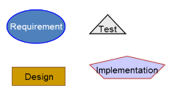
Thinking in Product Lines: Platforms, Reuse, Features
Core Platform (common components and artifacts)
Product A
Requirement
C1
Test
Implementation
Design
Platform Design / Reuse / Harvest Cycle
Requirement
C2
Product B
Test
Implementation
Design
A
A1
A1.1
A1.2
A2
A2.1
Feature
Sub-Feature
Option
Notes:
In this view of product line engineering, we see that you can start the cycle from either side. Some industries begin with a core platform and from it derive multiple product variations. Other industries start with a product they’ve developed, reuse aspects of it in another product, and then only later abstract this work to define a core platform to be used as the basis for other future products.
Core Platform design may come first, or may be derived from products
Create core assets, organized in components
Derive products from core assets and architecture
Create a feature variability model for the platform
Map features to products
Derive component configurations from feature selection

Slide 31

IBM Rational solution with product line
Product C
Core Platform
Product A
Component Reuse
Product Definition
Product B
Open architecture includes Rational platform and other integrated and in-house systems
Orchestrate multiple domains
Re-use all kinds of engineering artifacts
Rational solution
Federated approach keeps engineering information in discipline-specific, integrated management systems
T1
Requirements Management
R2
Verification & Test
I1
Component Implementation
R1
Internal Traceability
D1
SW1
Cross-Discipline
Traceability
Architecture & Design
Software Implementation
Notes:
Here, the dark red boxes represent parts of the product line engineering solution.

Slide 32

3 Patterns
Multi-stream
Configuration management approach
Branching as primary pattern
Reuse without “clone and own”
#ifdef
Parameterized
Automated derivation
General artifacts made specific with parameter values
Simplifies complicated variations
Feature-driven
Represents “problem space” familiar to business stakeholders
Easier traceability from business stakeholders to engineering
Complex feature combinations

Slide 33
Suggested next steps: build on a solid foundation
Ensure a foundation of integrated methods and tools across engineering disciplines
Develop comprehensive approach to configuration management and coordinate across product build space.
If requirements variability is important, ensure that requirements are well-managed today, and traced to downstream work products such as design and test.
Notes:
PLE can be a fundamental change in philosophy and approach for some organizations. Some organizations already think in terms of product lines, variations, parameters and features. For example, in automotive, there has long been the notion of the same car having alternatives of a “sport package” or a “luxury package” and of variants for the US market and the European market.
32

Slide 34
Suggested next steps: first steps with PLE
Identify opportunities for strategic reuse
Choose your product line approach: incremental or engineered for reuse?
Define and implement transformation: in organization, development practices, etc.
Take a measured approach
Notes:
PLE can be a fundamental change in philosophy and approach for some organizations. Some organizations already think in terms of product lines, variations, parameters and features. For example, in automotive, there has long been the notion of the same car having alternatives of a “sport package” or a “luxury package” and of variants for the US market and the European market.
33

Slide 35
Thank You!
Your Feedback is Important!
Access the Innovate agenda tool to complete your session surveys from your smartphone, laptop or conference kiosk.

Slide 36
Acknowledgements and Disclaimers
Availability. References in this presentation to IBM products, programs, or services do not imply that they will be available in all countries in which IBM operates.
The workshops, sessions and materials have been prepared by IBM or the session speakers and reflect their own views. They are provided for informational purposes only, and are neither intended to, nor shall have the effect of being, legal or other guidance or advice to any participant. While efforts were made to verify the completeness and accuracy of the information contained in this presentation, it is provided AS-IS without warranty of any kind, express or implied. IBM shall not be responsible for any damages arising out of the use of, or otherwise related to, this presentation or any other materials. Nothing contained in this presentation is intended to, nor shall have the effect of, creating any warranties or representations from IBM or its suppliers or licensors, or altering the terms and conditions of the applicable license agreement governing the use of IBM software.
All customer examples described are presented as illustrations of how those customers have used IBM products and the results they may have achieved. Actual environmental costs and performance characteristics may vary by customer. Nothing contained in these materials is intended to, nor shall have the effect of, stating or implying that any activities undertaken by you will result in any specific sales, revenue growth or other results.
© Copyright IBM Corporation 2012. All rights reserved.
U.S. Government Users Restricted Rights - Use, duplication or disclosure restricted by GSA ADP Schedule Contract with IBM Corp.
IBM, the IBM logo, and ibm.com are trademarks or registered trademarks of International Business Machines Corporation in the United States, other countries, or both. If these and other IBM trademarked terms are marked on their first occurrence in this information with a trademark symbol (® or ™), these symbols indicate U.S. registered or common law trademarks owned by IBM at the time this information was published. Such trademarks may also be registered or common law trademarks in other countries. A current list of IBM trademarks is available on the Web at “Copyright and trademark information” at www.ibm.com/legal/copytrade.shtml
Other company, product, or service names may be trademarks or service marks of others.
Notes:
IBM IOD 2011
9/9/2014
Prensenter name here.ppt
9/9/2014 1:02 AM
35

