Slide 1
Visual Definition in the Requirements Lifecycle: A Conceptual Framework
Daniel Moul
Senior Market Manager
IBM Rational Offering Strategy & Delivery
dmoul@us.ibm.com Session RDM-2031

Slide 2
Preliminaries
Abstract
This session provides a framework for evaluating the best uses of text and various visual notations in the requirements process. Presenters highlight this in reference to IBM Rational Requirements Composer, application simulation tools such as iRise, and UML/SysML modeling.
The presenter
Daniel Moul is a senior member of the Rational Strategy and Offering Delivery team. His focus is requirements in the development lifecycle. He has been working on and around enterprise software tools and runtimes for the last 15 years. Daniel was part of the team that initially brought Rational Requirements Composer to market.
Notes:
IBM IOD 2011
5/30/2012
Prensenter name here.ppt
5/30/2012 6:38 AM
2

Slide 3
Agenda
Visual Definition by Example
Visual definition in the requirements process
Modeling and textual requirements
Storyboards and simulations (and RRC and iRise)

Slide 4
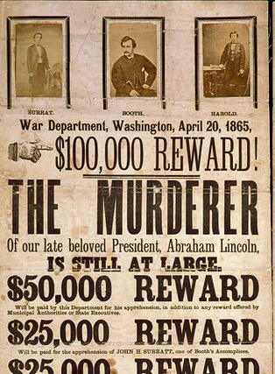
Visual Definition is not new
Notes:
Description in Pictures and text.
The buyer describes what he/she wants
Source: http://commons.wikimedia.org/wiki/File:John_Wilkes_Booth_wanted_poster.jpg

Slide 5
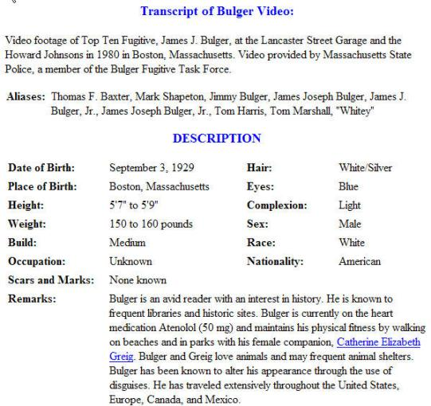
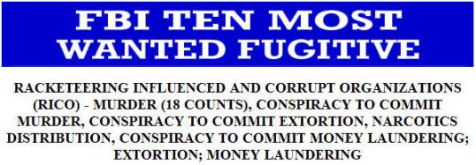
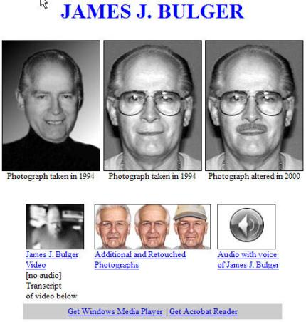
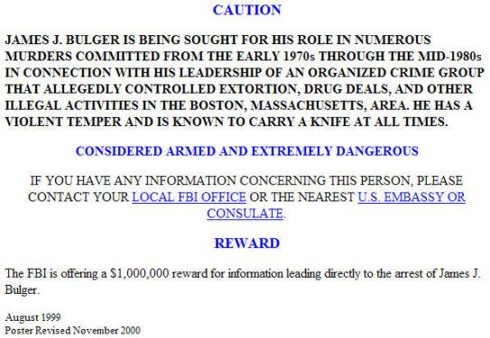
Visual Definition has staying power
More textual definition
Video: see his walk and other mannerisms
Pictures: see estimates of what he may look like today
Audio: hear his voice
Contractual offer in text
Notes:
Nearly 150 years later the government uses the same techniques, supplemented with newer media.
We are looking for one man in 7 billion
Capturing that one man is our definition of success.
Note the many specifications used here.
BTW “Whitey” Bulger was captured June 2011 in Santa Moncia CA.
Source: http://www.fbi.gov/wanted/topten/fugitives/bulger.htm

Slide 6
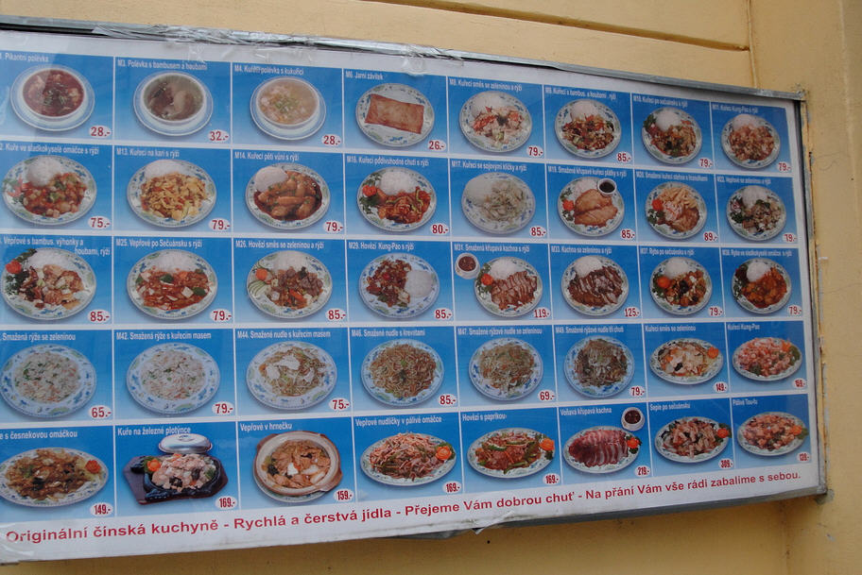
Sellers use Visual Definition too
Notes:
This is the menu at a Chinese restaurant in Prague.
I’m selling these things, but they don’t exist yet
I will start to make them as soon as you confirm what you want and contract to buy them
http://farm5.staticflickr.com/4020/4358160937_277fc9779a_b.jpg
Creative Commons-licensed content for commercial use, adaptation, modification or building upon

Slide 7
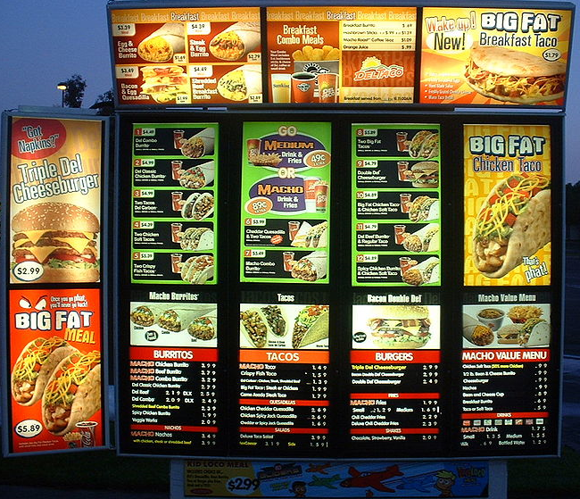
… and buyers like it when they do
Notes:
Image source: Renjishino http://upload.wikimedia.org/wikipedia/commons/0/0a/Del_Taco_menu_board.JPG
Why pictures? Because buyers …
find it faster to look at pictures
Conveys more information (higher bandwidth)
Conveys complex information (including relationships)
don’t understand the words
can’t put what they want into words
aren’t sure the words will give them what they want
don’t believe the words
Even so, some information is better communicated in text

Slide 8
Role of visual definition
So where does visual definition fit in the requirements process?
Notes:
Now that we’ve established the value of visual definition in general, let’s turn our attention to its role in the requirements process.

Slide 9
Requirements elicitation and validation
Goals
Remove ambiguity in the definition of success
Gain consensus on the answers
Notes:
A project is an exercise in gaining knowledge
When we initiate a project there is a lot we don’t know
The more ambiguity, the higher the risk
The purpose of the early stages of the requirements process is to reduce ambiguity, or to say it the other way, to clarify the what the project needs to deliver to be successful.
Ambiguity = risk

Slide 10
Requirements elicitation and validation
Which ambiguous parts?
Only the parts that matter most
Notes:
We can never remove all the ambiguity
Intuitively we start by tackling the most significant ambiguities
Eventually we reach a point where the information at hand is “detailed enough”
In other words, we don’t try to document everything.
Why? Because some things are obvious or so inconsequential that it’s not worth spending the time and effort to remove more ambiguity.
In other words, we do an intuitive ROI calculation in our heads: “Is it worth spending more effort on this? What would be the benefit?”
The right amount of detail depends on the characteristics of the project:
How much detail needs to be in the contract?
How much ambiguity is there in the subject matter?
Has the team been over this ground before?
Interestingly some methodologies deliberately delay starting the work to remove ambiguity on specific points until that information will be immediately useful.

Slide 11
Requirements elicitation and validation
How do we remove ambiguity?
Thinking “Writing” Conversations
Consensus
Approval
Notes:
We remove ambiguity in requirements by better understanding
What the customer needs
What other stakeholders need
What internal and external constraints affect the project and its deliverables?
This requires both conversation and thinking
We know ambiguity has been removed (at least somewhat) when there is consensus
(but keep in mind that consensus can be naïve. That’s why you need good requirements analysts working on your projects).

Slide 12
Requirements elicitation and validation
Expressed in what ways?
In the notations that best convey your ideas
Notes:
There are many possible ways to express requirements.
In explaining the idea of different notations to my middle school kids, I said “if you wanted me to pass you the salt at dinner, you wouldn’t write me a letter”
Same general principle applies in a business context, but the tools we make available to our teams in business constrain the notations available.

Slide 13
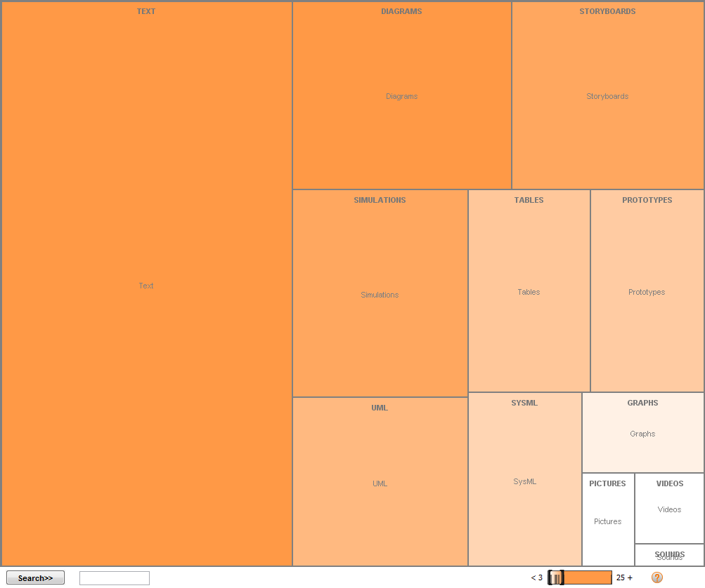
Requirements elicitation and validation
Diagrams
Storyboards
Which requirements notations are common?
TEXT
Proto-types
Simulations
Tables
UML
SysML
Graphics
Notes:
We always think first of text, and rightly so.
We are a society built on the written word, which remains unparalleled as a store of knowledge. Still true today despite all the advances in video and multi-media.
But not everything is best expressed in text.
That’s why we are talking today about visual definition.

Slide 14
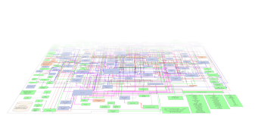
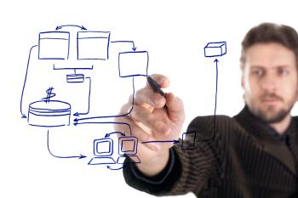






Requirements elicitation and validation
Expressed where?
Documents Whiteboards Other electronic notations Email and instant messages Hallway conversations Meetings Social media
Notes:
Requirements related information is expressed in many vehicles and places. Here I’m including related information like “how important” and “why”.
The important thing is to express this information in ways that it won’t get lost, and that the right information gets to the right people on the team.
Hallway conversations, emails and instant messages are infamous for causing “lost information”
The list here includes “electronic notations”. These include PowerPoint presentations, models, and UI storyboards and simulations.
And I think we’ll see more use of forums or other social media to identify and express requirements
It’s interesting to note that most of these are examples of information silos. They stand on their own, and it’s very difficult to relate them to other expressions in a meaningful way that you can share with others.

Slide 15
Requirements elicitation and validation
UI Storyboards and simulations are good for …
User interfaces
Visible system behavior
Notes:
UI storyboards and UI simulations are notations that have gained increasing prominence in recent years, and for good reason.
They are proving to be very helpful in expressing the visible aspects of an application or product.
They help project teams talk to non-technical customers using fewer technical abstractions … more concretely and in a context familiar or intuitive to the customer.
In addition the UX aspects in general are more valued by customers & users, who have higher expectations. UX aspects are naturally visual.

Slide 16
Requirements elicitation and validation
Text, BPMN and UML / SysML notations are better for …
Non-functional requirements
Business processes
Server-side behavior
Architectural considerations
Notes:
UML and SysML are much better for analyzing requirements that lack visual aspects
Nonfunctional requirements include performance, the various “ilitiies”, and compliance-related information: policies, standards and regulations
“ilities include Usability, Maintainability, Extensibility, Scalability, Availability/reliability, Security (and many more).

Slide 17
Requirements elicitation and validation
Visual notations are used in two kinds of conversations
Conceptual
Progressive design
Notes:
Conceptual conversations are the most important. They typically occur between the customer and the analyst. They address the big questions about what’s needed and reduce the most ambiguity.
Progressive design conversations are narrower in scope. They typically occur between user experience professionals and developers, with (ideally) customers validating progress along the way.

Slide 18
Requirements elicitation and validation
Different levels of abstraction … for different audiences
Concrete | User interfaces | Non-technical customers & project members
Abstract | Use cases Business Processes System context State charts Other UML/SysML | Semi-technical customers & project members Developers and Testers
Notes:
Some types of audience are better at interpreting abstract visual notations. Typically people in the line of business are not used to the abstract notations that IT like for their ability to communicate with precision. Scenarios presented concretely are often more effective with these stakeholders.

Slide 19

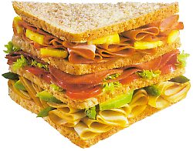



Text and models together The Requirements Rationale Sandwich
Requirements layer
modelling layer
Requirements layer
modelling layer
Requirements layer
modelling layer
Requirements layer
Notes:
In complex systems, textual requirements and system modeling can be used together to better understand the problem and explore the best solution
the relationship between requirements management and systems modelling is like a club sandwich.
requirements management is the ”bread and butter” of the development cycle.
the filling provided by system modelling holds the bread together, and makes the whole more interesting.
both the bread and the filling that make the sandwich.

Slide 20
Modeling bridges layers of requirements
Requirements layer
Statement
of need
Modeling layer
e.g Goal / Usage
modeling
Requirements layer
Stakeholder
Requirements
Modeling layer
e.g. Functional
modeling
Requirements layer
System
Requirements
Modeling layer
e.g. Performance
modeling
Requirements layer
Design
Specification
Notes:
Modeling supports the design activity. It assists the engineer in understanding enough of the system to decompose the requirements at a particular level into the next level down. The requirements themselves are a complete snapshot of what is required at increasing levels of detail. Modeling is where most the creative work takes place, resulting in a design document containing the diagrams of the model and textual explanantions, rationale and context.
Models can be used to derive each layer of requirements from the previous. The boxes on the left represent requirements documents, and on the right, design documents.
The requirements management activities can be considered to be generic since textual requirements are handled in a similar way regardless of the application domain. Modeling is potentially a domain-specific activity because different Modeling techniques can be applied to represent different aspects of a system. This is particularly true of the detailed design layers.

Slide 21
Requirements elicitation and validation
When to use storyboards versus simulations?
Notes:
As we do intuitively in other aspects of our lives, we choose from among the notations available to us when expressing ourselves.
In in a business context, our tools may limit the notations available to us. So it’s important to make sure the right notations are available to your teams.

Slide 22
Both UI storyboards and simulations have their place
Visual Definition
Simulations
Performance
System context diagrams
Financial Return
Diagrams
Load testing
Business Process
BPMN
Monte Carlo
Cost & Duration
Venn diagrams
Project Planning
UML/SysML
Stresses, heat flow, air flow
Pictures
UI Wireframes
CAD/CAM
Manufacturability
Behavior
Screens and storyboards in scenarios
Simulations of user experience
Notes:
There are many kinds of visual definition and many kinds of simulations.
Today we are considering only two: UI storyboards and UI simulations

Slide 23
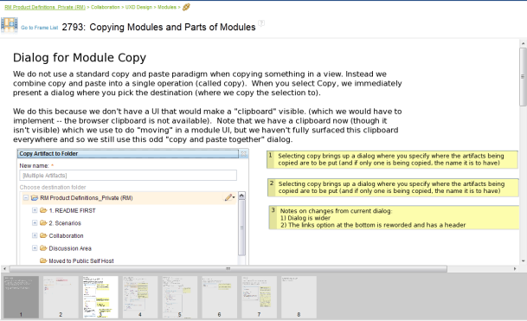
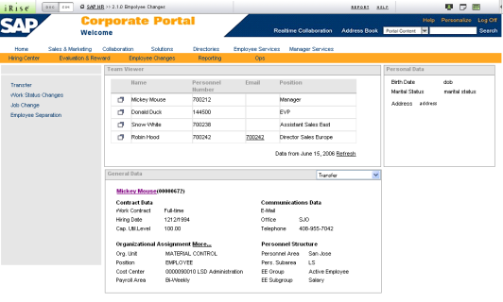
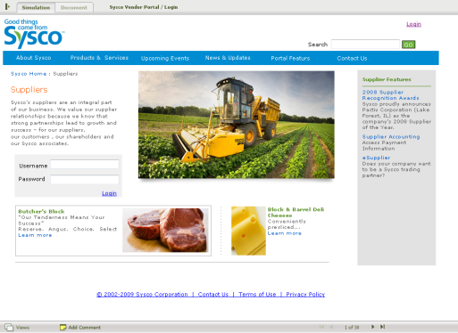
What do we mean by each?
RRC Storyboard
iRise Simulation
Notes:
We get a lot of questions about how Requirements Composer works with iRise, and how the two tools are different. So let’s use them as a concrete example.
RRC implements storyboards, which are a set of linear pictures that tell a story or represent a scenario.
You can think of them like movie storyboards.
It’s a lot less expensive in time and money to represent the look and a sketch of the story in pictures rather than rolling film.
You can make a lot of creative decisions from the storyboards.
By comparison, simulations provide a more immersive experience. The simulation behaves in some respects like the application that has not yet been built. You can click on UI elements like links and buttons to move to the next page. They give analysts and UX professionals a powerful way to represent the look and feel of an application and enabling someone to experience a scenario.

Slide 24
Visual and behavioral fidelity
Flow based on user selections and/or data input
Visual Fidelity
Storyboards – screens in scenarios based on a series of linear flows
Static, atomistic views – no attempt to communicate behavior
Behavioral/Data Fidelity
Notes:
We can think about this in two dimensions: visual fidelity and behavioral fidelity.
At any particular level of behavioral fidelity you could vary the visual fidelity, that is …
Independent sketches or pictures can be rough or fine
UI storyboards can be crude or nearly picture-perfect
UI simulations that can look rough our life-like
The behavioral fidelity refers to the faithfulness in the representation of users’ interaction with the artifacts
Independent sketches or images have no behavioral aspects
UI storyboards tell a linear story
UI simulations have UI widgets users can interact with and branch to additional screens based on user input

Slide 25
Choose the right notation for the job (and amount of effort)
Simulation for user acceptance test
Visual Fidelity
Simulation for project proposal
Storyboard for concept or UX review
Napkin for rough sketch
Behavioral/Data Fidelity
Notes:
You don’t want high fidelity in all cases.
High fidelity takes time and effort; you want to apply the least effort needed to remove the right amount of ambiguity to reach the goal at hand. That maximized your ROI in that activity.
In fact one temptation with simulations is that people can spend too much extra time making them look “cool”.
When you need higher fidelity, it’s helpful if you can take a low-fidelity artifact, work on it more, and make it higher fidelity. That’s a kind of reuse.

Slide 26
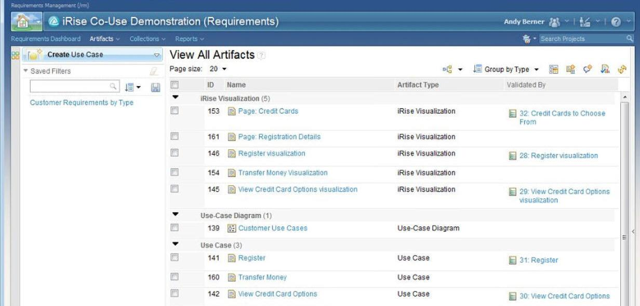
Using Rational Requirements Composer and iRise
Notes:
When using RRC you can …
Use RRC’s UI Storyboards
Or a simulation tool like iRise
It’s a question of … (1) what your teams value and (2) what their goals are
In either case RRC will help you …
Capture and organize requirements
Provide traceability to development and test activities

Slide 27
Many notations
Summary
We need many notations
Each has its limitations
Choose deliberately

Slide 28
One last thought …
Good versus valuable
A requirement isn’t valuable until it helps to change the world
in making commitments
in creating project deliverables
Notes:
Use because it …
Helps to get commitments (contract)
Guides activities that create project deliverables
Guiding activities ➔ traceability ➔ solution needs more than RM … ALM/SSE solution scope
Many teams struggle with the hand-offs to other teams, for example from the business analyst to development to test.
How can you be sure nothing was dropped?
How can you understand the impact of a proposed change to requirements?
Traceability helps project teams align their work and helps to make project status more visible.

Slide 29

Questions
www.ibm.com/software/rational

Slide 30

Daily iPod Touch giveaway
Complete your session surveys online each day at a conference kiosk or on your Innovate 2012 Portal!
Each day that you complete all of that day’s session surveys, your name will be entered to win the daily IPOD touch!
On Wednesday be sure to complete your full conference evaluation to receive your free conference t-shirt!

Slide 31
Acknowledgements and disclaimers
Availability: References in this presentation to IBM products, programs, or services do not imply that they will be available in all countries in which IBM operates.
The workshops, sessions and materials have been prepared by IBM or the session speakers and reflect their own views. They are provided for informational purposes only, and are neither intended to, nor shall have the effect of being, legal or other guidance or advice to any participant. While efforts were made to verify the completeness and accuracy of the information contained in this presentation, it is provided AS-IS without warranty of any kind, express or implied. IBM shall not be responsible for any damages arising out of the use of, or otherwise related to, this presentation or any other materials. Nothing contained in this presentation is intended to, nor shall have the effect of, creating any warranties or representations from IBM or its suppliers or licensors, or altering the terms and conditions of the applicable license agreement governing the use of IBM software.
All customer examples described are presented as illustrations of how those customers have used IBM products and the results they may have achieved. Actual environmental costs and performance characteristics may vary by customer. Nothing contained in these materials is intended to, nor shall have the effect of, stating or implying that any activities undertaken by you will result in any specific sales, revenue growth or other results.
© Copyright IBM Corporation 2012. All rights reserved.
U.S. Government Users Restricted Rights - Use, duplication or disclosure restricted by GSA ADP Schedule Contract with IBM Corp.
IBM, the IBM logo, ibm.com, Rational, the Rational logo, Telelogic, the Telelogic logo, Green Hat, the Green Hat logo, and other IBM products and services are trademarks or registered trademarks of International Business Machines Corporation in the United States, other countries, or both. If these and other IBM trademarked terms are marked on their first occurrence in this information with a trademark symbol (® or ™), these symbols indicate U.S. registered or common law trademarks owned by IBM at the time this information was published. Such trademarks may also be registered or common law trademarks in other countries. A current list of IBM trademarks is available on the Web at “Copyright and trademark information” at www.ibm.com/legal/copytrade.shtml
Other company, product, or service names may be trademarks or service marks of others.
Notes:
IBM IOD 2011
5/30/2012
Prensenter name here.ppt
5/30/2012 6:38 AM
31

Slide 32

Thank you
www.ibm.com/software/rational
© Copyright IBM Corporation 2012. All rights reserved. The information contained in these materials is provided for informational purposes only, and is provided AS IS without warranty of any kind, express or implied. IBM shall not be responsible for any damages arising out of the use of, or otherwise related to, these materials. Nothing contained in these materials is intended to, nor shall have the effect of, creating any warranties or representations from IBM or its suppliers or licensors, or altering the terms and conditions of the applicable license agreement governing the use of IBM software. References in these materials to IBM products, programs, or services do not imply that they will be available in all countries in which IBM operates. Product release dates and/or capabilities referenced in these materials may change at any time at IBM’s sole discretion based on market opportunities or other factors, and are not intended to be a commitment to future product or feature availability in any way. IBM, the IBM logo, Rational, the Rational logo, Telelogic, the Telelogic logo, and other IBM products and services are trademarks of the International Business Machines Corporation, in the United States, other countries or both. Other company, product, or service names may be trademarks or service marks of others.

