Slide 1



Notes:
Problems with leaving pets behind

Slide 2

The Problem
Travelling with pets requires effort and planning.
People give up on that idea.
Notes:
Problems with taking the pets with them

Slide 3
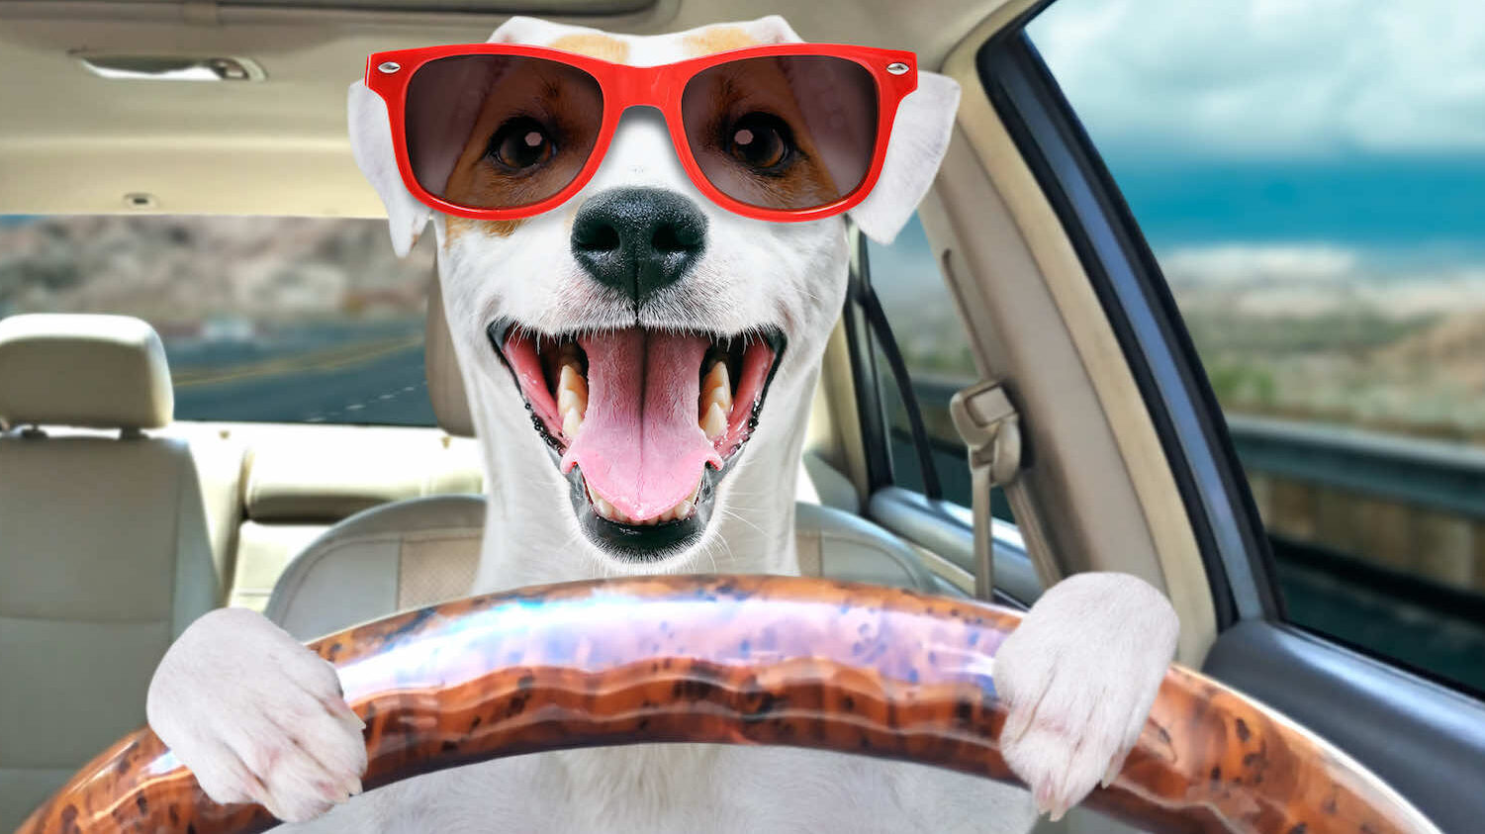
GoPet

Slide 4
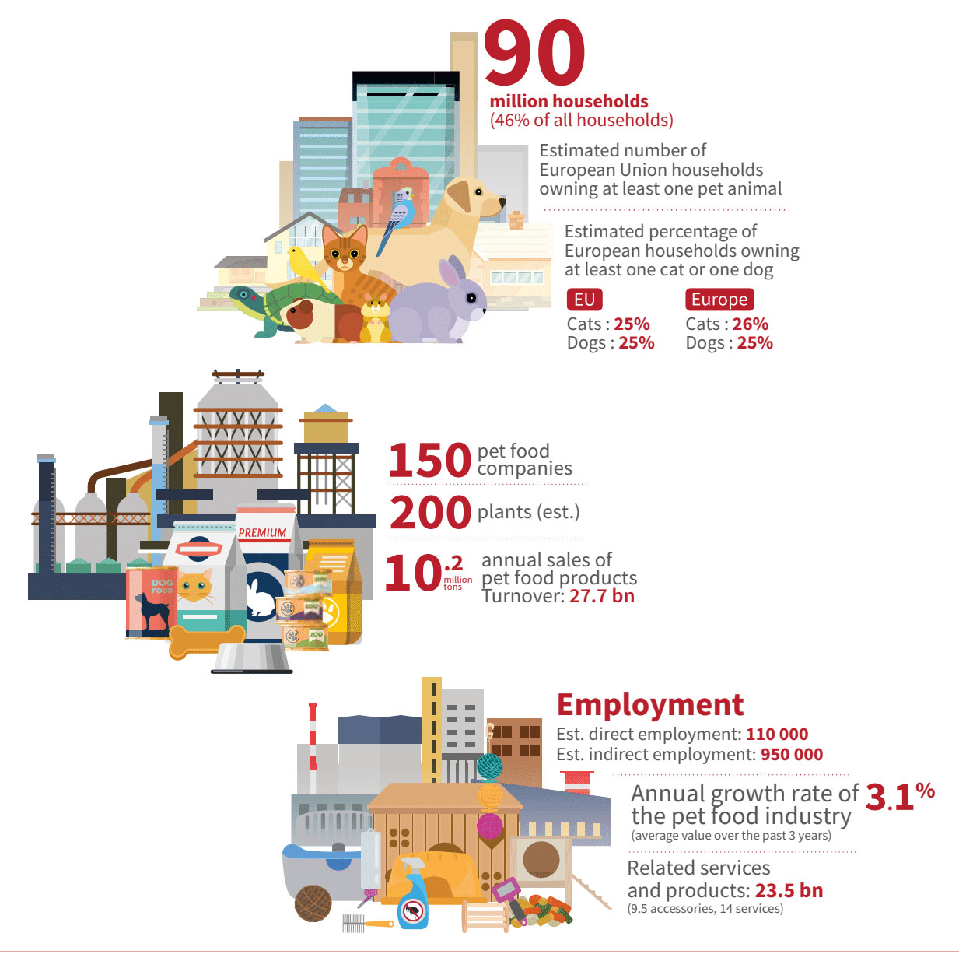
Statistics
People care about pets more than ever.
As an example:
Portuguese spend about 12% of their income with pets.

Slide 5
The Proposal
Transportation
Accommodation
Food and Water
Tracking system
Pet-friendly activities
Vet insurance
Notes:
Options according to people need

Slide 6

Business Value
A solution that simplifies bringing pets.
Pet-friendly companies can stand out from the competition.
Generation of employment: people can register to provide a service.
GoPet generates revenue by charging a fee for each provided service.

Slide 7

Summary
Travelling can cause anxiety and sadness for owners and pets.
We propose a service that simplifies traveling with pets, without the concern for their safety and wellbeing.

