Slide 1
Simplification Strategy
Breast Screen Queensland
Notes:
The current system has evolved incrementally over many years to support highly specific business rules, exceptions, and workforce authorisations. It was developed by multiple contributors with varying skill sets and limited adherence to consistent design or development standards.
While the system met operational needs at the time, this evolution has resulted in an over-engineered platform with structural design weaknesses. As a consequence, it is increasingly complex, costly to maintain, and difficult to support.
It is important to note that the development effort estimates submitted in the APP are based on detailed analysis used to quantify the number of API calls required to update the database. This represents the first time BSQ has been able to accurately measure the true scope of development effort. The estimate was deliberately uplifted to account for the potential replication of existing system nuances, which require explicit consideration as to whether they should be retained. This consideration is addressed in this presentation.

Slide 2
Purpose and Needs
Seek leadership direction on pathway for BSQ system development
Ensure the decision balances operational continuity, risk exposure, and future readiness
This decision will determine BSQ’s:
Long-term risk exposure
Cost and time involved in change
Ability to integrate and evolve
Any decision of whether to simplify must be definitive and enforced
Notes:
The organisation is already operating with increasing levels of risk, and what is decided with either deliberately reduce that risk over time or permanently embed it into the next iteration of the system.
Importantly, this decision cannot be partial. A mixed or selective approach undermines governance, increases inconsistency, and reintroduces the very risks we are trying to mitigate.

Slide 3
Background and Understanding
You must appreciate:
The nature of the current BSQ problem
The overheads required to sustain it
Real-world examples of over-engineering
Why a simpler, more structured approach delivers better value, lower risk, and greater sustainability
Notes:
I will provide just two basic examples of these challenges to help explain why a more pragmatic solution is required

Slide 4
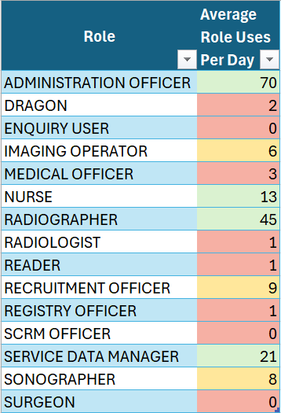
Current Over-Engineered State
Key characteristics of the current system include:
Proprietary FOEX logic controlling when fields appear, can be edited, or must be locked
Complex business rules tied to historic workforce user roles that may no longer exist
Data Disparity requires use of backend SQL scripts rather Application screens to fix
Notes:
…
The system supports 15 differing user roles, many of which have limited daily use.
Enforcing role-based presentation and business logic increases development effort and expands the scope of testing.
As a result, the system is complex and fragile and remains difficult to understand even for experienced support and development staff, often requiring months or years to reach knowledge proficiency.

Slide 5
Today’s Operational Overheads
Operational impacts include:
Heavy reliance on specialist Oracle and legacy FOEX skills
Frequent data disparities that disrupt clinical workflows
Regular use of back-end SQL scripts by Registry staff to manually correct database data
In complex cases, Oracle developers spending hours per day writing or executing corrective scripts
Notes:
Maintaining this complexity comes at a significant cost.
….
Within the two years that FOEX has been implemented one of the two developers has never trained or been involved in its development.
The data disparities exist because the system is built round a ridged pathways (or processing stubs), that do not support out-of-sequence events. When these occur, manual intervention is required.
Examples of correction include:
Merge/Unmerge Clients records
Update Client Record Statuses
Adjustment Appointment States to enable workflow progression
I was completely shocked to discover that end-user are allowed to run back-end SQL scripts to rectify data inconsistencies.

Slide 6
Case 1 - Permissions & Access Control
Current behaviour
Form field level permissions are inconsistent
Conflicting rules between menu and data elements
Parent menu permissions are adopted, automatically applying access to child level menus and forms
The are varying levels of permission controls – form fields, data elements and menu access
Notes:
…

Slide 7
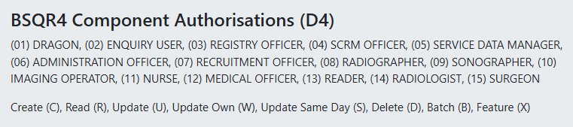
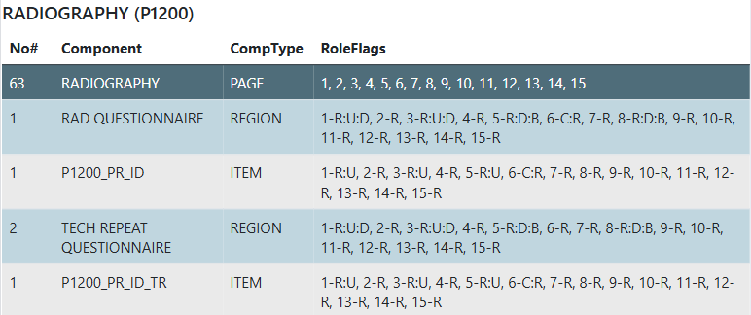
Non-hierarchical Access Permissions
6
BSQ - Simplification Strategy
Notes:
At the top are the 15 different types of users
Here the first (01) DRAGON role assumes a higher responsibility in the application, yet they lack Create Authority and can only Read Update and Delete.
The (06) ADMINISRATION OFFICER can Create but has no Update authority, so consequentially requires a DRAGON user to modify any selection they make.
This approach departs from conventional design principles and is indicative of unnecessary complexity. It is important to note that the system is fully audited, with all user-initiated changes traceable.

Slide 8
Case 2 –Scrollbars Vs UI Expansion
Current behaviour
Fixed Scrollbars Navigation
Higher UI Effort and Unreliable Behaviour
Increase in Development and Testing
Target State
Native APEX Field Expansion
Responsive and Predictable UI Behaviour
Lower Development and Support Overheads

Slide 9
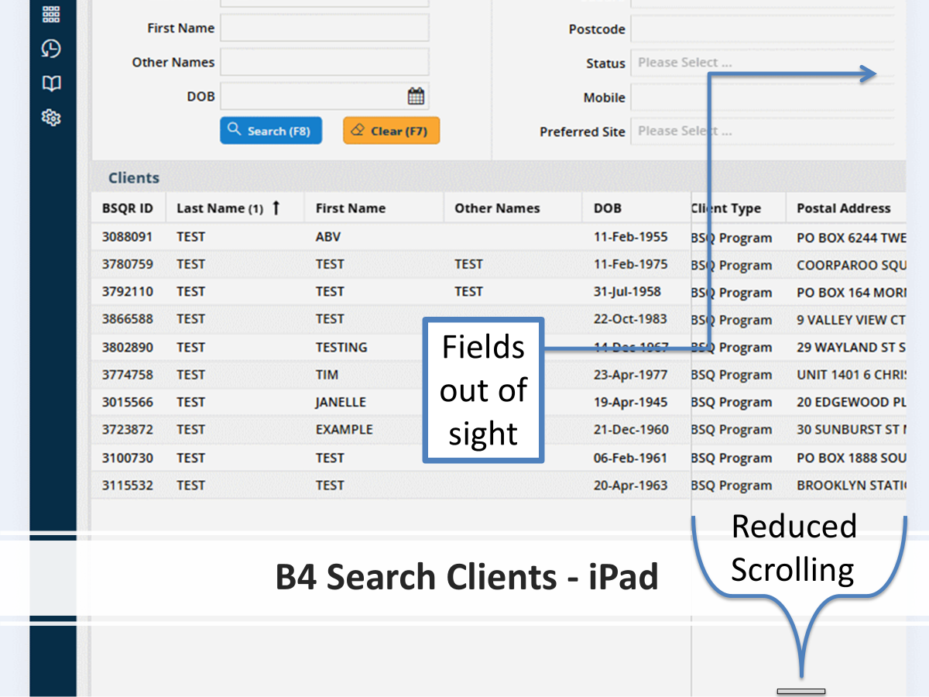
Notes:
For BSQR4 FOEX uses a scrolling window which is reduced for small screens or when the zooming in to ease user readability.

Slide 10
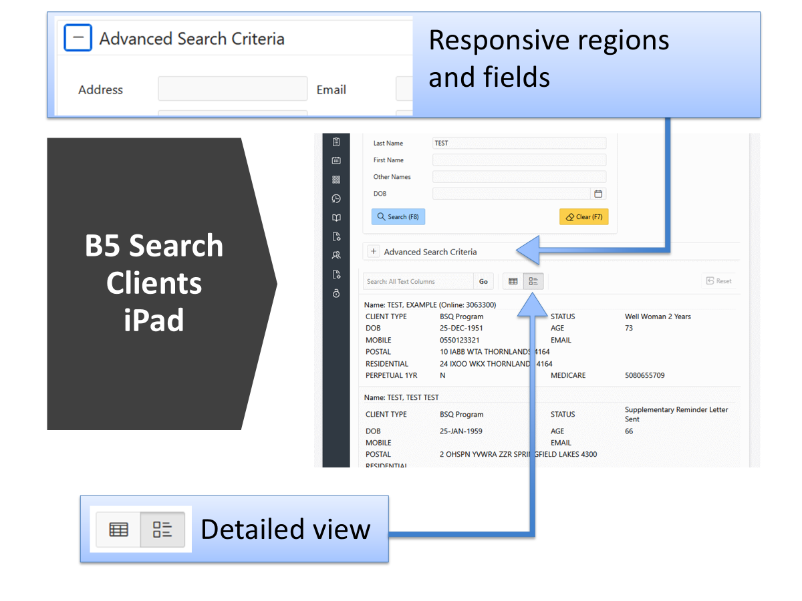
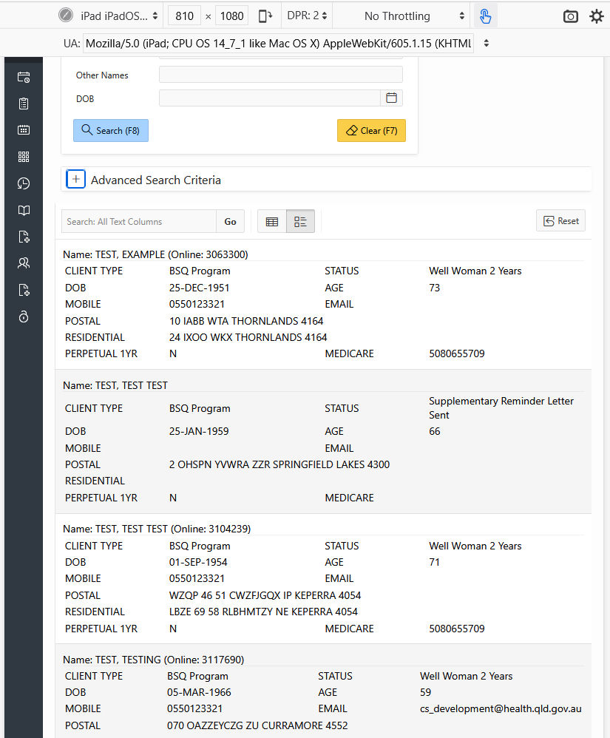
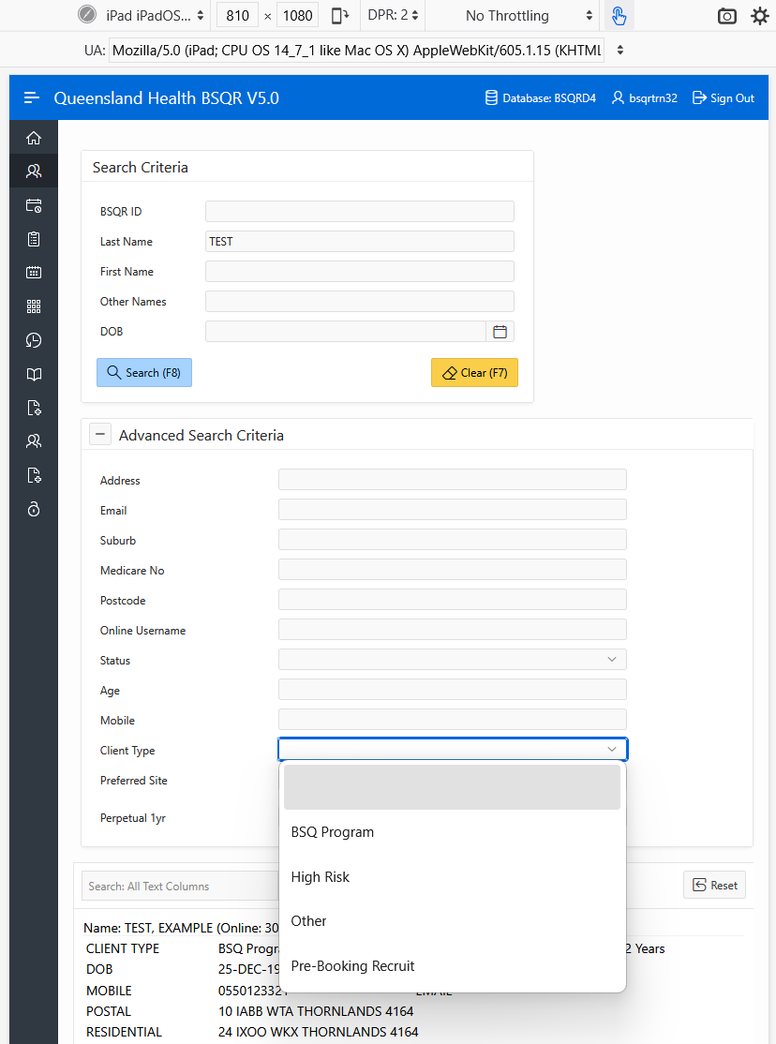
+ Scroll Down
OR Extend Search
Notes:
Native APEX designs allows regions to collapse and are automatically responsive to cater for the use of different types of devices (PC, iPad, tablet, phone).
This provides an alternate solution to scrollbars while not reducing the capabilities to search records.
When this was presented, the layout was deemed unacceptable. My view is simply, as long as the interface is intuitive for end users, the design should leverage native design principles, rather than attempting to replicate legacy layouts.

Slide 11
Two Paths, with two very Differing Outcomes
Path 1 – Rebuild Like-for-Like
Exact replication of existing features and behaviours
Legacy UI patterns preserved
Business logic tightly coupled to the interface
Inefficiencies and historical workarounds re-embedded
Path 2 – API-Led Architecture
Business logic abstracted into services
APIs become the system contract
UI becomes replaceable and responsive
Supports simplification and standardisation
Notes:
The choice is not between modern and traditional development.
It is between replicating a system exactly as it exists today — including its inefficiencies — or deliberately designing a system that is simpler, more generic, and easier to maintain.
An API-led architecture and interaction model is not designed to preserve system nuance; it is designed to remove it.

Slide 12
An API-Led Approach Provides (and Gives Up)
An API approach enables
Generic, reusable system functions
Reduced dependency on system-specific knowledge
Easier integration with 3rd party enterprise platforms
It intentionally relinquishes
Exact replication of legacy features
Historical UI design conventions
Custom behaviours that do not align with modern design principles
Notes:
The purpose of the API framework is to provide a more efficient, generic, and maintainable way of updating and interacting with the system.
This means some existing UI patterns and behaviours — while familiar — may need to be relinquished because they are not aligned with modern, responsive design principles or long-term sustainability.

Slide 13
Recommended Direction & Leadership Endorsement Required
Recommended direction
Adopt an all-or-nothing API-led architecture & interaction model
Do not pursue exact feature replication
Accept managed change in UI design principles
Leadership endorsement requested
Confirm API-led architecture as mandatory
Endorse simplification over replication
Accept change to reduce long-term risk
Notes:
The recommendation is clear and deliberate.
If BSQ proceeds with an API-led architecture, it must be adopted fully and consistently.
The goal is not to preserve every historical behaviour, but to create a system that is easier to manage, safer to change, and fit for the future state.
What is needed from leadership is endorsement of this direction and acceptance of the trade-offs involved.

Slide 14
We can either design for familiarity today, or sustainability for the next decade — but not both!
Thank you.

