Slide 1
An Introduction to Apache NiFi
A Modern Day Dataflow Engine
By andy vold

Slide 2

Agenda
What is Apache NiFi
Uses and Architecture Examples
Core Concepts of NiFi
NiFi Architecture
High Level Overview of Key NiFi Features

Slide 3
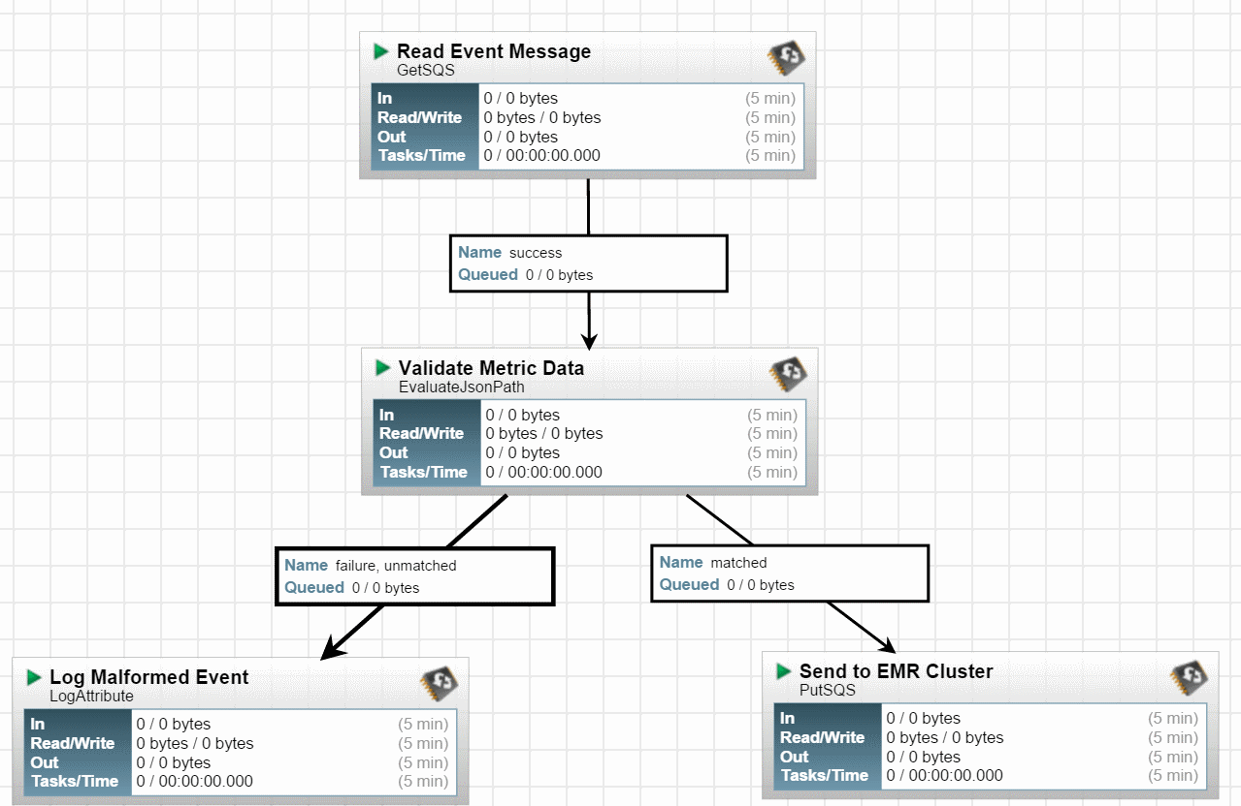
What is Apache NiFi?
An open-source software project from the Apache Software Foundation
NiFi was built to automate the flow of data between systems
Is based on the flow-based programming model
‘Dataflow’ is the term used by NiFi to mean the automated and managed flow of information between systems
Based on the “NiagaraFiles” software previously developed by the NSA
It was open-sourced as a part of NSA’s technology transfer program in 2014
GUI Interface
Kind of like SSIS, but NOT like SSIS

Slide 4
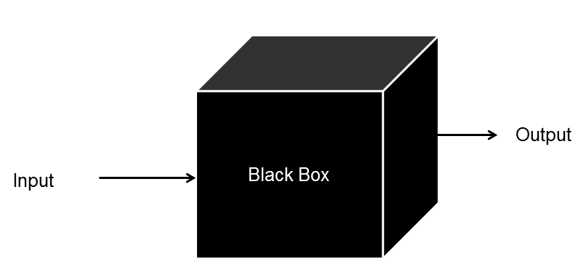
Flow-based Programming
Wikipedia - Flow-based programming (FBP) is a programming paradigm that defines applications as networks of "black box" processes, which exchange data across predefined connections by message passing, where the connections are specified externally to the processes. These black box processes can be reconnected endlessly to form different applications without having to be changed internally. FBP is thus naturally component-oriented.
FBP is a particular form of dataflow programming based on
bounded buffers, information packets with defined lifetimes,
named ports, and separate definition of connections.

Slide 5

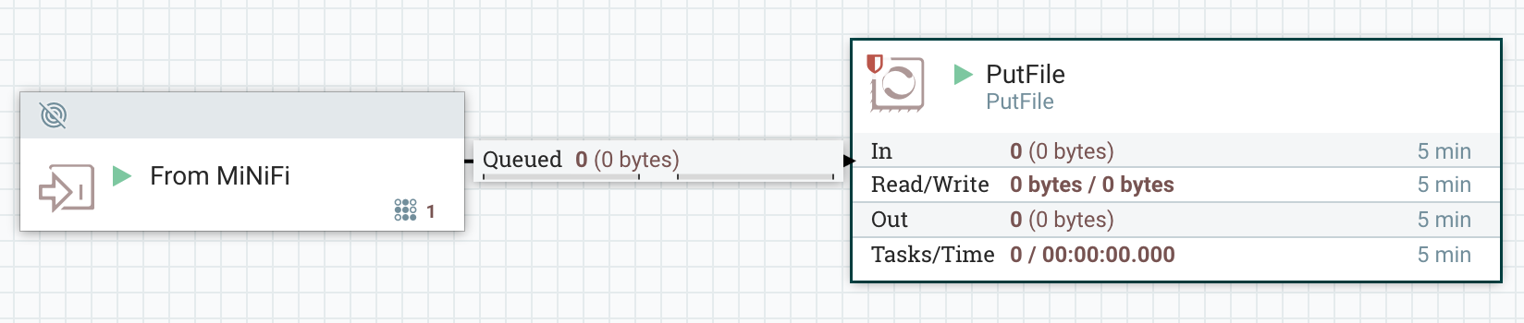
What is Apache MiNiFi?
MiNiFI is a subproject of NiFi
Designed to solve the difficulties of managing and transmitting data feeds to and from the source of origin
Enabling edge intelligence to adjust flow behavior/bi-directional communication
MiNiFi agents make use of the Site to Site Protocol to aid in the transmission of data from where it is collected to a core NiFi installation

Slide 6
Use Cases
NiFi
Listening for HTTP Posts
Polling a RESTFul API to Extract a JSON Attribute
Importing Datasets into a Database
Collecting IoT data
So many more…
MiNiFi
Distributed Systems of Devices with data to be collected
Manufacturing Line
Routers
Security Cameras
Cable Modems
ATM
Fleet of Trucks/Ships
Point of Sale
Thermostats

Slide 7
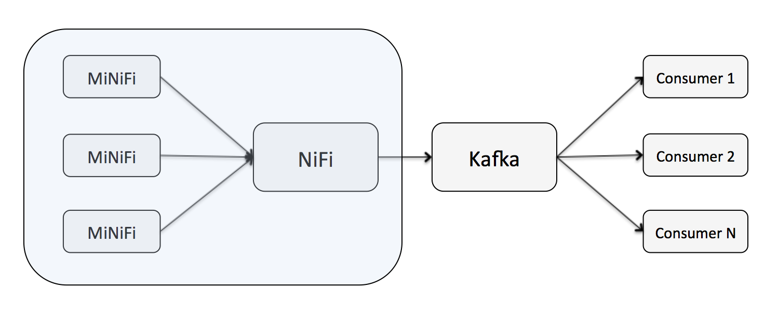
NiFi as a Producer

Slide 8
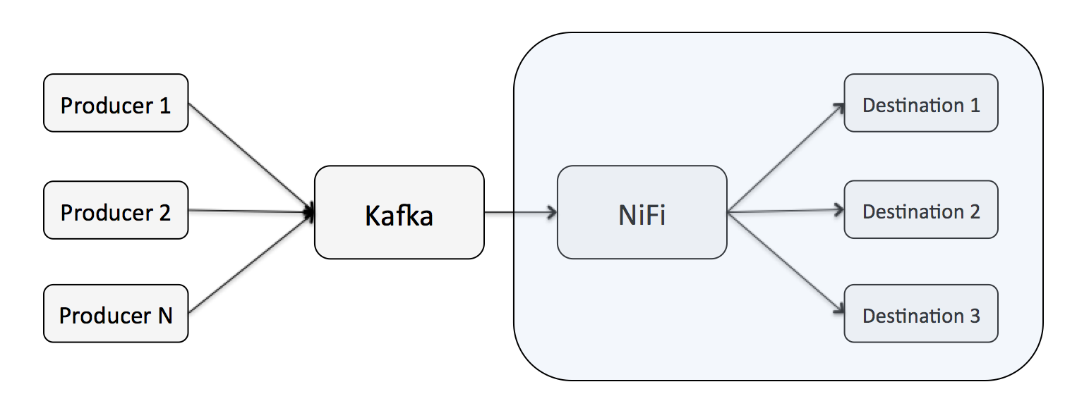
NiFi as a Consumer

Slide 9
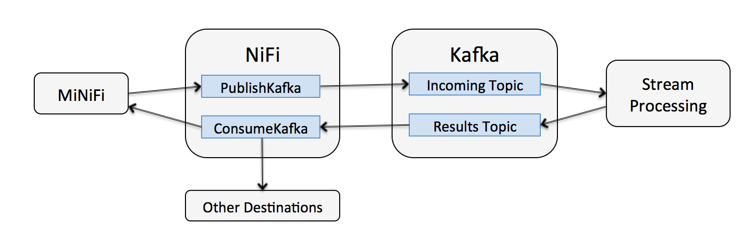
Bi-Directional Data Flows

Slide 10
Core Concepts of NiFi
Concept | Description
FlowFile | A FlowFile represents each object moving through the system and for each one, NiFi keeps track of a map of key/value pair attribute strings and its associated content of zero or more bytes.
FlowFile Processor | Processors actually perform the work. Doing some combination of data routing, transformation, or mediation between systems. Processors have access to attributes of a given FlowFile and its content stream. Processors can operate on zero or more FlowFiles in a given unit of work and either commit that work or rollback.
Connection | Connections provide the actual linkage between processors. These act as queues and allow various processes to interact at differing rates. These queues can be prioritized dynamically and can have upper bounds on load, which enable back pressure.
Flow Controller | The Flow Controller maintains the knowledge of how processes connect and manages the threads and allocations thereof which all processes use. The Flow Controller acts as the broker facilitating the exchange of FlowFiles between processors.
Process Group | A Process Group is a specific set of processes and their connections, which can receive data via input ports and send data out via output ports. In this manner, process groups allow creation of entirely new components simply by composition of other components.

Slide 11
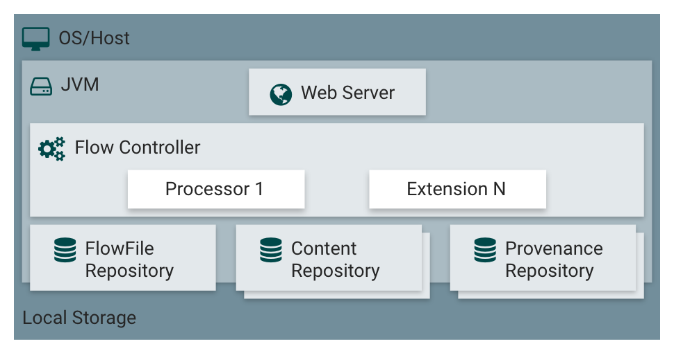
NiFi Architecture
NiFi executes within a JVM on a host operating system. The primary components of NiFi on the JVM are as follows:
Web Server
The purpose of the web server is to host NiFi’s HTTP-based command and control API
Flow Controller
The flow controller is the brains of the operation
It provides threads for extensions to run on, and manages the schedule of when extensions receive resources to execute
Extensions
There are various types of NiFi extensions, the key point here is that extensions operate and execute within the JVM
FlowFile Repository
The FlowFile Repository is where NiFi keeps track of the state of what it knows
about a given FlowFile that is presently active in the flow
Content Repository
The Content Repository is where the actual content bytes of a given FlowFile live
Provenance Repository
The Provenance Repository is where all provenance event data is stored

Slide 12
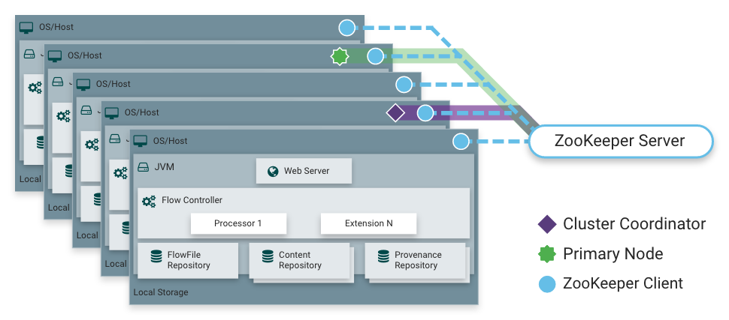
NiFi Architecture – Cluster (Scale-out)
Each node in a NiFi cluster performs the same tasks on the data, but each operates on a different set of data
Apache ZooKeeper elects a single node as the Cluster Coordinator, and failover is handled automatically by ZooKeeper
All cluster nodes report heartbeat and status information to the Cluster Coordinator
The Cluster Coordinator is responsible for disconnecting and connecting nodes
Every cluster has one Primary Node, also elected by ZooKeeper.
As a DataFlow manager, you can interact with the NiFi cluster through the user interface (UI) of any node
Any change you make is replicated to all nodes in the cluster, allowing for multiple entry points.

Slide 13
NiFi Features – Flow Management
Concept | Description
Guaranteed Delivery | A core philosophy of NiFi has been that even at very high scale, guaranteed delivery is a must. This is achieved through effective use of a purpose-built persistent write-ahead log and content repository. Together they are designed in such a way as to allow for very high transaction rates, effective load-spreading, copy-on-write, and play to the strengths of traditional disk read/writes.
Data Buffering w/ Back Pressure and Pressure Release | NiFi supports buffering of all queued data as well as the ability to provide back pressure as those queues reach specified limits or to age off data as it reaches a specified age (its value has perished).
Prioritized Queuing | NiFi allows the setting of one or more prioritization schemes for how data is retrieved from a queue. The default is oldest first, but there are times when data should be pulled newest first, largest first, or some other custom scheme.
Flow Specific QoS (latency v throughput, loss tolerance, etc.) | There are points of a dataflow where the data is absolutely critical and it is loss intolerant. There are also times when it must be processed and delivered within seconds to be of any value. NiFi enables the fine-grained flow specific configuration of these concerns.

Slide 14
NiFi Features – Ease of Use
Concept | Description
Visual Command and Control | Dataflows can become quite complex. Being able to visualize those flows and express them visually can help greatly to reduce that complexity and to identify areas that need to be simplified. NiFi enables not only the visual establishment of dataflows but it does so in real-time. Rather than being 'design and deploy' it is much more like molding clay. If you make a change to the dataflow that change immediately takes effect. Changes are fine-grained and isolated to the affected components. You don’t need to stop an entire flow or set of flows just to make some specific modification.
Flow Templates | Dataflows tend to be highly pattern oriented and while there are often many different ways to solve a problem, it helps greatly to be able to share those best practices. Templates allow subject matter experts to build and publish their flow designs and for others to benefit and collaborate on them.
Data Provenance | NiFi automatically records, indexes, and makes available provenance data as objects flow through the system even across fan-in, fan-out, transformations, and more. This information becomes extremely critical in supporting compliance, troubleshooting, optimization, and other scenarios.
Recovery / Recording a rolling buffer of fine-grained history | NiFi’s content repository is designed to act as a rolling buffer of history. Data is removed only as it ages off the content repository or as space is needed. This combined with the data provenance capability makes for an incredibly useful basis to enable click-to-content, download of content, and replay, all at a specific point in an object’s lifecycle which can even span generations.

Slide 15
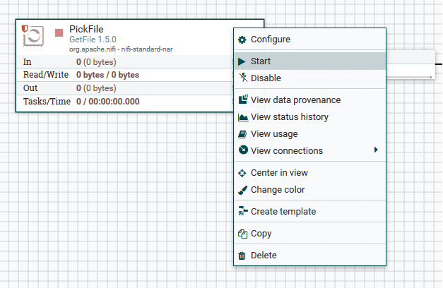
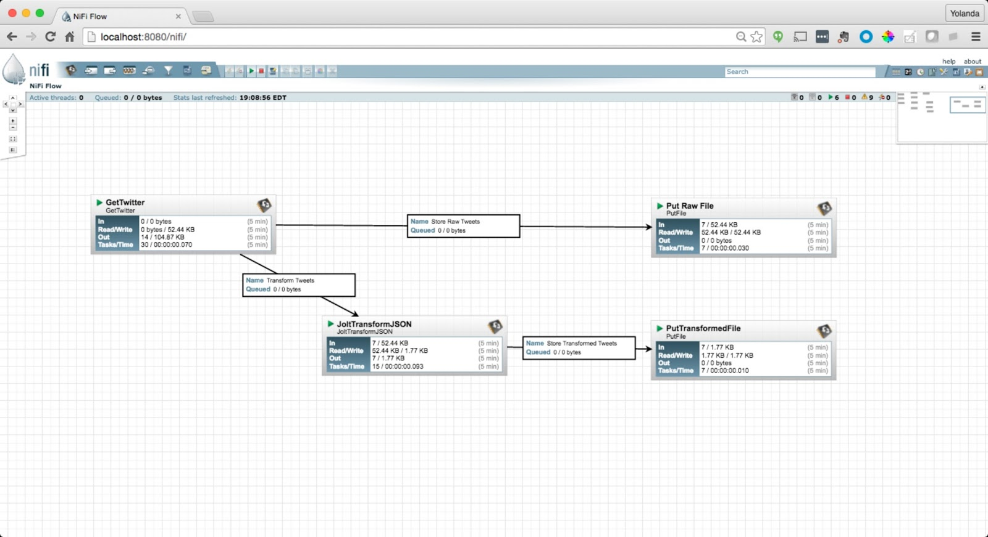
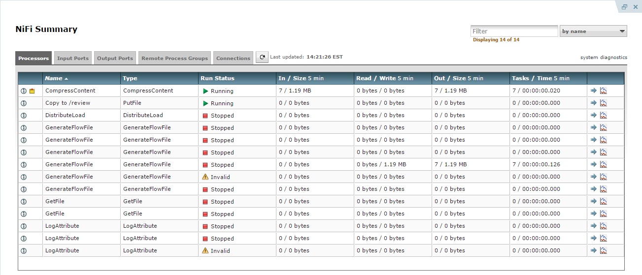
NiFi Features – Ease of Use

Slide 16
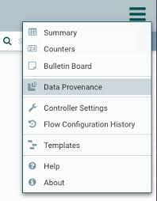
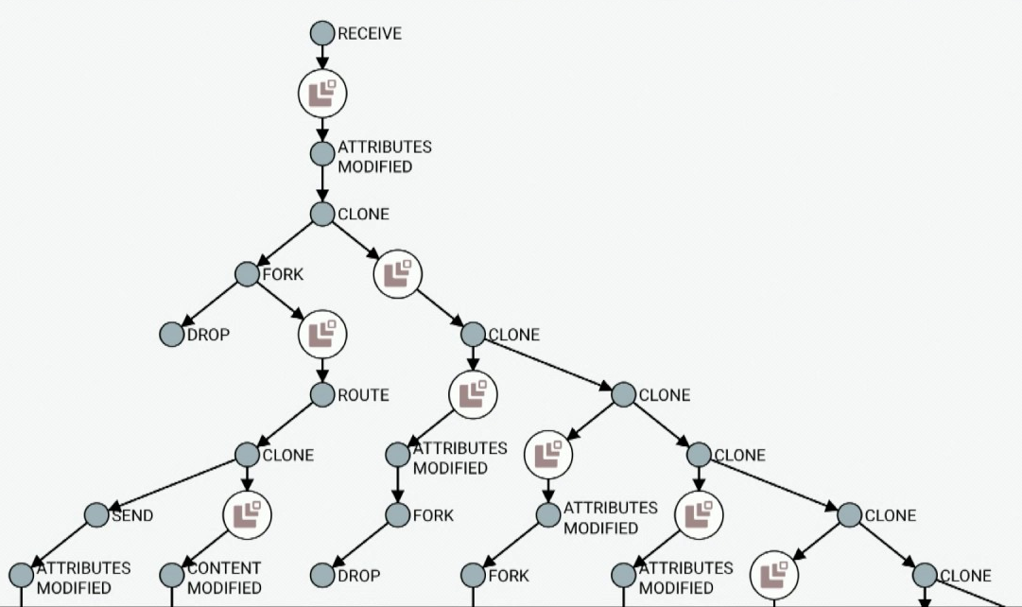
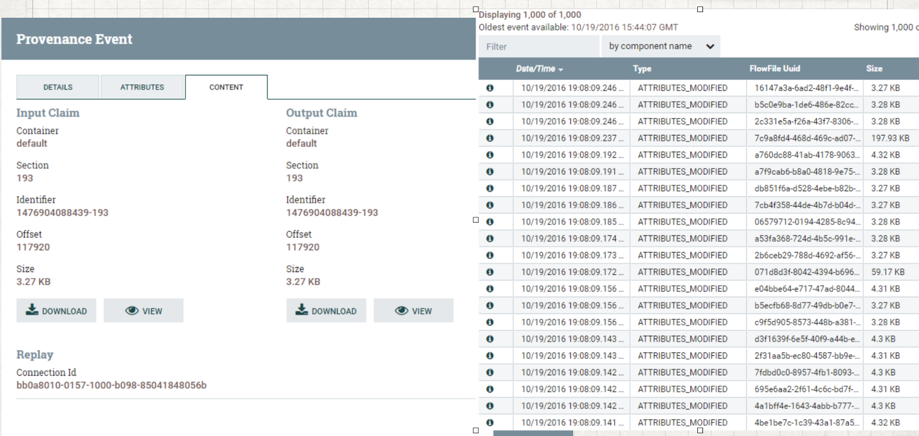
NiFi Features – Ease of Use

Slide 17

Demo – Time Permitting

Slide 18

Questions & Answers

Slide 19
Sources of Information
https://nifi.apache.org/docs/nifi-docs/html/overview.html
https://en.wikipedia.org/wiki/Apache_NiFi
https://community.hortonworks.com/articles/57262/integrating-apache-nifi-and-apache-kafka.html
https://hortonworks.com/ebook/ni-fi-dummies/
https://nifi.apache.org/minifi/getting-started.html
https://hortonworks.com/blog/edge-intelligence-iot-apache-minifi/

