Slide 1

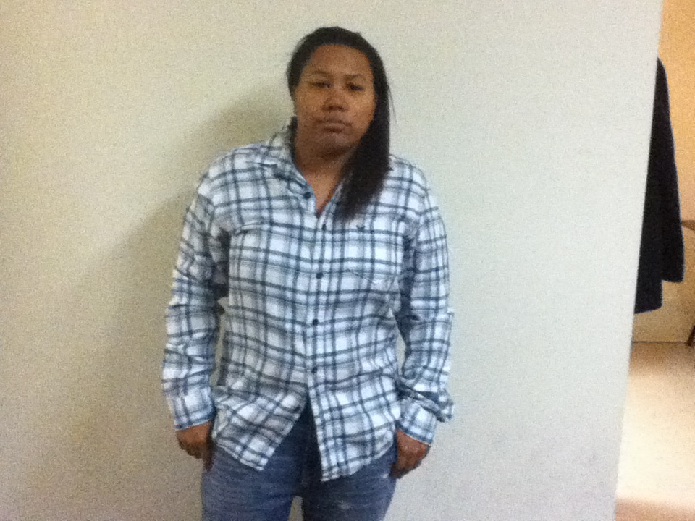
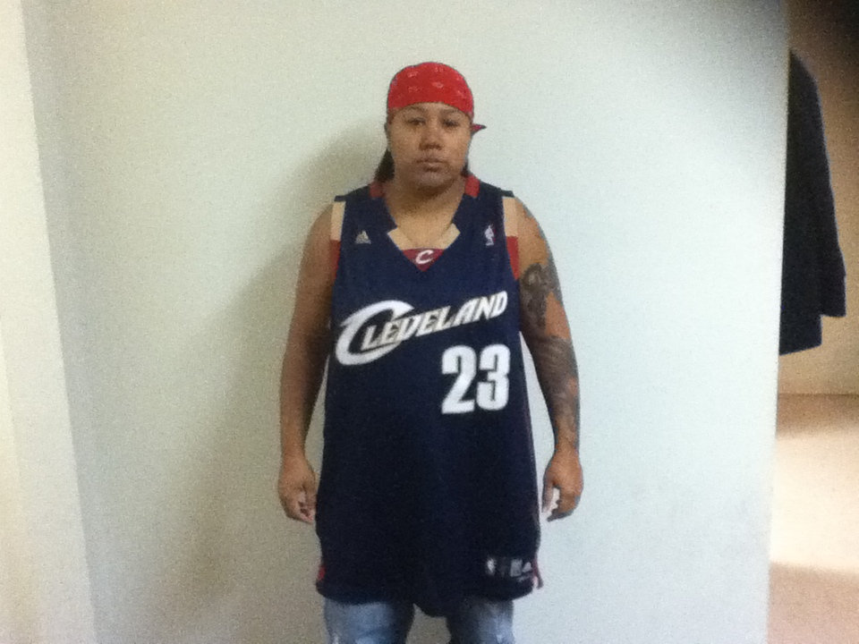

Arizona
Florida
Texas
Notes:
Florida

Slide 2

Goes AGAINST the 4th amendment
  “Protection from unreasonable search's and seizures.”
Section 17-5-100
  “If during the lawful detention of such suspect, the officer develops reasonable suspicion to also suspect that such person is an illegal alien, then the officer shall, when reasonably practicable, make an attempt to determine the immigration status of such suspect..”

Slide 3

Eliminate section 17-5-100
Enforce harder punishment for employers that hire illegal immigrants.
Make punishment a felony instead of a misdemeanor.

Slide 4


Disadvantage
Advantage
Notes:
Disadvantage

Slide 5
Sign The Petition
http://www.ipetitions.com/petition/hb87
OR
Hotline for abuse- 1-855-353-1010
Notes:
http://www.ipetitions.com/petition/hb87

