Slide 1
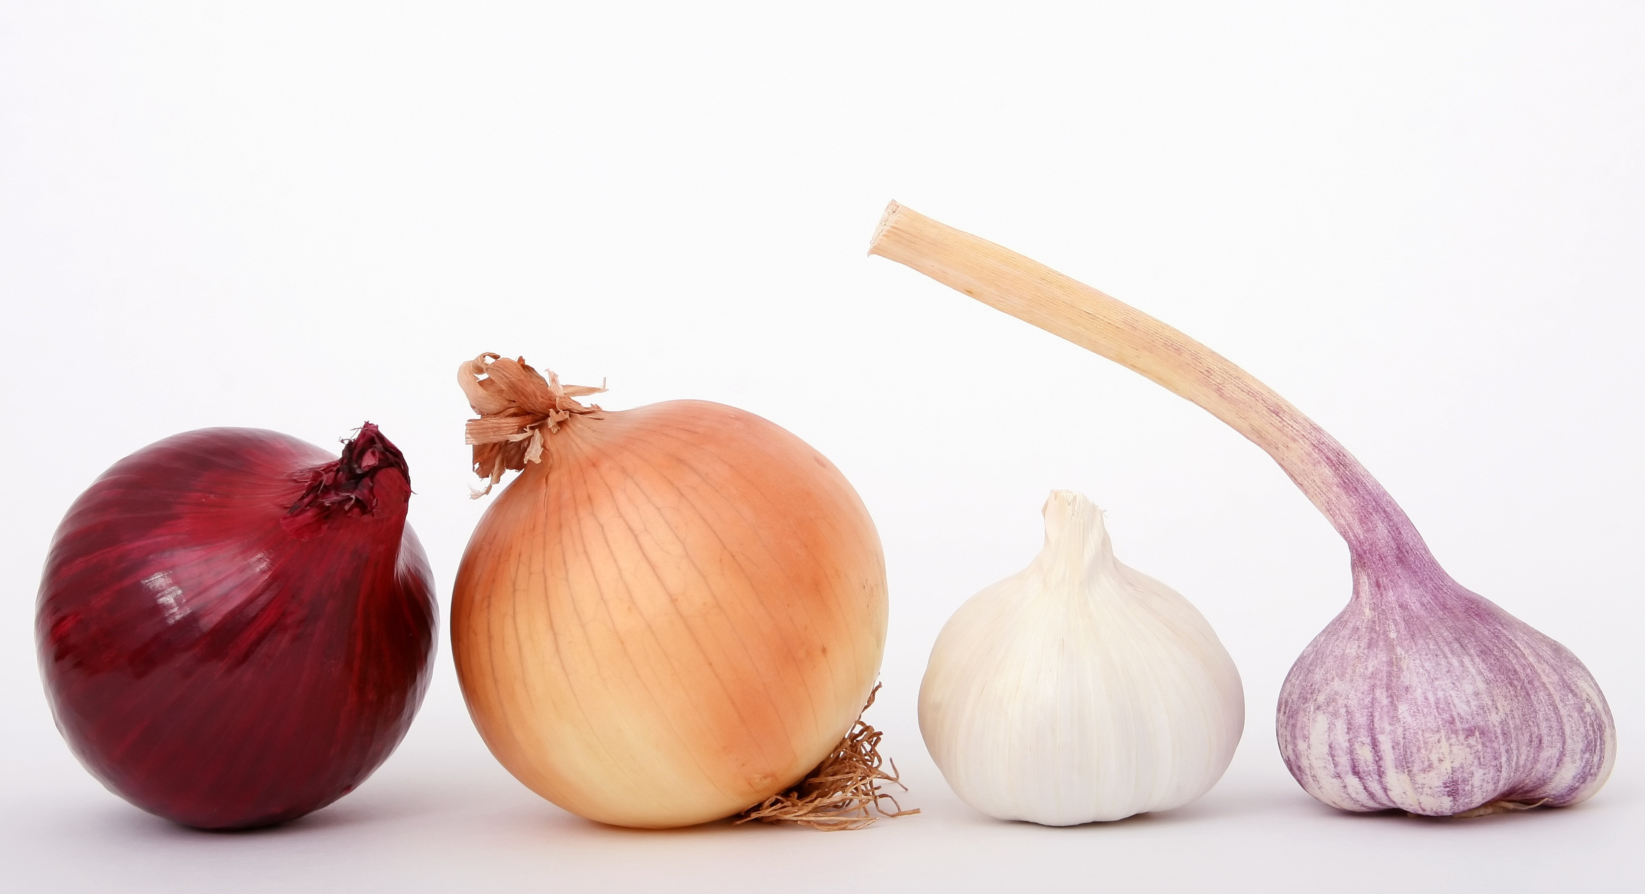
Wild and cultivated .onions
A ground survey + recipes & planting tips
by: Dave the Onion Eater

Slide 2

whoami
“Daily” TorBrowser user (main browser)
Common Tor user beyond the browser
.onion eater
Privacy advocate
Independent security impostor, amateur
Disclaimer:
This presentation is produced independently from the Tor® anonymity software and carries no guarantee from The Tor Project about quality, suitability, or anything else.

Slide 4
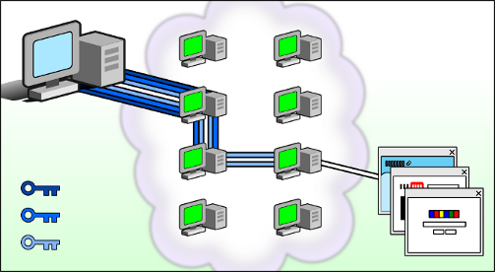
Tor: onion routing
Image © The Tor Project, Inc. Reproduction permitted under CC BY 3.0 United States License.

Slide 5



Onion Services – Intro
guard
(for client)
xyz.onion
rendezvous
point
(RP)
guard
(for .onion)
User visits xyz.onion without exiting the Tor network (e.g. no IP resolution)
Originally called “Hidden Services”
Onion logo © and TM The Tor Project, Inc. Reproduction permitted under CC BY 3.0 United States License. Used in accordance with trademark policy.

Slide 6
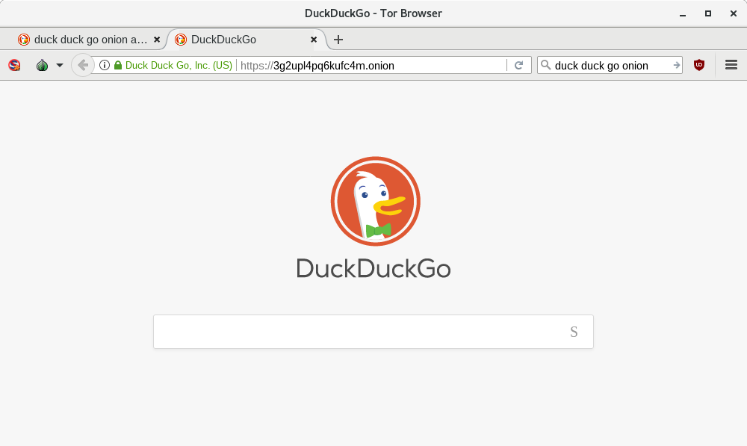
In the browser...

Slide 7


Onion Services – History/Future
2004 – first added to tor
~2006 – “Hidden services”
notoriety started perhaps by leak
for ethics of pharm. company
Dec 2007 – switch to decentralized Onion Services directory (distributed hash table / DHT)
...
Nov 2013 – first draft of proposal for next-generation Onion Services (prop 224)
…
Sep 2015 – RFC 7686 approved; reserves .onion
...
Dec 2017 – anticipated next-generation uplift ready for Tor stable
Lilly logo TM Eli Lilly and Company. Trademark used under fair use to refer to the company visually.

Slide 8


{ scope }
tor .onion on Linux
  public,
  non-anonymous
  private
.onion user
(any common OS, Debian easiest)
NOT public + anonymous
AKA “hidden”
not much on next-generation

Slide 9

“
This is not only decentralised and distributed, it is disintermediated communication: there’s no DNS-name to be censored, nor spoofed nor hijacked, there’s no fixed network route to be blocked, there’s no firewall to be bypassed nor a single big ISP router to be DDoSed by some attacker.
In short: Tor is a very attractive proposition for secure networking.
”
– Alec Muffett
https://medium.com/@alecmuffett/tor-is-end-to-end-encryption-for-computers-to-talk-to-other-computers-34e41d81c9e2

Slide 10

.onion properties
address is self-authenticating to key
NAT piercing =>
  reduce attack surface
onion-to-onion encryption with PFS (perfect forward secrecy)
~DDoS protection
censorship resistance
avoid exit node =>
  security:
  defeat MITM, BGP hijacking, bad CAs, bad DNS, ...
  performance:
  reduce load on exits... (potentially) faster, scales better
  privacy:
  avoid protocol leaks
  ...

Slide 11
DEMO TIME
BANG

Slide 12

ground survey: public

Slide 13





Bootstrapping?
Discoverability?
wikipedia.org
xyz.onion
Wikipedia logo TM Wikimedia Foundation, Inc.
Trademark used under fair use to refer to the website visually.

Slide 14

here be dragons

Slide 15




Bootstrapping? Discoverability?
Almost no consistency, poor UX, poor assurance
https://onion.domain.tld
(e.g. https://onion.debian.org)
1st-party “clearnet” website
  footer
  notification for tor users – blocks “clearnet”
  seamless HTTP redirect for tor users – blocks “clearnet”
  GPG-signed list/info – freshness?
  buried
  wiki / forum posts / comments / etc.
3rd-party website(s), list(s), …

Slide 16
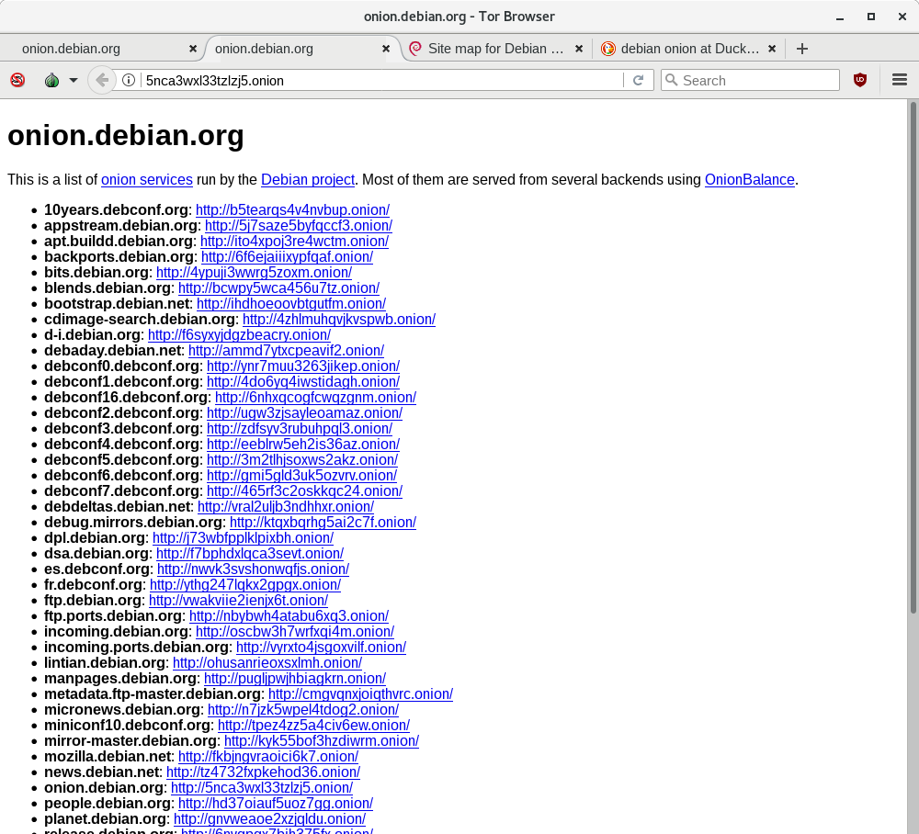
Bootstrapping? Discoverability?

Slide 17

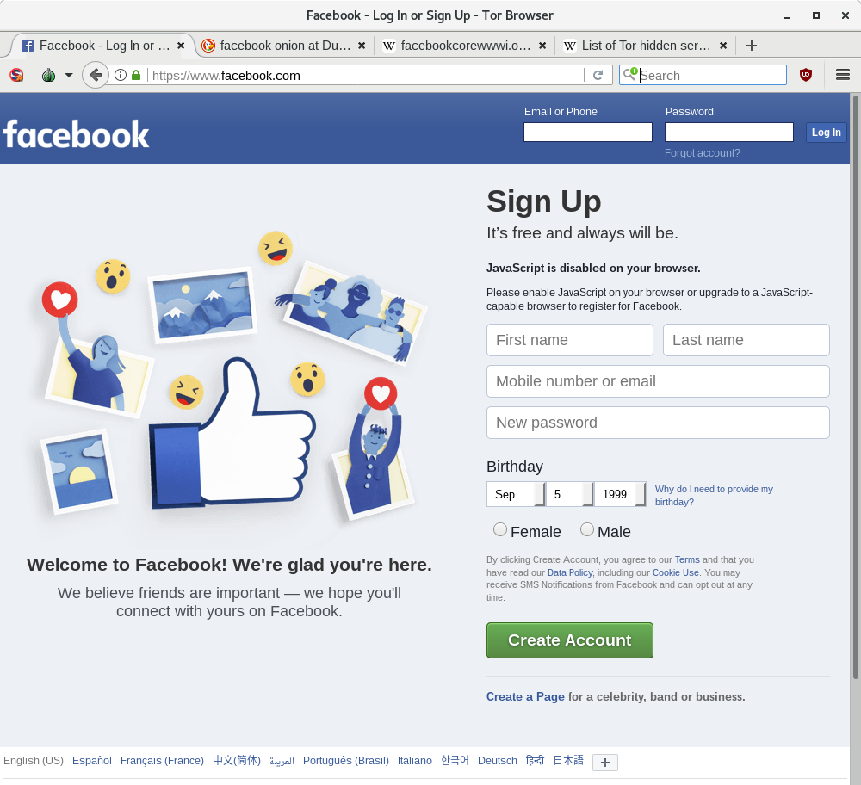
Bootstrapping? Discoverability?

Slide 18
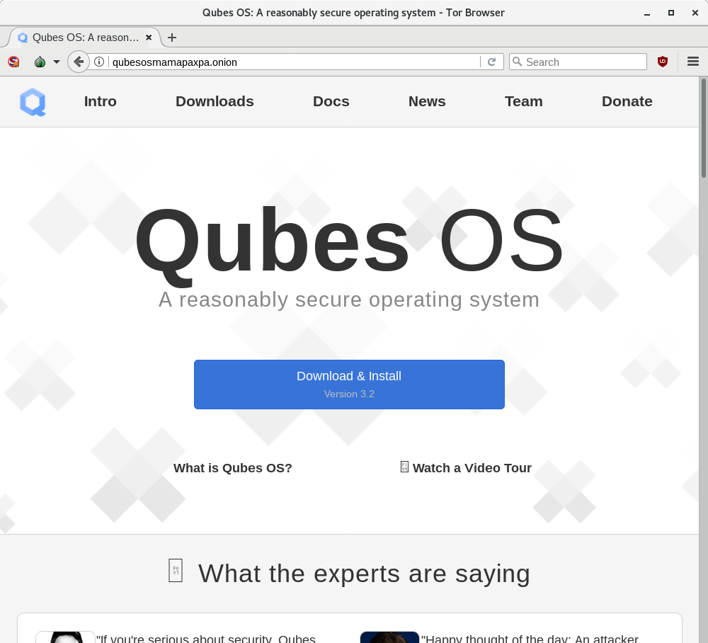


Bootstrapping? Discoverability?

Slide 19
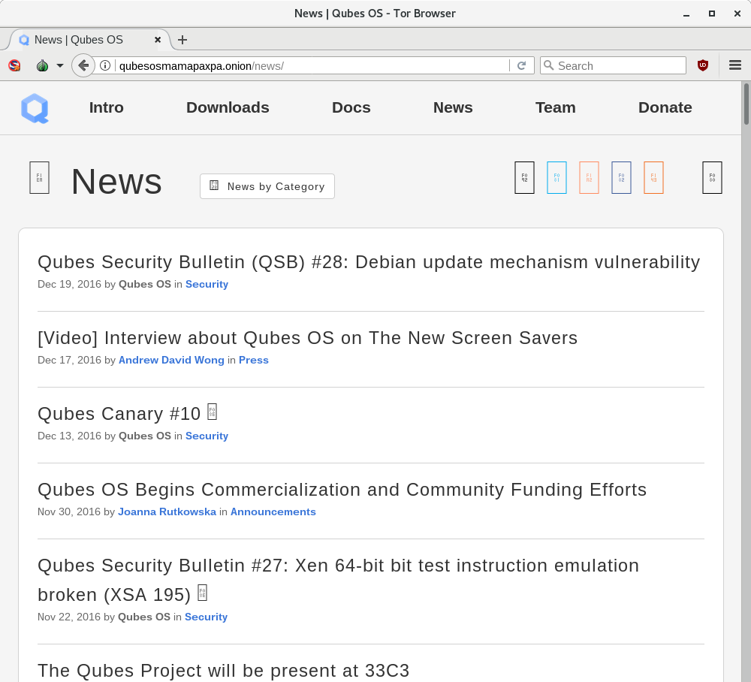
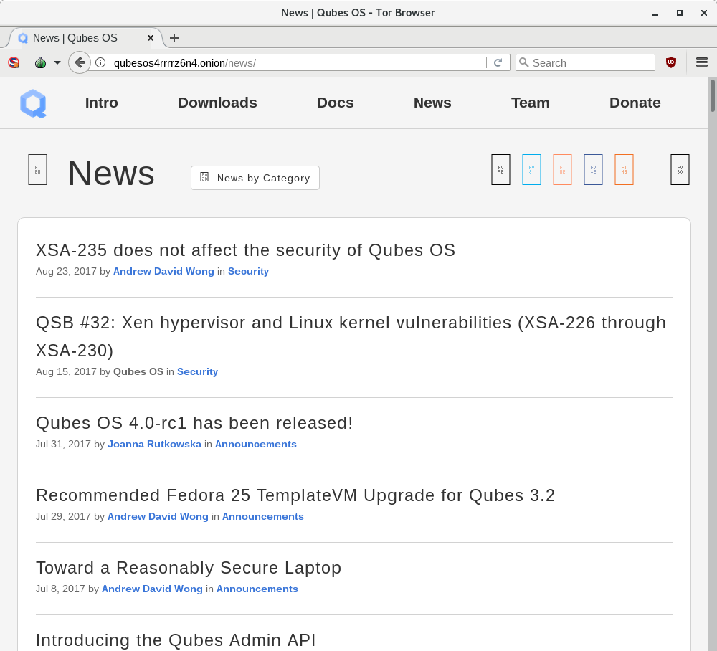
Bootstrapping? Discoverability?

Slide 20

Bootstrapping? Discoverability?
Bootstrapping may even be unsafe...
...when not done over Tor...
SNI anyone? (Server Name Indication in TLS)
  https://securedrop.theguardian.com/
  https://securedrop.pogo.org/
  https://securedrop.propublica.org/
  https://securedrop.radio24syv.dk/
  https://securedrop.dagbladet.no/
  https://sec.theglobeandmail.com/securedrop/
  https://sourceanonyme.radio-canada.ca/
  https://contact.buzzfeed.com/
  https://newstips.sfchronicle.com/
  https://newstips.usatoday.com/securedrop.html
  https://www.nytimes.com/tips#securedrop
SecureDrop logo © and TM the Freedom of the Press Foundation.
Licensed under CC Attribution 3.0 Unported. Trademark used under fair use to refer to the software visually.

Slide 21
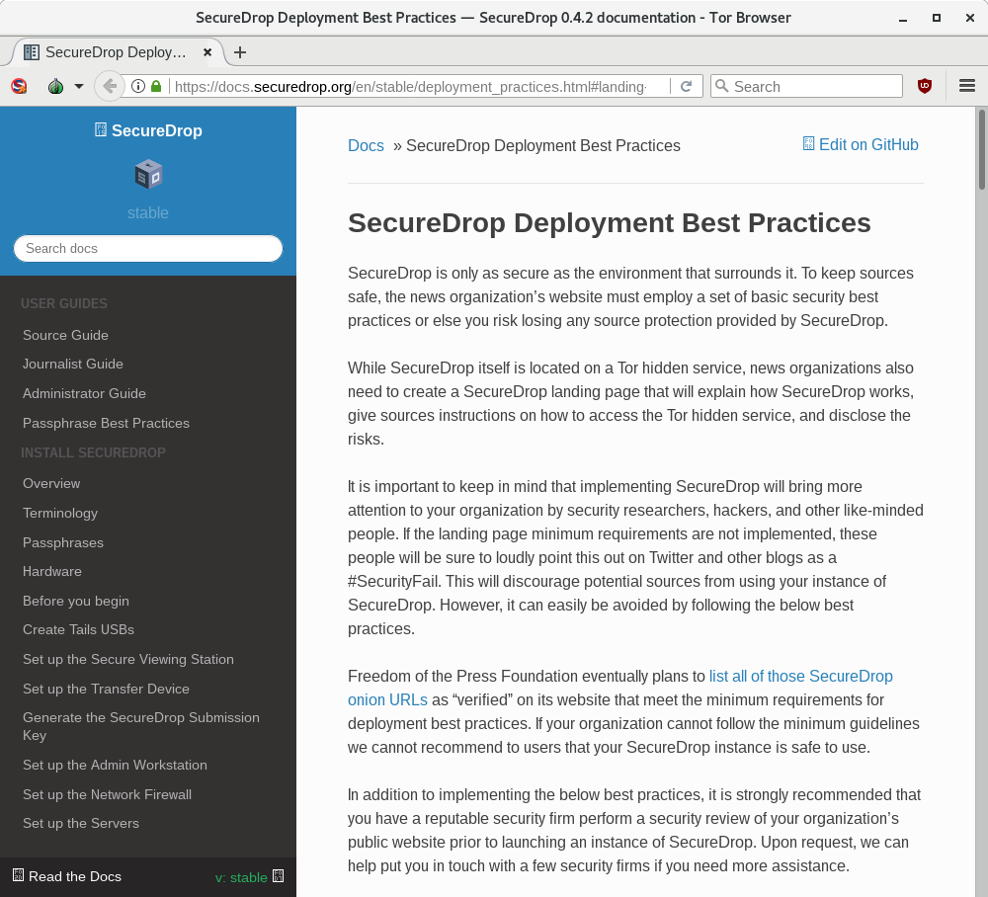
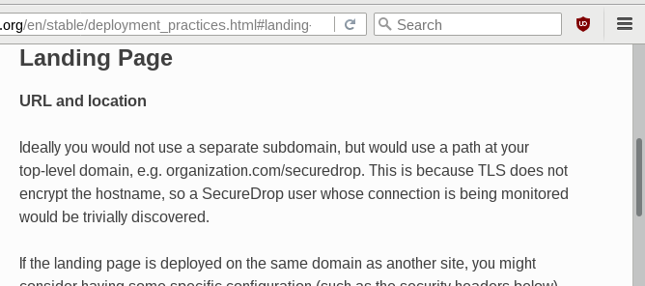

Bootstrapping? Discoverability?
Bootstrapping may even be unsafe...
...when not done over Tor...
SNI anyone? (Server Name Indication in TLS)
  https://securedrop.theguardian.com/
  https://securedrop.pogo.org/
  https://securedrop.propublica.org/
  https://securedrop.radio24syv.dk/
  https://securedrop.dagbladet.no/
  https://sec.theglobeandmail.com/securedrop/
  https://sourceanonyme.radio-canada.ca/
  https://contact.buzzfeed.com/
  https://newstips.sfchronicle.com/
  https://newstips.usatoday.com/securedrop.html
  https://www.nytimes.com/tips#securedrop
https://docs.securedrop.org/en/stable/deployment_practices.html#landing-page
SecureDrop logo © and TM the Freedom of the Press Foundation.
Licensed under CC Attribution 3.0 Unported. Trademark used under fair use to refer to the software visually.

Slide 22
Well, I think I found the right .onion …
… a year ago …
… or maybe it was last week …
I wrote it down / bookmarked it...

Slide 23






Slide 24

… but if we layer the security properties ...

Slide 25
HTTPS + .onion
TLS
Transport-level sec.
HSM use possible
Revocable* cert
Authenticity via CAs
  address → identity
Modern crypto
  stronger primitives
.onion
Network-level sec.
No HSM support
Irrevocable key/addr
Limited authenticity
  address → key
Outdated* crypto
  RSA1024, SHA1
* via OCSP, which leaks data if not using OCSP stapling + Must-Staple
* being addressed in next-gen. onions

Slide 26
HTTPS + .onion
A brief history...
June 2013 – DuckDuckGo – improper TLS onion (HTTPS presents domain mismatch)
Nov 2014 – 1st EV cert onion: Facebook
Dec 2014 – 2nd EV cert onion: Blockchain.info
Apr 2015 – 3rd EV cert onion: TheIntercept
Sep 2015 – .onion recognized as a special-use, top-level domain (officially allowing EV certs)
July 2016 – 7 organizations total deployed EV cert onion, per OnionScan report
sometime after – DDG gets EV cert onion

Slide 27
.onion usability, privacy
.onion family “dropping”
non-.onion resources (e.g. Google Analytics)
  still use exits

Slide 28


.onion recipes

Slide 29
apt-transport-tor + .onion
repos over .onion exist for…
  Debian
  Tor Project
  Whonix
  Qubes
  Tails
  ...?
Privacy, but also security
  refs: 2008 academic paper, apt CVE 2016-1252
Not just for personal machines
  ref: blog post about the server security gained from anonymity
GPG is not enough
  refs: Duo Tech Talk – Diogo Monico, The Update Framework (TUF)
apt-get install apt-transport-tor
# edit /etc/apt/sources.list
# and /etc/apt/sources.list.d/*.list
deb tor+http://abcdefghijklmnop.onion/path rel repos

Slide 30
GnuPG .onions
https://github.com/Whonix/anon-gpg-tweaks/blob/master/etc/skel/.gnupg/gpg.conf
  hkp://qdigse2yzvuglcix.onion
https://sks-keyservers.net/overview-of-pools.php#pool_tor
  hkp://jirk5u4osbsr34t5.onion
gpg traffic typically “in the clear”
gpg not designed for anonymity! Beware!
  torsocks -i gpg --refresh-keys
    parcimonie tool might help
  gpg2… dirmngr started for not-tor

Slide 31

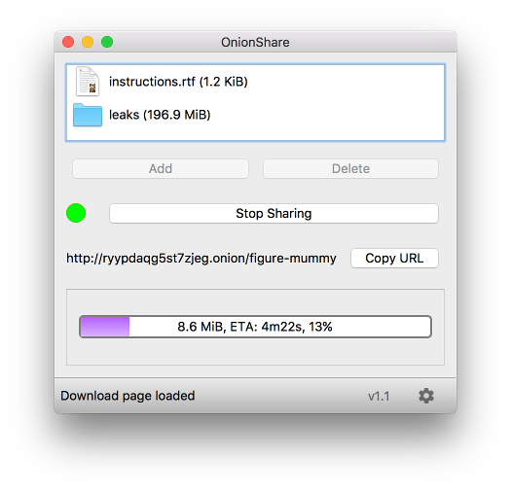
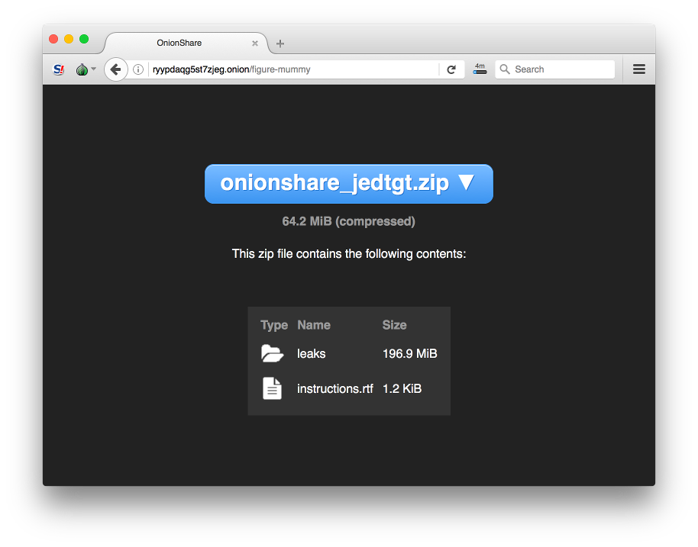
OnionShare

Slide 32
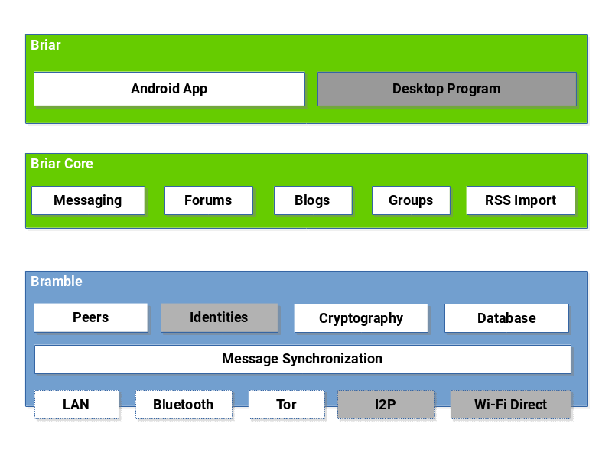

.onion messaging
Ricochet
Briar – public beta
unMessage – alpha
Pond (??)

Slide 33

Rendezvous

Slide 34
Rendezvous
guard
(for client)
xyz.onion
rendezvous
point
(RP)
guard
(for .onion)

Slide 35
guard
(for .onion)
Onion logo © and TM The Tor Project, Inc. Reproduction permitted under CC BY 3.0 United States License. Used in accordance with trademark policy.
xyz.onion

Slide 36
guard
(for .onion)
introduction points
(random)
Onion logo © and TM The Tor Project, Inc. Reproduction permitted under CC BY 3.0 United States License. Used in accordance with trademark policy.
xyz.onion

Slide 37
guard
(for .onion)
introduction points
(random)
Onion logo © and TM The Tor Project, Inc. Reproduction permitted under CC BY 3.0 United States License. Used in accordance with trademark policy.
xyz.onion

Slide 38
HSDirs (replica0)
HSDirs (replica1)
guard
(for .onion)
introduction points
(random)
Onion logo © and TM The Tor Project, Inc. Reproduction permitted under CC BY 3.0 United States License. Used in accordance with trademark policy.
xyz.onion

Slide 39
HSDirs (replica0)
HSDirs (replica1)
guard
(for .onion)
introduction points
(random)
Onion logo © and TM The Tor Project, Inc. Reproduction permitted under CC BY 3.0 United States License. Used in accordance with trademark policy.
xyz.onion

Slide 40


HSDirs (replica0)
HSDirs (replica1)
guard
(for .onion)
introduction points
(random)
Onion logo © and TM The Tor Project, Inc. Reproduction permitted under CC BY 3.0 United States License. Used in accordance with trademark policy.
xyz.onion

Slide 41
guard
(for client)
HSDirs (replica0)
HSDirs (replica1)
guard
(for .onion)
introduction points
(random)
Onion logo © and TM The Tor Project, Inc. Reproduction permitted under CC BY 3.0 United States License. Used in accordance with trademark policy.
xyz.onion

Slide 42

guard
(for client)
HSDirs (replica0)
HSDirs (replica1)
guard
(for .onion)
introduction points
(random)
Onion logo © and TM The Tor Project, Inc. Reproduction permitted under CC BY 3.0 United States License. Used in accordance with trademark policy.
xyz.onion

Slide 43
cached
guard
(for client)
guard
(for .onion)
introduction points
(random)
Onion logo © and TM The Tor Project, Inc. Reproduction permitted under CC BY 3.0 United States License. Used in accordance with trademark policy.
xyz.onion

Slide 44
cached
guard
(for client)
1-time cookie
rendezvous point
guard
(for .onion)
introduction points
(random)
Onion logo © and TM The Tor Project, Inc. Reproduction permitted under CC BY 3.0 United States License. Used in accordance with trademark policy.
xyz.onion

Slide 45
cached
guard
(for client)
1-time cookie
rendezvous point
“meet me at RP”
1-time cookie
auth data
Diffie-Hellman data (g^x)
guard
(for .onion)
introduction points
(random)
Onion logo © and TM The Tor Project, Inc. Reproduction permitted under CC BY 3.0 United States License. Used in accordance with trademark policy.
xyz.onion

Slide 46
cached
guard
(for client)
1-time cookie
rendezvous point
“meet me at RP”
1-time cookie
auth data
Diffie-Hellman data (g^x)
guard
(for .onion)
introduction points
(random)
Onion logo © and TM The Tor Project, Inc. Reproduction permitted under CC BY 3.0 United States License. Used in accordance with trademark policy.
xyz.onion

Slide 47
cached
1-time cookie
Diffie-Hellman data (g^y)
Handshake digest
guard
(for client)
1-time cookie
rendezvous point
“meet me at RP”
1-time cookie
auth data
Diffie-Hellman data (g^x)
guard
(for .onion)
introduction points
(random)
Onion logo © and TM The Tor Project, Inc. Reproduction permitted under CC BY 3.0 United States License. Used in accordance with trademark policy.
xyz.onion

Slide 48
cached
guard
(for client)
rendezvous point
guard
(for .onion)
introduction points
(random)
Onion logo © and TM The Tor Project, Inc. Reproduction permitted under CC BY 3.0 United States License. Used in accordance with trademark policy.
xyz.onion

Slide 49
Descriptors, HSDirs, DHT
descriptor-id = H(permanent-id |
H(time-period | descriptor-cookie | replica) )
replica = 0 or 1
permanent-id = H(public-key)[:10]
AKA ~base32-decode(onion address without “.onion”)
time-period = (current-time + permanent-id-byte * 86400 / 256)
/ 86400
changes once per day, network-distributed offset
"current-time" :=
the current system time in seconds (since epoch)
"permanent-id-byte" :=
the first (unsigned) byte of the permanent identifier
Legend
H(…) SHA1
| concatenation
{grey} Invariant
{purple} Variant, predictable
{red} Secret
{green} Random

Slide 50
Descriptors, HSDirs, DHT
descriptor-id = H(permanent-id |
H(time-period | descriptor-cookie | replica) )
replica = 0 or 1
descID_0 = H(~"zti6p9h6spbtx5xr" |
H(17573 | "" | 0) )
descID_0 = 3xqunszqnaolrrfmtzgaki7mxelgvkje

Slide 51


Descriptors, HSDirs, DHT
descriptor-id = H(permanent-id |
H(time-period | descriptor-cookie | replica) )
replica = 0 or 1
replica = 0
descID_0
desc0
HSDirs (replica0)
xyz.onion
Legend
H(…) SHA1
| concatenation
{grey} Invariant
{purple} Variant, predictable
{red} Secret
{green} Random
descID_1
replica = 1
desc1
HSDirs (replica1)

Slide 52
Descriptors, HSDirs, DHT
descriptor-id = H(permanent-id |
H(time-period | descriptor-cookie | replica) )
replica = 0 or 1
descID_0 = 3xqunszqnaolrrfmtzgaki7mxelgvkje
Base16(descID_0) =
337871756E737A716E616F6C7272666D747A6761...
HSDirs:
33789F22470A22C8BEEF907CED29847781E15C5D
337B7E307550F48DCDADA7481FA8436B2FCDADA9
337DA8971BE4580EAC5D1D7AE4E508020CF04594

Slide 53

Descriptors, HSDirs, DHT
descriptor-id = H(permanent-id |
H(time-period | descriptor-cookie | replica) )
replica = 0 or 1
descID_1
HSDirs (replica1)
Hashring
HSDirs (replica0)
descID_0

Slide 54

Planting tip: stealth

Slide 55
DEMO TIME
BANG

Slide 56
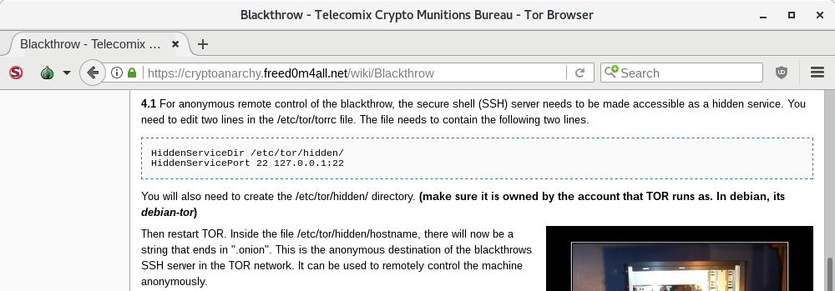
...
https://cryptoanarchy.freed0m4all.net/wiki/Blackthrow

Slide 57

Planting tips: .onion tools

Slide 58
Tools – especially for public...
OnionScan
scallion (GPU,CPU) / shallot (CPU) / eschalot / etc.
  vanity names
  8 characters easily doable
OnionBalance
  load balancing
  identity-key separation
Enterprise Onion Toolkit (EOTK) by Alec Muffett
ALPaCA – fingerprinting defense
  stage: research prototype

Slide 59
Tools – for private...
OnionScan – security in depth
OnionBalance – security in depth, maybe
FreedomBox
  make sure to set up stealth auth yourself
home-assistant.io
ALPaCA, potentially

Slide 60
Tools – more universal
arm/nyx, as an example tor controller
Whonix
  VM separation for tor .onion and application
corridor – tor-traffic whitelisting proxy
Tails – live distro, much onions
torsocks – use tor for non-tor-aware applications
  Linux via LD_PRELOAD
  mostly works
parcimonie – all the gpg freshness

Slide 61


 |  |  | Next Gen
Address is too short → authenticity? | TLS (e.g. HTTPS) | Use additional crypto layer(s)
Outdated crypto | TLS (e.g. HTTPS) | Use additional crypto layer(s)
HSDir camping | Maintain clearnet service | client secret → cannot predict descriptor
HSDir sees public identity key | “meh” | client secret → cannot connect
Guard discovery attack | “meh” | client secret → cannot connect 9001 times
Website fingerprinting | ALPaCA (soon?) | Less of a concern, but ALPaCA potentially | ?
HSDir deanonymization attack | ? | Less of a concern, but ? | ?
End-to-end correlation | ? | Think about host location, networks | ?

Slide 62
Refs: guides!
Alec Muffett’s guide on a “Basic Production Onion Server”
https://github.com/alecmuffett/the-onion-diaries/blob/master/basic-production-onion-server.md
Riseup’s Guide on best practices for Onion Services
http://nzh3fv6jc6jskki3.onion/en/security/network-security/tor/onionservices-best-practices
https://riseup.net/en/security/network-security/tor/onionservices-best-practices

Slide 63

Questions?

Slide 64

Appendix

Slide 65
Bootstrapping? Discoverability?

Slide 66
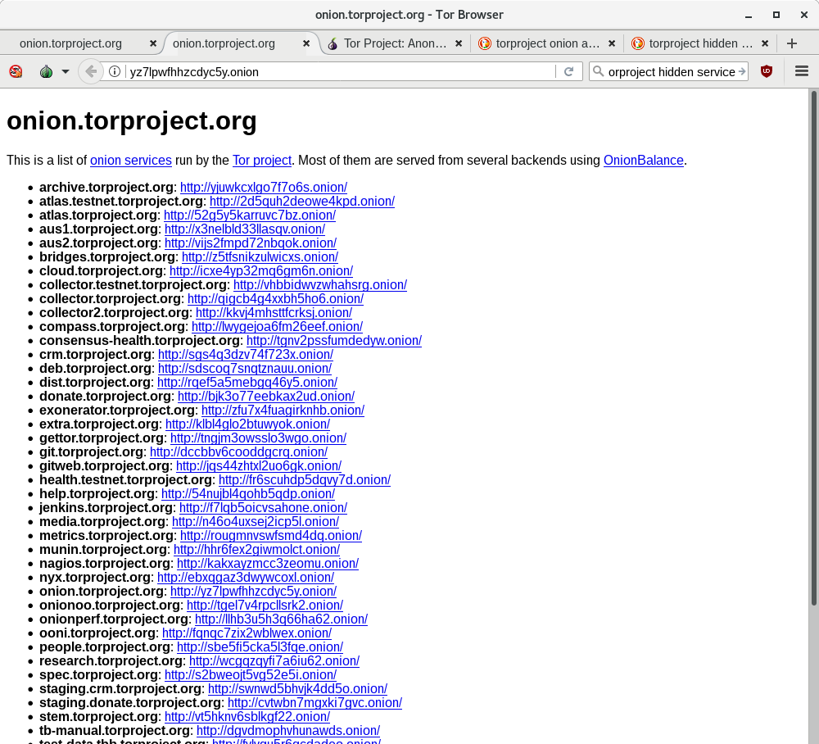
Bootstrapping? Discoverability?

Slide 67
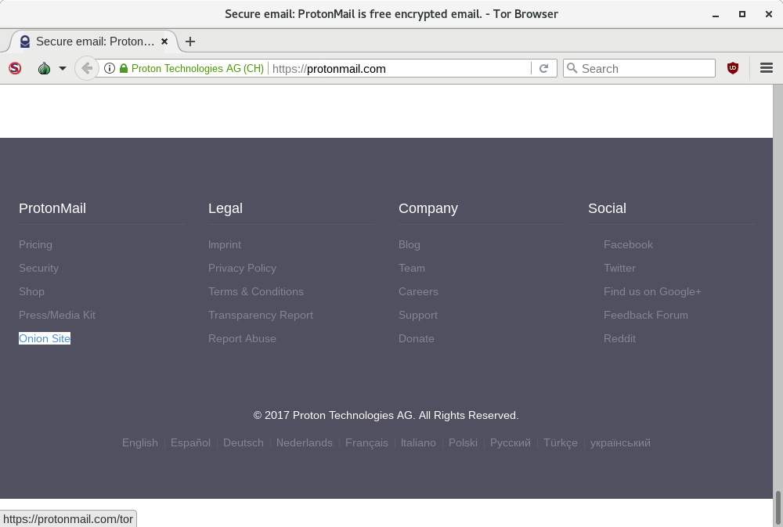

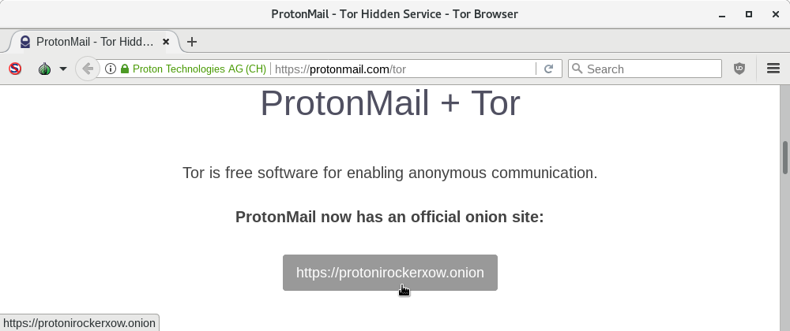

Bootstrapping? Discoverability?

Slide 68
Bootstrapping? Discoverability?
-----BEGIN PGP SIGNED MESSAGE-----
Hash: SHA512
riseup.net: nzh3fv6jc6jskki3.onion (port 80)
help.riseup.net: nzh3fv6jc6jskki3.onion (port 80)
black.riseup.net: cwoiopiifrlzcuos.onion (port 80)
imap.riseup.net: zsolxunfmbfuq7wf.onion (port 993)
lists.riseup.net: xpgylzydxykgdqyg.onion (port 80)
mail.riseup.net: zsolxunfmbfuq7wf.onion (ports 80, 465, 587)
mx1.riseup.net: wy6zk3pmcwiyhiao.onion (port 25)
pad.riseup.net: 5jp7xtmox6jyoqd5.onion (port 80)
pop.riseup.net: zsolxunfmbfuq7wf.onion (port 995)
share.riseup.net: 6zc6sejeho3fwrd4.onion (port 80)
smtp.riseup.net: zsolxunfmbfuq7wf.onion (ports 465, 587)
account.riseup.net: j6uhdvbhz74oefxf.onion (port 80)
we.riseup.net: 7lvd7fa5yfbdqaii.onion (port 443)
xmpp.riseup.net: 4cjw6cwpeaeppfqz.onion (ports 5222, 5269)
0xacab.org vivmyccb3jdb7yij.onion (port 80)
-----BEGIN PGP SIGNATURE-----
iQKTBAEBCgB9FiEETgeRJo98Z+q+iPGwMEPitxOado4FAli0RZhfFIAAAAAALgAo
aXNzdWVyLWZwckBub3RhdGlvbnMub3BlbnBncC5maWZ0aGhvcnNlbWFuLm5ldDRF
MDc5MTI2OEY3QzY3RUFCRTg4RjFCMDMwNDNFMkI3MTM5QTc2OEUACgkQMEPitxOa
do5u7BAAuBPYcnuU4HAQtddb+p8y0V+Fw76fPszPjIE19ACTtfN39U+NyhSj/5LI
i7n2++O6lXhNfwnh1A5OPIHxv8ZbA9pMeXZFYA3gHC1IVRNokRq22uxvCrfastS6
BNmGICsTuHqIcbiZJgkkaQImywpOryT0aoWHgGU1QgprK27sWIz6tfUt5KXH5vvx
EAyx8itiREJtNQwVMFk3epVCAnl1rAfay/6Gk/jz7rLji3mFjVzGf3wEXff3OuTS
jVg5NqAO99k8RjHvaNqVCVkMOdPjoByvVrvJ68XHtbk+ICKDQtwTMiktgKBdAaVr
2tf/vWeOyB/egvjpM89+uLHsxIujvUjGAUxUt/W0cu1mCC3VpdAeR7Wj+1NomNlw
Iw0U07LVT8fqBL42CaZowtkiVAuGZ9+Aeam+ys53CksQ2/phLCZ18JNgzpBZKBnr
x62vnfskmezW0SRjTlMbwlVejtg2HTlx6aVUd2wS8BTNyl+c7W6MMybYIxV/iNA4
S/y5sJbcJNn5iRqIg33i95+1hhTvUqZYnvXFsXCdsgTvy4CrUt5n5vSkU9vPqBA8
bIojBuofKErdf/vTT112c3hz0xE5LDerGuftCO4UmeOx1Cf3d2JiRRmWD0Xg5sdx
4BL4mJThuyabxTNdLX8lS0kRvXtgY/1owiQ90VAS0ykg4FqXe8U=
=2Mol
-----END PGP SIGNATURE-----
http://nzh3fv6jc6jskki3.onion/security/network-security/tor/hs-addresses-signed.txt
https://riseup.net/security/network-security/tor/hs-addresses-signed.txt

Slide 69

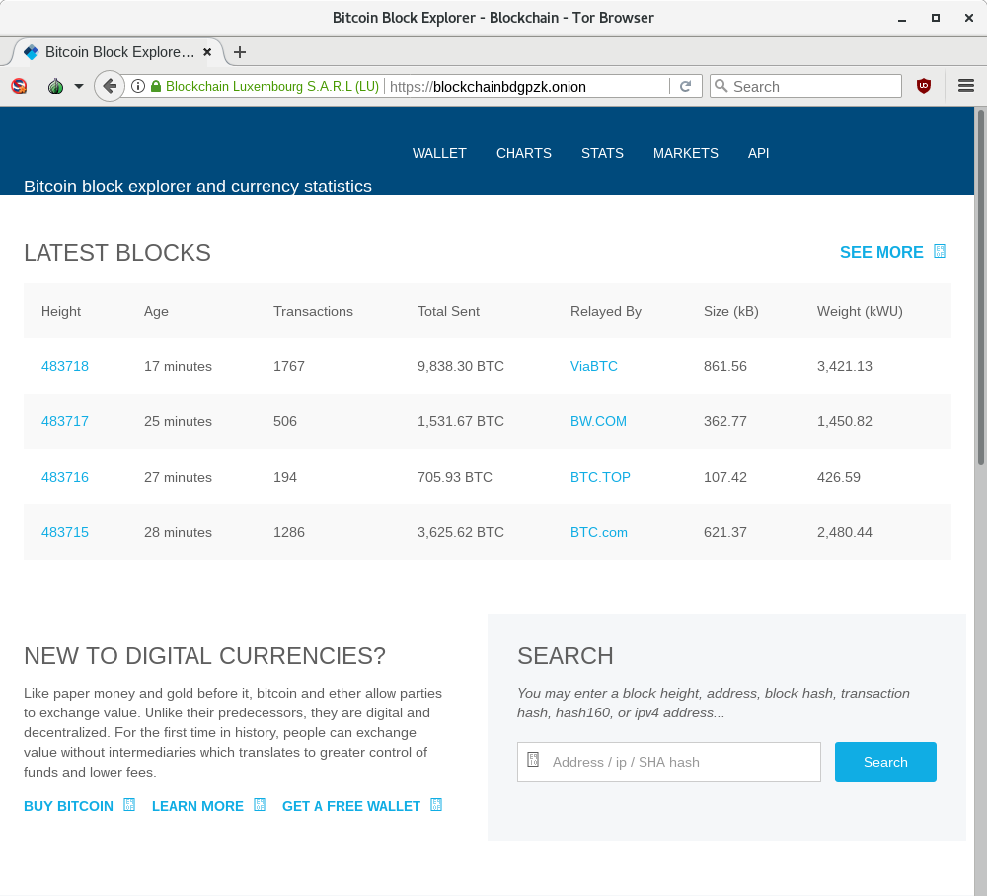
Bootstrapping? Discoverability?

Slide 71
Bootstrapping? Discoverability?
Securedrop
GPG

Slide 72
Bootstrapping? Discoverability?
Riseup, about to type in url
.onion redirect

Slide 73
Bootstrapping? Discoverability?
whonix
qubes

Slide 74
Bootstrapping? Discoverability?
propublica

Slide 75
Bootstrapping? Discoverability?
Autistici/Inventati

Slide 76
Bootstrapping? Discoverability?
Tails logo
DDG

Slide 77
Bootstrapping? Discoverability?

Slide 78
cached
1-time cookie
Diffie-Hellman data (g^y)
Handshake digest
guard
(for client)
HSDirs (replica0)
HSDirs (replica1)
1-time cookie
rendezvous point
“meet me at RP”
1-time cookie
auth data
Diffie-Hellman data (g^x)
guard
(for .onion)
introduction points
(random)
Onion logo © and TM The Tor Project, Inc. Reproduction permitted under CC BY 3.0 United States License. Used in accordance with trademark policy.
xyz.onion

Slide 79
HTTPS + .onion
Demos/screenshots, blah, ...

Slide 80
HTTPS + .onion

Slide 81
Metrics...

