Slide 1


Parallel Acceleration of CALPUFF
DJ Rasmussen and Prof. Mike Kleeman
Presented to TRC Environmental Corporation and the U.S. Environmental Protection Agency
December 11, 2012
Notes:
Explain motivation for project

Slide 2
Outline
Profiling and assessment of possible performance improvements of CALPUFF (v5.8 – level 070623)
Implementation of parallel algorithms in CALPUFF, profiling results, and numerical accuracy the parallel CALPUFF variant
Summary of capabilities of parallel CALPUFF
Suggestions for future performance improvement
[NASA, Terra Sat.]
1

Slide 3
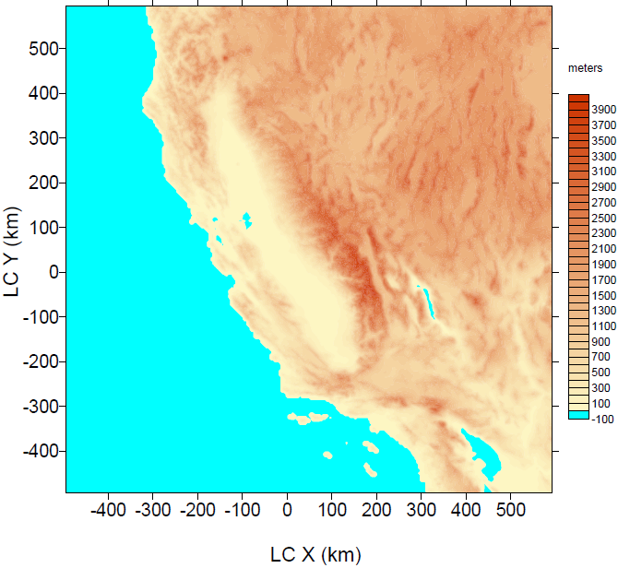
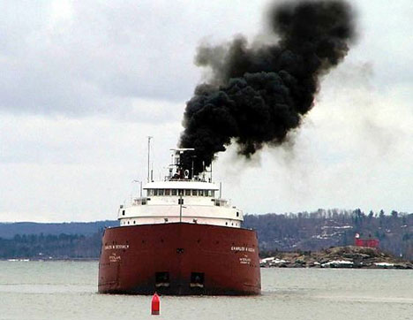
Profiling serial CALPUFF to ID bottlenecks
Test scenario (serial CALPUFF)
8 days, 100 area sources
4-km X 4-km resolution
Hourly sampling at 74,529 gridded receptors only
Simulated diesel particulate matter dispersion from ocean going vessels
273 receptors
[NASA, Terra Sat.]
273 receptors
Run time ~ 4 hrs. with Intel® Core™2 Quad Q6600 processor (8MB Cache, 2.40 GHz, 1066 MHz FSB) with 4GB DDR3 SDRAM.
Source: http://www.viewzone2.com/sixteen-pollution.jpg
2

Slide 4
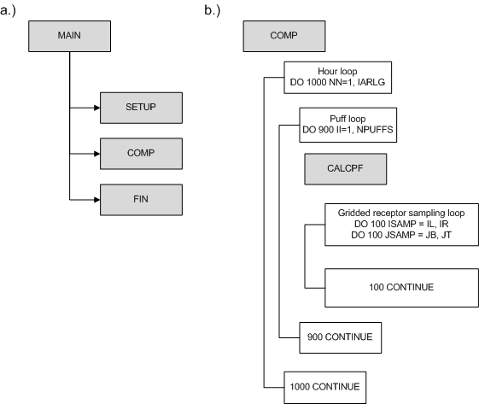
Profiling serial CALPUFF to ID bottlenecks
Almost 99% of runtime confined to subroutine CALCPF!
Result also found by previous studies attempting to accelerate performance of CALPUFF:
Using OpenMP [Suk-Hyun et al., 2011]
Used loop parallel directives
Speed-ups of ~ 2
Did not explore consistency in results (serial vs. parallel variants)
Using GPUs [Cremades et al., 2010]
Found speed-ups of ~ 5
Failed to produce consistent results
Hypothesize that using MPI (MPICH-2) library would provide an affordable, scalable, and portable optimization solution to address the computational load on the subroutine CALCPF and would ultimately improve model performance
3
Notes:
Profiling results are a strong function of how the model is configures to run

Slide 5
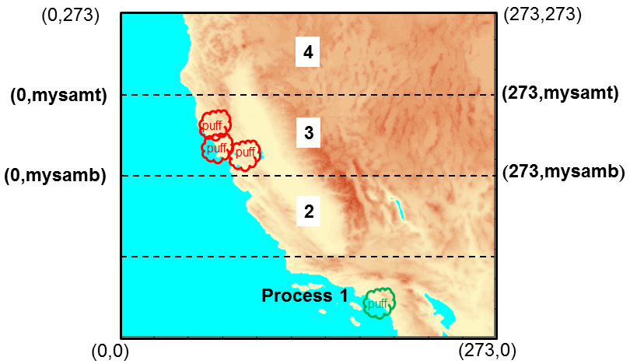
Improving receptor sampling performance
Receptor grid (i.e. our California domain) is divided amongst the number of processors (e.g. 4 processors) in a 1-dimensional domain decomposition
All processors perform redundant calculations, but each processor only samples receptors in assigned portion of receptor grid ( loop limits: mysamb to mysamt)
Process 3 samples red “puffs” because they are over its receptors. Green “puff” not sampled by process 3
4
Notes:
Hypothesize that it is faster for each processor to perform each calculation redundantly that it is to perform all calculations in parallel given the performance overhead associated with inter-process communication. Each processor performs dispersion, chemistry, ect. for every puff
Next step is to output concentrations…

Slide 6





Implementing parallel output routines
Each process writes their portion of the global field to the file each hour using an offset pointer
Proc. 1
Proc. 2
Proc. 3
Proc. 4
Fortran sequential binary file
CALPUFF compression routine replaces sequences of 0’s with negative reals to represent the number of successive zeros in an array (i.e. concentrations or fluxes)
Array before compression…
Array after compression…
$$\left[\begin{aligned}\text{0 0 1.425}\text{E}\text{−6 0 0 0 0 0 0 8.432}\text{E}\text{−13 0} \\ \text{0 0 0 0 0 1.345}\text{E}\text{−7 0 0 0 1.453}\text{E}\text{−10} 0 \end{aligned}\right]$$
$$\left[\begin{aligned}\text{−2.001 }\text{1.425}\text{E}\text{−6 −6.001 8.432}\text{E}\text{−13 } \\ \text{−5.001 }\text{1.345}\text{E}\text{−7 −3.001 1.453}\text{E}\text{−10} −1.001 \end{aligned}\right]$$
CALPOST will not allow consecutive counts of zeros in the global fields (e.g. ….-1.001 -10.001…)
So , if one matrix ends in a zero count and another starts with a zero count, they need to be added…
Process. 1’s field
$$\text{−1}\text{1}\text{.00}\text{2}$$
$$\left[\begin{aligned}\text{−2.001 }\text{1.425}\text{E}\text{−6 −6.001 8.432}\text{E}\text{−13 } \\ \text{−5.001 }\text{1.345}\text{E}\text{−7 −3.001 1.453}\text{E}\text{−10} −1.001 \end{aligned}\right]$$
Process. 2’s field
Need to know about neighbor’s start/ end points to know if adjustments are needed…
$$\left[\begin{aligned}\text{−10.001 }\text{7}\text{.}\text{86}\text{5}\text{E}\text{−5 −9.001 1.442}\text{E}\text{−12 } \\ \text{−55.001 4}\text{.3}\text{2}\text{5}\text{E}\text{−8 −7.001 8.653}\text{E}\text{−11} −12.001 \end{aligned}\right]$$
5

Slide 7
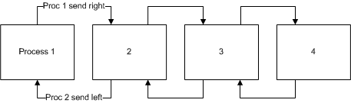


“Cascading” send and receive algorithm
A “cascading” send and receive algorithm is used to communicate the start/ endpoints of each processor’s portion of the global field to their neighbors
Proc. 1 send array end pt. right
Proc. 2 send array start pt. left
At the end of this procedure, each process will have an array that is fit to be written to disk.
i.e. there are no consecutive zero counts spanning two local fields:
Process 1’s field
-1.001 and -10.001 are added
$$\left[\begin{aligned}\text{−2.001 }\text{1.425}\text{E}\text{−6 −6.001 8.432}\text{E}\text{−13 }\text{−5.001} \\ \text{1.345}\text{E}\text{−7 −3.001 1.453}\text{E}\text{−10} −11.002 \end{aligned}\right]$$
Process 2’s field
$$\left[\begin{aligned}\text{7}\text{.}\text{86}\text{5}\text{E}\text{−5 −9.0}\text{01 1.442}\text{E}\text{−12 }\text{−55.001} \\ \text{4}\text{.3}\text{2}\text{5}\text{E}\text{−8 −7.001 8.653}\text{E}\text{−11} −12.001 \end{aligned}\right]$$
Process 2 removes one element of its array
The global field can now be resurrected cohesively in CALPOST with out issue
6

Slide 8
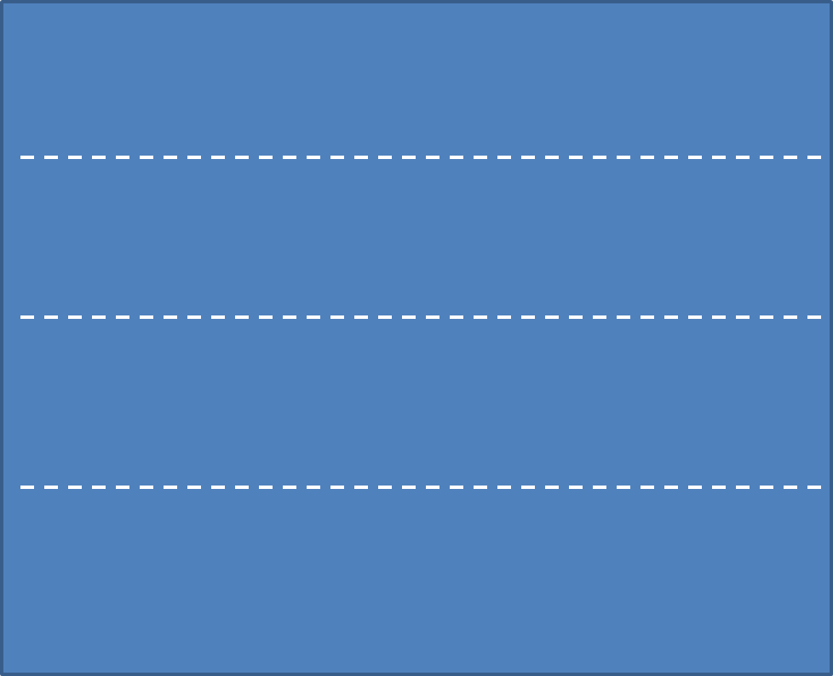
Summary of parallel CALPUFF approach
All processes sample all receptors in their assigned domain
All processes output data from their assigned receptors
4
Data compression
writes output
3
Data compression
writes output
2
Data compression
writes output
process 1
Data compression
writes output
All processes send & receive array start/ end points from/ to their neighbor(‘s)
Inter-process communication occurs only during array compression routine
7

Slide 9
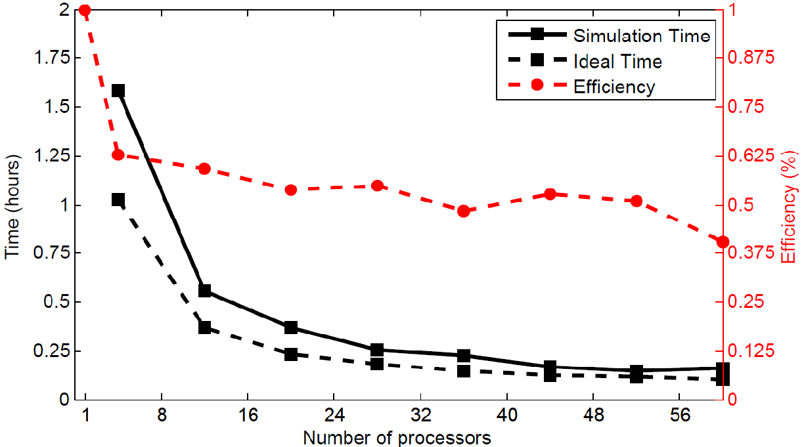
Scaling of parallel CALPUFF (100 area sources)
Returned to initial 8-day, 100 area source simulation using parallel CALPUFF to assess speed-ups and scaling (network connecting each node was Gbps)…
Using 52 processors: ~4 hrs. → ~15 mins. (~16x speed-up)
8

Slide 10
Parallel CALPUFF: adding more sources
Hourly sampling at 74,529 gridded receptors only
Note: Speed-ups ≥2 observed when reading from NFS instead of HDFS; what is shown may be a “worst-case scenario” given this observation
9

Slide 11
Parallel CALPUFF: adding more sources
Ultimate goal of project was to make CALPUFF more efficient at handling several thousand sources on a large modeling domain for year-long simulations (i.e. BIG problem sizes)
Hourly sampling at 74,529 gridded receptors only
8GB of RAM needed for 10K+ sources to hold several thousand “puffs” on the grid at once
10

Slide 12
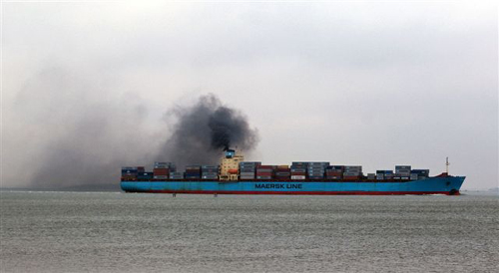
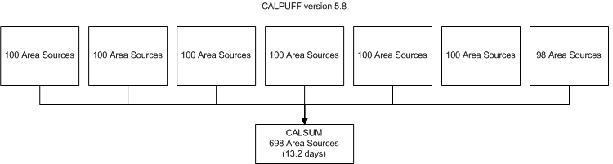
Evaluating numerical accuracy of parallel CALPUFF
We are interested in evaluating the numerical accuracy of the model (serial vs. parallel) with a larger problem size (1 year, 698 area sources, CA domain)
Traditional approach with serial variant….
Impractical to run 698 sources on one CPU, so divide up sources arbitrarily and run one simulation per machine…
…then add with CALSUM program
OK for hundreds of sources, but trouble when using thousands of sources
Took about 13.2 days to simulate with serial variant using 7 machines and about 1.3 days with parallel CALPUFF (60 processors) (speed-up ~ 10)
Using both results, we compare annual avg. 1-hr. species concentrations…
11

Slide 13
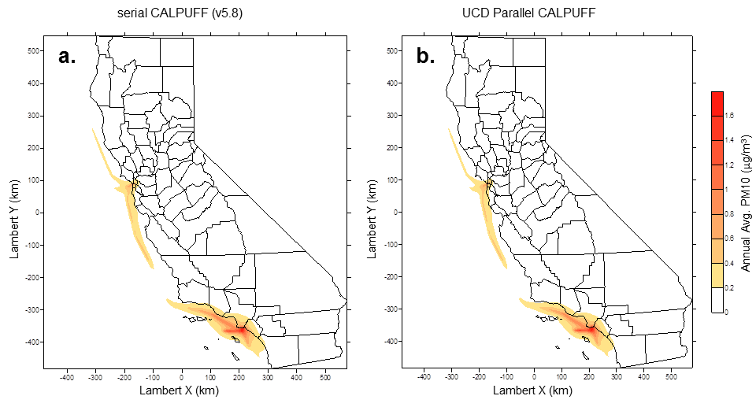
Comparing serial vs. parallel CALPUFF results
Annual Avg. PM10 (μg m⁻³ )
Hard to see differences here, but…
12

Slide 14
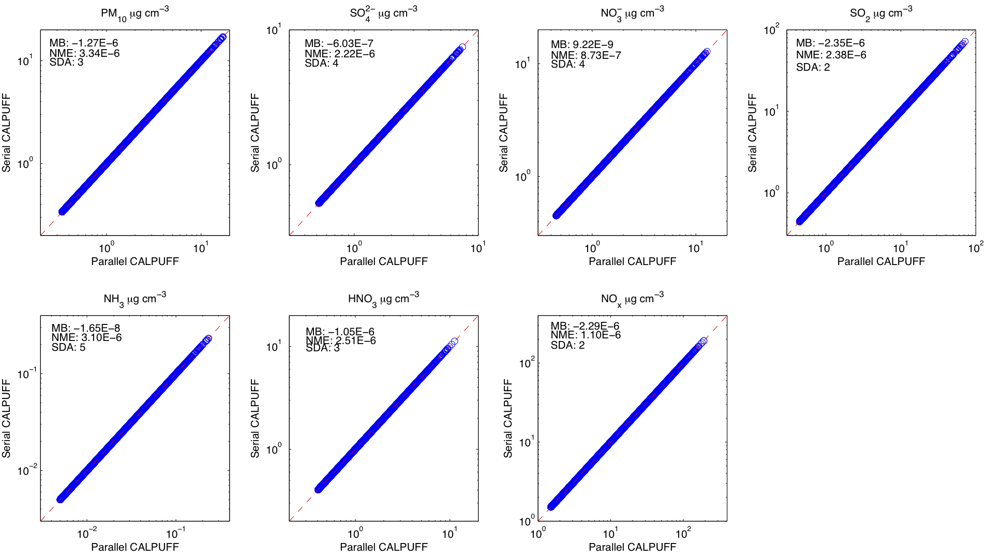
Numerical Accuracy of all species
All concentrations ≥ 75th percentile
13

Slide 15
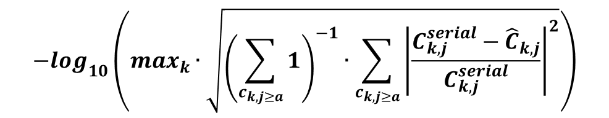
Numerical Accuracy of all species
Species | PM₁₀ | SO4 ²⁻ | NO3 ⁻ | SO₂ | NH₃ | HNO₃ | NO_{x}
Mean Bias (μg m⁻³) | -1.27E-06 | -6.03E-07 | 9.22E-09 | -2.35E-06 | -1.65E-08 | -1.05E-06 | -2.29E-06
NMB (%) | -2.73E-04 | -1.30E-04 | 1.97E-06 | -1.88E-04 | -2.51E-04 | -1.91E-04 | -7.26E-05
NME (%) | 3.34E-04 | 2.22E-04 | 8.73E-05 | 2.38E-04 | 3.10E-04 | 2.51E-04 | 1.10E-04
SDA | 3 | 4 | 4 | 2 | 5 | 3 | 2
$$−\log_{10}\left(\max_{k}∙\sqrt{{\left(\sum_{c_{k,j≥a}}{1}\right)}^{−1}∙\sum_{c_{k,j≥a}}{{\left|\frac{C_{k,j}^{serial}−{\hat{C}}_{k,j}}{C_{k,j}^{serial}}\right|}^{2}}}\right)$$
Significant digits of accuracy (SDA) =
k = species, j = receptor, a = threshold value
[Sandu et al., 1997]
14
Notes:
SDA uses modified root mean square norm of the relative difference of the parallel solution (${\hat{C}}_{k,j}$) with respect to the serial solution ($C_{k,j}^{serial}$) for species “k” at receptor “j”.

Slide 16
Further parallel CALPUFF testing
sub-grid scale (discrete) and complex terrain receptors (both also 1-D decomposed) tested OK
Compressed and uncompressed data tested OK
Other output files: Dry flux, wet flux, visibility data, “puff” debug data, mass flux over a specified area, mass balance, restart file tested OK
Since all processors perform redundant calculations (only sampling different), we have confidence that most of model options function normally
15

Slide 17
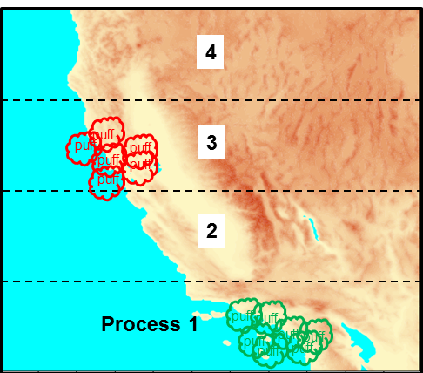
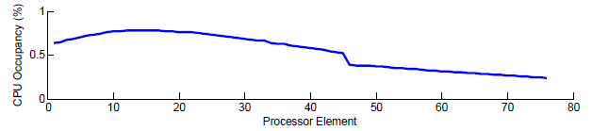

Potential future improvements
Address processor load imbalances with a dynamic decomposition
CPU occupancy =
$\frac{\text{time} \text{spent} \text{sampling} \text{receptors}}{\text{total} \text{time}}$ X 100%
Some processors have many “puffs” to sample, while others have little/ none
Many “puffs” to sample
Fewer “puffs” to sample
Improving efficiency of meteorology input (i.e. broadcasting met.)
-met files inundated by many processes trying to read at once; becomes more of a problem as more processes are conscripted
16

Slide 18
Conclusions
Parallel CALPUFF speed-ups ~ 16 when using 52 processors with a 100 source simulation (typical problem size) (efficiency ~37%)
Can simulate tens of thousands of emissions sources, beyond the capabilities of the serial CALPUFF model
Results are numerically equivalent
Hope to show utility of model in a future publication
Interested in obtaining EPA approval
Acknowledgements:
This work was funded by the California Air Resources Board (Contract No. 11-760)
17

