Slide 2
A non-stationary, risk-based approach for determining design flood elevations under sea-level rise
D.J. Rasmussen, PhD, Aff.M.ASCE
Earth & Environment, WSP USA, Inc.
DJ.Rasmussen@wsp.com
Maya Buchanan, PhD
Earth & Environment, WSP USA, Inc.
Notes:
E&E WSP USA
Kick off ASCE INSPIRE…
Session on climate-resilient coastlines
application of an existing way to incorporate sea-level rise into the design of facilities. There are many ways to do this.
You’ll be seeing another way from another presentation in this session. Given how important it is, it’s great to see a lot of work in this area.

Slide 3
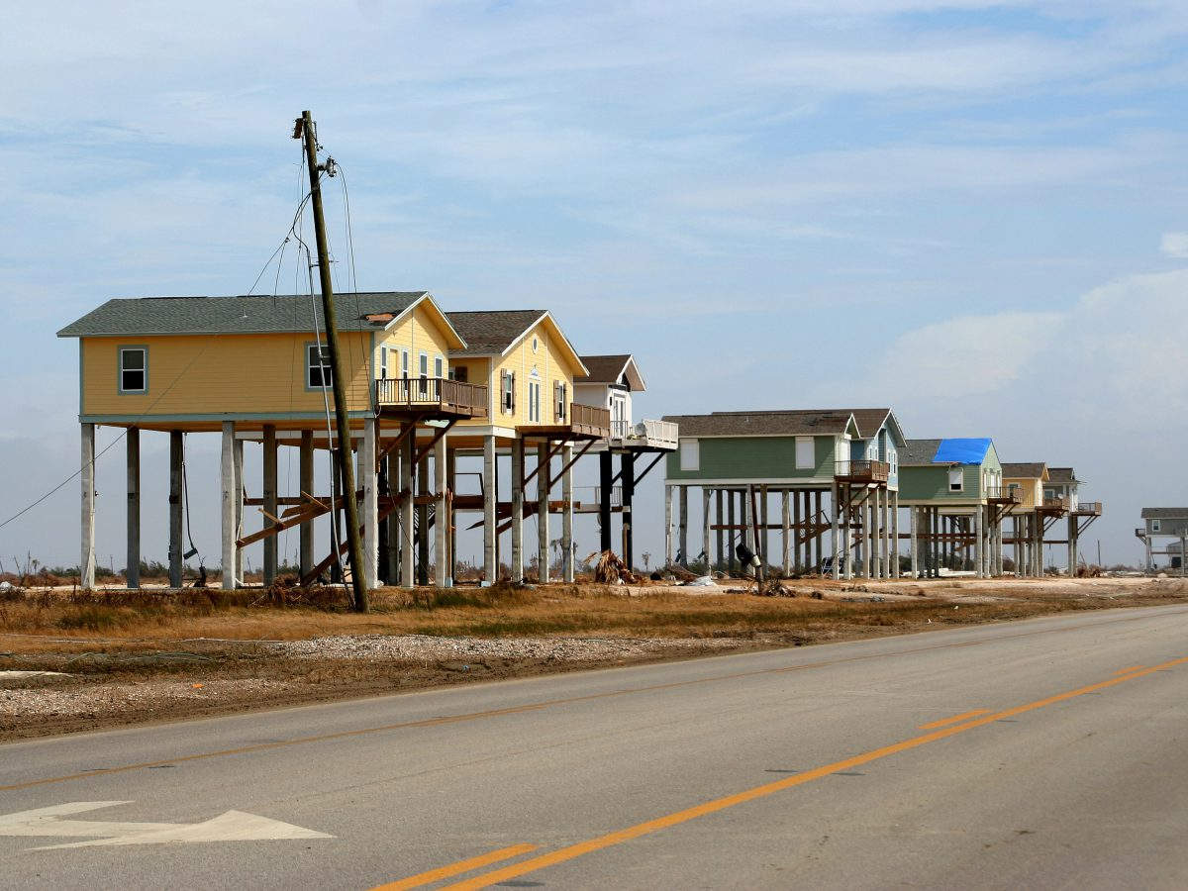
Facility elevation choice is a critical flood-relevant decision
Bolivar Peninsula, Texas (FEMA/Greg Henshall)
Notes:
Common engineering practice to consider facility elevation in design.
Changing the elevation of a structure is the most straightforward way to reduce flood risk (considering still water elevation only)

Slide 4
Presentation Overview
State of practice: how design flood elevations are selected and opportunities for improvement
Review of a non-stationary “risk of failure” approach
Showcase a hypothetical example
Application: Selecting design flood elevation considering stakeholder risk tolerance and future sea-level rise projections for a new Transit Facility in South Florida
Opportunities for improvement

Slide 5
Conventional approaches for selecting the design flood elevation
Using the locally defined Base Flood Elevation (BFE) in Special Flood Hazard Areas (SFHA)
e.g., flood elevation with 1% annual exceedance probability (AEP)
Usually with an additional safety buffer (“freeboard”)
Prescribed by the local authority having jurisdiction
Federal Flood Risk Management Standard (FFRMS)
ASCE/SEI 7-22 Flood Supplement (released May 2023)
Notes:
Freeboard may be arbitrarily chosen and not necessarily informed by sea-level rise projections
FFRMS – for federally relevant projects

Slide 6
Areas for improvement in selecting design flood elevation
Stakeholders may a desire a higher level of protection
Canonical design standards (e.g., the “100-yr event”) may not be desirable in the context of a long-lived facility
e.g., for facilities supplying essential services, such as hospitals
Account for changing hazard frequency (hazard “non-stationarity”)
Facilities can have very long lifetimes (half century or more)
No longer a 1:1 relationship between return level and return period. For example, 6 ft of coastal flooding in 2000 may have a 1% AEP, but in 2050 will have a different AEP
Notes:
Annual probabilities of floods can accumulate over time and can reach head-turning levels

Slide 7
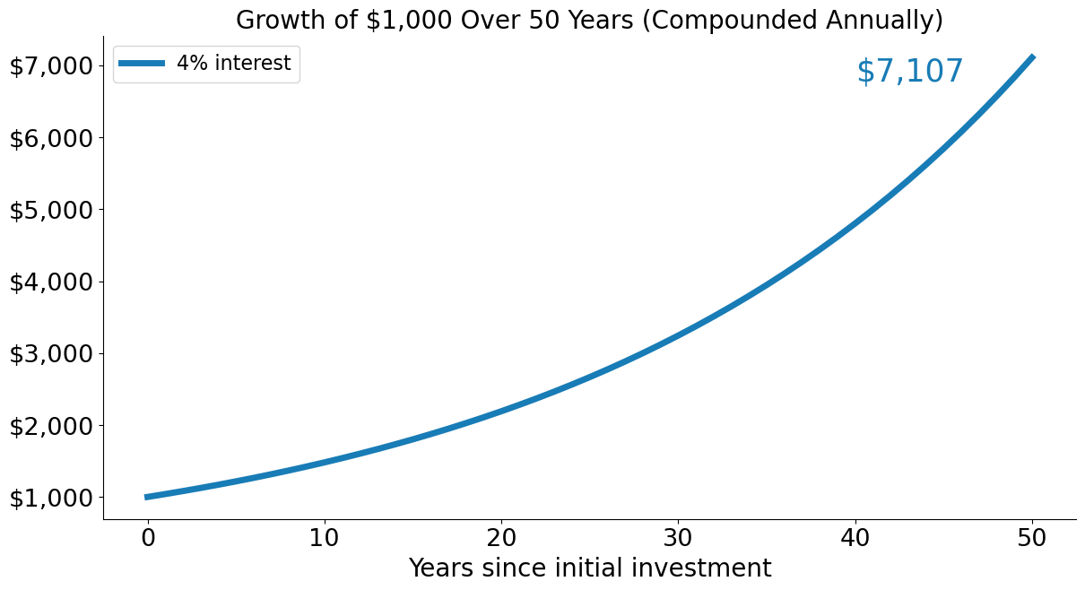
Consider the growth of $1000 at 4% interest…

Slide 8
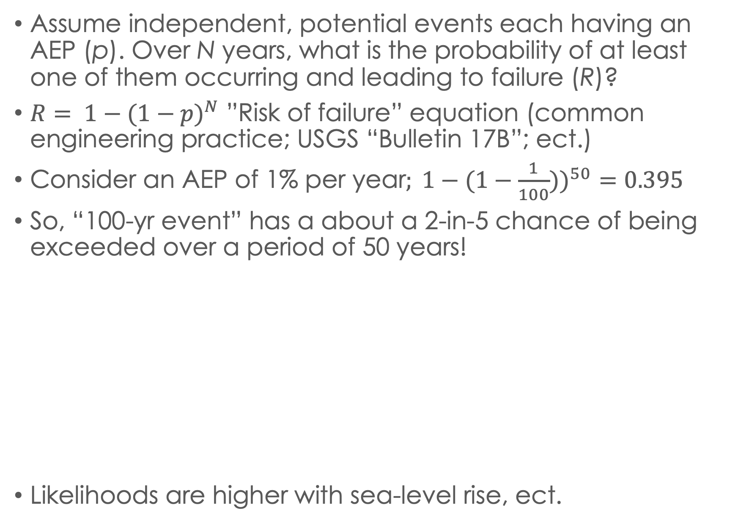
Over a long time horizon, “rare events” are likely to occur…
Assume independent, potential events each having an AEP (p). Over N years, what is the probability of at least one of them occurring and leading to failure (R)?
${R= 1−(1−p)}^{N}$ ”Risk of failure” equation (common engineering practice; USGS “Bulletin 17B”; ect.)
${\text{Consider} \text{an} \text{AEP} \text{of}\text{ 1\% }\text{per} \text{year}; 1−(1−\frac{1}{100}))}^{50}=0.395$
So, “100-yr event” has a about a 2-in-5 chance of being exceeded over a period of 50 years!
Likelihoods are higher with sea-level rise, ect.
Notes:
Accounts for cumulative probability of failure
This seems very obvious to us as practioners and researchers, but is very surprising to many

Slide 9
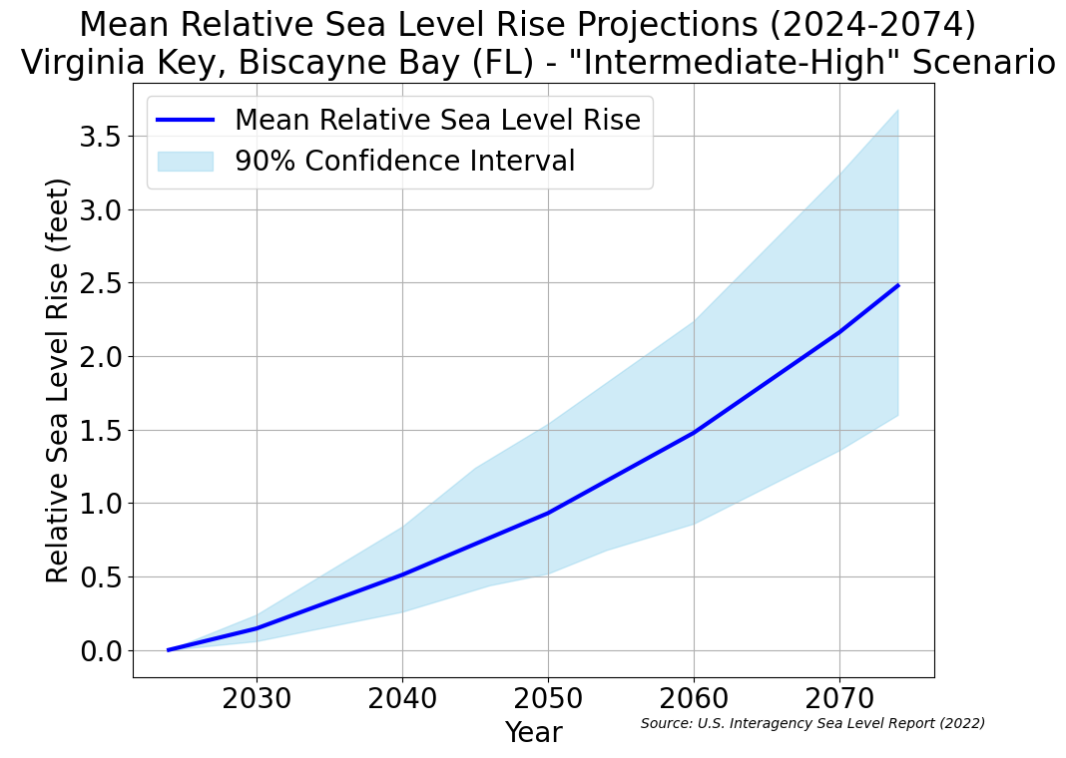
Increasing probabilities of hazards can significantly impact the likelihood of at least one exceedance over the design life (e.g., coastal flood)
Rising mean sea levels raise the baseline from which historical floods have occurred
For example, 1.6 ft to 3.6 ft of local sea-level rise in South Florida occurring over 50 years
5th /95th percentile range

Slide 10
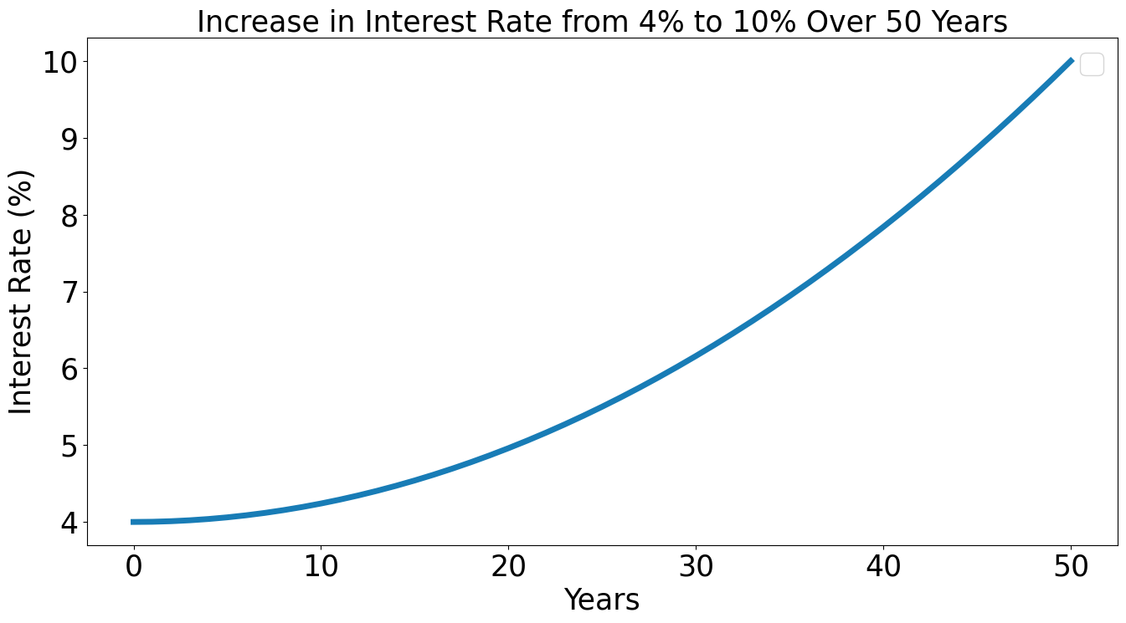
What if the interest rate grows from 4% to 10% over the 50-year time period?

Slide 11
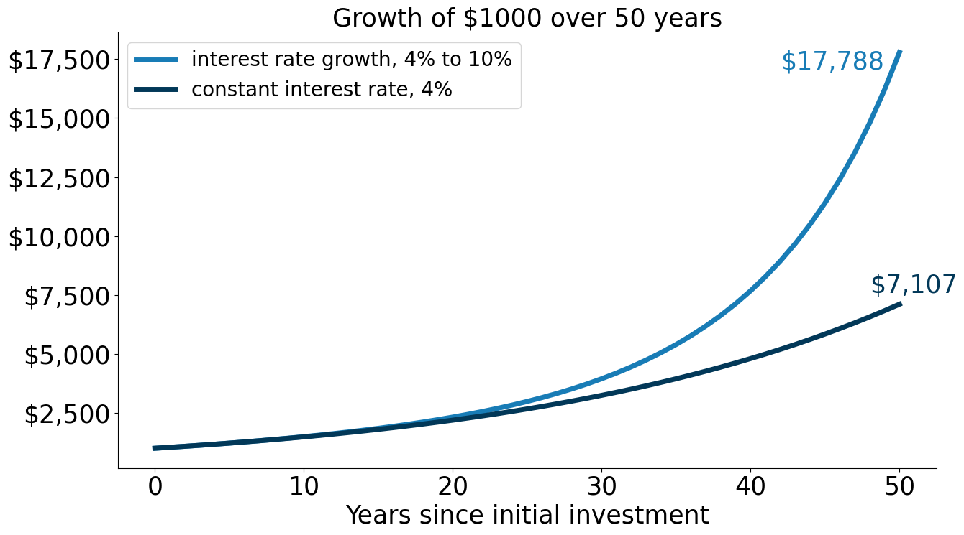
The initial investment of $1,000 grows to nearly $18,000!
+ $10,000

Slide 12
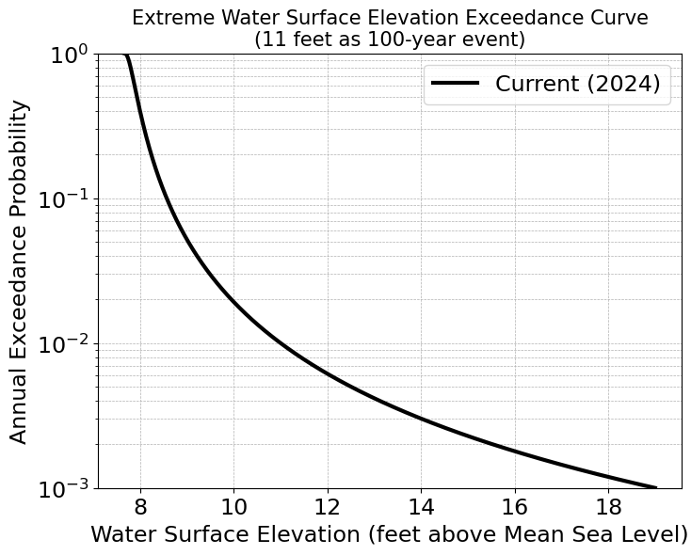
As sea-levels rise, annual exceedance probabilities increase…
Notes:
1/AEP is the return period, or average waiting time between events
Less Likely
* Values are illustrative only
Notes:
How to read this figure…. Log base 10 scale… lower frequency events are further down the y-axis.
So higher Water Surface Elevations are less common…

Slide 13
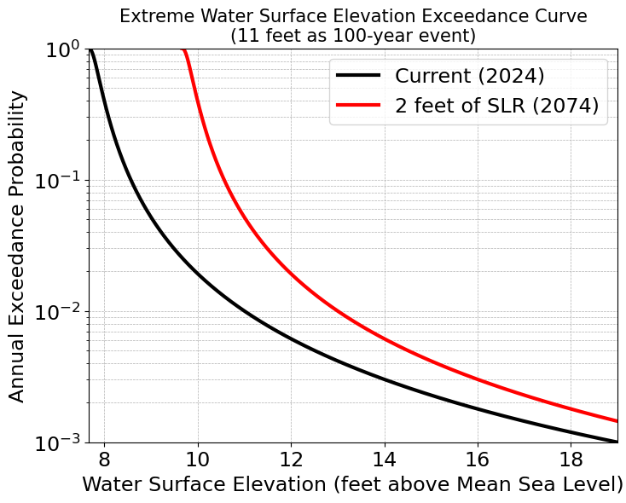
As sea-levels rise, annual exceedance probabilities increase…
Notes:
Sea-level rise increases the frequency of all water surface elevations…
* Values are illustrative only
Notes:
Assuming an additive relation between extremes and sea-level rise and no change in storm climate

Slide 14
As sea-levels rise, annual exceedance probabilities increase…
Notes:
The current 1% AEP event increase from 11 ft to 13 ft
The current 1% AEP water surface elevation become the 6% AEP event (6x more frequent)
* Values are illustrative only

Slide 15
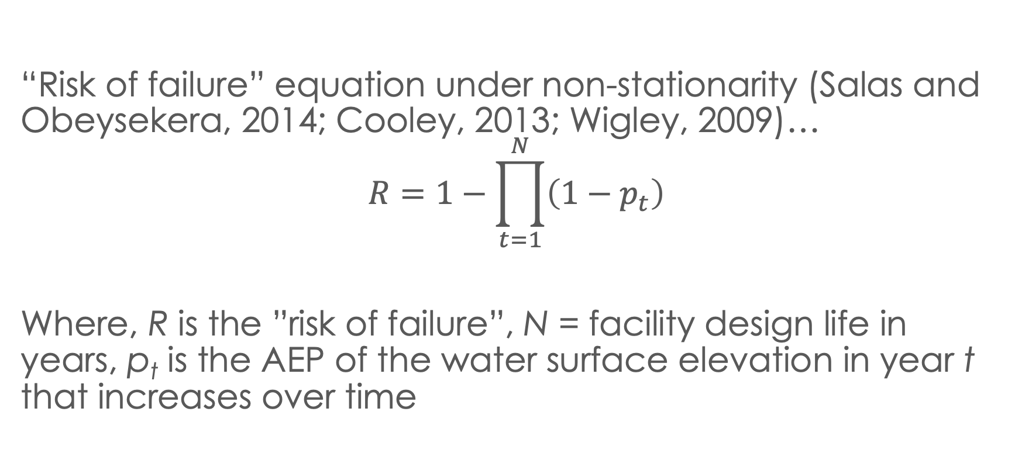
Facilities may underperform if stakeholder risk tolerance and changing hazard conditions are not incorporated
“Risk of failure” equation under non-stationarity (Salas and Obeysekera, 2014; Cooley, 2013; Wigley, 2009)…
$$R=1−\prod_{t=1}^{N}{\left(1−p_{t}\right)}$$
Where, R is the ”risk of failure”, N = facility design life in years, p_{t} is the AEP of the water surface elevation in year t that increases over time
Notes:
Similar to the earlier equation but in this case, AEP is changing with time as SLR increases

Slide 16
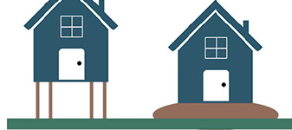
Let’s illustrate the equation with a hypothetical example…
Consider a water surface elevation of 11 feet above mean sea-level (the chosen facility elevation) that currently has a 1% AEP
Facility has a 50-year design life
Assume sea-level rise of 2 feet over 50 years
11 feet above mean sea level

Slide 17
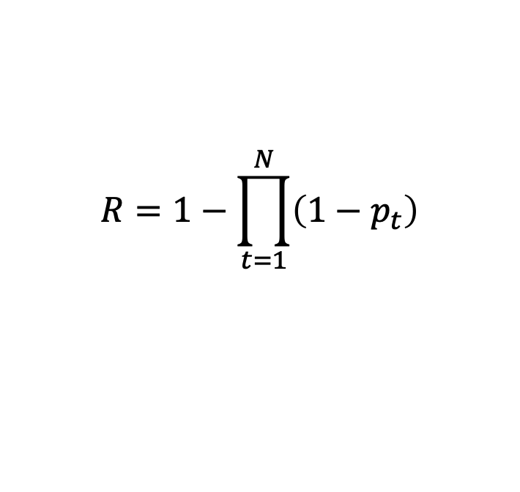
What is the probability of at least one exceedance of 11 feet over this facility lifetime?
1. Historical water surface elevation return curve
2. Sea-level rise over time
$$R=1−\prod_{t=1}^{N}{\left(1−p_{t}\right)}$$
3. “Risk of failure” equation

Slide 18
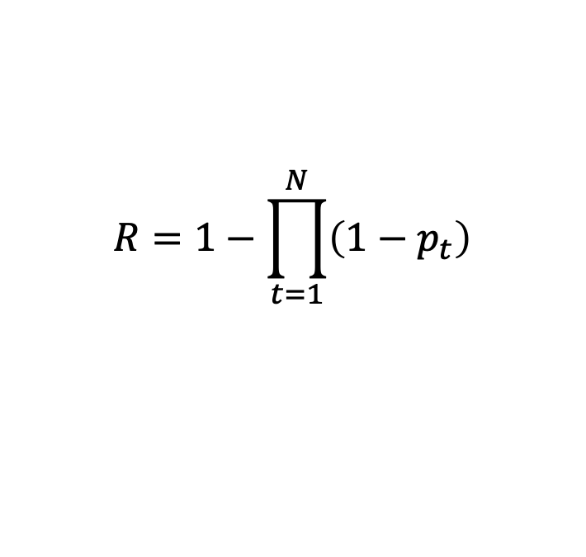
Using the “risk of failure” equation, there is roughly a 7-in-10 chance that a flood will exceed the 11 ft facility elevation over the 50-year design life!
$$R=1−\prod_{t=1}^{N}{\left(1−p_{t}\right)}$$
0.06
Facility Design Life
values of p_{t}
Multiple alternative facility elevations could be assessed to understand the “risk of failure”
0.01

Slide 19
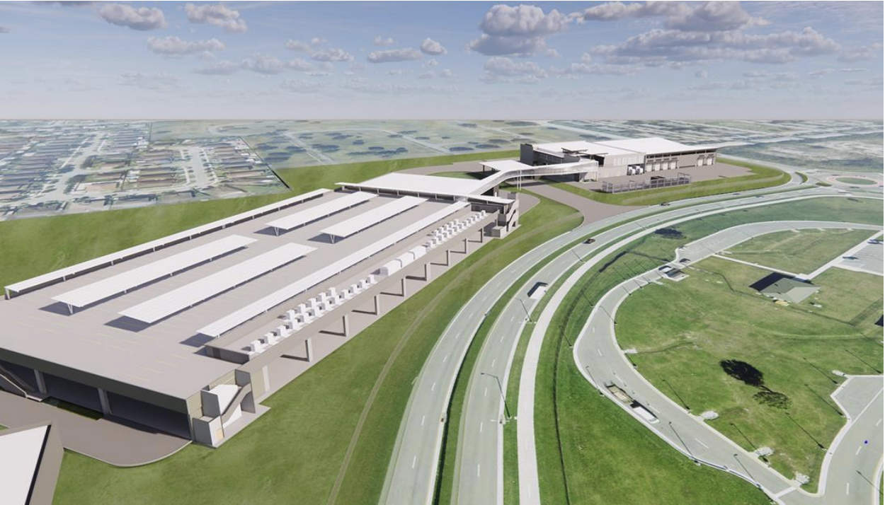
Example Application: Transit Operations and Bus Maintenance Facility in South Florida
New construction, 50-year life (ending in 2070s)
Plan to store 100 electric busses during a hurricane
Developed a menu of “risk of failure” probabilities for the facility over its intended useful life
Client selected a design elevation that met their desired risk tolerance
Notes:
Framework was applied to a real-world project.
To protect client information, the proceeding elevations and probabilities are illustrative only.

Slide 20
Approach
For multiple plausible facility design elevations, estimate the probability of at least one exceedance over the facility design life
Multiple plausible design elevations
Determine this information…
* To ensure client confidentiality, values are illustrative only

Slide 21
Approach
Determine this information…
* To ensure client confidentiality, values are illustrative only
For each facility design elevation, determine the AEP of over time under a single sea-level rise curve
Use non-stationary “risk of failure” equation to get probability of flooding at least once over 50-yr facility lifespan

Slide 22
Data sources
Storm surge modeling from USACE South Atlantic Coastal Study (SACS)
Still water surface elevations (several return periods)
Neglected wave action and erosion (facility was inland)
One sea-level rise scenario
2.7 ft of local sea-level rise (incl. non-linear interactions)
Local sea-level rise projections (U.S. Government Interagency Report, 2022)
Projections from nearest tide gauge (Virginia Key/Biscayne Bay, Florida)
”Intermediate-High” scenario (4.9 ft of global mean sea-level rise by 2100)
Notes:
”Intermediate-High” --> a rather pessimistic SLR scenario

Slide 23
Results
* To ensure client confidentiality, values are illustrative only
Client subsequently selected a facility floor elevation from the table, weight risk tolerance with additional costs
Notes:
This seems very obvious to us as practioners and researchers, but is very surprising to many

Slide 24
Results
Chosen design elevation
* To ensure client confidentiality, values are illustrative only
Client subsequently selected a facility floor elevation from the table, weight risk tolerance with additional costs

Slide 25
Summary
Canonical flood return periods used for design can have a noteworthy likelihood of exceedance over a long lifetime (e.g., designing to the current 1% AEP)
Stakeholders may desire a higher level of protection
Existing non-stationary engineering tools facilitate estimates of “risk of failure” over the facility design life
Tabulating alternative risk levels facilitates more informed design flood elevation selection for stakeholders

Slide 26
Other opportunities
Consideration of uncertainty in flood frequency and sea-level rise
Only consider 2.7 ft of sea-level rise, but other amounts possible
Sea-level rise allowances frameworks set design flood elevation and incorporate uncertainty in the timing of sea-level rise and in the frequency of water surface elevations (e.g., Hunter, 2012; Buchanan et al., 2016)
Notes:
There’s still the concern of designing to one number that is within a range of the true value, but probably not the exact right number. Considering the uncertainty range is one approach to deal with this.

Slide 27
Other opportunities
Account for the impact of a flood events (what gets wet and what are the associated consequences?)
E.g., employing flood vulnerability/fragility functions to link flood depth to damage
Other flood sources
e.g., consideration of local stormwater flooding

Slide 28
Summary
Canonical flood return periods used for design can have a noteworthy likelihood of exceedance over a long lifetime (e.g., designing to the current 1% AEP)
Stakeholders may desire a higher level of protection
Existing non-stationary engineering tools facilitate estimates of “risk of failure” over the facility design life
Tabulating alternative risk levels facilitates more informed design flood elevation selection for stakeholders

