Slide 1


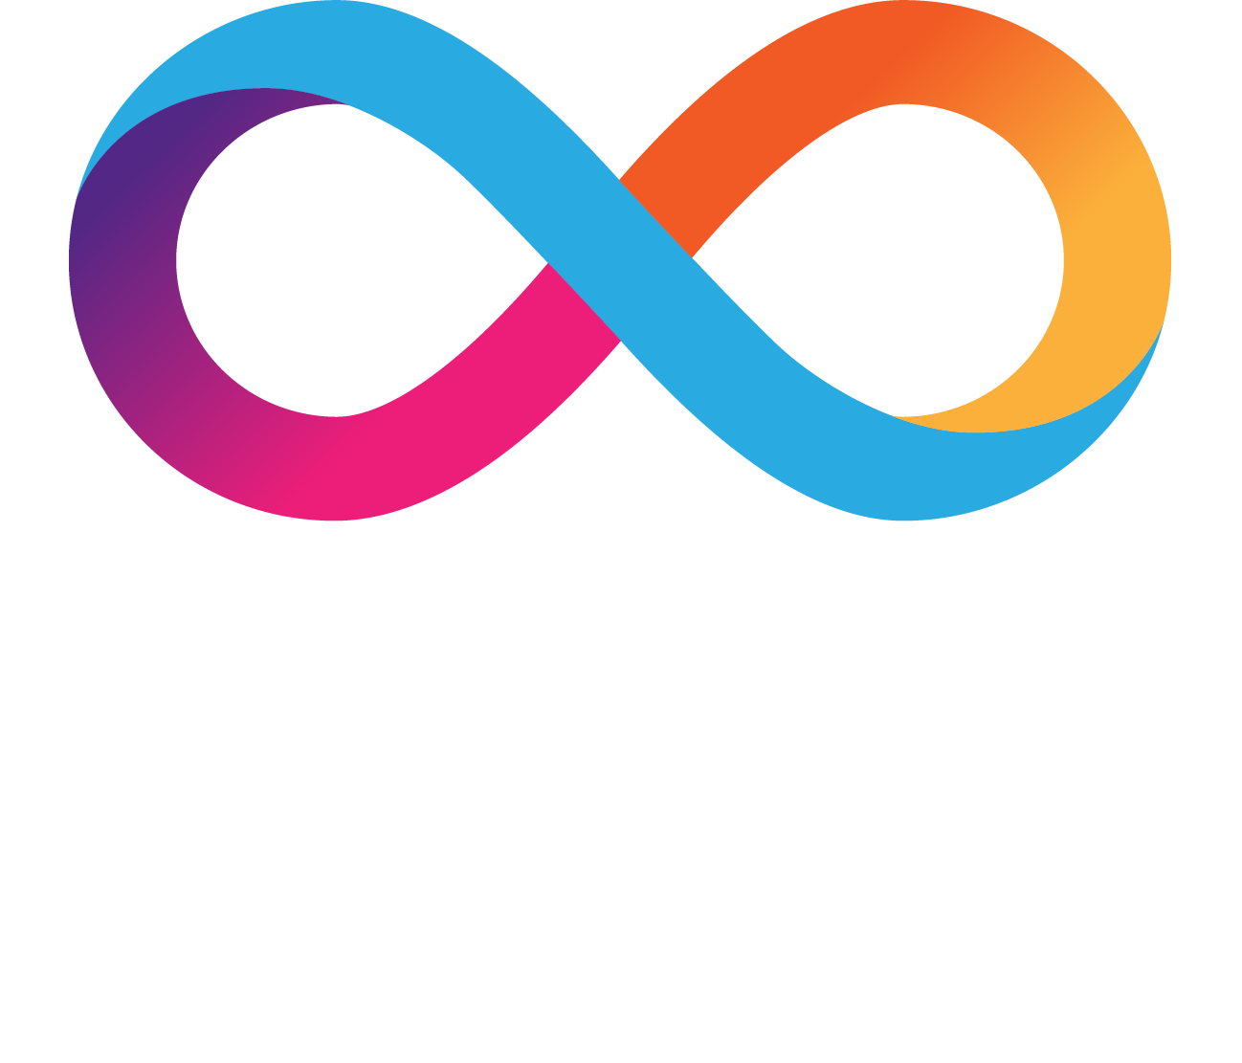
BitUnity
Cross-Chain Asset Management

Slide 2
What is Cross-Chain Asset Managment?
Cross-chain asset management refers to the practice of managing and transferring digital assets across different blockchain networks seamlessly. In the blockchain and cryptocurrency space, various platforms operate on distinct blockchain protocols, each with its own set of rules and standards. Cross-chain asset management addresses the challenges associated with interoperability between these diverse blockchain networks.

Slide 3
What BitUnity try to solve?
BitUnity addresses the fragmentation and complexity in managing digital assets across multiple blockchains by providing a unified and user-friendly cross-chain asset management platform integrated with Bitfinity's EVM compatibility, streamlining asset deployment, and enhancing overall portfolio management.

Slide 4
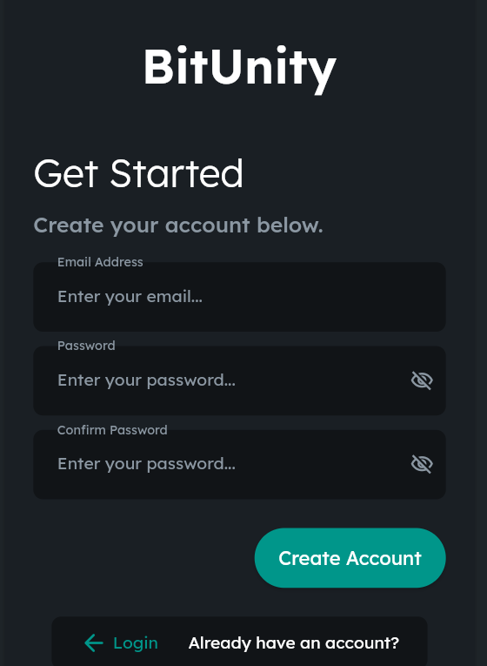

Slide 5
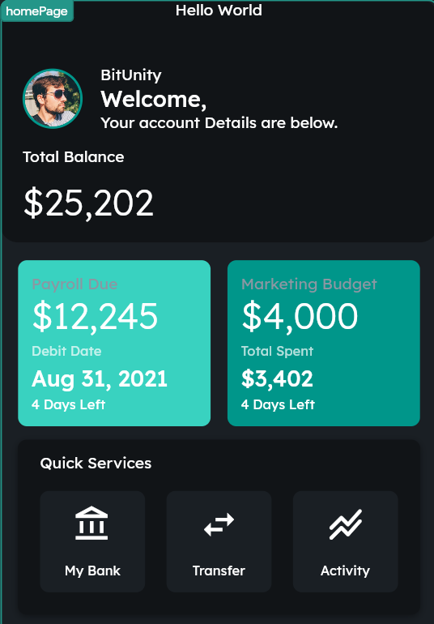

Slide 6

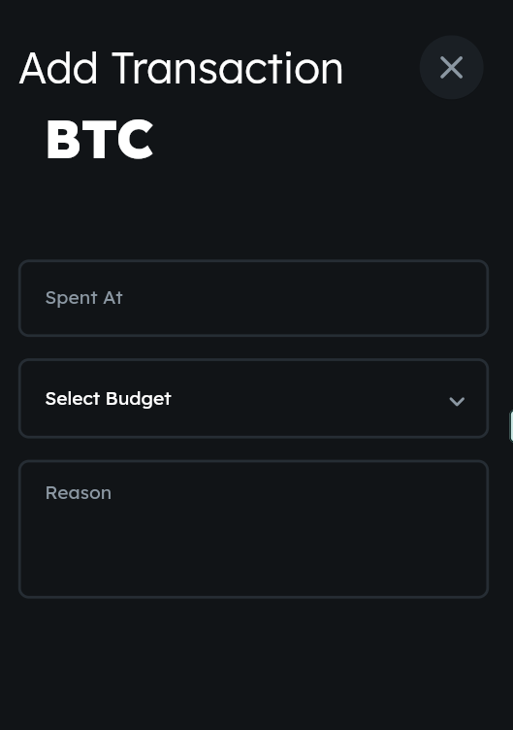

Slide 7
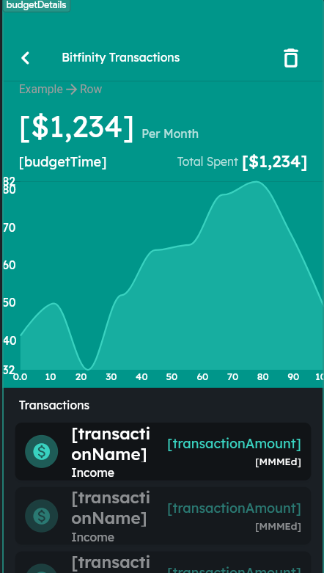

Slide 8
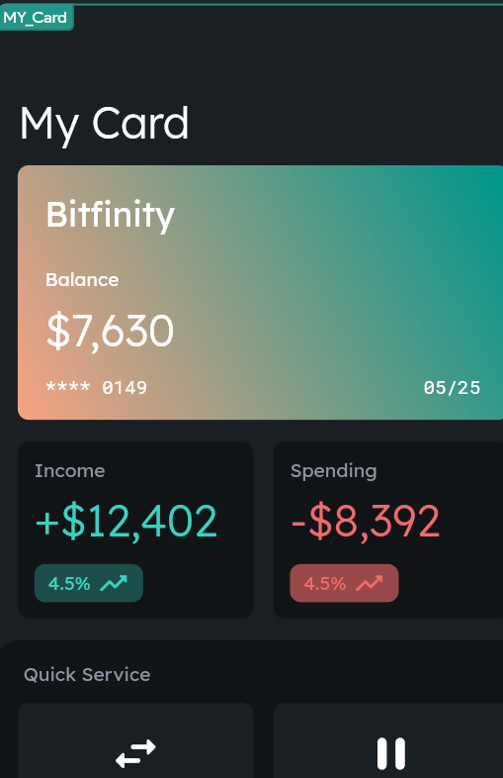

Slide 9
Thank you
https://github.com/arhansuba/BitUnity/tree/main/default_workspace%202

