Slide 1



In-Vehicle Payment System
The mobile application that facilitates the purchase of fuel through cryptocurrency payments

Slide 2
Problem Statement
At gas stations, traditional payment methods during fuel purchases require drivers to get out of their vehicles to make payments, causing a loss of time and dissatisfaction among users. This process also limits the stations' ability to provide quick service. Furthermore, these methods increase the use of paper receipts, leading to paper waste. Alternative solutions like digital payment systems, however, eliminate these problems, allowing users to manage their time and environmental resources more efficiently.

Slide 3
Our solution
To overcome this problem and make the payment process during fuel purchases more efficient for users, a mobile application could be developed. This app allows users to make payments with cryptocurrency without getting out of their vehicles or going to the cashier. Additionally, it can monitor the congestion at gas stations, access past orders, and earn non-fungible tokens (NFTs) when certain payment limits are reached.

Slide 4
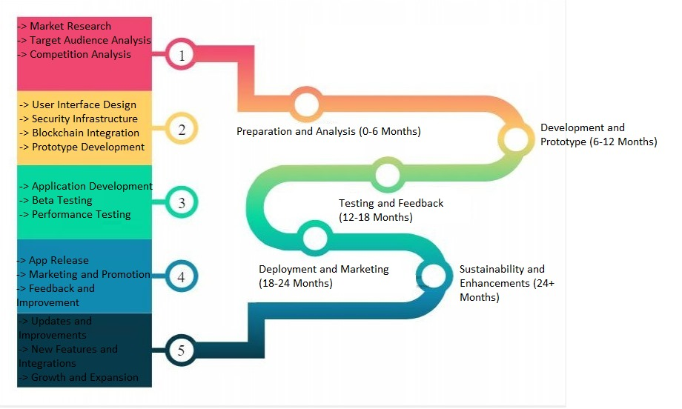
Roadmap

Slide 5
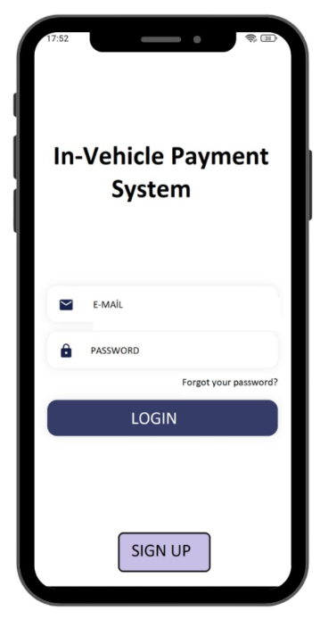
Login Screen
It's an interface where users access the system with their email addresses and passwords. This interface allows users to authenticate their identity to log in to the platform. Users don’t need to log in again for subsequent actions as long as they haven't logged out of the application.

Slide 6
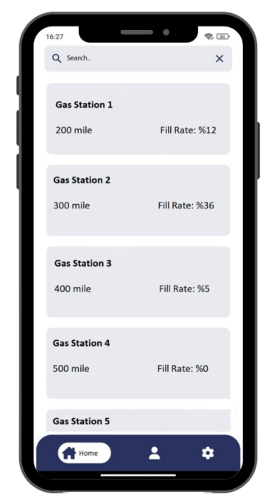
Gas Station Information
It provides users with an interface where they can see nearby gas stations based on their locations and check the congestion status of these gas stations.

Slide 7
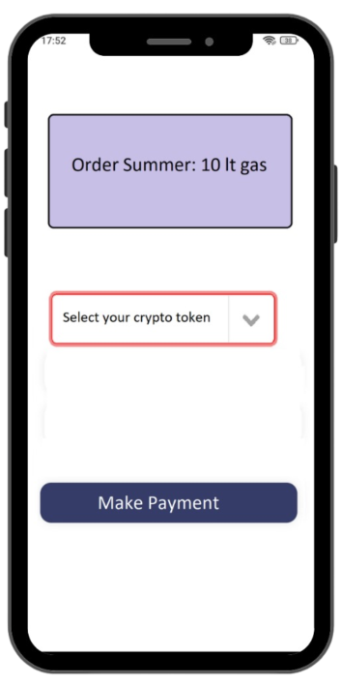
Payment Screen
Users can make payments using the services offered by the blockchain using their preferred cryptocurrency. When the payment is completed, users will have purchased gasoline equivalent to the specified amount.

Slide 8
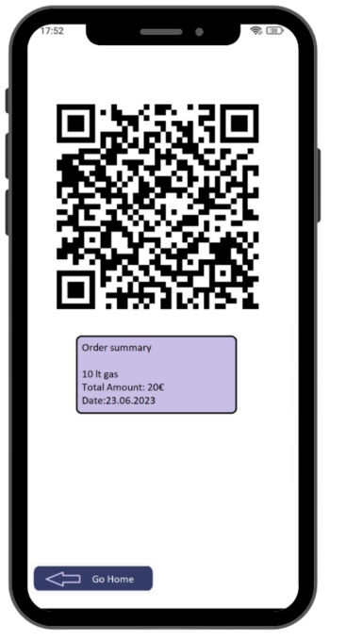
QR Code Screen
Users automatically receive a unique QR code specific to their payment transactions. This QR code contains information such as the amount of gasoline purchased (in liters), the transaction amount, and the date of the transaction. Gas station attendants complete the user's fuel filling process by scanning this QR code.

Slide 9
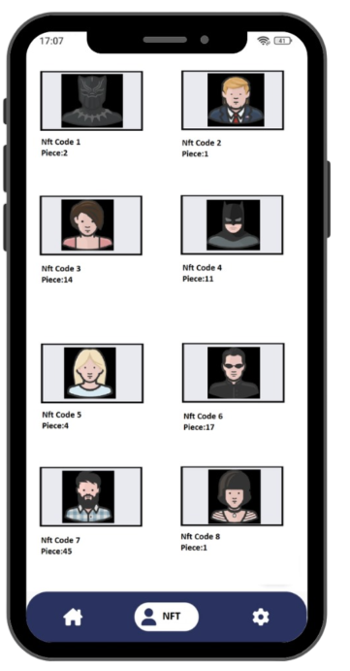
Nft Screen
It provides an interface where users can view the NFTs they have accumulated from their previous purchases. Users can review their collected NFTs, see details about them, and have the option to sell any NFT they wish. This screen allows users to manage their digital collections

Slide 10
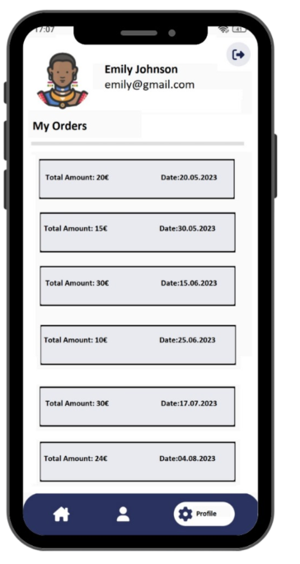
Profile Screen
It's an interface where users can view details of their past purchases. This interface shows the user's previous gasoline purchase amount, the price, and the date of purchase. Additionally, users can log out using this screen.

Slide 11



Team members
Murat Dal
Hasan Ayas

Slide 12
Thank you

