Slide 1
Oil Blend Optimization (Maximize Oil Company Profit)
Sumeet Parashar, Technical Specialist – IBM Data Science and Decision Optimization

Slide 2
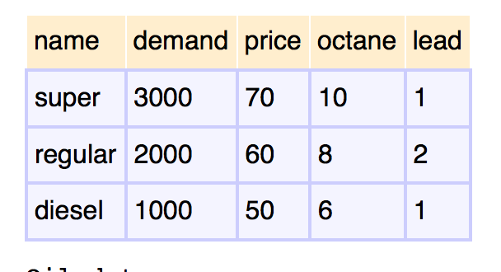
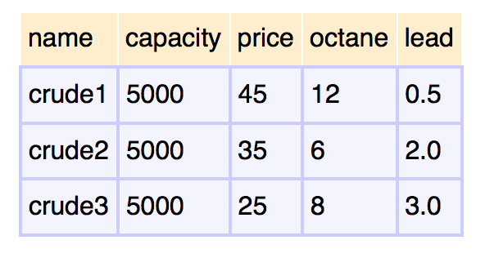
Problem Statement
Given: Oil company manufactures different types of gasoline and diesel by blending different types of crude oils
Gas Data
Oil Data
Objective: maximize profit.
Decide: decide how much crude oil to buy
Constraints:
Meet demand; Octane level; Lead restrictions
Company can only purchase 5,000 barrels of each type of crude oil per day
Company can process at most 14,000 barrels a day.
 | Super | Regular | Diesel
Crude 1 | x | x | x
Crude 2 | x | x | x
Crude 3 | x | x | x

Slide 3
Problem Statement
Additional Variables and Constraints:
The company has the option of advertising a gasoline, which increases the demand for this type of gasoline by ten barrels for every dollar spent.
Decision Variable: How much to spend on each product promotion

Slide 4
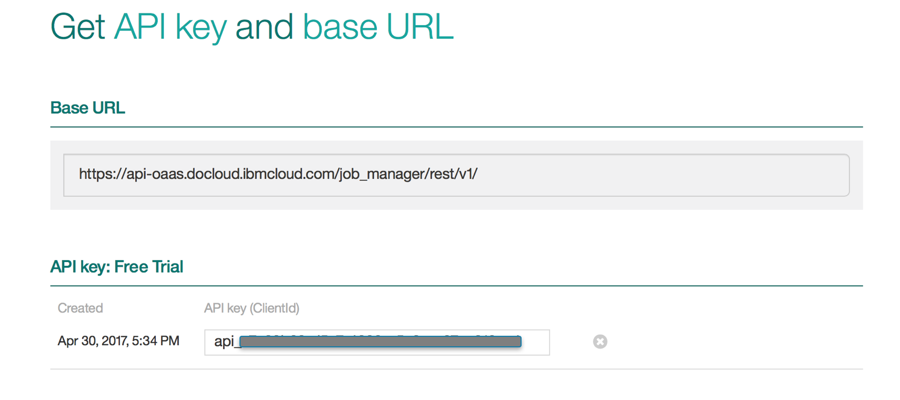
DOcplexCloud: url and API key

