Slide 1
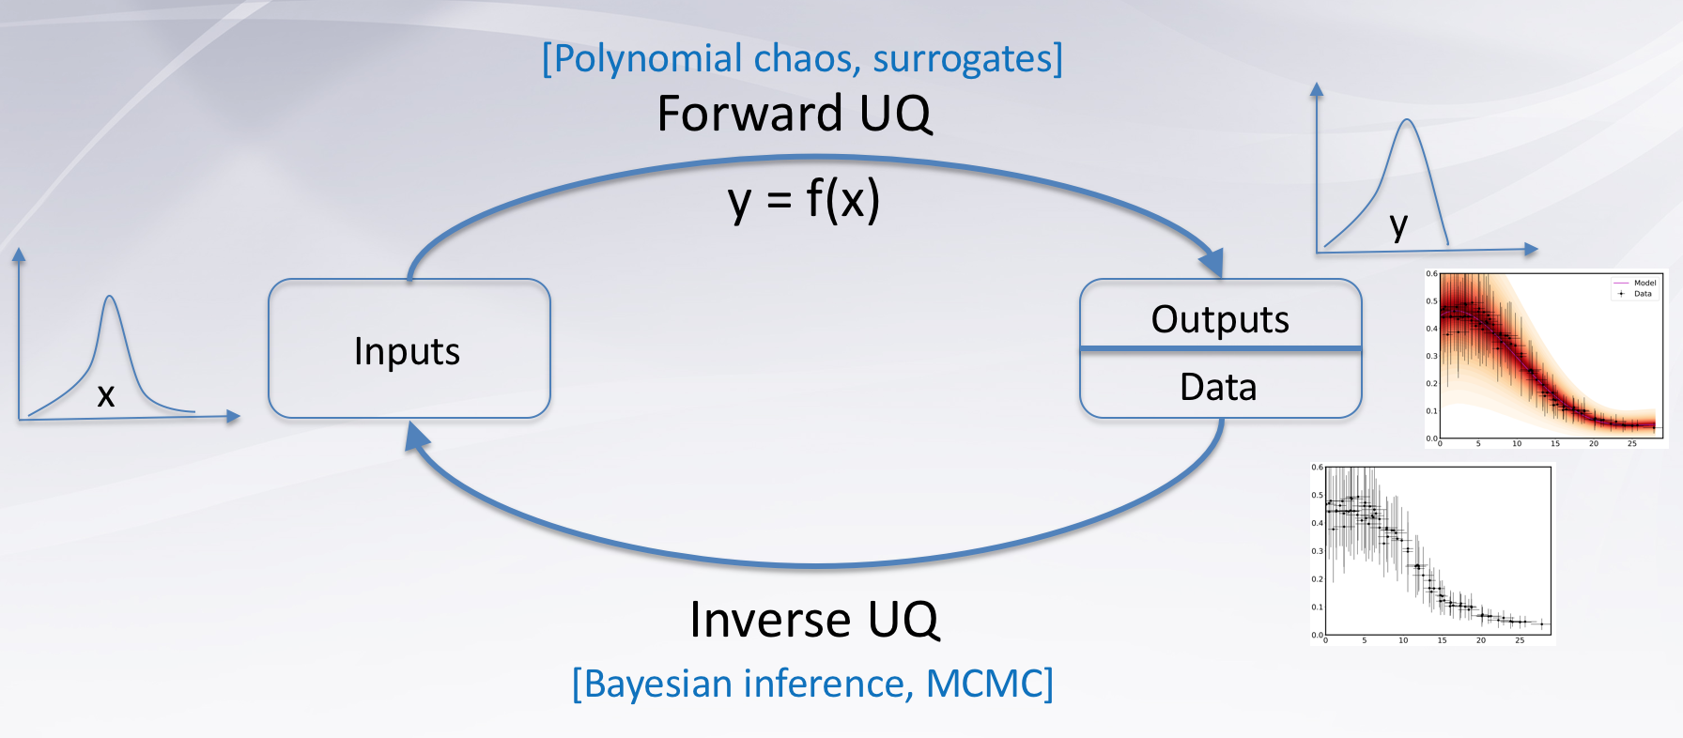
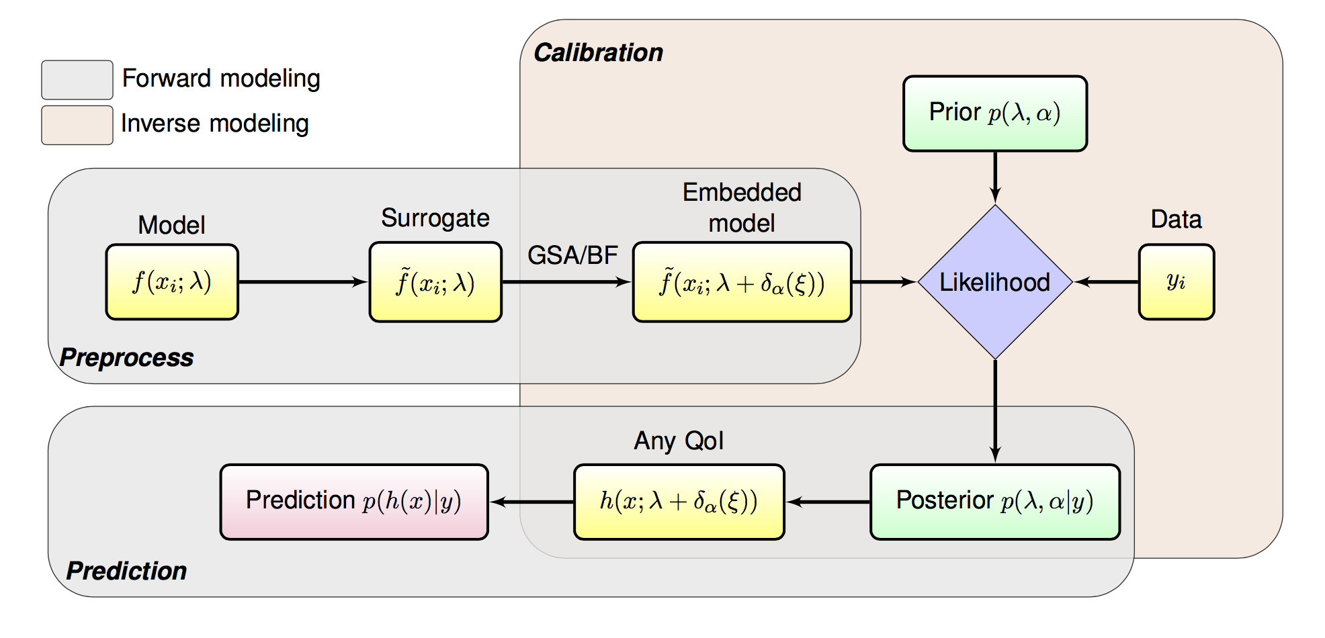
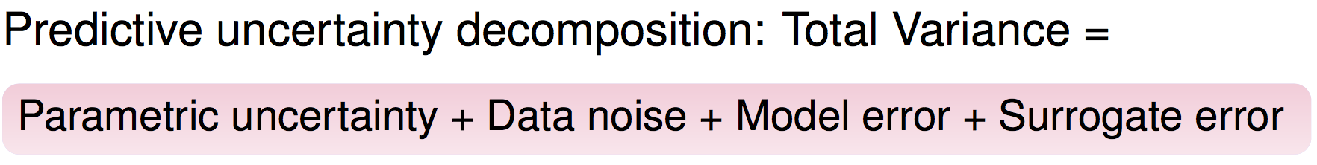
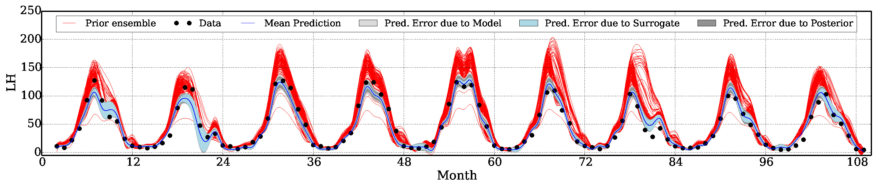



Overview of Uncertainty Quantification (UQ)
Methods for Complex Models
Khachik Sargsyan (SNL-CA), Cosmin Safta (SNL-CA), Daniel Ricciuto (ORNL)
UQ Components
UQ Workflow
Surrogate construction
Perturbed parameter ensemble
Prior predictive distribution
Global sensitivity analysis
Dimensionality reduction
Model structural error embedding
Model correction
Can be non-intrusive!
Respects physics
Disambiguated with data error
Calibration/tuning
Bayesian inference
Adaptive Markov chain Monte Carlo
Posterior analysis and model selection
Prediction
Posterior predictive
Output uncertainty decomposition
Forward UQ
Given input parameter uncertainty,
find output QoI distributions
Uncertainty propagation, model surrogate construction
… otherwise called emulator, proxy, metamodel, response surface
Global Sensitivity Analysis (GSA):
variance-based decomposition,
Sobol sensitivities
Major challenges
Large number of input parameters
(curse of dimensionality)
Strong nonlinearities of input-output maps
Expense of forward simulations
Main tools
Polynomial Chaos surrogates are ideally fitted for parameter uncertainty propagation and surrogate construction, also providing free access to GSA
Weighted Iterative Bayesian Compressive Sensing (BCS) builds accurate surrogate models adaptively to enable forward UQ for large number of inputs and few forward simulations
Inverse UQ
Given experimental/observational data,
find input parameter distributions
… otherwise called calibration, tuning, parameter estimation
Major challenges
Large number of input parameters (curse of dimensionality)
Physical constraints, identifiability, data scarcity
Model structural errors
Main tools
Bayesian calibration is well-suited for accounting uncertainties from various sources, e.g. observational noise, parametric uncertainties, internal stochasticity
Internal model error embedding approach to enable structural error representation and quantification, followed by accurate predictions (even extrapolatory!) with fair assessment of all sources of uncertainty, including structural errors
Selected ELM Results
GSA for gross primary productivity (GPP) at 96 FLUXNET sites, grouped by PFTs
GSA for latent heat flux (LH) at the Missouri Ozark flux tower, showing monthly changes in sensitivities over a 3-year period
Main and joint sensitivities for Harvard Forest site
Results from a calibration of monthly latent heat flux data at the Missouri Ozark flux. This calibration method partitions posterior uncertainties into errors from the surrogate model representation, posterior uncertainty and model error.
Software
References
git clone git@github.com:ACME-Climate/Uncertainty-Quantification.git
Python interface to UQTk v3.0 (www.sandia.gov/uqtoolkit)
Full workflow is non-intrusive, i.e. model runs as a black-box
D. Ricciuto, K. Sargsyan, P. Thornton, The impact of parametric uncertainties on biogeochemistry in the ACME land model. Journal of Advances in Modeling Earth Systems, 10(2), p. 297-319, 2018.
K. Sargsyan, H. N. Najm, R. Ghanem, On the statistical calibration of physical models, International Journal for Chemical Kinetics, 47(4), p.246–276, 2015.
K. Sargsyan, C. Safta, H. Najm, B. Debusschere, D. Ricciuto, P. Thornton, Dimensionality reduction for complex models via Bayesian compressive sensing, International Journal for Uncertainty Quantification, 4(1), p.63-93, 2014.
e3sm.org
For additional information, contact:
Khachik Sargsyan
Principal Member of Technical Staff
Sandia National Laboratories
(925) 294-4885
ksargsy@sandia.gov

