Slide 1
Approximate ECC via Feistel-Permuted CRC Hashing
Burst resilience and overhead scaling for AI accelerator memory
Research Presentation · 2026
Notes:
Lead with burst immunity — that is the primary contribution.

Slide 2
Motivation: Two Kinds of DRAM Errors
AI accelerators store model weights in HBM/DRAM — soft errors corrupt inference silently
▸ Modern AI accelerators (A100, H100, TPU) keep billions of weight parameters in DRAM
▸ Soft errors occur at rates of 10⁻⁶–10⁻³ per bit per hour — high enough to matter at scale
▸ Two physically distinct failure modes require different protection:
Random errors
Burst errors
Cosmic rays / alpha particles Isolated, uniformly scattered bits
Row-hammer / retention failures Contiguous run of corrupted bits
0 1 0 1 1 0 0 1 0 0 1 0 0 0 1 0 0 1 0 0 0 1 0 0 1 0 0 0 1 0 0 1 0 0 0 1
0 1 0 1 1 0 0 1 0 0 1 0 0 0 ■ ■ ■ ■ ■ ■ 0 1 0 0 1 0 0 0 1 0 0 1 0 0 0 1
No single existing code handles both cheaply — you must choose one or deploy two separate systems.
Notes:
Motivate the need — existing ECC is designed for one model. BCH assumes BSC (random). RS is symbol-based (burst). Neither is free.

Slide 3
Why BCH Fails on Burst Errors
BCH is designed for the Binary Symmetric Channel — independent random errors
20-bit burst
4096-bit data block (16 × 256-bit BCH sub-blocks, each correcting t = 19 random bits)
B0
B1
B2
B3
✗ FAIL >19 bits in block
B4
B5
B6
B7
B8
B9
B10
B11
B12
B13
B14
B15
256 bits t=19
256 bits t=19
256 bits t=19
256 bits t=19
256 bits t=19
256 bits t=19
256 bits t=19
256 bits t=19
256 bits t=19
256 bits t=19
256 bits t=19
256 bits t=19
256 bits t=19
256 bits t=19
256 bits t=19
256 bits t=19
▸ A 20-bit burst hits B3–B4, putting 20 errors into block B3 alone (t = 19 → uncorrectable)
▸ BCH has no way to redistribute the burst — each block decodes independently
▸ BCH corrects t random bits per block; burst errors concentrate in one block and exceed t immediately
▸ Interleaving can help — but requires reordering all data before write and after read (latency cost)
Notes:
Key: BCH's independence assumption is violated by burst. Each block decodes alone.

Slide 4
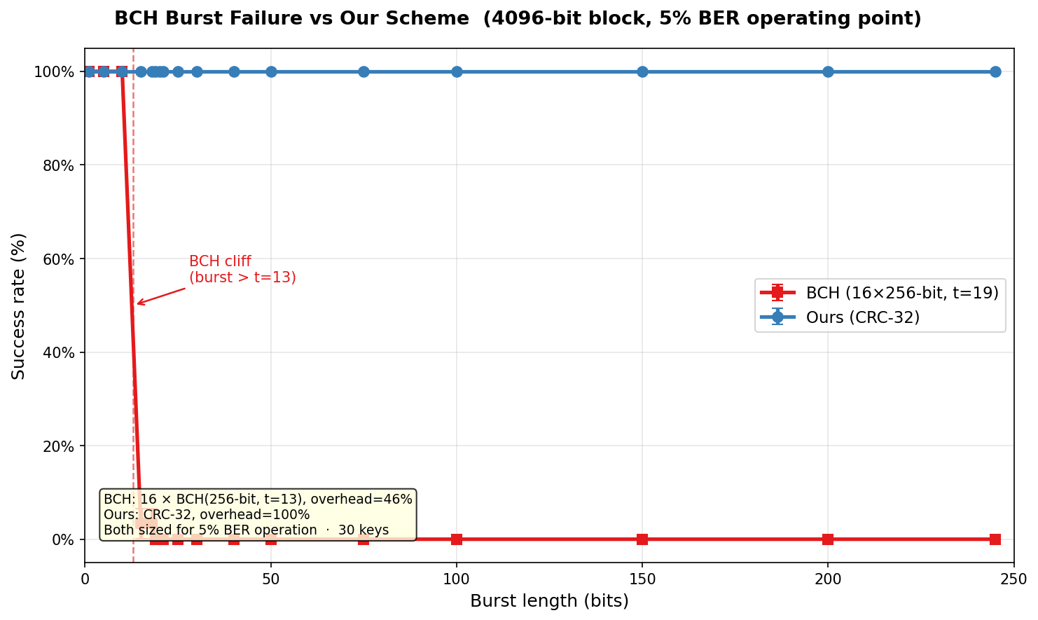
BCH Burst Failure — Empirical Confirmation
BCH(256-bit blocks, t=13) vs our scheme — success rate vs contiguous burst length
BCH collapses the moment burst length exceeds t per block. Our scheme stays at 100% success across all burst lengths tested.
Notes:
The cliff at t=13 is sharp — this is a hard mathematical boundary, not gradual degradation.

Slide 5
Our Approach: Feistel-Permuted CRC Hash DAG
A single scheme that handles both error types via uniform bit redistribution
① Feistel Permutation
Key Insight
Map source bits onto an N×N grid via a keyed Feistel shuffle
The Feistel permutation scatters contiguous burst bits uniformly across the 2D grid. From the solver's perspective, burst errors are indistinguishable from random errors. This means one scheme — one overhead budget — corrects both error patterns.
② CRC Hash Nodes
Compute CRC-8/16/32 over each row and column group
③ Hash DAG
Build constraint graph: edges between overlapping nodes
④ DAG-Guided Solver
Enumerate flip combinations until all hashes agree
Overhead = 2 × HASH_BITS / √L BER-independent — set once at deployment
Notes:
The Feistel permutation is the mechanism. Without it, burst errors cluster in one row/column and overwhelm that node.

Slide 6
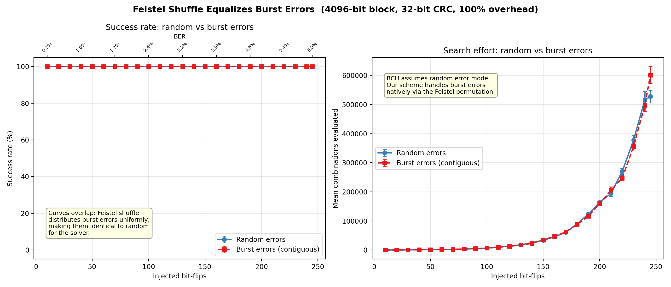
Empirical Proof: Burst Errors = Random Errors
4096-bit block, CRC-32, 100% overhead — success rate and solver effort vs injected flip count
Both curves overlap exactly across all flip counts. The Feistel permutation eliminates any distinction between burst and random for our solver.
Notes:
This is the central empirical result. The overlap is exact — not approximate.

Slide 7
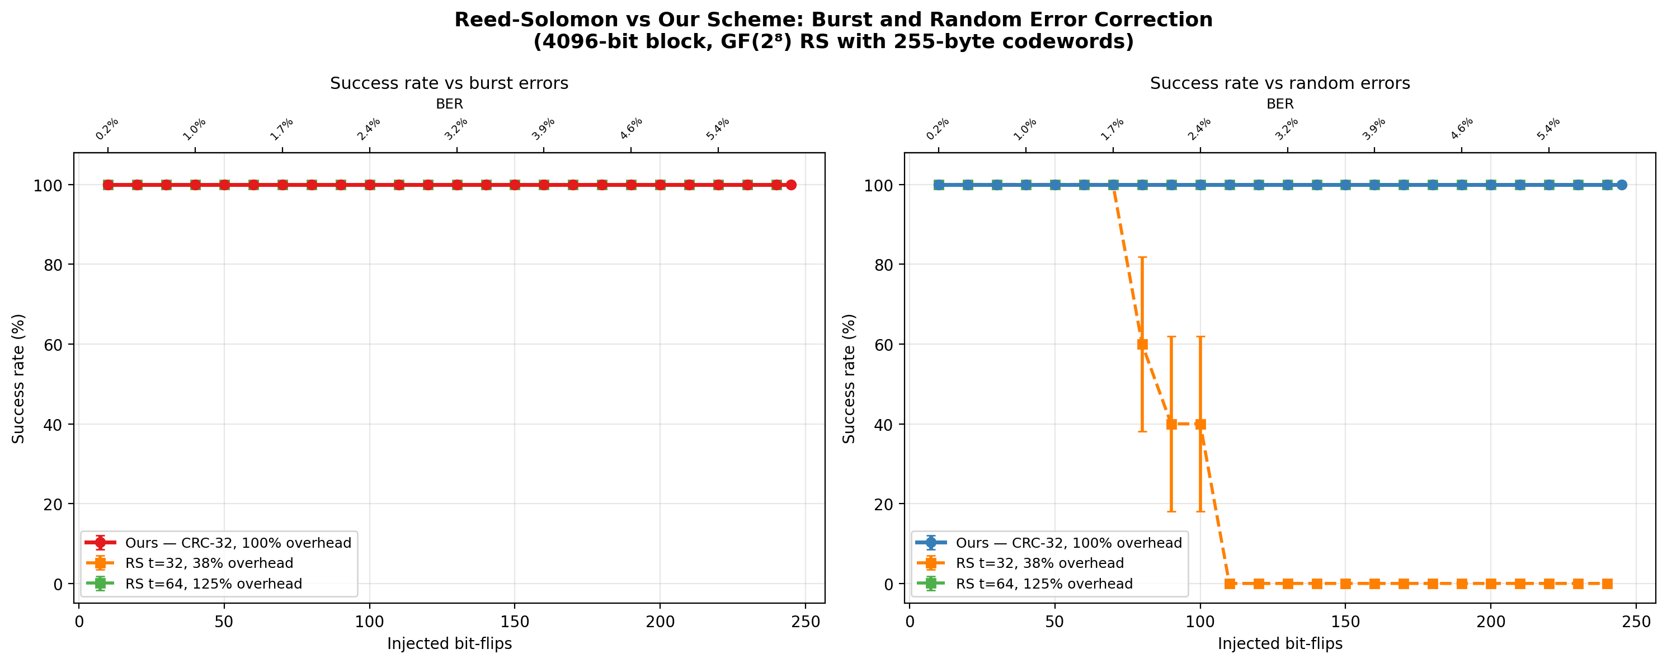
Reed-Solomon Comparison: Burst vs Random
RS over GF(2⁸), 255-byte codewords — empirical success rate at two overhead levels
RS at 38% overhead handles burst but collapses on random. At 125% overhead RS handles both — but costs more than our 100% overhead scheme.
Notes:
RS is symbol-based: cheap for burst (contiguous bits hit few symbols) but expensive for random (39% symbol error rate at 6% BER).

Slide 8
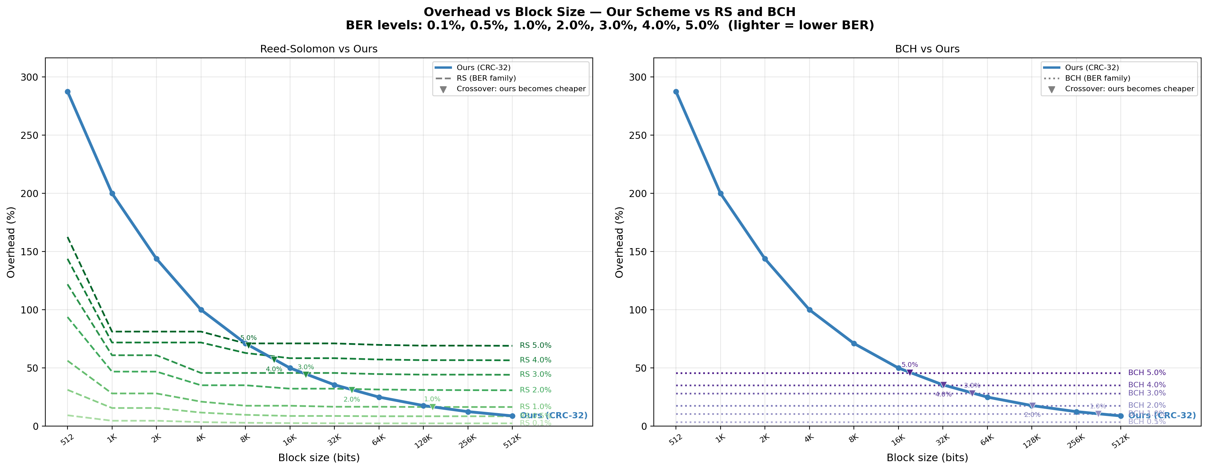
Overhead vs Block Size — All Schemes, All BER Levels
Left: RS vs Ours · Right: BCH vs Ours · Each BER level shown (lighter = lower BER)
Our O(1/√L) overhead beats RS (for equal correction) above ~7K bits, and BCH above ~15K bits. Crossover shifts left at higher BER.
Notes:
BCH is flat because it tiles at the natural 256-bit codeword. RS starts high because small data underfills the larger 2040-bit natural codeword.

Slide 9
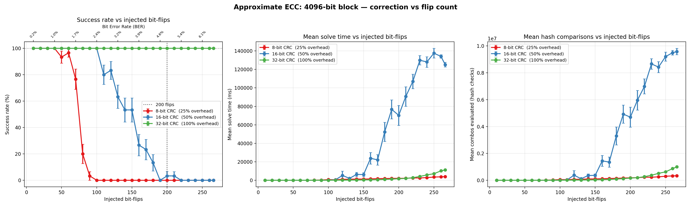
Correction Capability vs Flip Count
4096-bit block — success rate, solve time, and hash checks for CRC-8/16/32
CRC-32 (100% overhead) corrects 200+ bit flips at 100% success. CRC-16 (50%) handles ~100 flips. CRC-8 (25%) handles ~60 flips.
Notes:
Show the three operating points. The 32-bit config is the comparison point for RS and BCH slides.

Slide 10
Contribution Summary
Single scheme that handles both error types with sub-linear overhead growth
Scheme | Burst errors | Random errors | Overhead at 6% BER | Scales O(1/√L)
BCH | ✗ Fails | ✓ 53% overhead | 53% (flat) | ✗
RS | ✓ 38% overhead | ✓ 125% overhead | 38–125% (flat) | ✗
Ours ✦ | ✓ 100% overhead | ✓ 100% overhead | 100% → shrinks with L | ✓
▸ BCH is cheaper for random at small blocks — but completely blind to burst errors
▸ RS handles burst cheaply — but random errors cost 3× more due to symbol granularity
▸ Our scheme pays the same overhead for both, and that overhead shrinks as L grows
▸ Above ~7K bits: our scheme is cheaper than RS for equal correction. Above ~15K bits: cheaper than BCH.
Notes:
Emphasize: BCH and RS each solve half the problem. We solve both halves with one mechanism.

Slide 11
Conclusions
Feistel equalization
The Feistel permutation distributes burst bits uniformly — empirically confirmed. Burst and random errors are identical for our solver.
O(1/√L) overhead scaling
Overhead formula: 2·HASH_BITS / √L. BER-independent. Beats RS above ~7K bits, BCH above ~15K bits — and keeps shrinking.
Single unified scheme
One deployment replaces two separate ECC systems. No interleaving, no field switching, no mode selection.
Thank you
Notes:
End here. Backup slides available if asked about false-positive probability, solver complexity, or multi-burst patterns.

