Slide 1
Analytics for the Digital
Music Market
Final Project MIS 670
presented by
Miriam Rodriguez

Slide 2
Business Problem
The music business has changed dramatically in the last 25 years due to technology.
The access to music and media has changed the way musicians and recording studios generate an income.
The internet, cell phones and social media have impacted this industry.
This study provides analytics regarding digital music distribution and publishing companies as a revenue channel for musicians and recording studios.

Slide 3
Approach
The approach was to perform analytics on Twitter tweets and Facebook comments and statuses.
Texts were collected from Facebook fan pages of 5 known digital music distributors and publishers.
Tweets from Twitter were collected based on general criteria for music publishing and music distribution.

Slide 4
Digital Sites Researched
Reverbnation
Bandcamp
TuneCore
CD Baby
SoundCloud

Slide 5
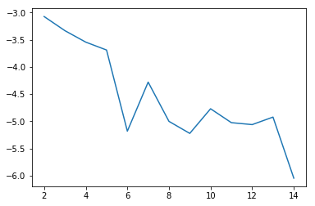
Methods / Results Facebook Statuses
Used Gensim for Topic Modeling for Facebook statuses for all sites.

Slide 6
Methods/Results – Topic Modeling Statuses
Used 13 for the number of topics.
Used pyLDAvis to generate a Intertopic Distance Map.
Top topics appear to be related to playlists, sharing video albums, downloads, free downloads, touring and music festivals.

Slide 7
Methods/Results Fan Metrics
Also did Fan Metrics for the two older sites CD Baby and TuneCore.
Total Fans = 234332 for TuneCore
Total Fans = 161820 for CD Baby
Even though TuneCore has more fans, comparison shows that CD Baby is actually more popular than TuneCore.
In terms of commitment, an artist is not necessarily committed and may with a different distributor.

Slide 8
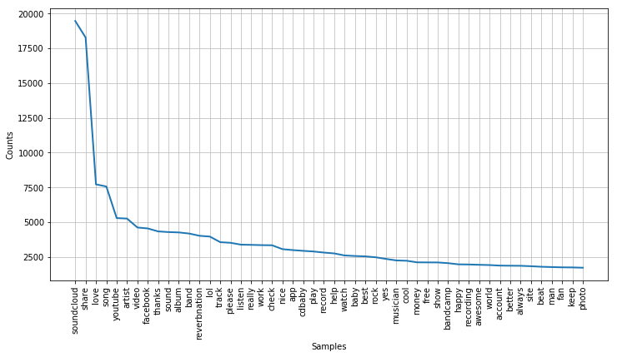
Methods and Results
Conducted word frequency analysis to determine how many times any of the distro sites were referenced.

Slide 9
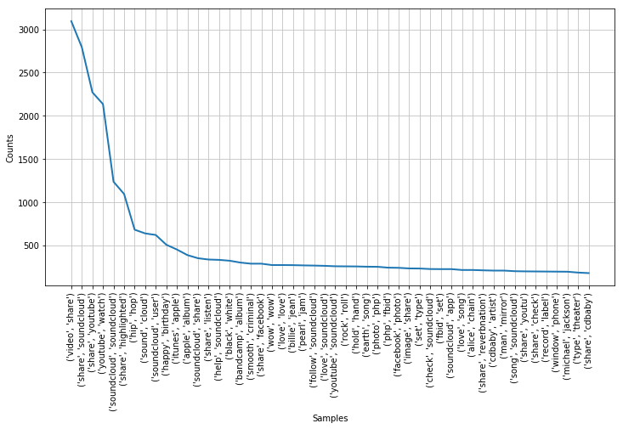
Methods and Results- bigrams

Slide 10
Methods and Results (continued)
Soundcloud appears to be the most talked about over the other four distributers¶
When looking at bigrams for comments, The most popular words are related to sharing video's, SoundCloud, watching YouTube, ITunes, Apple, Facebook, and Michael Jackson songs¶
Sharing and watching media online is very popular with Soundcloud a popular source,

Slide 11
Results - Network Analysis
The file, "Reverbnation.gdf" was generated from Netvizz with a crawl depth of 1 for “Page Like Network”. This file was imported into Gephi for analysis and visualization.

Slide 12
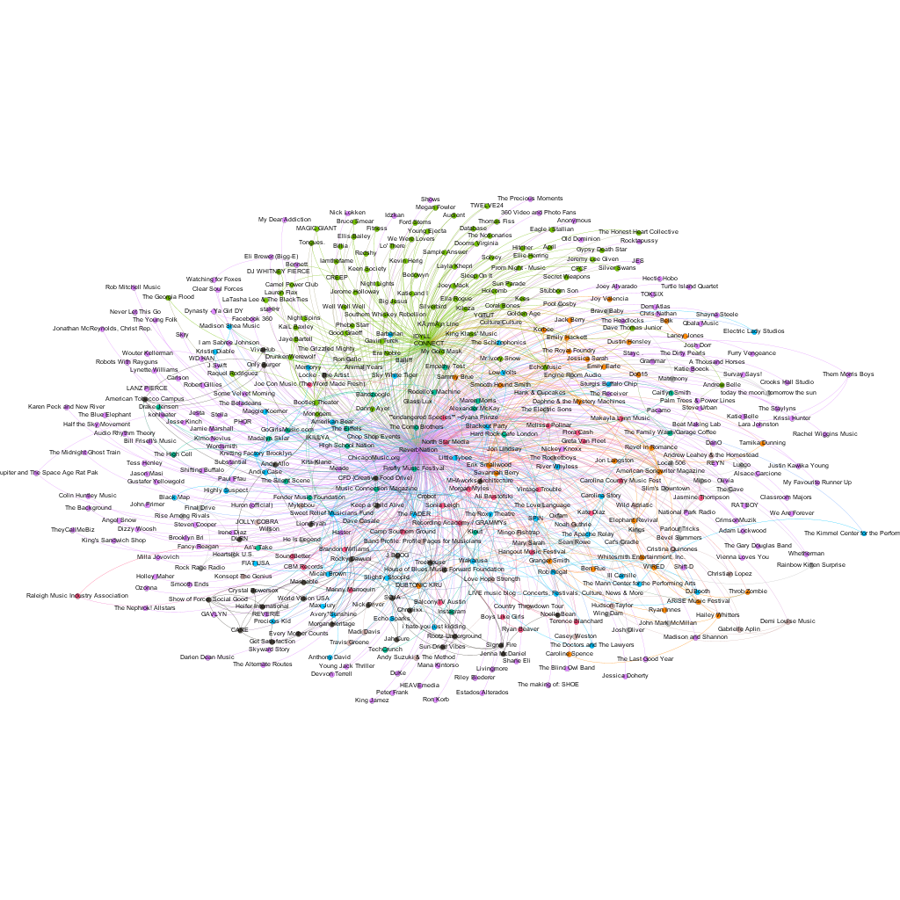
Results – Network Analysis

Slide 13
Results – Network Analysis
Major organizations, internal organizations, media, concerts, public figures are most important to Reverbnation.
There are two major nodes in this visualization:
ReverbNation and IDYLL Connect, both internal
These two show in the top entities with the highest betweenness centrality along with the Wakarusa (music fest). They also the highest weighted degree.
The number of communities after running the modularity statistic is 13.

Slide 14
Methods and Results - Twitter
Extracted tweets from Twitter using Tweepy.
Criteria was digital music topics in general to see which of the five digital music publishing and distribution sites were tweeted about.

Slide 15
Methods and Results - Twitter
Tweets containing the hashtag #Soundcloud appears be about hip hop beats, DJ's, Indie type groups, rock, and radio - Totalng 18
Soundcloud had the largest occurrence is this data extract of all of the sites.

Slide 16
Results Twitter - other
Hashtags for Tunecore and Bandcamp were not found.
Other hashtags occurred such as Indie and Indiemusic totaling 127 rows.
This indicates that Indie bands utilize these sites, especially Soundcloud.

Slide 17
Findings / Results
Playlists are becoming a more popular product.
One of the more popular genres is hip hop. A recording studio can produce ‘Beats’ and sell them online.
Another popular genre is Indie Music.

Slide 18
Conclusion
Based on the findings, the most popular and effective type of distribution is with a company that provides the most services for the musician.
Depending on the goals and experience of the musician, one distribution site may be more suited than another one.
The use of social media, such as Facebook and Twitter is essential in marketing music and video.

