Slide 1
Analytics for the Digital
Music Market
Final Project MIS 670
presented by
Miriam Rodriguez

Slide 2
Business Problem
The music business has changed dramatically in the last 25 years due to technology.
The access to music and media has changed the way musicians and recording studios generate an income.
The internet, cell phones and social media have impacted this industry.
This study provides analytics regarding digital music distribution and publishing companies as a revenue channel for musicians and recording studios.

Slide 3
Business Questions
Where do we focus effort in the digital music market?
What should the recording studio be focusing on?
What are the trends for marketing music online?

Slide 4
Approach
The approach was to perform analytics on Twitter tweets and Facebook comments and statuses.
Facebook statuses and comments were collected from fan pages of 5 known digital music distributors and publishers using Python.
The separate status extracts were combined into one file and the separate comment extracts were combined into their own file as well.
Tweets from Twitter were collected based on criteria related to music publishing and music distribution.

Slide 5
Digital Sites Researched
Reverbnation
Bandcamp
TuneCore
CD Baby
SoundCloud
Each one has variations in services offered, but in general, each has ‘stores’ that the artist(s) can place music or videos for sale and download by the public.
Artists sign contracts for the right of these sites to distribute and publish their products.
Sites
Services

Slide 6
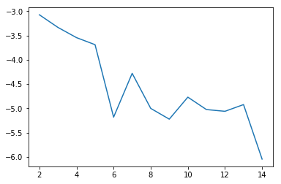
Methods / Results Facebook Statuses
Used Gensim for Topic Modeling for Facebook statuses for all sites.

Slide 7
Methods/Results – Topic Modeling Statuses
Used 13 for the number of topics.
Used pyLDAvis to generate a Intertopic Distance Map.
Top topics appear to be related to playlists, sharing video albums, downloads, free downloads, touring and music festivals.

Slide 8
Methods/Results Fan Metrics
Analyzed Fan Metrics for the two older sites CD Baby and TuneCore.
Total Fans = 234332 for TuneCore
Total Fans = 161820 for CD Baby
Even though TuneCore has more fans, comparison shows that CD Baby is actually more popular than TuneCore.
Commitment is low for both, indicating an artist is likely to switch distributors.

Slide 9
Comparison of Fan Metrics
Total Fans = 234332
Popularity
P1 = Number of posts with likes / total posts = 0.93
P2 = Total likes / total number of posts = 28.63
P3 = (P2/number of fans) * 1000 = 0.12
Commitment
C1 = Number of posts with comments / total posts = 0.58
C2 = Total comments / total posts = 3.04
C3 = (C2/number of fans) * 1000 = 0.01
Virality
V1 = Number of posts with shares / total posts = 0.50
V2 = Total shares / total posts = 4.91
V3 = (V2/number of fans) * 1000 = 0.02
Total Fans = 161820
Popularity
P1 = Number of posts with likes / total posts = 0.99
P2 = Total likes / total number of posts = 34.05
P3 = (P2/number of fans) * 1000 = 0.21
Commitment
C1 = Number of posts with comments / total posts = 0.79
C2 = Total comments / total posts = 6.72
C3 = (C2/number of fans) * 1000 = 0.04
Virality
V1 = Number of posts with shares / total posts = 0.64
V2 = Total shares / total posts = 10.83
V3 = (V2/number of fans) * 1000 = 0.07
TuneCore
CD Baby

Slide 10
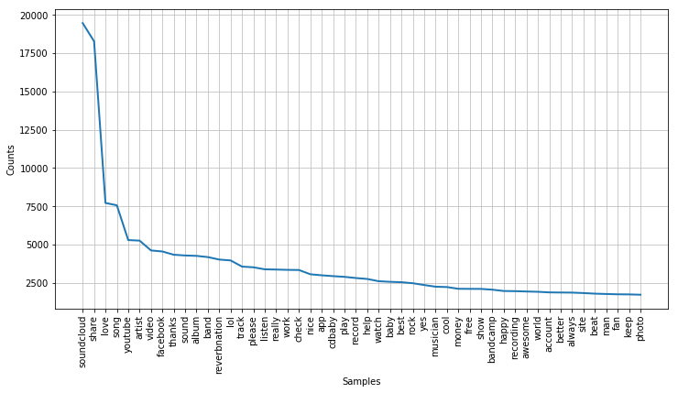
Methods and Results
Conducted word frequency analysis to determine how many times any of the distro sites were referenced.

Slide 11
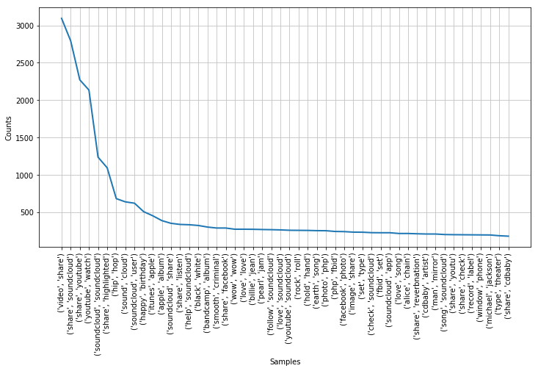
Methods and Results- bigrams

Slide 12
Methods and Results (continued)
Soundcloud appears to be the most talked about over the other four distributers¶
When looking at bigrams for comments, The most popular words are related to sharing video's, SoundCloud, watching YouTube, ITunes, Apple, Facebook, and Michael Jackson songs¶
Sharing and watching media online is very popular with Soundcloud a popular source,

Slide 13
Results - Network Analysis
The file, "Reverbnation.gdf" was generated from Netvizz with a crawl depth of 1 for “Page Like Network”. This file was imported into Gephi for analysis and visualization.

Slide 14
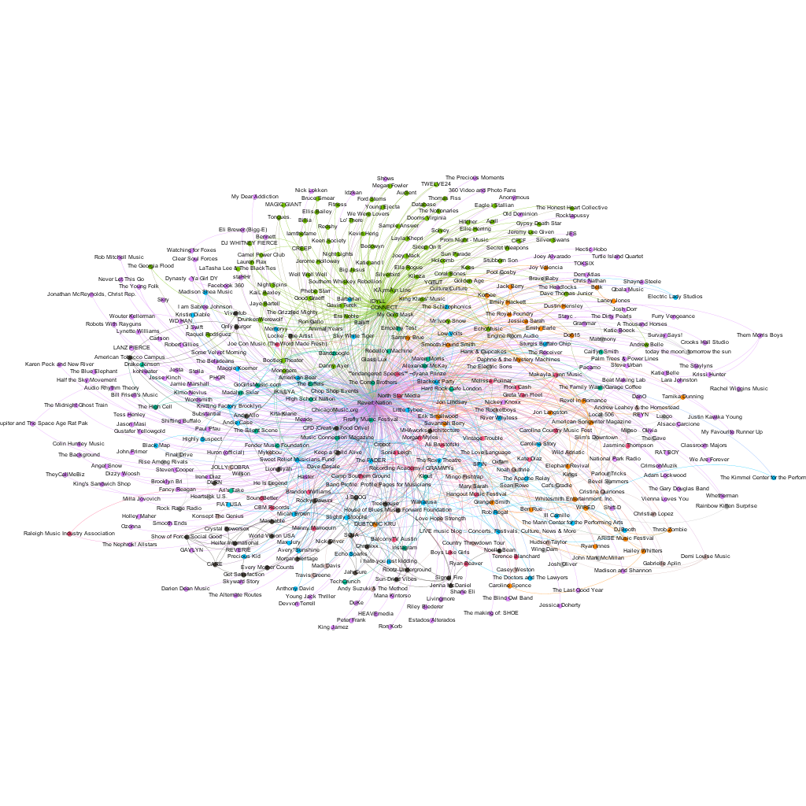
Results – Network Analysis

Slide 15
Results – Network Analysis
Major organizations, internal organizations, media, concerts, public figures are most important to Reverbnation.
There are two major nodes in this visualization:
ReverbNation and IDYLL Connect, both internal
These two show in the top entities with the highest betweenness centrality along with the Wakarusa (music fest). They also the highest weighted degree.
The number of communities after running the modularity statistic is 13.

Slide 16
Methods and Results - Twitter
Extracted tweets from Twitter using Tweepy.
Criteria was digital music topics in general to see which of the five digital music publishing and distribution sites were tweeted about.

Slide 17
Methods and Results - Twitter
Tweets containing the hashtag #Soundcloud appears be about hip hop beats, DJ's, Indie type groups, rock, and radio - Total 18
Soundcloud had the largest occurrence.

Slide 18
Results Twitter - other
Hashtags for TuneCore and Bandcamp were not found.
Hashtags Indie and IndieMusic totaled 127 rows.
This indicates that Indie bands utilize these sites, especially Soundcloud.

Slide 19
Findings / Results
Playlists are becoming a more popular product.
One of the more popular genres is hip hop. A recording studio can produce ‘Beats’ and sell them online.
Indie music, basically alternative rock is mentioned more than any other genre.

Slide 20
Conclusion
Based on the findings, the most popular and effective type of distribution is with a company that provides the most services for the musician.
Depending on the goals and experience of the musician, one distribution site may be more suited than another one.
The use of social media, such as Facebook and Twitter is essential in marketing music and video.

