Slide 1

2nd SSLC Meeting
16th March 2022

Slide 2
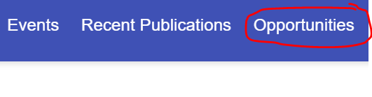
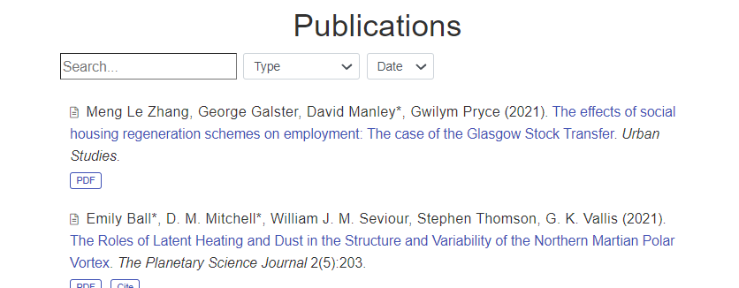
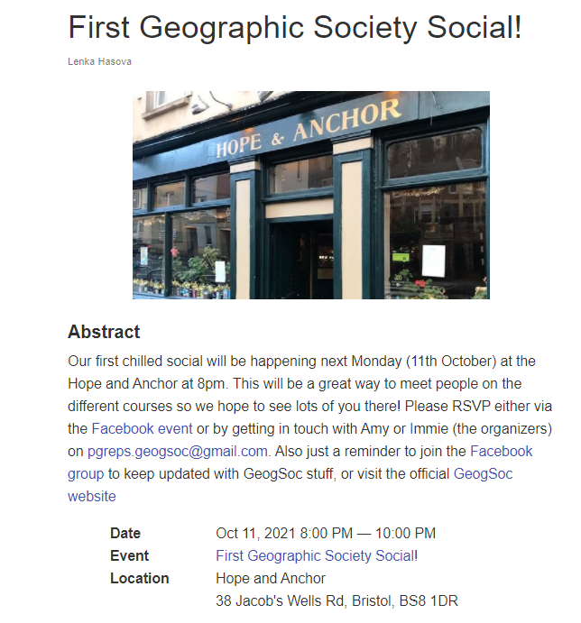
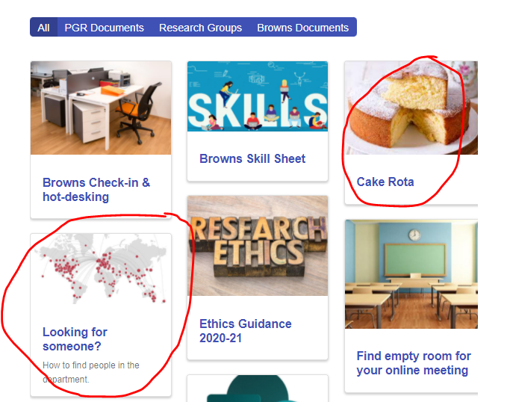
What’s new?
geogbrowns.info
1. New opportunities tab
3. New publications
2. Don’t miss Mondays Geogsoc social
4. Cake Rota &
How to find people in department
Tools added

Slide 3
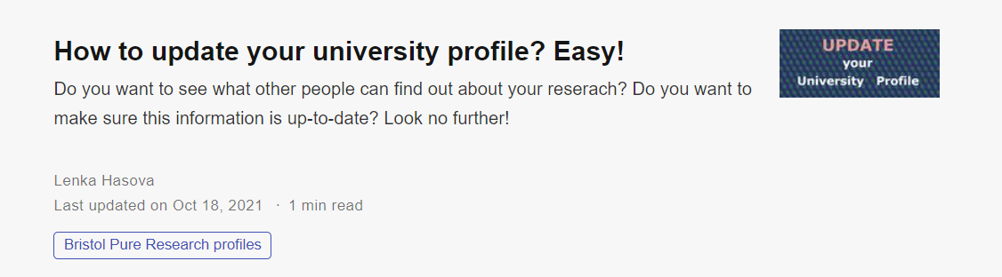
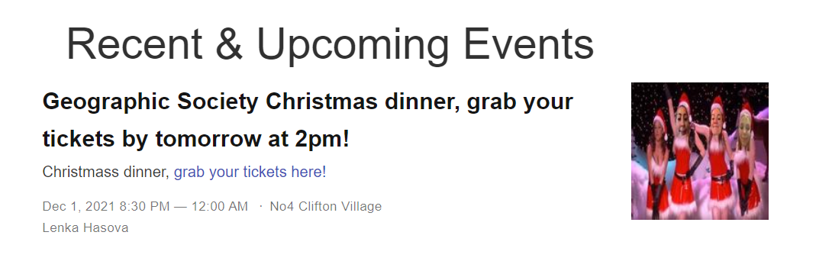
What’s new?
geogbrowns.info
1. Directions to how to update your research profile
2. Tickets for GS Christmas dinner are out!

Slide 4
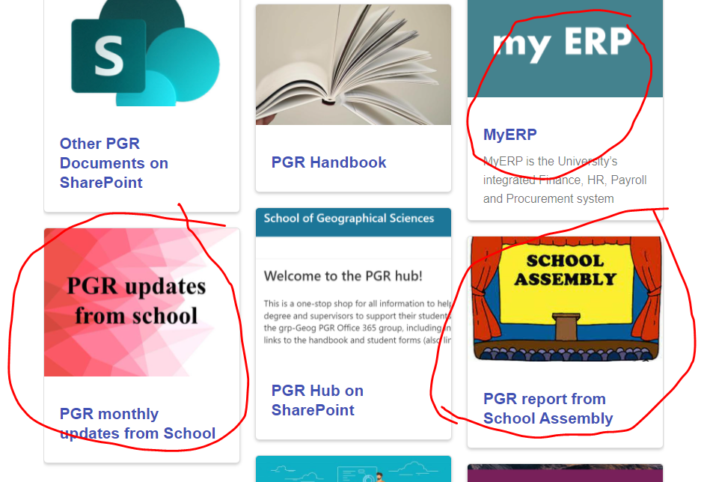
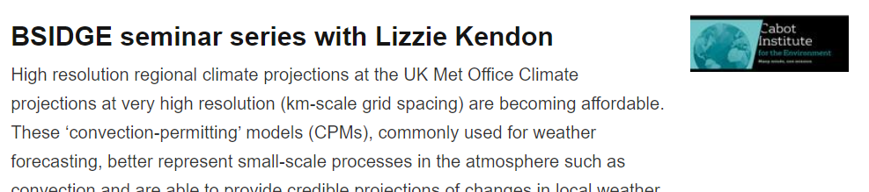
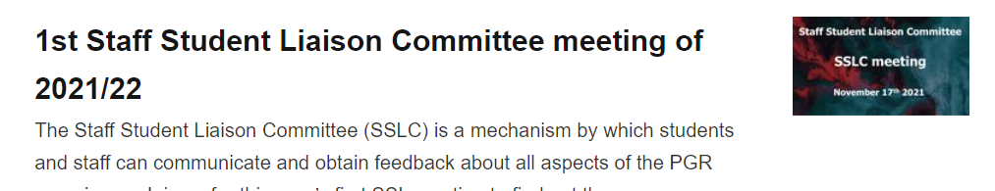
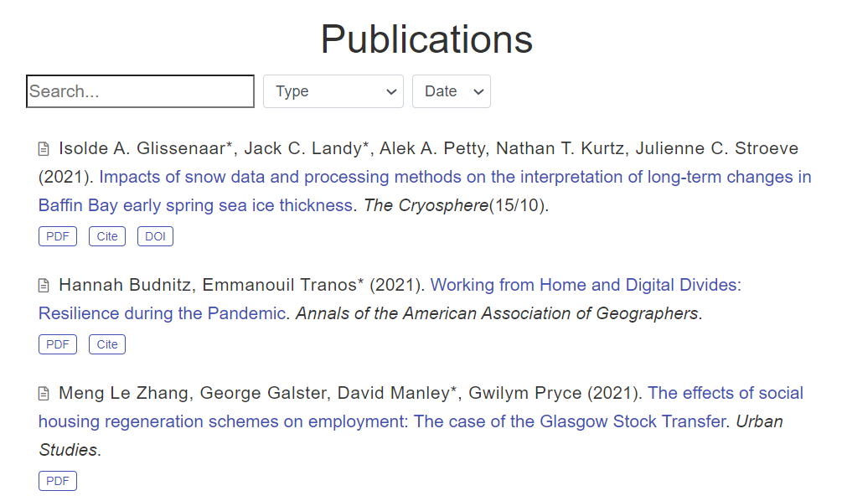
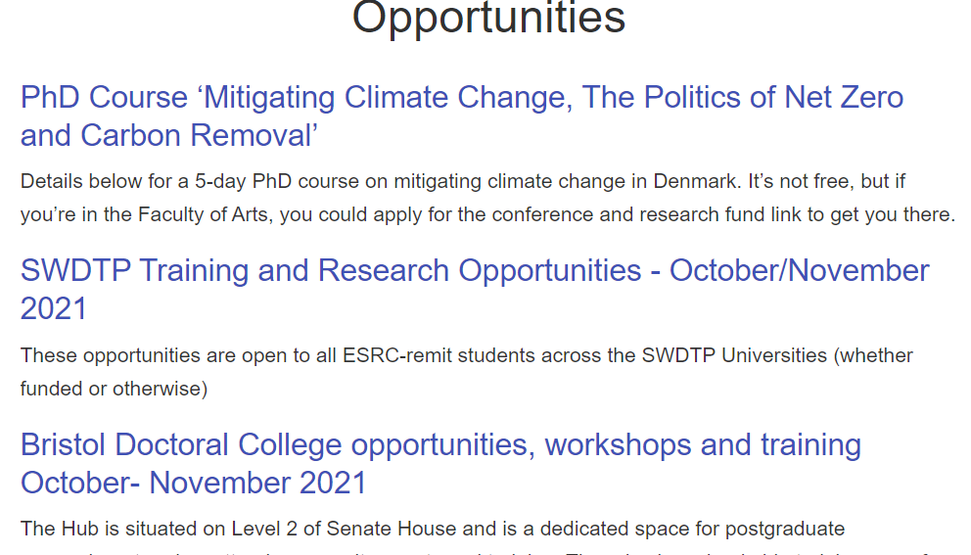
What’s new?
geogbrowns.info
Tools & Links
1. New tools, all the news and school updates on one place
3. Important dates
4. All the opportunities at one place
2. New articles from your peers and lecturers

Slide 5
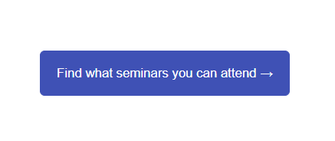
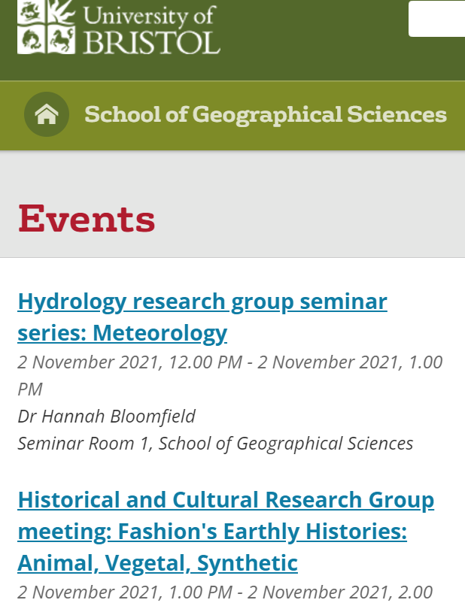
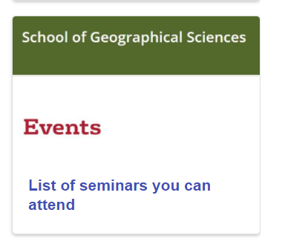
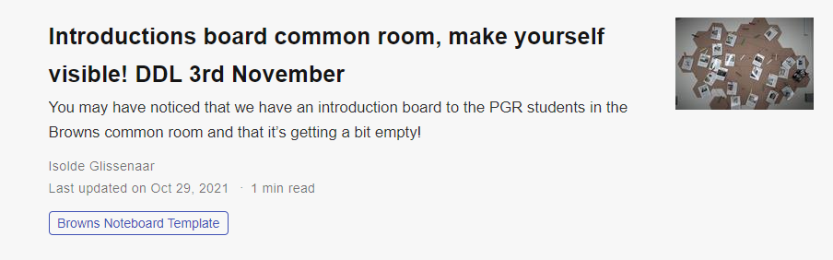
What’s new?
geogbrowns.info
Main page
1. Seminars on visible place
Tools & Links – research groups
2. Deadline tomorrow.

Slide 6
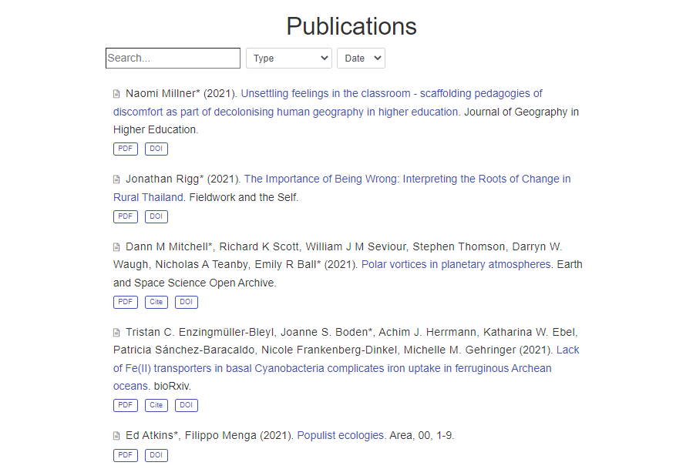
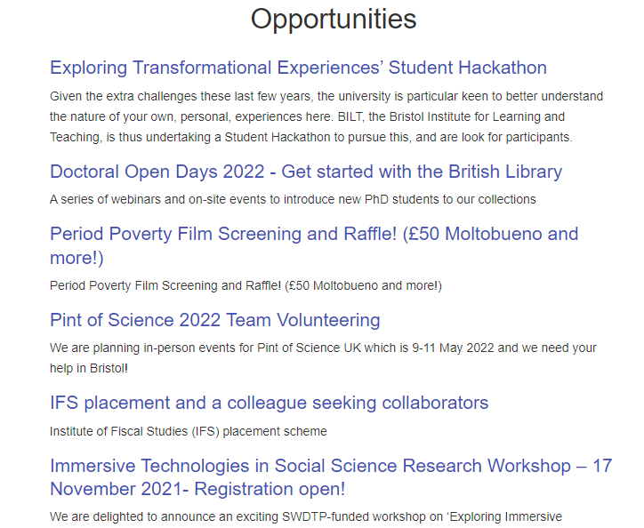
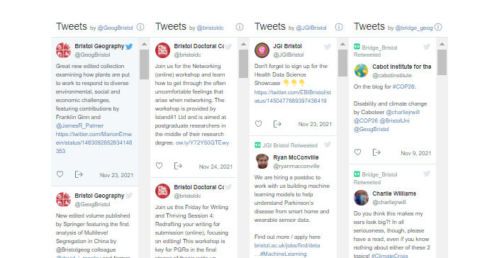
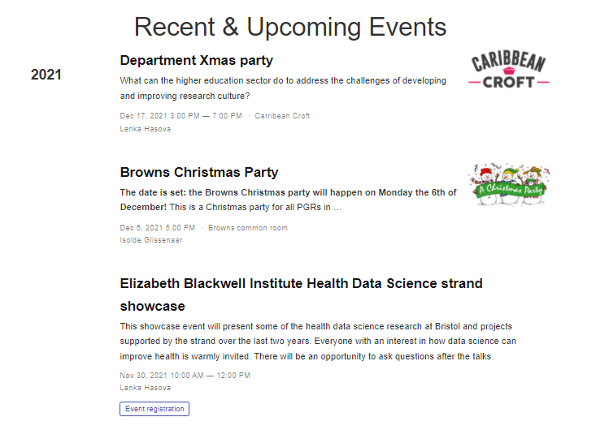
What’s new?
geogbrowns.info
New publications
New opportunities
Keep up to date with events and twitter

Slide 7
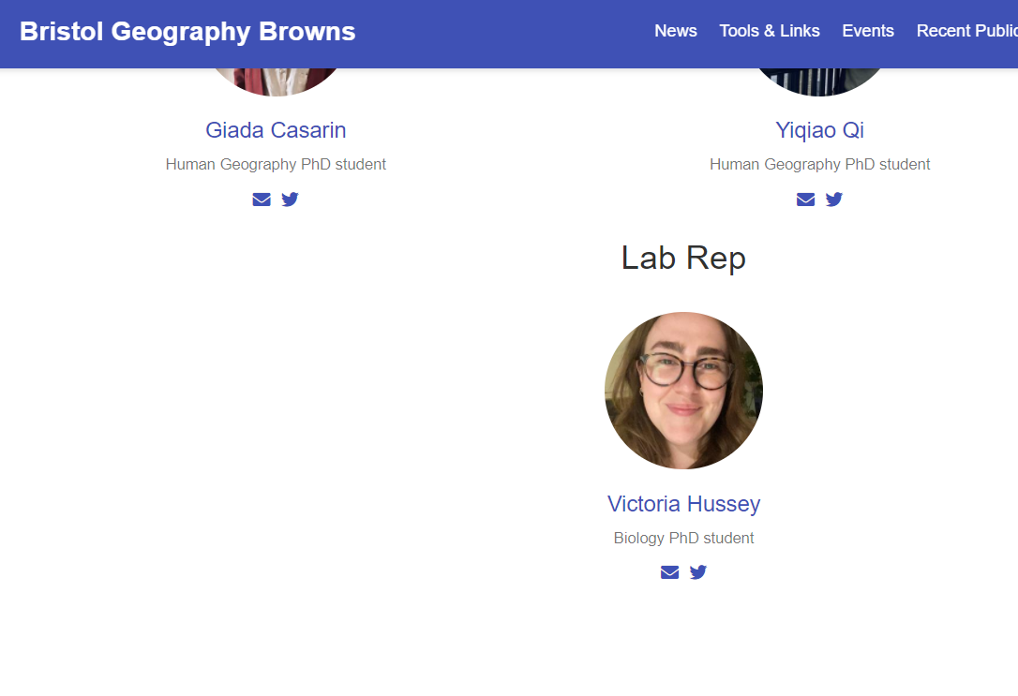
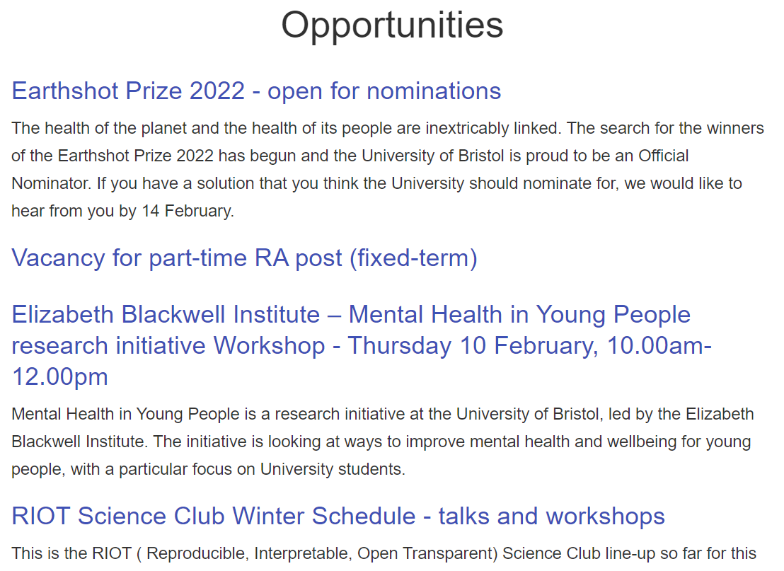
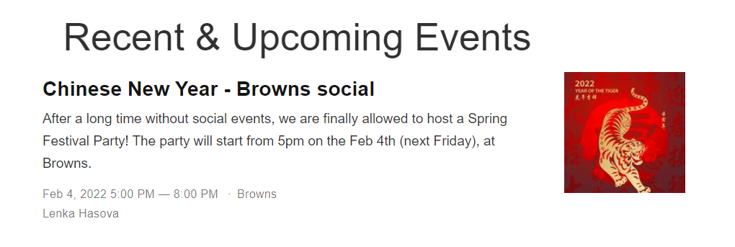
What’s new?
geogbrowns.info
Victoria has joined our Rep team
New opportunities
Don’t forget for Friday social

