Slide 1
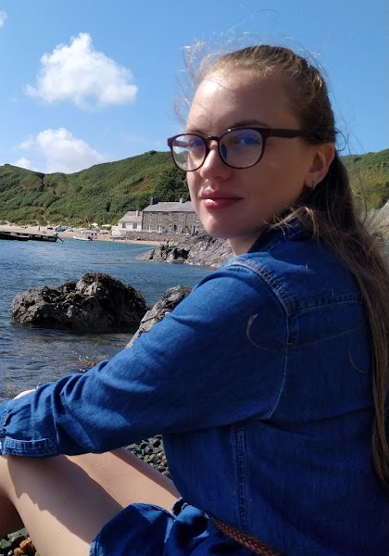
Lenka Hasova
I’m working on PhD in Advanced Quantitative Human geography .
My research investigates the role of space in
Spatial Interaction Models, using machine learning and Network science.

