Slide 1
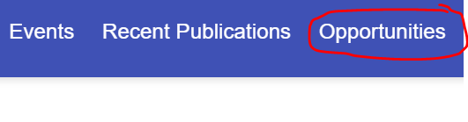
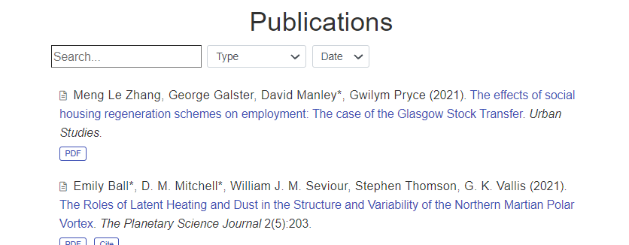
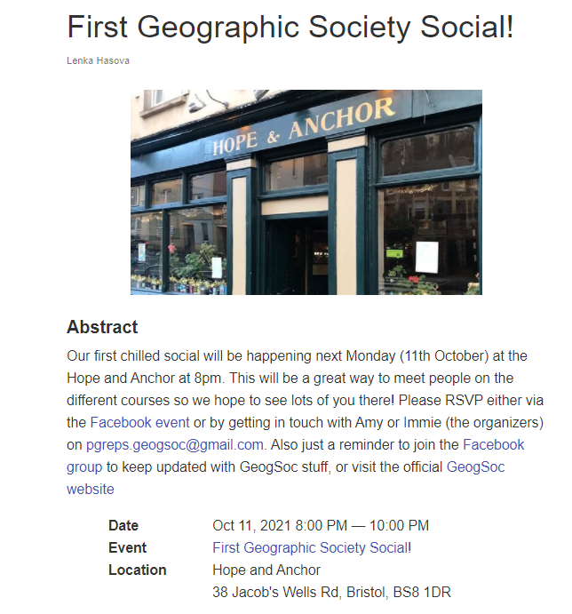
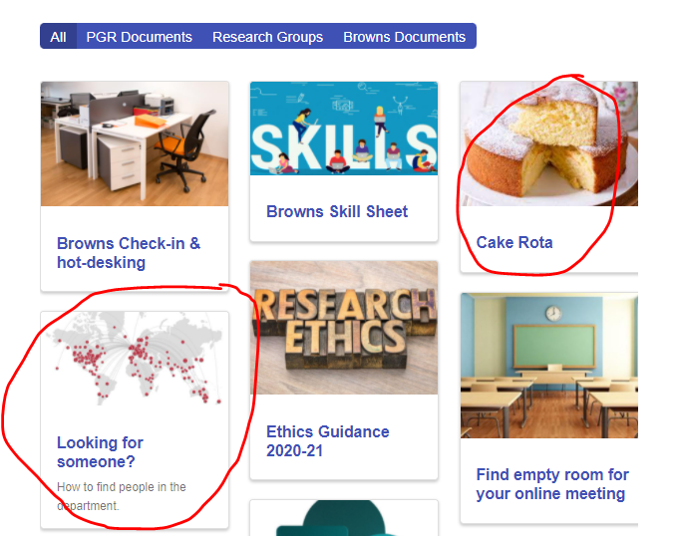
What’s new?
geogbrowns.info
1. New opportunities tab
3. New publications
2. Don’t miss Mondays Geogsoc social
4. Cake Rota &
How to find people in department
Tools added

Slide 2
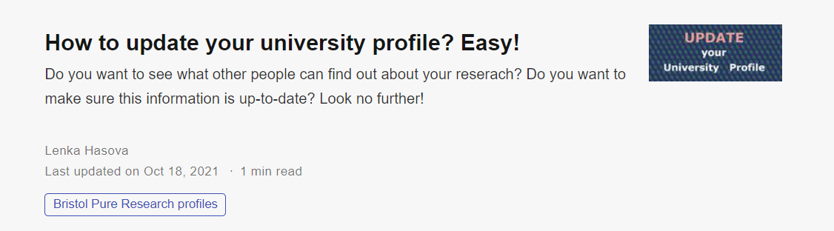
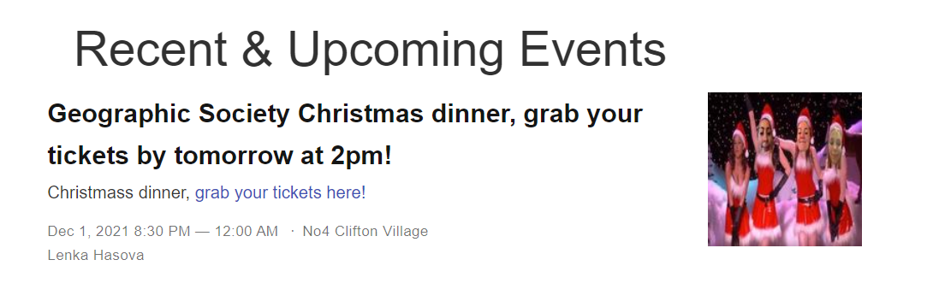
What’s new?
geogbrowns.info
1. Directions to how to update your research profile
2. Tickets for GS Christmas dinner are out!

Slide 3
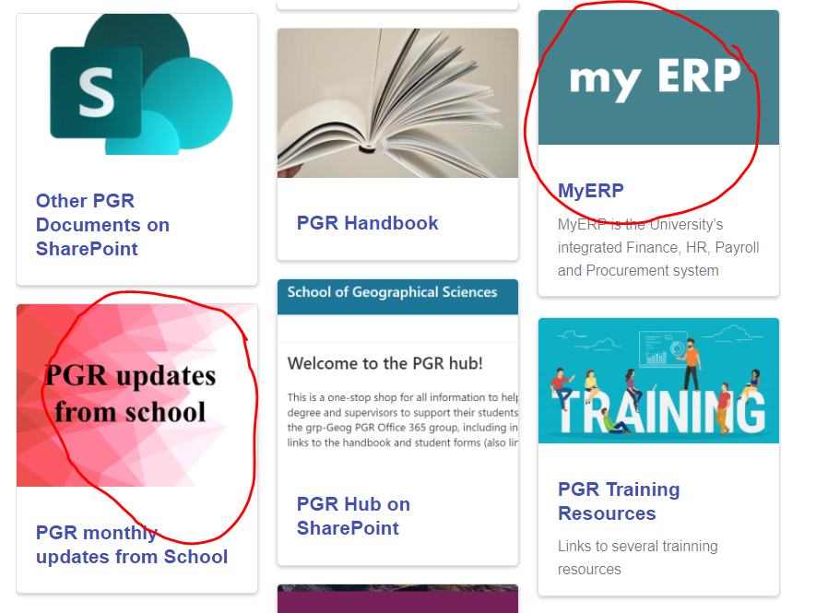
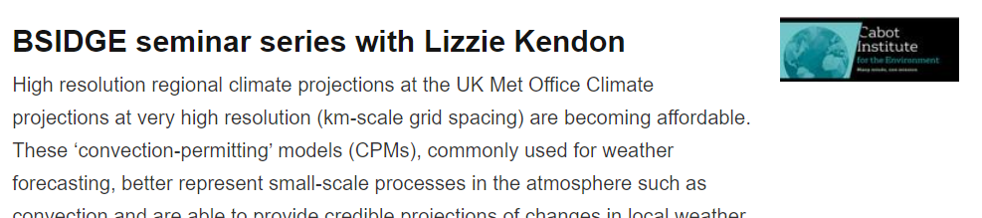
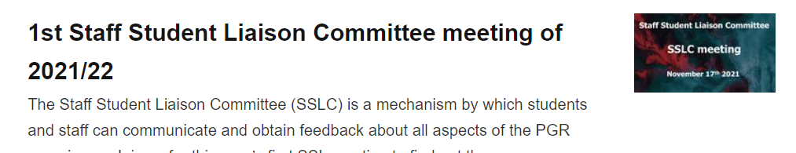
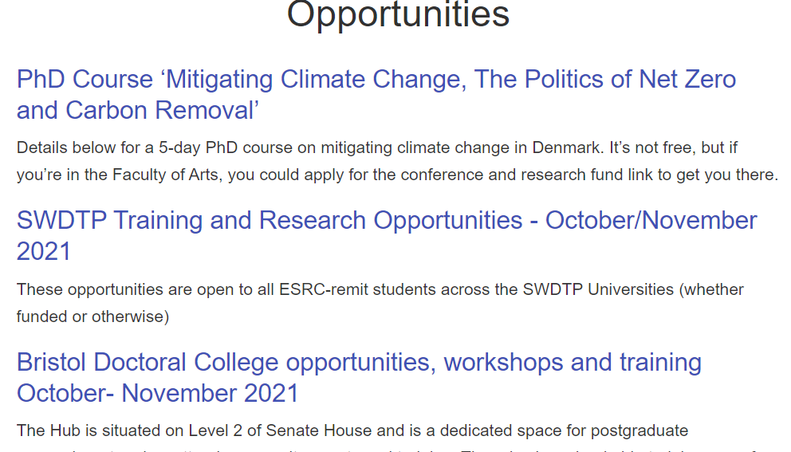
What’s new?
geogbrowns.info

