Slide 1
A Domain Speciﬁc Language for Automotive Systems Integration
Renato Oliveira, David Pereira, Cláudio Maia, Pedro Santos
CISTER Research Centre, ISEP – P.Porto
Porto, Portugal

Slide 2
Table of contents
Context
Problem
Approach
Proposed Solution
Concluding remarks & Future work

Slide 3

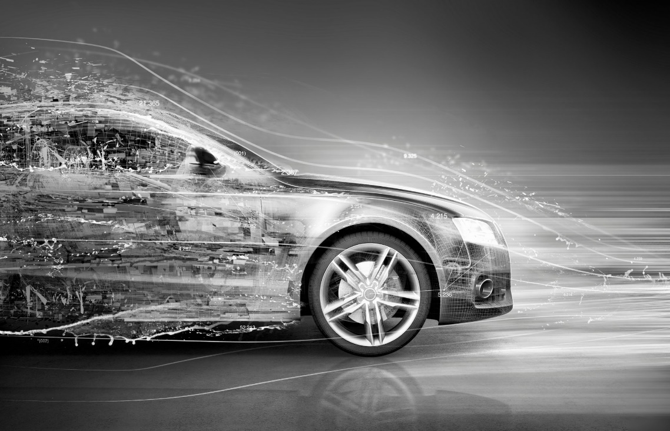

Context
Secure Cyber Physical Systems
Automotive Industry
Different technologies
Vortex Collab
Notes:
AUTOMOTIVE INDUSTRY
Attack the integration problem from the very beginning! Motivated by the activities of CISTER within the VORTEX Colab

Slide 4
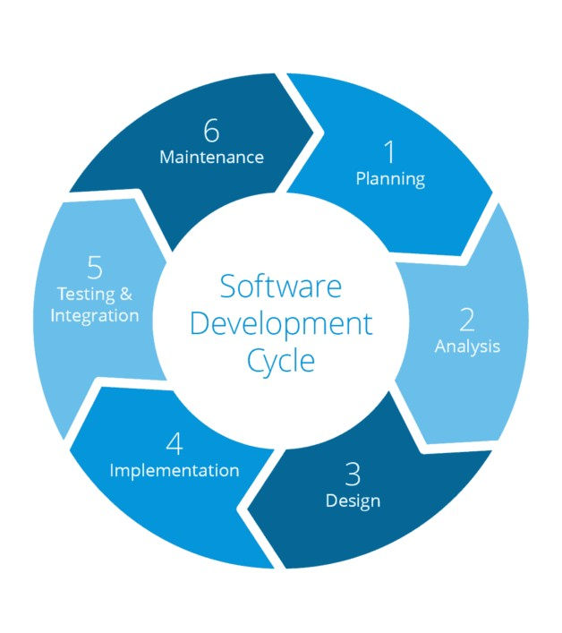


Problem
Technology disparity
Lengthy development cycles
Safety & Security issues
Notes:
Specify each of the problems briefly
The differences in the inherent nature of technology for the automotive domain pose a problem in what concerns integration. In this context, integration means inter utilization of services and / or resources of the different system intervenients by intervenients of the same system.
Due to this fact, development cycles become lengthier and error prone
Security issues also may arise, a resource which is Secure by itself can become insecure and/or create security issues in other intervenients of the system.

Slide 5
Approach Requirements
Language Oriented:
Simple and intuitive syntax for the integration of different technologies
Multi-view:
More accurate capture of domain requirements and establishing links related to how components interact
System-wide constraints:
Each view has its own set of constraints, which may propagate to other views
Notes:
Specify what is a dsl
Specify why we need a unique syntax
Explain view organization as a SOLUTION not as OUR specific solution

Slide 6
Proposed Solution
Implement a DSL to facilitate the integration of complex systems
Organized by views to better capture and reflect the purpose of each layer
To be verified formally in such a way that guarantees its security
Notes:
Reinforce the needs we enumerated and match them against what we’ve done.
Specify our view organized DSL
Explain need for inter-layer communication (explain that upper layers get molded by the definitions of the bottom layers, i.e., memory addresses in hypervisor must match defined hardware)
Explain need for inter-layer communications, i.e., partition communication (Automotive industry needs ever more higher degree of isolation between components, since they have different levels of criticality and security needs)

Slide 7
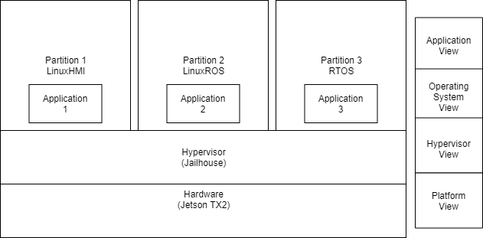
Solution - Example CPS Application
Notes:
Briefly re-explain the view examples and the hierarchy using this practical example CPS application
Explain need for inter-layer communication (explain that upper layers get molded by the definitions of the bottom layers, i.e., memory addresses in hypervisor must match defined hardware)

Slide 8

Solution – Platform View
In charge of hardware related code generation and verification
Generates code for target hardware (e.g., kernel configuration, memory address definition)
Prepares the foundation whereupon the Hypervisor View operates
Notes:
Explain the contents of the platform view
Explain achieved verification (changes in AST trigger verification) and that it may pave the way for formal verification techniques

Slide 9
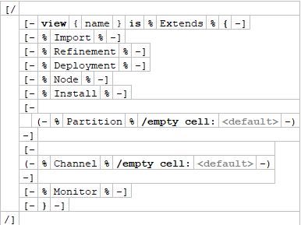
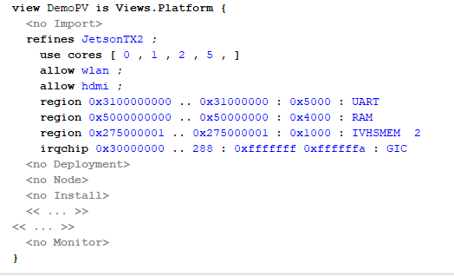
Solution – Platform View Schema
Schema definition
Practical usage
Notes:
Explain syntax definition (this syntax is what we think is adequate for the purpose)
Explain the REFINES keyword (purpose is to obtain a stub for that board & desired hypervisor to complete with our DSL generated code
Explain memory address region validation AND consistency with Hypervisor View
Explain effects in kernel configuration and hypervisor configuration
Explain Views.Platform stub at the DSL level (use of Refines and Cores is needed for this view type)

Slide 10

Solution – Hypervisor View
In charge of hypervisor related code generation
Generates code for target hypervisor (in the case of the jailhouse hypervisor, generates jailhouse cells)
Prepares the foundation whereupon the Operating System View assembles
Notes:
Explain the contents of the platform view
Explain achieved verification (changes in AST trigger verification) and that it may pave the way for formal verification techniques

Slide 11
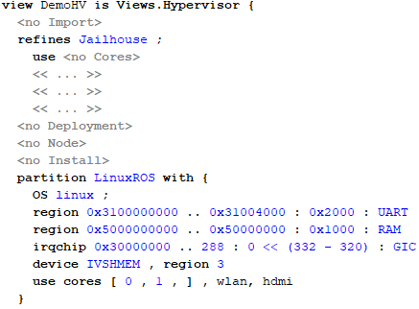
Solution - Hypervisor View
Hypervisor view instance definition
Notes:
Reinforce memory address constraints
Explain partition concept
Reinforce Refines Jailhouse (explain it generates a stub for the jailhouse hypervisor)

Slide 12
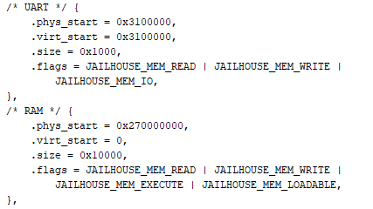
Solution – HV Code Generation
DSL Code
Generated code shard
Notes:
Explain code generation (AST nodes and mapping)
Show with practical example, matching the requested memory addresses and the obtained ones

Slide 13

Solution - HV Code Generation
Intermediate Language
Generated code
Notes:
Explain intermediate language

Slide 14
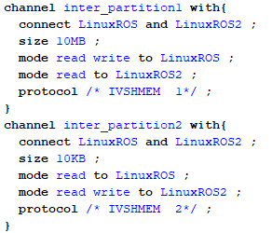
Solution – HV Intra-Layer communication
Communication channel definition
Notes:
Explain generated code completion with previous slide
Explain flag modes

Slide 15

Solution – Operating System View
In charge of OS related code generation
Generates the scripts that compile kernels, generate OS images with pre-defined packages and/or installing those packages
Prepares the foundation to be used by the Application View
Notes:
Explain the contents of the platform view
Explain achieved verification (changes in AST trigger verification) and that it may pave the way for formal verification techniques

Slide 16
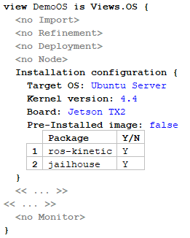
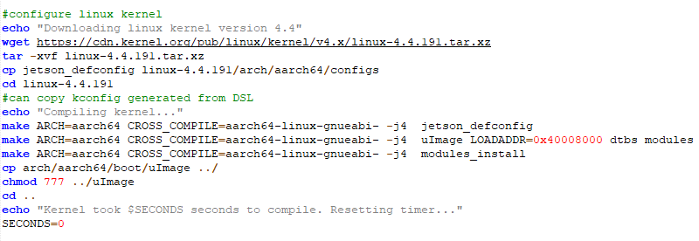
Solution - Operating System View
OS View instance definition
Generated code
Notes:
Explain need for packages
Explain target board (generating board specific configurations, not only for kernel but for boot modes)
Pre installed image (direct ISO application) or explain Image skeleton with FS creation
Explain install script

Slide 17
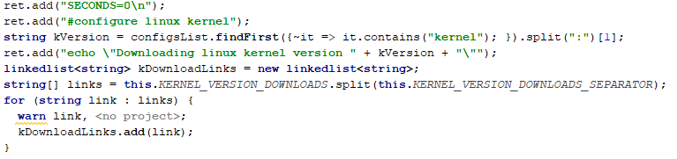
Solution - Operating System View
Intermediate language parser
Notes:
Explain that script is not hardcoded, it is molded by the values we insert either in the DSL or in Stubs
We make the intermediate language by reading the DSL nodes then parse the intermediate language for the real output

Slide 18

Solution – Application View
In charge of Application deployment code generation
Generates necessary files for the deployment of an application (e.g., a ROS topic or ROS node)
Notes:
Explain application view, still WIP

Slide 19
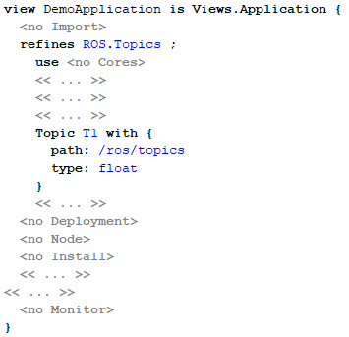
Solution – Application View
Application View Instance Definition
Notes:
Syntax explaining, follows same shape as other definitions

Slide 20
Concluding Remarks & Future Work
This DSL is a WIP, with current resources focused on OS and Application Views to deliver a proof of concept
Contribution to the Collaborative Laboratory Vortex
Future Work:
Support for different Hypervisors (namely Xen), boards, operating systems and applications to be added

Slide 21
Thank you for your time Questions?

