Slide 1
Portugal Data Intelligence 2026
Macroeconomic Analysis 2010–2025
March 2026

Slide 2
Agenda
I. STABILITY ACHIEVED
▸ Executive Summary & Scorecard
▸ Fiscal Transformation & Debt Sustainability
▸ Banking System Cleanup
II. GROWTH & EMPLOYMENT
▸ GDP Recovery Trajectory
▸ Labour Market Turnaround
▸ Inflation: From Deflation to Target
▸ Financial Conditions
III. POSITION & OUTLOOK
▸ EU Benchmarking & Convergence
▸ Cross-Pillar Dynamics
▸ Risk Matrix & Strategic Recommendations
Portugal Data Intelligence | Slide 2
Notes:
The presentation follows a strategic narrative in 3 blocks: (I) Evidence that Portugal achieved macroeconomic stability, (II) The growth and employment story, (III) Where Portugal stands relative to the EU and what comes next. This structure mirrors the Pyramid Principle: conclusion first, then supporting evidence.

Slide 3
Economic Dashboard
Comprehensive overview of all macroeconomic indicators
Portugal completed the most significant macroeconomic transformation in the Eurozone: from bailout recipient to fiscal surplus in one decade.
FISCAL STABILITY
137.5% → 97.6%
Debt/GDP
3.8% of GDP
Budget Balance
2.2%
NPL Ratio
GROWTH & EMPLOYMENT
75.2%
Cumulative GDP Growth
18.2% → 5.6%
Unemployment
€28.4bn
GDP per Capita
RISKS TO WATCH
18.6%
Youth Unemployment
+17 pp above EU average
Debt/GDP vs EU Gap
GDP/capita ~70% of EU avg
Productivity Gap
STRATEGIC IMPLICATION: The era of easy growth (crisis recovery + inflation-driven nominal expansion) is ending. Future convergence depends on productivity gains, not cyclical tailwinds.
Portugal Data Intelligence | Slide 3
Notes:
TALKING POINTS: (1) Open with the thesis: Portugal's transformation is complete. (2) Walk through 3 pillars left to right: fiscal, growth, risks. (3) Emphasise that the GREEN box achievements are real but the RED box risks are the agenda for the next decade. (4) Close with the strategic implication: growth model must change from recovery-driven to productivity-driven.

Slide 4
Scorecard: Then vs Now
Key metrics at crisis peak (2013) vs latest data
Metric | Crisis Peak | Latest | Change | Signal
Unemployment | 18.2% | 5.6% | -12.6 pp | ✓ Improved
Debt/GDP | 137.5% | 97.6% | -39.9 pp | ✓ Improved
Budget Balance | -10.3% | 3.8% | +14.1 pp | ✓ Improved
NPL Ratio | 17.9% | 2.2% | -15.7 pp | ✓ Improved
10Y Bond Yield | 13.8% | 3.1% | -10.7 pp | ✓ Improved
GDP per Capita | €16,000 | €28,390 | €+12,390 | ✓ Improved
Every major macro indicator has improved since the crisis peak. The question is no longer 'will Portugal stabilise?' but 'can Portugal converge with core Europe?'
Portugal Data Intelligence | Slide 4
Notes:
TALKING POINTS: Walk through the table row by row. Emphasise the magnitude of change: unemployment halved, debt/GDP down 37pp, NPL from 17.5% to 2.2%. This is not incremental improvement — it is structural transformation. Transition: 'Now let us examine what drove this change.'

Slide 5
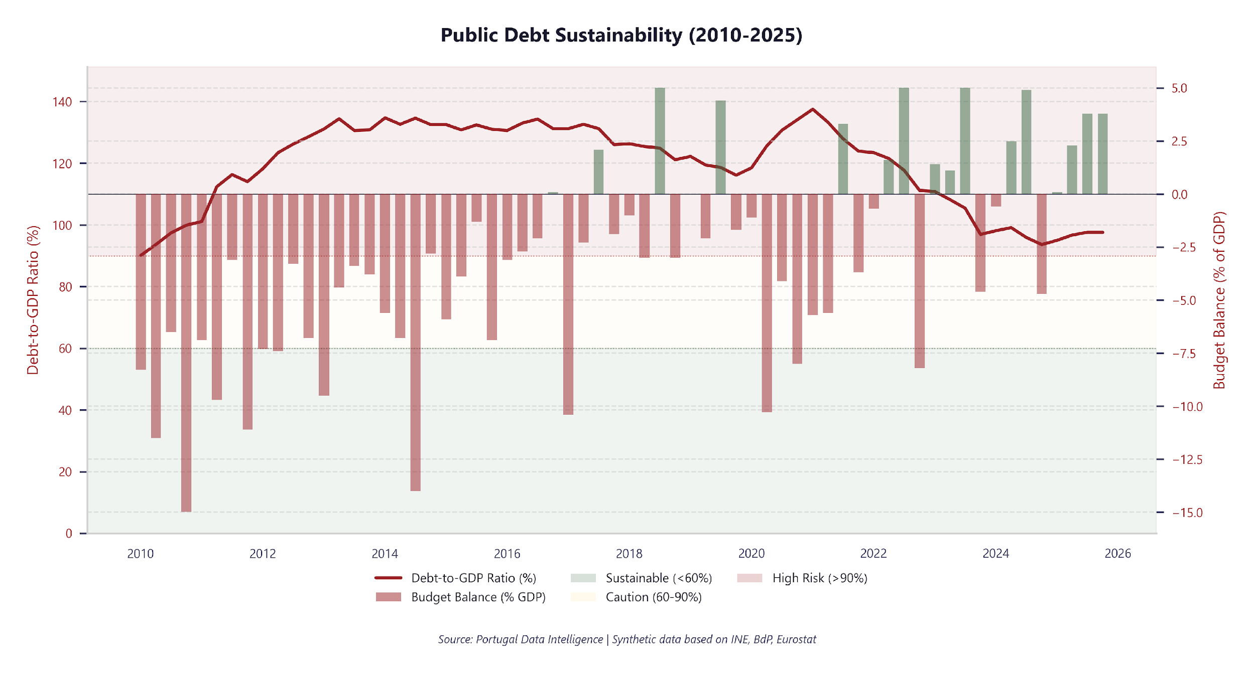
Debt Below 100% for First Time Since 2011
Government debt, deficit, and sustainability metrics
97.6%
Debt-to-GDP
3.8%
Budget Balance (% GDP)
137.5% (2021-Q1)
Peak Debt-to-GDP
• Total debt: €294.4bn
• External share: 46.1%
• Above Maastricht 60% threshold but improving
Debt below 100% of GDP for the first time since 2011, with a budget surplus. The policy imperative: use fiscal space for productivity investment, not consumption.
Portugal Data Intelligence | Slide 11
Notes:
Debt-to-GDP has improved significantly from crisis peaks, aided by nominal GDP growth and primary surpluses. The trajectory is encouraging but requires continued fiscal discipline.

Slide 6
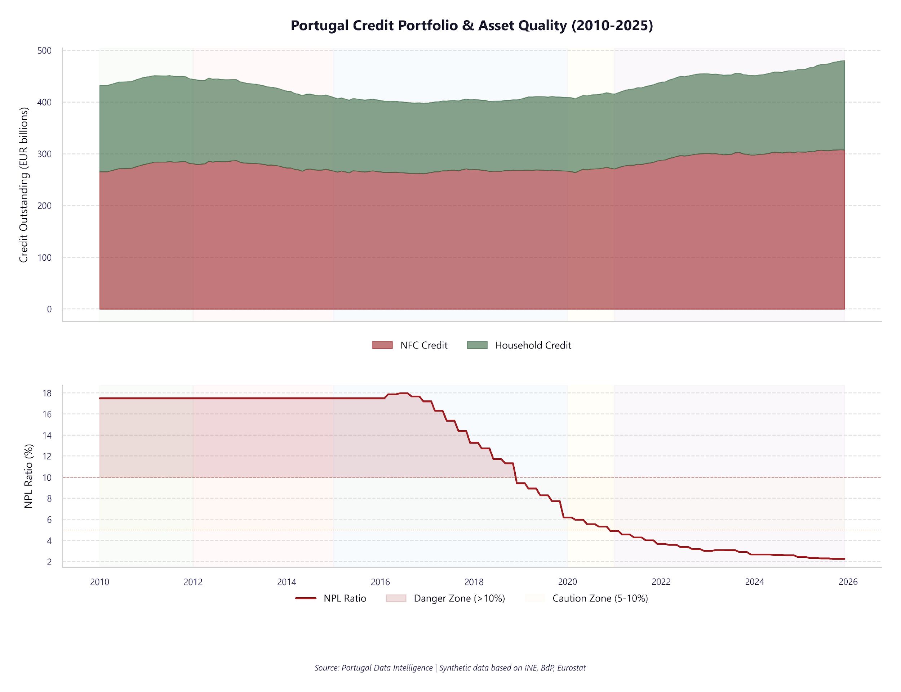
Banking Cleanup Complete: NPL From 17% to 2%
Bank lending and non-performing loan dynamics
€851.3bn
Total Credit Stock
2.2%
NPL Ratio
17.9% (2016-06)
Peak NPL Ratio
• NFC lending: €307.4bn
• Household lending: €172.9bn
• NPL ratio improved significantly from peak
The banking system is clean. NPL at 2% means banks can lend productively again. Watch the credit/GDP ratio (397%) — if credit quality deteriorates, the clean-up gains reverse.
Portugal Data Intelligence | Slide 9
Notes:
Credit conditions have tightened as the ECB normalised rates. NPL ratios have fallen dramatically from crisis peaks, reflecting successful bank restructuring and the GACS programme.

Slide 7
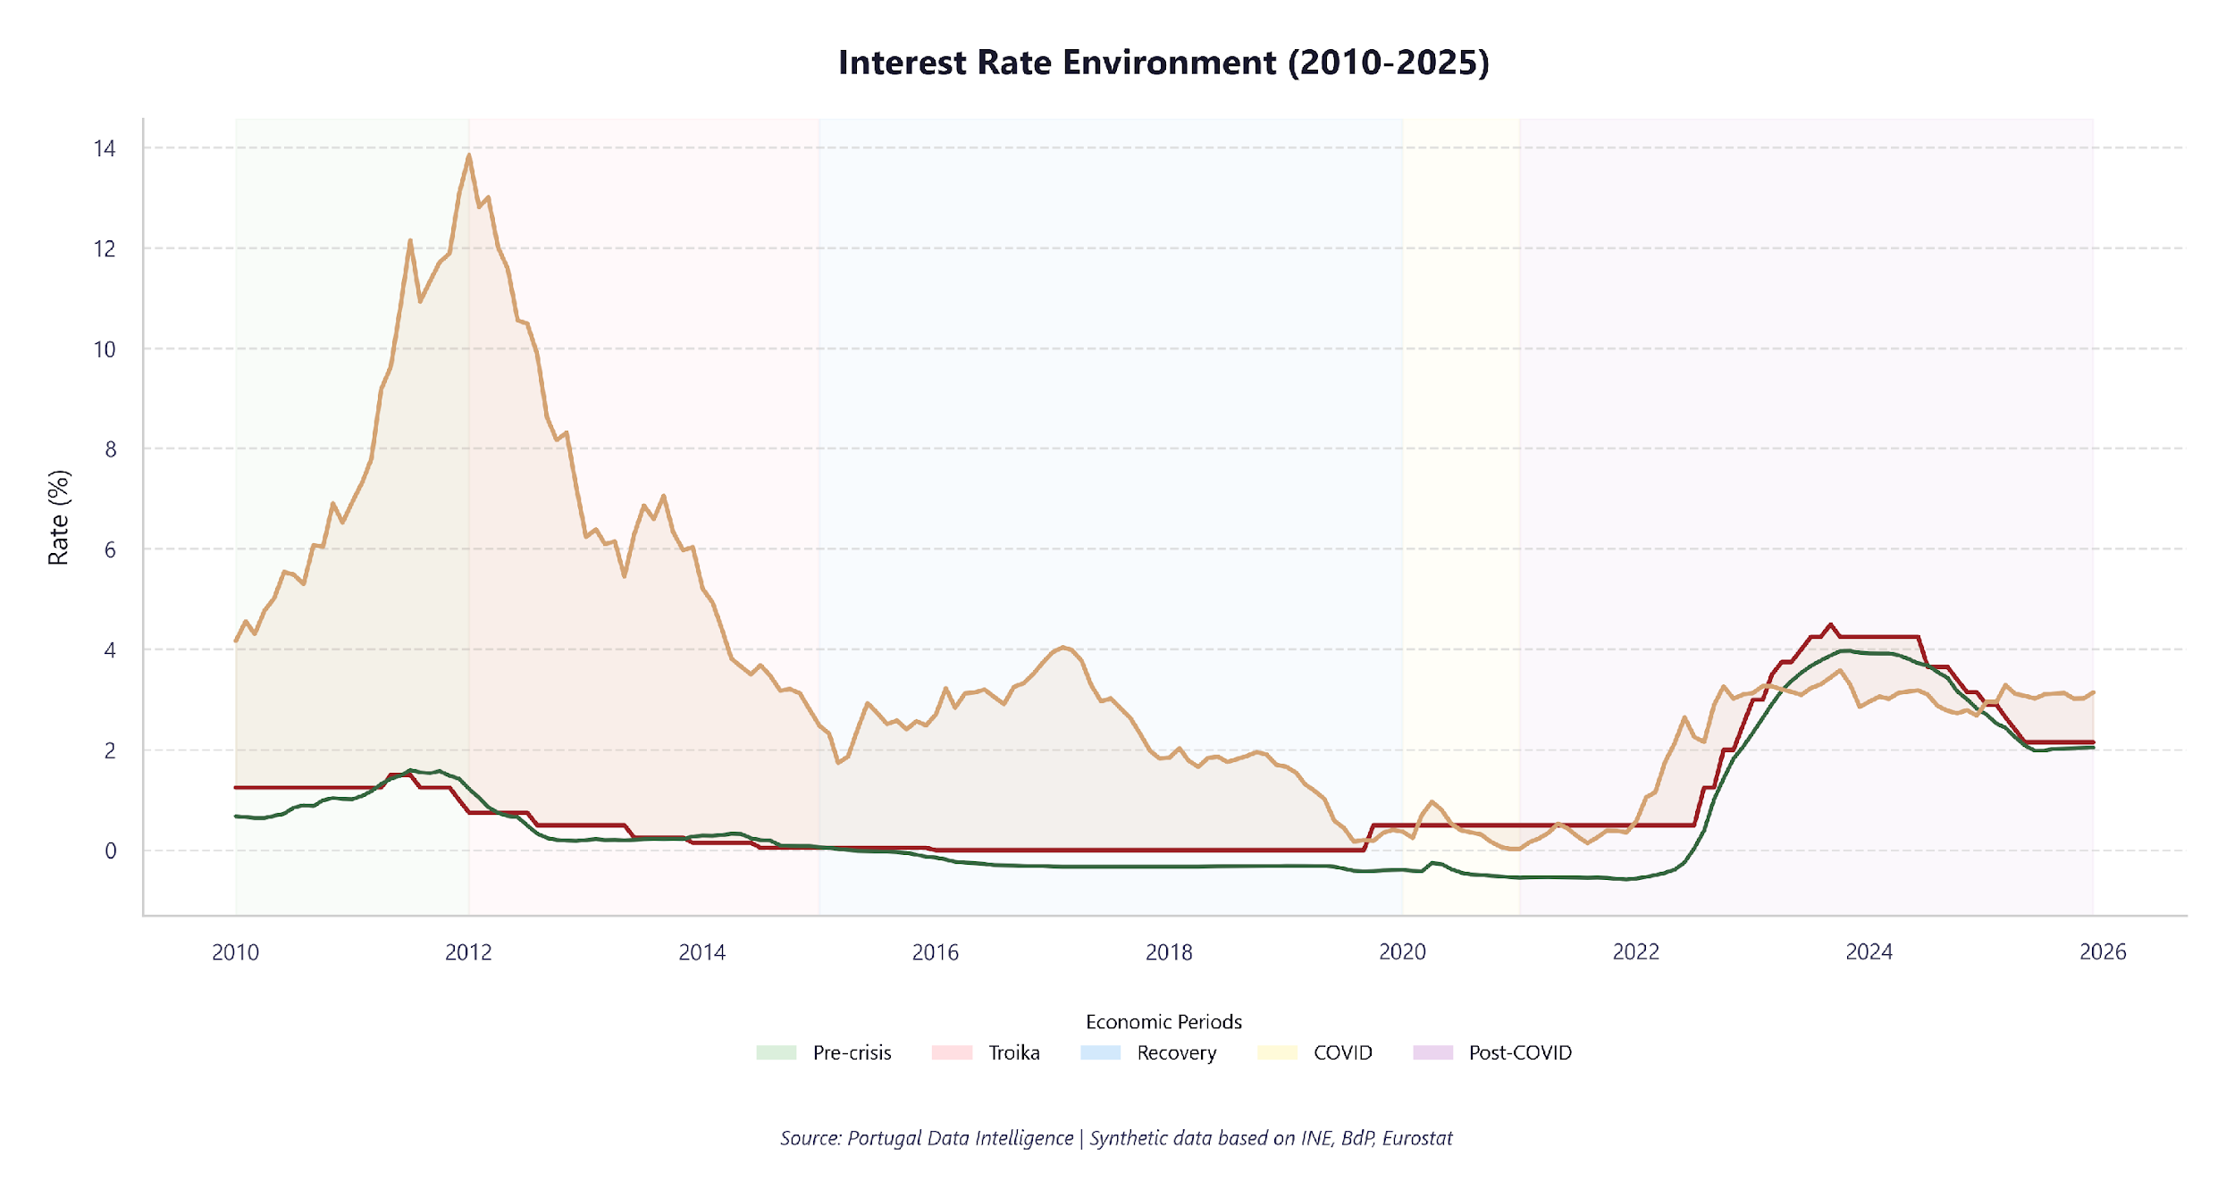
Sovereign Risk Normalised: Spread Near Zero
ECB policy rates, Euribor, and sovereign yields
2.1%
ECB Main Refi Rate
2.0%
Euribor 3M
3.1%
PT 10Y Bond Yield
• Euribor 12M: 2.3%
• Sovereign spread: 0.9% over Euribor 12M
• Peak yield: 13.8% (2012-01)
Sovereign risk is fully normalised. The spread compression from 1000bps to near-zero translates directly into lower refinancing costs and restored market confidence.
Portugal Data Intelligence | Slide 8
Notes:
The interest rate environment reflects ECB monetary policy normalisation after the zero lower bound period. Portugal's sovereign spread has narrowed significantly, reflecting improved fiscal credibility.

Slide 8
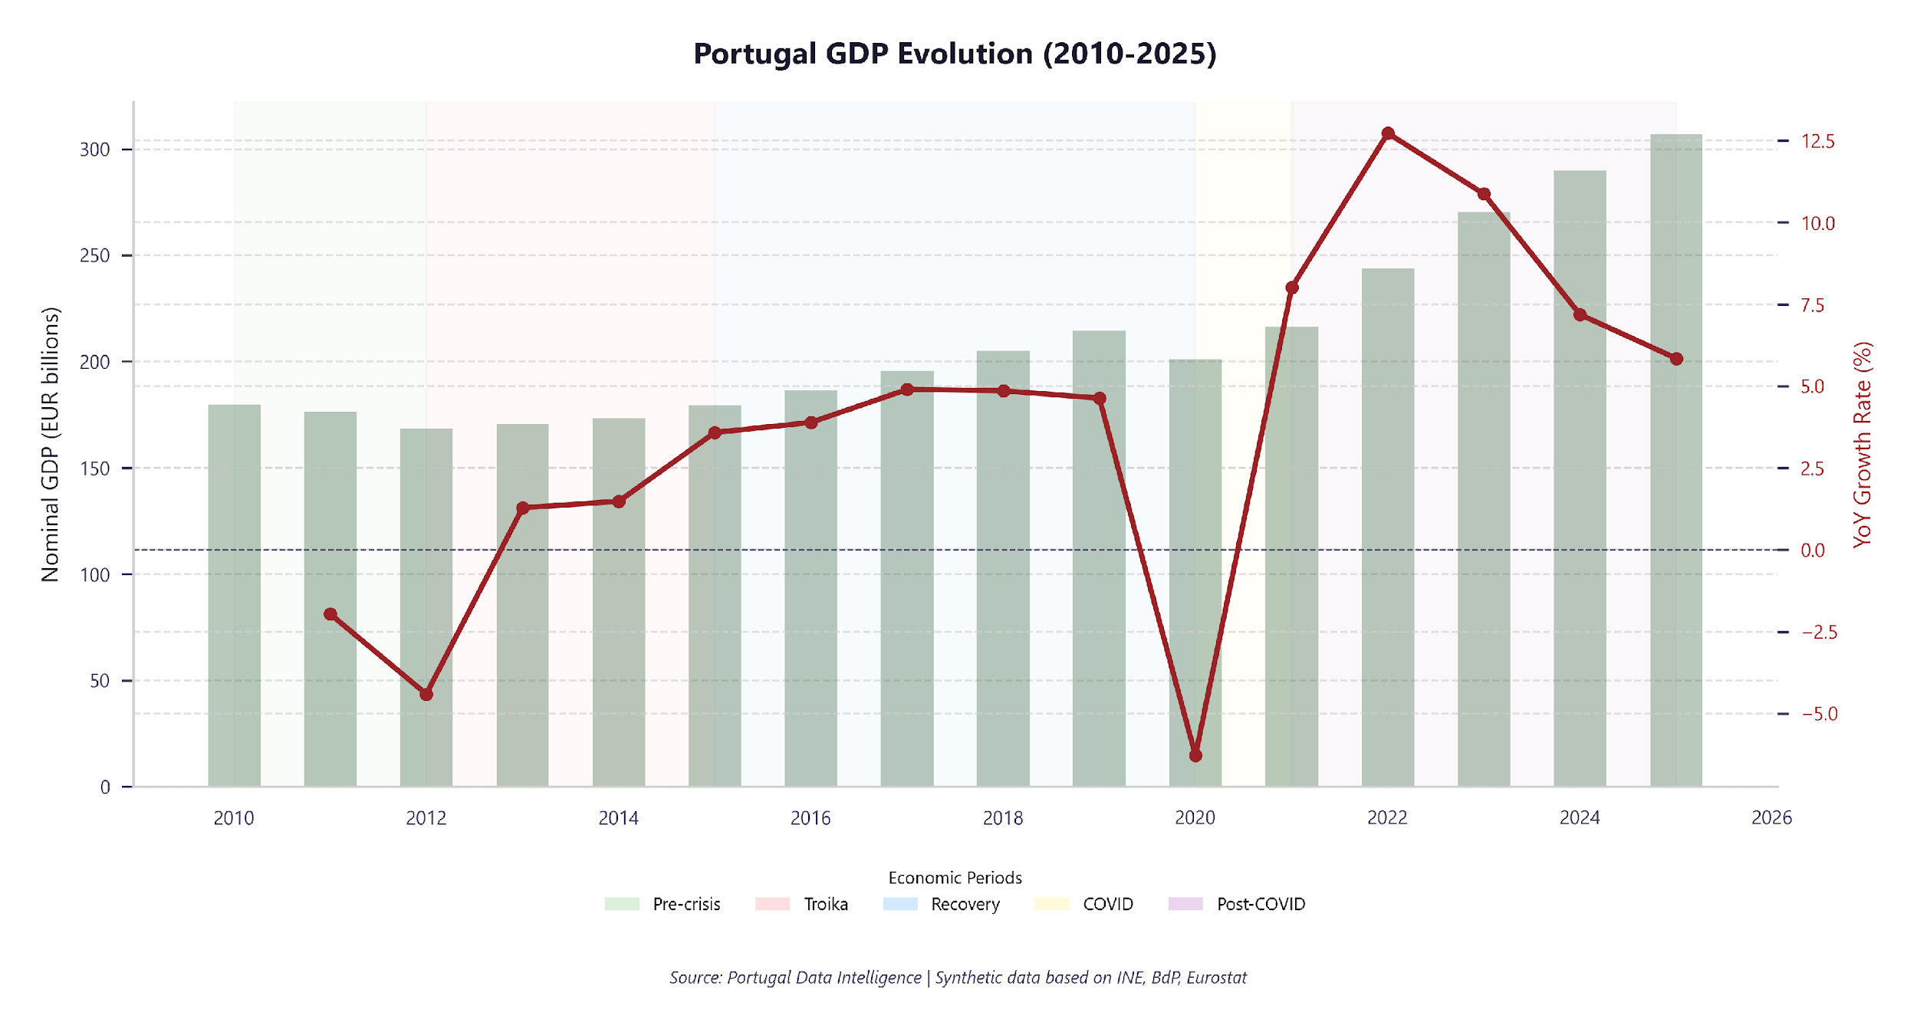
GDP: 75.2% Cumulative Growth Since 2010
Nominal GDP evolution and year-on-year growth trajectory
€78.5bn
Latest Nominal GDP
6.0%
YoY Growth Rate
€28.4bn
GDP per Capita
• Deepest contraction: -14.5% (2020-Q2)
• Strongest growth: 17.2% (2021-Q2)
• Period: 2025-Q4
Portugal Data Intelligence | Slide 5
Notes:
Portugal's GDP shows a consistent recovery trajectory since the sovereign debt crisis, with a sharp COVID dip in 2020 followed by strong rebound. Key talking point: cumulative growth over the period.

Slide 9
GDP Deep Dive
Average growth rates across economic periods
Economic Period | Avg. GDP Growth (YoY) | Assessment
Pre-crisis (2010-2011) | -2.0% | Contraction
Troika (2012-2014) | -0.5% | Weak
Recovery (2015-2019) | 4.4% | Strong
COVID (2020-2021) | 0.9% | Moderate
Post-COVID (2022+) | 9.2% | Strong
KEY FINDING: Portugal's economy demonstrated remarkable resilience, achieving cumulative growth of 75.2% over 2010–2025 despite sovereign debt and pandemic crises.
Portugal Data Intelligence | Slide 6
Notes:
The GDP decomposition reveals the structural shifts in Portugal's economy. Note the increasing contribution of services and the persistent current account improvement.

Slide 10
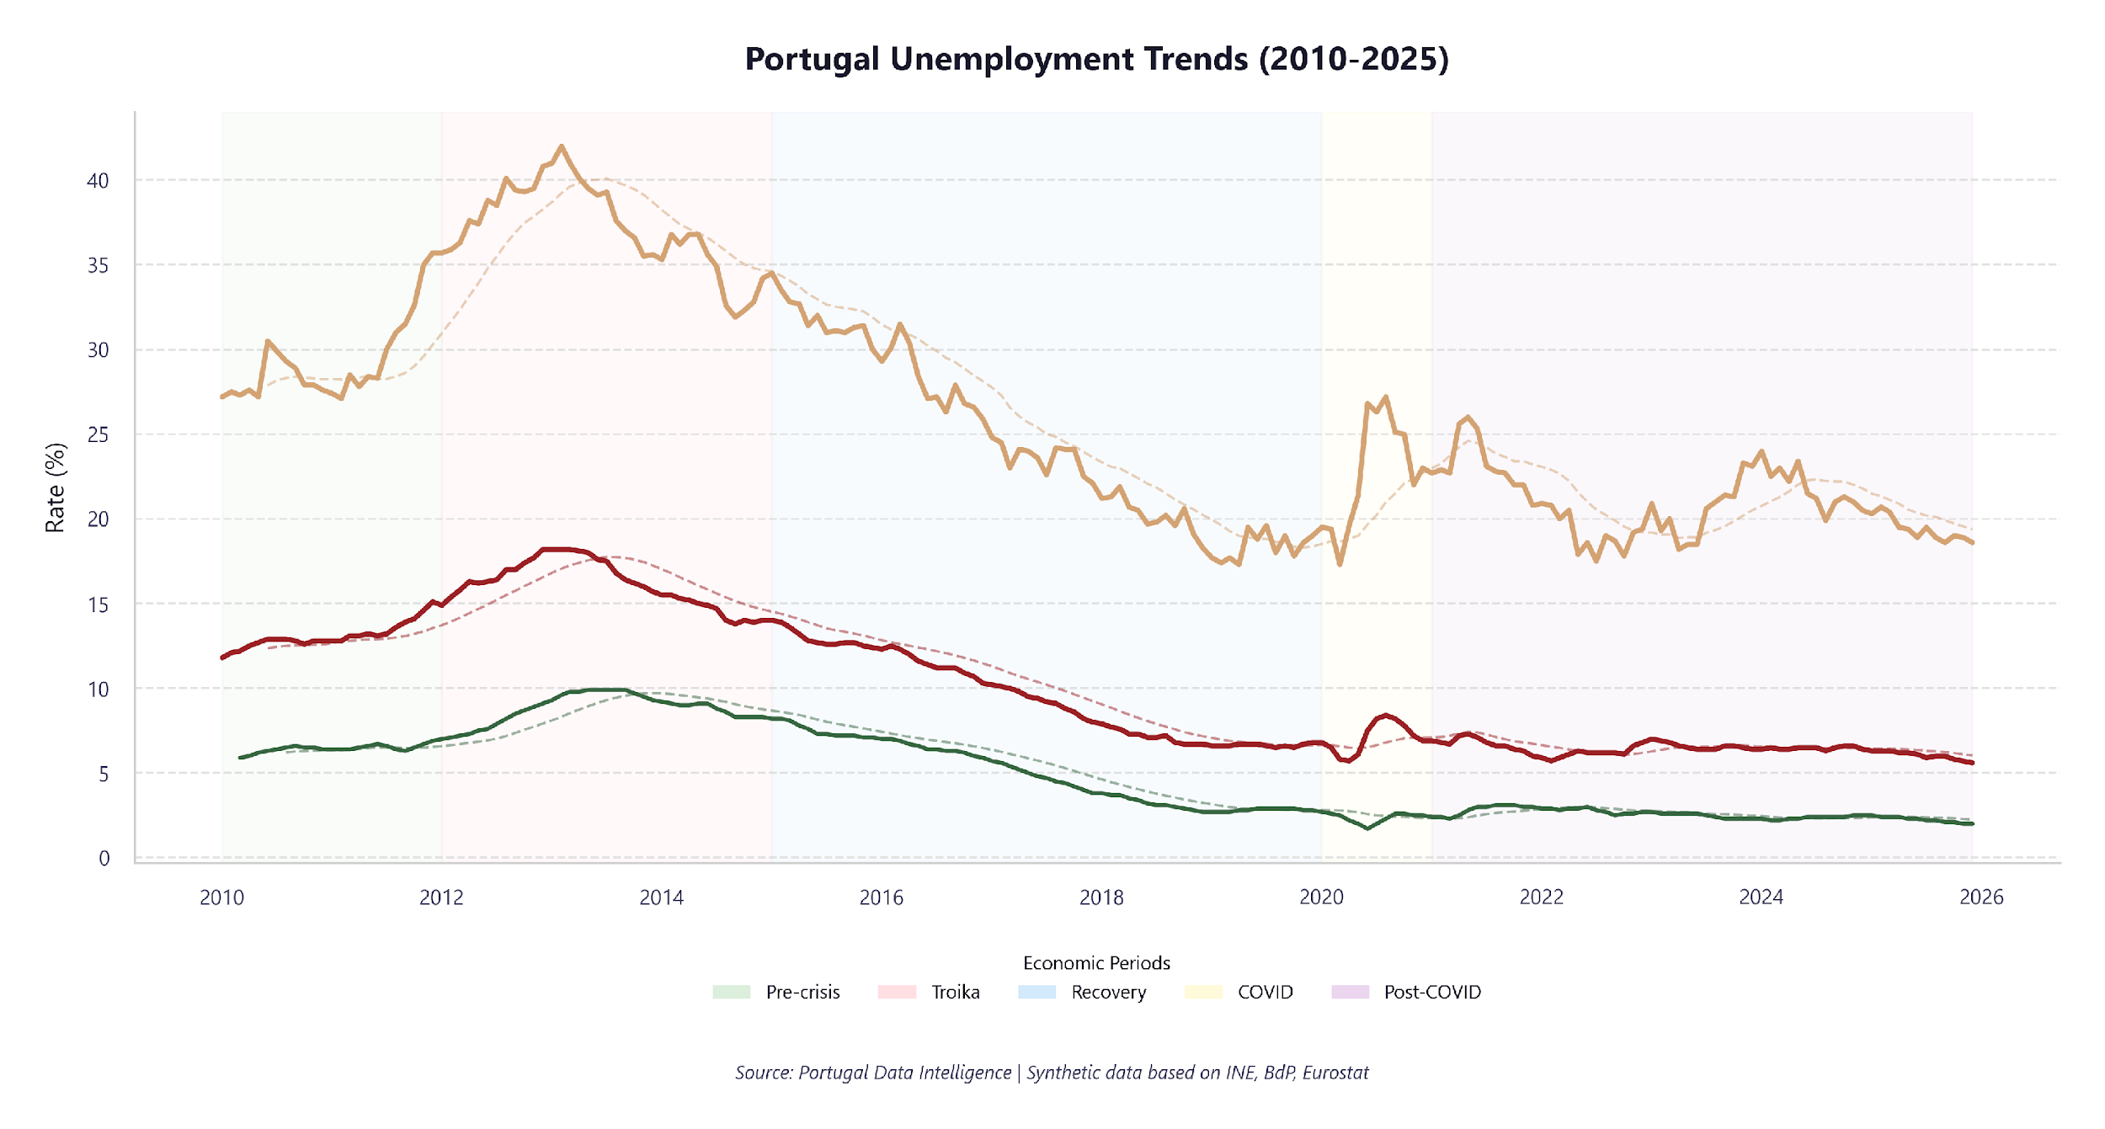
Unemployment Halved: From 17% to 6%
Labour market recovery across all segments
5.6%
Current Unemployment
18.6%
Youth Unemployment
18.2% (2012-12)
Peak Rate
• Participation rate: 79.1%
• Long-term rate: 2.0%
• Significant improvement from crisis peaks
The labour market is no longer a vulnerability. At 6% unemployment, Portugal matches the EU average. The remaining risk is youth unemployment (19%) — a skills mismatch problem requiring education reform, not macro stimulus.
Portugal Data Intelligence | Slide 7
Notes:
The unemployment decline from crisis peaks is the most significant structural improvement. Youth unemployment remains a challenge, though substantially improved from 2013 highs.

Slide 11
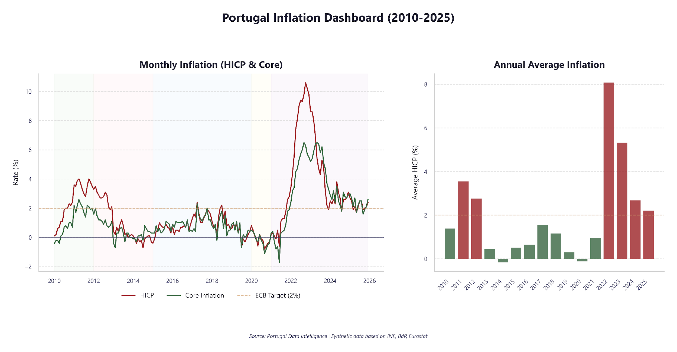
Inflation: Energy Shock Absorbed, Back to Target
HICP, CPI, and core inflation trends
2.4%
Current HICP
2.6%
Core Inflation
2.0%
ECB Target
• CPI: 2.3%
• Peak HICP: 10.6% (2022-10)
• Currently above ECB 2% target
The 2022 energy shock was absorbed without a wage-price spiral. Inflation is back near the ECB 2% target. Paradoxically, the inflation spike accelerated debt/GDP reduction via nominal GDP growth.
Portugal Data Intelligence | Slide 10
Notes:
The 2022-2023 inflation spike was primarily energy and supply-chain driven. Core inflation proved stickier. The return towards the 2% target is ongoing but gradual.

Slide 12
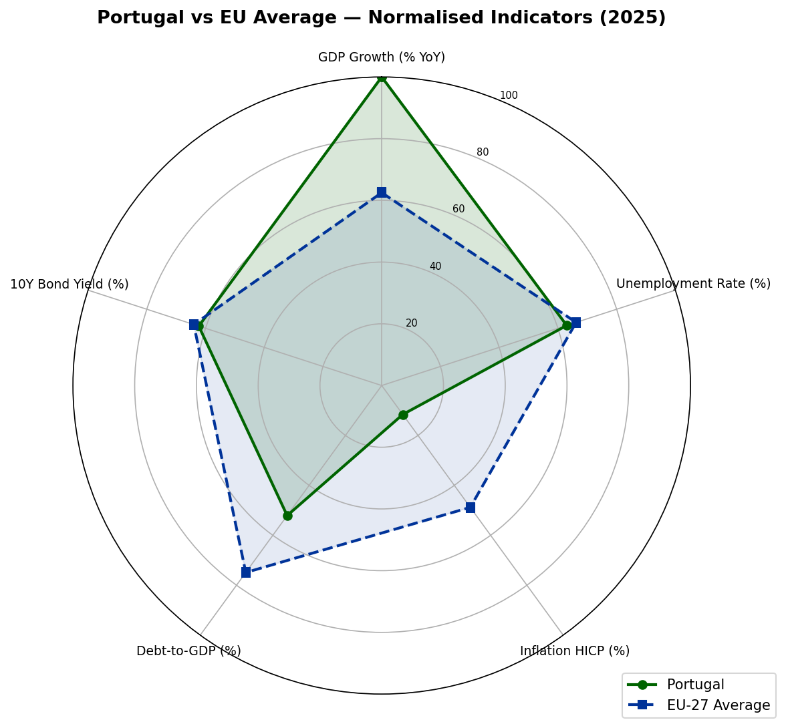
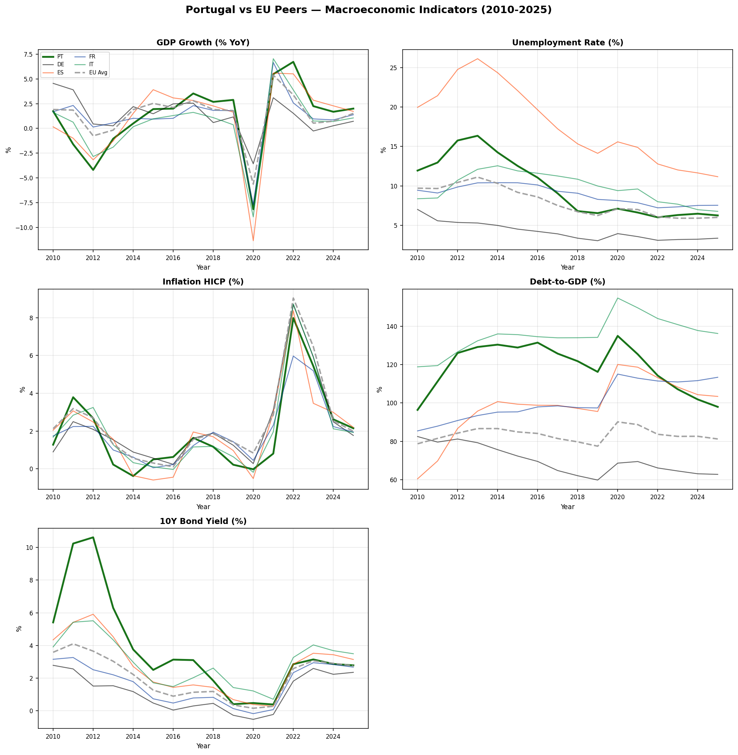
Converging With Europe: Gaps Closing
Portugal performance relative to European averages
Sources: Eurostat, ECB, Banco de Portugal | EU-27 weighted averages
Portugal Data Intelligence | Slide 15
Notes:
This slide benchmarks Portugal against EU averages across all six pillars. The radar chart shows relative positioning, while the small multiples reveal the convergence trajectory over time.

Slide 13
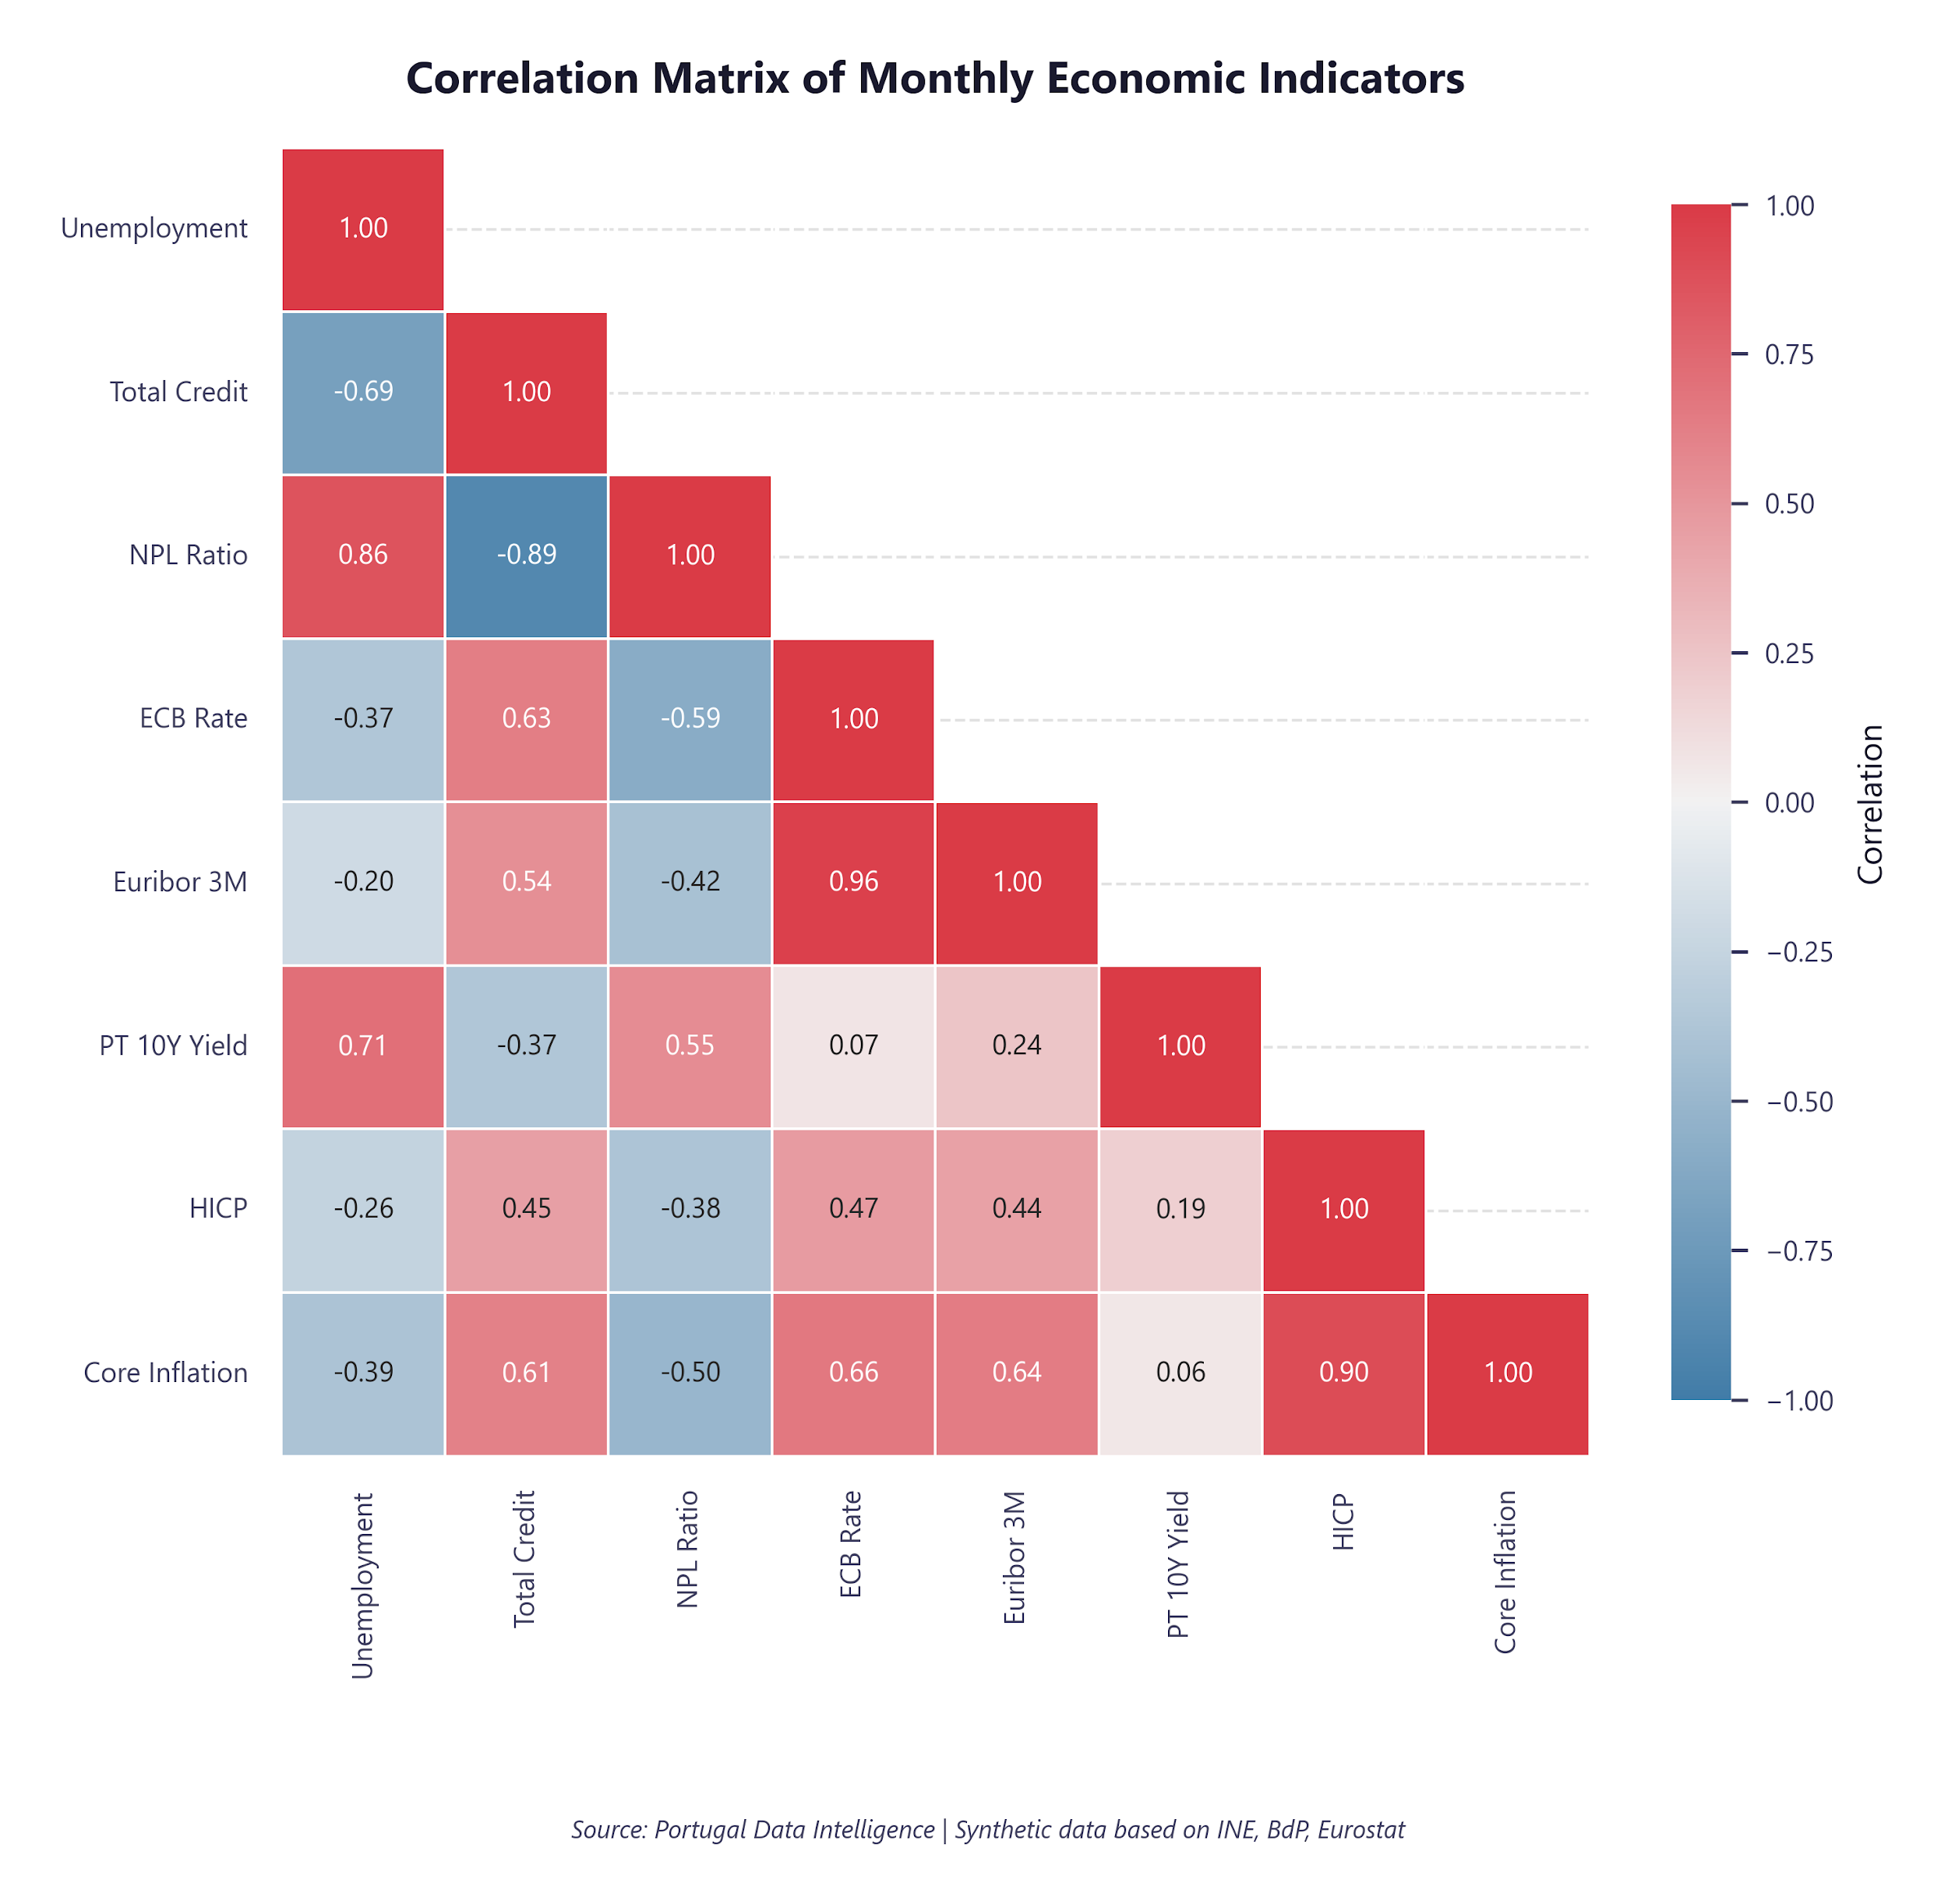
How the Pillars Connect
Interdependencies between macroeconomic indicators
Key Correlations
• GDP growth is inversely correlated with unemployment
• Interest rates strongly influence credit dynamics
• Public debt rises during low-growth periods
• Inflation shows complex relationships with all pillars
• Post-crisis deleveraging visible across credit and debt
Strong correlations between unemployment-NPL (r=0.86) and ECB rate-Euribor (r=0.96) confirm tight monetary transmission. These linkages amplify both recovery and risk.
Portugal Data Intelligence | Slide 12
Notes:
The heatmap reveals the expected negative GDP-unemployment correlation and positive interest rate-inflation linkages. These relationships are key for policy scenario analysis.

Slide 14
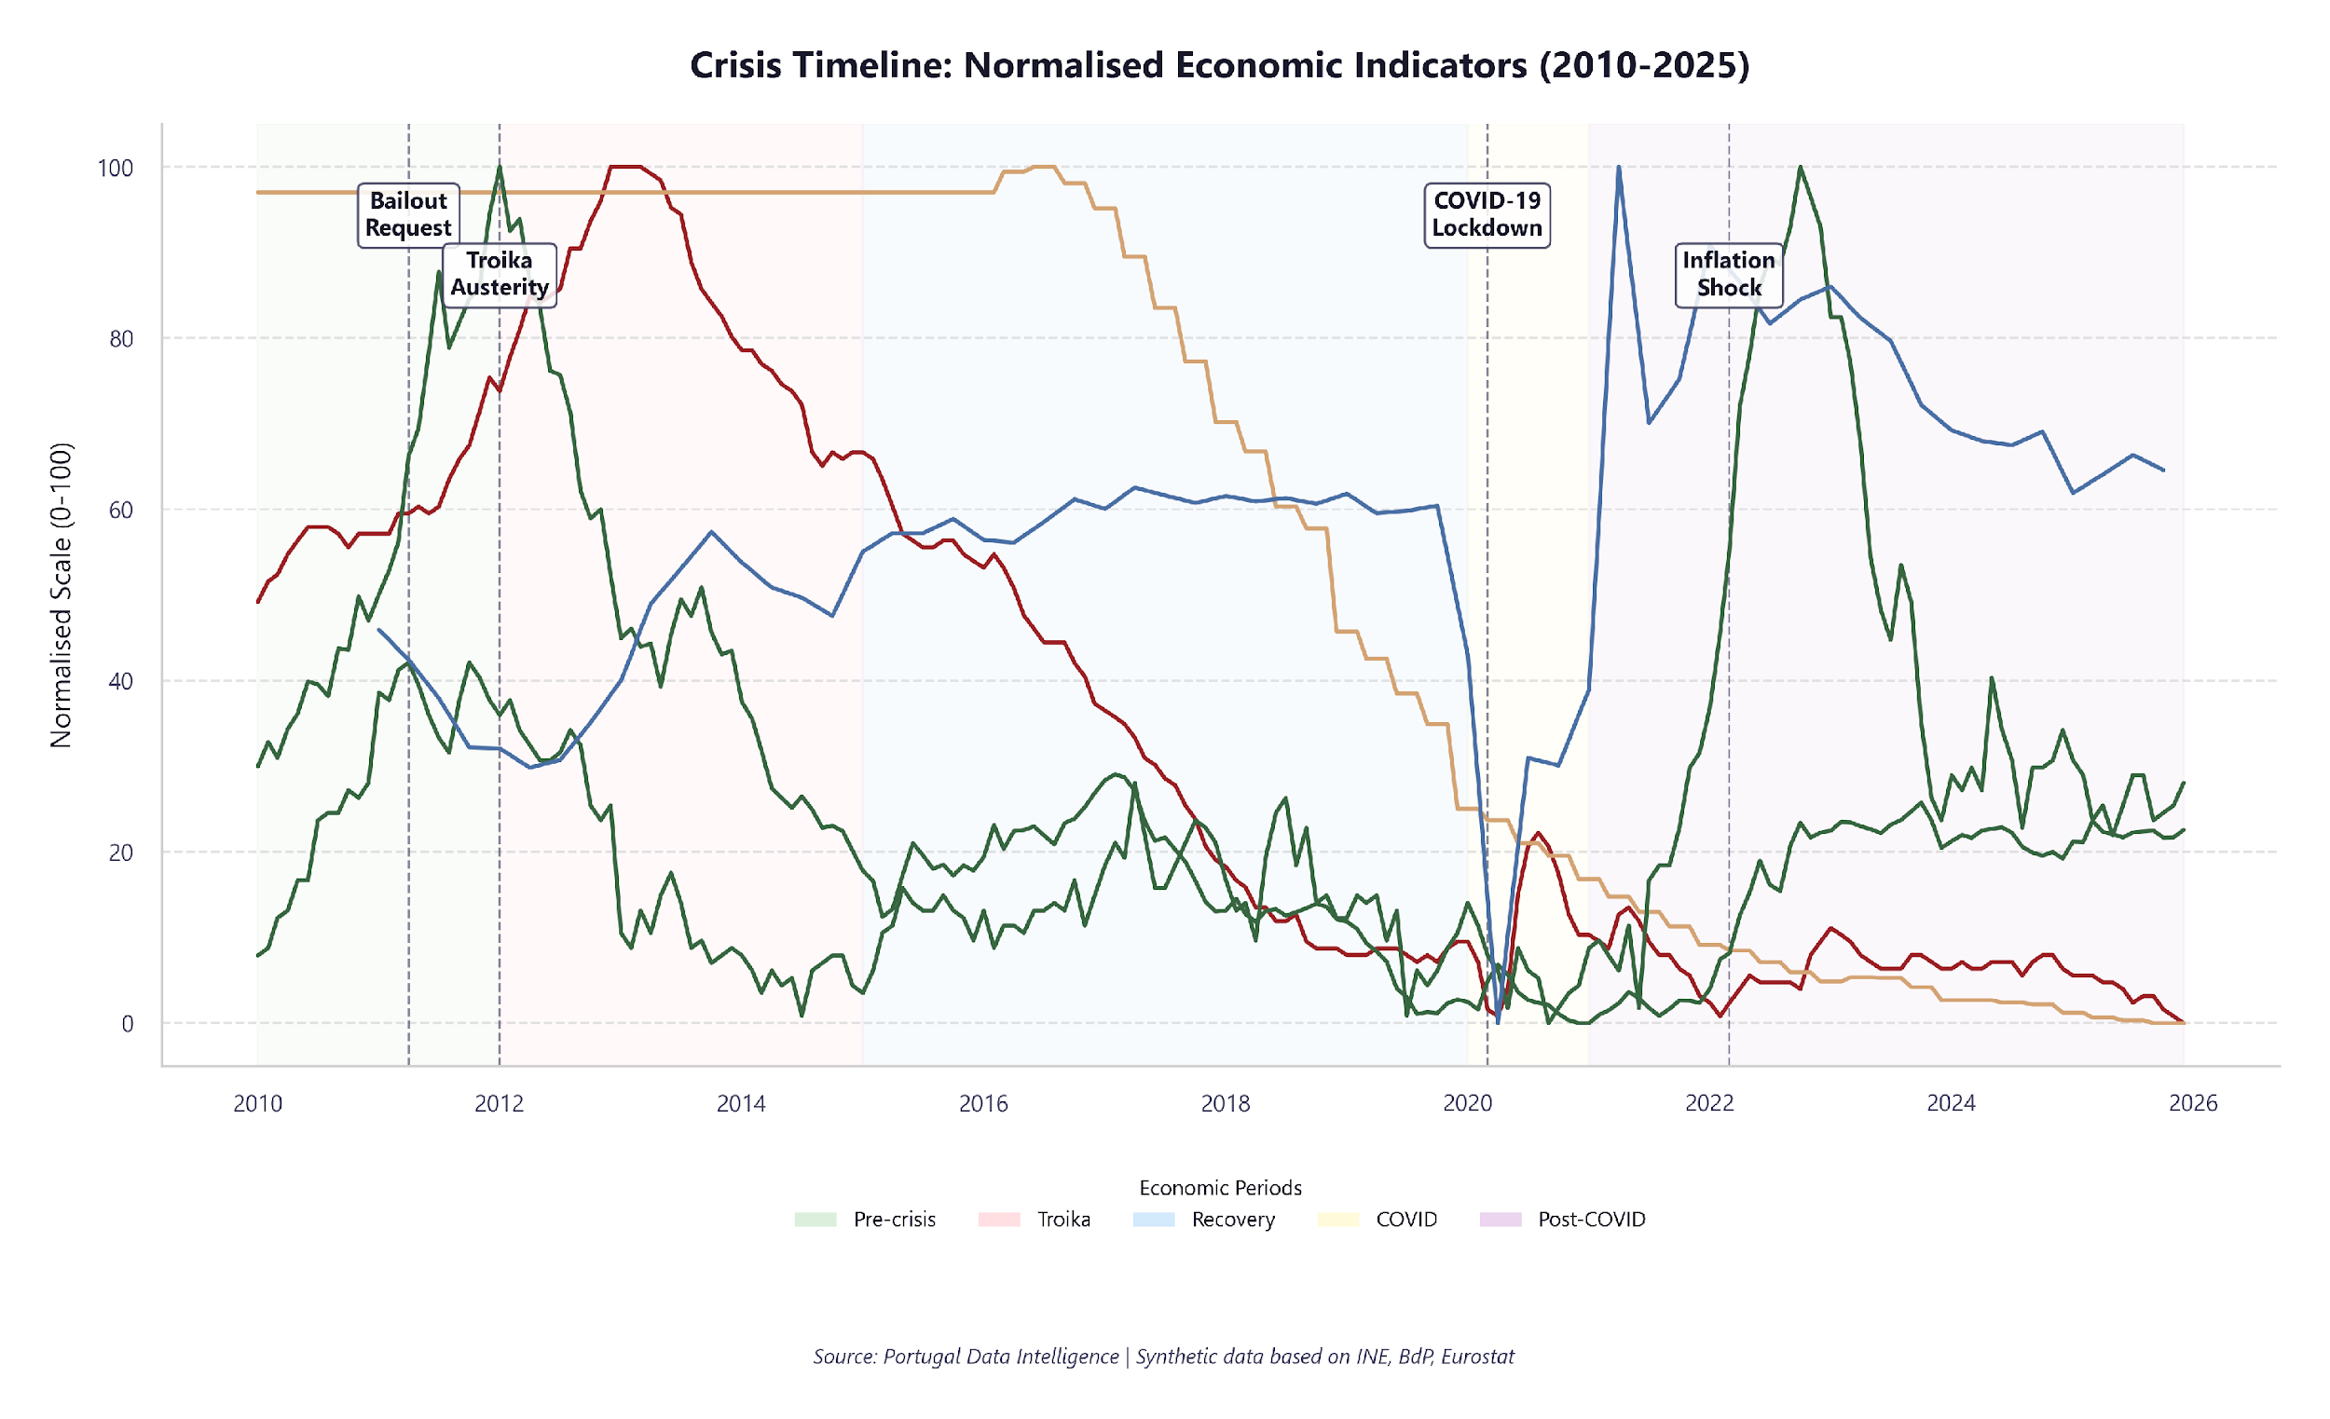
15 Years in Perspective: Four Shocks, One Trajectory
Major economic events impacting Portugal (2010–2025)
Four major shocks in 15 years, each with different transmission channels. The economy’s response time shortened with each shock — a sign of institutional learning.
Key events: Eurozone Debt Crisis (2010–12) │ Troika Bailout (2011–14) │ Recovery & Tourism Boom (2015–19) │ COVID-19 Pandemic (2020–21) │ Energy Crisis & Inflation Surge (2022–23) │ Monetary Tightening (2022–24)
Portugal Data Intelligence | Slide 14
Notes:
Three major shocks define the period: the sovereign debt crisis (2011-2014), COVID-19 (2020-2021), and the energy crisis (2022-2023). Each had distinct transmission mechanisms.

Slide 15
Risk Matrix
Pillar-level risk assessment and mitigations
Pillar | Risk Level | Key Risk | Mitigation | Status
GDP | LOW | Growth slowdown / recession | Diversify economic drivers | ● LOW
Unemployment | LOW | Structural unemployment persistence | Active labour market policies | ● LOW
Credit | LOW | NPL deterioration in tightening cycle | Prudential supervision | ● LOW
Inflation | LOW | Price stability deviation from target | ECB policy pass-through | ● LOW
Public Debt | MEDIUM | Debt sustainability pressure | Fiscal consolidation programme | ● MEDIUM
Interest Rates | MEDIUM | Sovereign spread widening | Credible fiscal framework | ● MEDIUM
Portugal Data Intelligence | Slide 17
Notes:
The risk matrix synthesises our assessment across all pillars. Green indicators reflect the structural improvements achieved; amber and red flags highlight areas requiring continued policy attention.

Slide 16
Strategic Recommendations
Evidence-based policy and investment considerations
SHORT-TERM (0–12 months)
▸ Protect the budget surplus — resist expansionary pressure to preserve fiscal credibility
▸ Monitor credit/GDP ratio — total credit growing faster than GDP despite NPL at 2.2%
MEDIUM-TERM (1–3 years)
▸ Address youth unemployment (17% est.) — dual-education programmes and first-job incentives
▸ Accelerate debt reduction from 98% towards 80% — use surplus for amortisation, not spending
LONG-TERM (3–5+ years)
▸ Close the productivity gap — GDP per capita still ~70% of EU average; invest in I&D above 2% GDP
▸ Build counter-cyclical fiscal buffers for the next downturn — stabilisation fund from surplus years
Portugal Data Intelligence | Slide 16
Notes:
These recommendations are structured by time horizon. Short-term actions focus on monitoring and adjustment; medium-term on structural reform; long-term on resilience building.

Slide 17
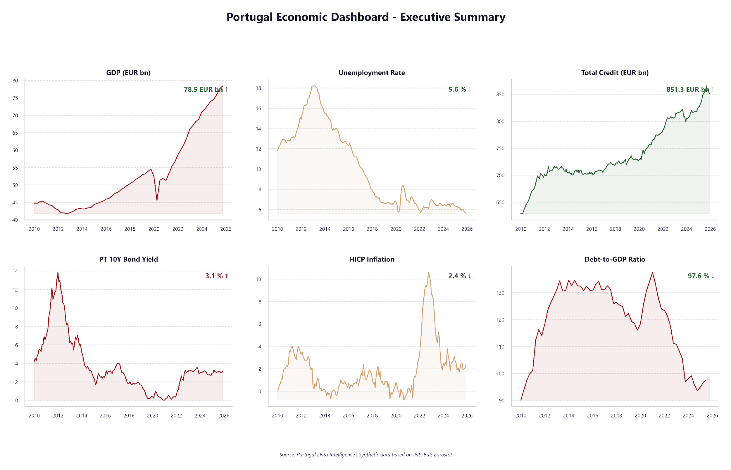
Six Pillars, One Story
All indicators confirm the recovery-to-stability trajectory
All six indicators show the same arc: crisis (2010-2013), recovery (2014-2019), COVID dip (2020), and normalisation (2021-2025). The consistency across pillars confirms this is structural, not cyclical.
Portugal Data Intelligence | Slide 5

Slide 18
Thank You
Portugal Data Intelligence 2026

