Slide 1
An FPGA toolchain for
Graph Neural Network
acceleration using
High-Level Synthesis
ADVISOR
FABRIZIO FERRANDI
AUTHOR
DEMASI GIOVANNI
CO-ADVISORS
SERENA CURZEL, MICHELE FIORITO

Slide 2
Contents
01
02
03
Introduction
Solution
Conclusion
- motivations
- objectives
- background
- state of the art
- Proposed toolchain
- experiments
- matrix multiplication
acceleration
- GCN accelerator
- model accuracy
- solution analysis
and comparison
- future developments
02

Slide 3
Thesis motivations and objectives
Growing popularity of Graph Neural Networks in past years
Mostly used in domains characterized by vast amounts of data, such as social networks and chemistry
Main goal of this thesis was to develop a comprehensive toolchain for Graph
Neural Network inference acceleration
on FPGA architectures
03

Slide 4
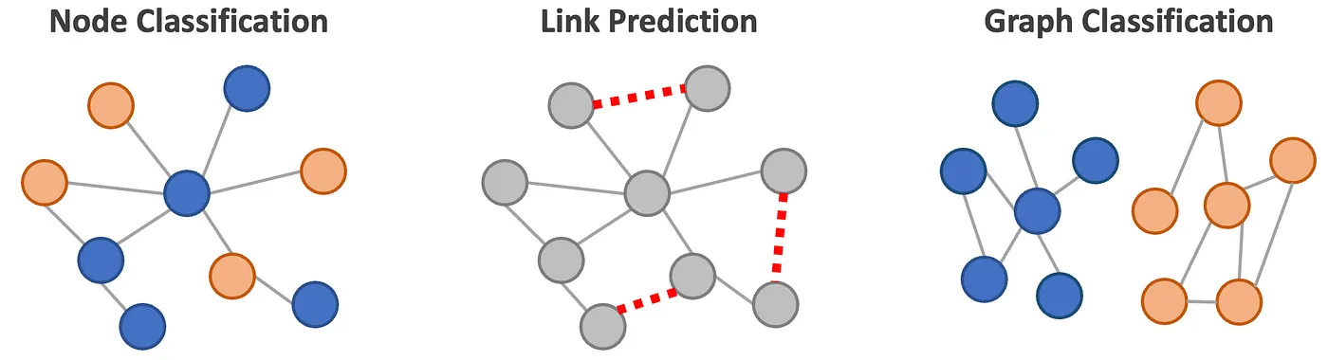
Graph Neural Networks
Deep learning techniques that operate on graph-structured data to solve prediction tasks
Graph Neural Networks consist of multiple interconnected layers and typically encompasses three main stages
pre-processing
Iterative updates
readout
04

Slide 5
MLIR and High-Level Synthesis
MLIR
High-Level Synthesis
C/C++
input design
HLS tool
VHDL/Verilog
output RTL
- A novel approach to construct
reusable and extensible compiler
infrastructure
- Reduces the effort to build
domain-specific compilers.
- Simplified hardware development
- Reduces design time and effort
- Final implementation’s functionality
independent of hardware design
knowledge
05

Slide 6
State of the art GNN accelerators
Unified
architecture
Tiled
architecture
Hybrid
architecture
SW-HW
Co-design
AWB-GCN
ENG
Auten et al.
HyGCN
GRIP
Zhang et al.
GCoD
High-Level Synthesis based
C++ models
FlowGNN is a GNN acceleration framework utilizing
High-Level Synthesis.
C++ model implementations ready to be synthesized.
FlowGNN
Accelerator
06

Slide 7
Design of the toolchain
PyTorch
Popular framework for neural network implementations.
Torch-MLIR
enables the generation of the MLIR representation.
Synthesizer
The MLIR representation serves as input for the synthesizer. Frontend optimization are applied, then the refined version proceeds to the backend, where the actual GNN accelerator is effectively produced.
07

Slide 8
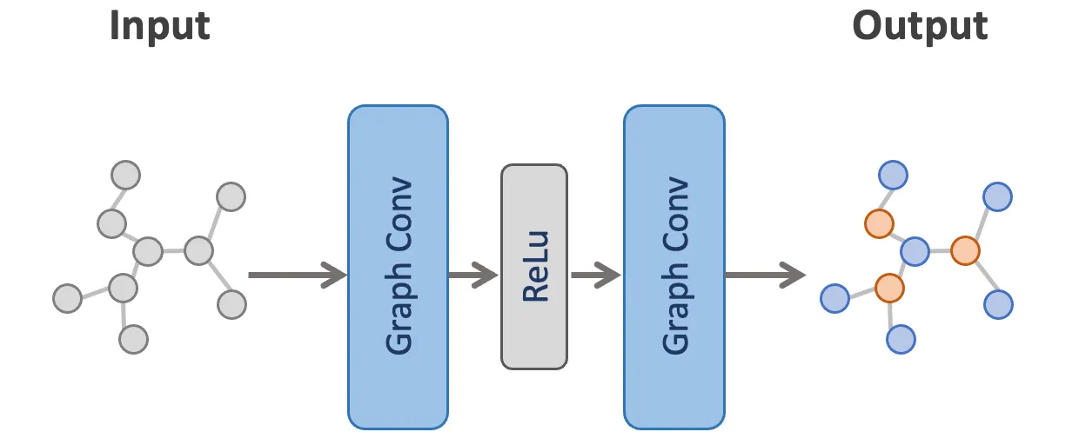
Toolchain inputs
Cora dataset
GCN model
- scientific publications
- multiclass classification
Name | Nodes | Words | Links | Classes
Cora | 2708 | 1433 | 5429 | 7
Cora15 | 15 | 15 | 3 | 7
Cora30 | 30 | 30 | 4 | 7
Cora60 | 60 | 60 | 8 | 7
Cora90 | 90 | 90 | 18 | 7
Cora120 | 120 | 120 | 22 | 7
Cora150 | 150 | 150 | 37 | 7
- Implemented in PyTorch
- Two convolutional layers
- Convolutional layers made
of two matrix multiplications
- Task is node classification
Datasets used for experiments; subsets of Cora dataset
08

Slide 9
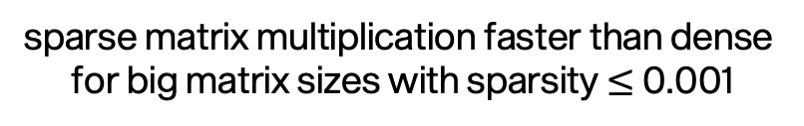
Performance analysis
PyTorch matrix multiplication analysis
Model analysis
Name | %
aten::mm | 50.25%
aten::addmm | 36.30%
aten::add | 4.64%
aten::mm=matrix multiplication; aten::add=
matrix sum; aten::addmm=matrix
multiplication plus, matrix sum
>50% of the computational
time used by matrix
multiplication
sparse matrix multiplication faster than dense
for big matrix sizes with sparsity $≤$ 0.001
09

Slide 10
From PyTorch to MLIR
Torch script is an intermediate representation used to generate serializable and optimizable models directly from PyTorch code; it represents the bridge between PyTorch and Torch-MLIR.
The model must be adapted to Torch Script, then it can be compiled using Torch-MLIR to obtain its MLIR representation.
Model PyTorch
implementation
Adapt model
to Torch Script
Training
torch_mlir.compile
MLIR representation
10

Slide 11
Synthesis
SODA-OPT
PandA-Bambu
MLIR representation
Low-Level IR
Outline kernel function
Low level optimizations
High level optimizations
RTL IR
Low-Level IR
Accelerator
- high level optimization
- subset of MLIR optimization
passes
- output represent the input of
Panda-Bambu
- HLS tool
- last phase of synthesis
- low level optimizations
- output the final accelerator
11

Slide 12
FPGA-accelerated matrix multiplication
Understanding how to optimize matrix
multiplication, the model bottleneck.
Comparative analysis between PyTorch matrix multiplication operation and the baseline accelerator performance.
The baseline accelerator is faster than PyTorch when matrices are relatively small. The reasons behind this behaviour may lie in the fact that:
- the generated accelerator assumes that all data is available in BRAM
- PyTorch times have been measured using all the eight available threads on
the machine, exploiting more parallelism with respect to the accelerator.
12

Slide 13
Synthesis optimizations
Loop unrolling
Parallel memory access
data
read
before
after
for i in range(0,4){
code
}
for i in range(0,2){
code
code
}
1 | 3 | 0
2 | 8 | 3
3 | 2 | 6
- increasing the number of memory
channels
- better exploitation of available
parallelism
- more parallel memory accesses
but more cycles due to external
memory
- expanding completely or partially
the loop
- unroll factor parameter to decide
the number of loop iterations to
unroll
- more chances of parallelization
13

Slide 14
Optimized matrix multiplication accelerator
- Low available parallelization = using two
channels and storing all memory
objects in BRAMs is the best option
- High available parallelization = 32
channels with external memory
- 2 channels with external memory is the
least favourable choice - External memory beneficial when large
volume of data can be simultaneously
loaded and stored to offset the additional
cycles required for external
memory access
Cycles comparison between configurations with different number of channels with BRAM/external memory.
14

Slide 15
GCN accelerator
- analysed synthesis optimizations
applied to the GCN model
- optimized accelerator uses two
channels with on-chip BRAMs
and one full unroll of the
innermost loop
- it outperforms PyTorch
- advantage maintained also with
bigger dataset sizes
Graph Convolutional Network inference time comparison between PyTorch and FPGA implementations for different sizes of the dataset.
15

Slide 16
GCN accelerators comparison
analysis to show how the accelerator has been affected by the loop unrolling technique with respect to the baseline performance
- optimized accelerator uses
two channels and one full
unrolling of the innermost
loop
- the speedup increases as
the size of the dataset
increases
- trade-off between
performance and area
Graph Convolutional Network number of cycles comparison between baseline and optimized accelerators for different sizes of the dataset.
16

Slide 17
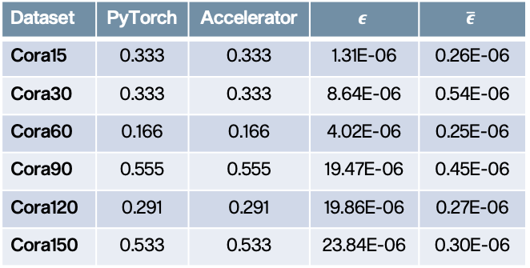

Model accuracy
- understandably low accuracy
- synthesis has not impacted the
accuracy of the model
- the average error is stable even
for increasing graph sizes
- very low probability of
misclassification even when
dealing with large dataset
Dataset | PyTorch | Accelerator | $$ε$$ | $$\overline{ε}$$
Cora15 | 0.333 | 0.333 | 1.31E-06 | 0.26E-06
Cora30 | 0.333 | 0.333 | 8.64E-06 | 0.54E-06
Cora60 | 0.166 | 0.166 | 4.02E-06 | 0.25E-06
Cora90 | 0.555 | 0.555 | 19.47E-06 | 0.45E-06
Cora120 | 0.291 | 0.291 | 19.86E-06 | 0.27E-06
Cora150 | 0.533 | 0.533 | 23.84E-06 | 0.30E-06
Accuracy comparison between PyTorch and Accelerator. 𝝐=total error; $\overline{ε}$=average error.
17

Slide 18
Proposed solution analysis
Characteristic | State of the art | FlowGNN | Toolchain
Supported models | mostly focused on a specific model, only some solution are generalizable | Set of implementations in C++ that can be modified | All models that can be implemented in PyTorch
Customization | mostly not customizable, only few propose some settable parameters | Four configurable parallelization parameters | Optimization during synthesis, fine-tuning of model performance
Hardware design | mostly required, only one solution uses HLS tools | Use of HLS, no need of low-level programming | Use of HLS, no need of low-level programming
New model and features should be implemented in C++ a possible blocking factor
FlowGNN is the only state of the art solution using HLS
Limited possibility
of customization to
specific needs
About FlowGNN
18

Slide 19
Conclusions and future developments
Accomplishments
- Toolchain for GNN inference acceleration
- Matrix multiplication and GCN accelerators
with fine-tuned optimizations
- Analysis of SODA and Bambu optimizations
- Implementation of new Torch-MLIR feature
- Identification of possible area of
improvements of Torch-MLIR
Future developments
- Support of PyTorch Geometric
- Support of sparse tensor operations,
possible solution is PyTaco
19

Slide 20
Thanks for your
attention
GIOVANNI DEMASI, 2023

