Slide 1
An FPGA toolchain for
Graph Neural Network
acceleration using
High-Level Synthesis
ADVISOR
FABRIZIO FERRANDI
AUTHOR
DEMASI GIOVANNI
CO-ADVISORS
SERENA CURZEL, MICHELE FIORITO

Slide 2
Contents
01
02
03
Introduction
Solution
Conclusion
motivations
objectives
background
toolchain
experiments
solution analysis and comparison
future developments
02

Slide 3
Thesis motivations and objectives
Motivations of the thesis
Optimizing and accelerating the capabilities of Graph Neural Networks is necessary due to their increasingly popularity, especially in fields characterized by vast amount of data.
Objectives of the thesis
A comprehensive toolchain for Graph Neural Network inference acceleration on FPGA architectures
Identify the models bottlenecks and accelerate the heaviest computational operations
Identify customized optimizations designed to finely enhance model performance
Usage of the toolchain for the generation of a GNN inference accelerator
Growing popularity of Graph Neural Networks in past years on Google Scholar.
03

Slide 4
Graph Neural Networks
Graph Neural Networks are deep learning techniques that operate on graph-structured data to solve prediction tasks:
Classify nodes according
to labels of their neighbours
Predict the evolution of connection between two entities
Classify the whole graph into
different categories
Graph Neural Networks consist of multiple interconnected layers and typically encompasses three main stages:
pre-processing
Iterative updates
readout
transforming
the input data
edge and vertex feature vectors update
aggregates embeddings
in a global feature vector
04

Slide 5
Design of the toolchain
The toolchain proposed in this thesis makes use
of MLIR and is based on High-Level Synthesis.
MLIR
High-Level Synthesis
A novel approach to construct reusable
and extensible compiler infrastructure.
Simplified hardware development.
Reduces design time and effort.
C/C++
HLS tool
VHDL
Synthesizer
It takes the MLIR representation as input and transform it into accelerator. Firstly, it apply high-level optimizations, then the refined version proceeds to the Bambu HLS backend, where the GNN accelerator is effectively produced.
FPGA Toolchain for Graph Neural Network Acceleration
05

Slide 6
Toolchain inputs
Cora dataset
PyTorch
Toolchain entry point, for neural network implementations.
Scientific publications
Multiclass classification
Subsets to contain synthesis and evaluation times
Graph Convolutional Network
Name | Nodes | Words | Links | Classes
Cora | 2708 | 1433 | 5429 | 7
Cora15 | 15 | 15 | 3 | 7
Cora30 | 30 | 30 | 4 | 7
Cora60 | 60 | 60 | 8 | 7
Cora90 | 90 | 90 | 18 | 7
Cora120 | 120 | 120 | 22 | 7
Cora150 | 150 | 150 | 37 | 7
Model’s characteristics:
Two convolutional layers
Convolutional layers made of two matrix multiplications
Task is node classification
Datasets used for experiments: subsets of Cora dataset.
06

Slide 7
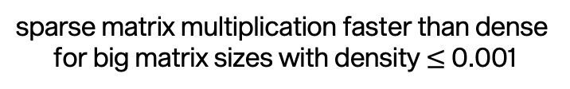
Performance analysis
PyTorch matrix multiplication analysis
Model analysis
Analysis to identify the computational
bottlenecks of the model
Name | %
aten::mm | 50.25%
aten::addmm | 36.30%
aten::add | 4.64%
aten::mm=matrix multiplication; aten::add=
matrix sum; aten::addmm=matrix
multiplication plus matrix sum
>50% of the computational
time used by matrix
multiplication
PyTorch CPU execution time of matrix multiplication with
dense and sparse matrix representations. COO=Coordinate list; CSR=Compressed Sparse Row
sparse matrix multiplication faster than dense
for big matrix sizes with density $≤$ 0.001
07

Slide 8
From PyTorch to MLIR
Torch-MLIR
The Torch-MLIR project aims to provide first class compiler support from the PyTorch ecosystem to the MLIR ecosystem.
It leverages torch script, an intermediate representation used to generate serializable and optimizable models directly from PyTorch code; it represents the bridge between PyTorch and Torch-MLIR.
After having created a set of general rules to adapt different GNN models to torch script, the GCN model has been adapted to Torch Script; then it has been compiled using Torch-MLIR to obtain its MLIR representation.
PyTorch model
implementation
Adapt model
to Torch Script
Model training
torch_mlir.compile
MLIR IR
From PyTorch model implementation to MLIR IR flow
08

Slide 9
Synthesis
The synthesizer includes SODA-OPT and PandA-Bambu and represents the final step of the toolchain. which optimizes and synthesizes the MLIR representation, targeting FPGA.
SODA-OPT
PandA-Bambu
MLIR representation
Low-Level IR
Outline kernel function
Low level optimizations
High level optimizations
RTL IR
Low-Level IR
Accelerator
High level optimization
Subset of MLIR passes
Output represents the input of Panda-Bambu
High-Level Synthesis tool
low level optimizations
output is the final accelerator
09

Slide 10
FPGA-accelerated matrix multiplication
Experimental phase setup
CPU
Intel Core i9, 8
cores, 2.3 GHz
Accelerators
AMD Virtex UltraScale+ (Alveo U280) FPGA.
Analysis to identify performance differences between PyTorch matrix multiplication
operation and the baseline accelerator.
Analysis results
The baseline accelerator is faster than PyTorch when matrices are relatively small. The reasons behind this behaviour may lie in the fact that:
The generated accelerator assumes that all data is available in BRAM
PyTorch times have been measured using all available threads on the machine, exploiting more parallelism with respect to the accelerator
Comparative analysis between PyTorch matrix multiplication operation and the baseline accelerator performance.
10

Slide 11
Synthesis optimizations
To make the accelerator able to exploits more parallelism, two main optimizations have been applied: loop unrolling and parallel memory accesses.
Loop unrolling
Parallel memory access
data
read
before
after
for i in range(0,4){
code
}
for i in range(0,2){
code
code
}
1 | 3 | 0
2 | 8 | 3
3 | 2 | 6
Expanding completely or partially the loop, according to unroll factor
Unroll factor parameter to decide the number of loop iterations to unroll
More chances of parallelization
Increasing the number of memory channels for parallel r/w
Better exploitation of parallelism
More parallel memory accesses but more cycles due to external memory
11

Slide 12
Optimized matrix multiplication accelerator
Analysis aiming to analyse the relation between the number of execution cycles when using BRAM/external memory and the unroll factor.
Analysis results showed that, in some situations, using external memory is better than BRAM:
Small unroll factor: better setting is using 2 channels, storing all memory objects in BRAMs
Large unroll factor: 32 channels with external memory is the best option
2 channels with external memory is always the least favourable choice
Usage of external memory is beneficial when large volume of data can be simultaneously loaded and stored to offset the additional cycles required for external memory
Cycles comparison between accelerator configurations using different number of channels with BRAM/external memory (NO_BRAM), for increasing unroll factor.
12

Slide 13

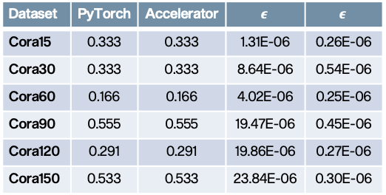
GCN accelerator
Analysis to measure difference in floating precision on FPGA implementations and its impact on model accuracy.
Application of the analysed optimizations to the Graph Convolutional Network.
Accelerator outperforms PyTorch
Performance improvement maintained with increasing dataset sizes
Synthesis has not impacted the accuracy of the model
Average error is stable; not affected by the dataset size
Low probability of misclassification
Dataset | PyTorch | Accelerator | $$ε$$ | $$\overline{ε}$$
Cora15 | 0.333 | 0.333 | 1.31E-06 | 0.26E-06
Cora30 | 0.333 | 0.333 | 8.64E-06 | 0.54E-06
Cora60 | 0.166 | 0.166 | 4.02E-06 | 0.25E-06
Cora90 | 0.555 | 0.555 | 19.47E-06 | 0.45E-06
Cora120 | 0.291 | 0.291 | 19.86E-06 | 0.27E-06
Cora150 | 0.533 | 0.533 | 23.84E-06 | 0.30E-06
Graph Convolutional Network inference time comparison between PyTorch and FPGA implementations for different sizes of the dataset. Optimized accelerator uses 2 channels with BRAMs and one full unroll.
Accuracy comparison between PyTorch and Accelerator. 𝝐=total error; $\overline{ε}$=average error.
13

Slide 14
GCN accelerators comparison
Analysis to show how the accelerator using 2 channels with BRAMs and one full unroll
of the innermost loop has been affected by loop unrolling technique, compared to the baseline performance with 2 channels BRAMs and unroll factor equal to 1.
The baseline accelerator does not exploit parallelism at all
The optimized accelerator exploits parallelism more and more as the size of the dataset increases the speedup increases as the size of the dataset increases
Trade-off between performance and area: more parallel operations means more computational units
Graph Convolutional Network number of cycles comparison between baseline and optimized accelerators for different sizes of the dataset.
14

Slide 15
State of the art analysis
The proposed toolchain offers new and improved ways to accelerate Graph Neural Network inference time on FPGA architectures.
Characteristic | State of the art | FlowGNN | Toolchain
Supported models | Mostly focused on a specific model, only some solutions are generalizable | Set of implementations in C++ that can be modified | Any models that can be implemented in PyTorch
Customization | Mostly not customizable, only few propose some settable parameters | Four configurable parallelization parameters | Optimization during synthesis, fine-tuning of model performance
Hardware design | Mostly required, only one solution uses HLS tools | Use of HLS, no need of low-level programming | Use of HLS, no need of low-level programming
15

Slide 16
Conclusions and future developments
Accomplishments
FPGA toolchain for GNN inference acceleration
Enhanced compatibility of toolchain elements
General set of rules to make models compatible with torch script
Support of constant of tuple Type in Torch-MLIR
Identification of area of improvements for PyTorch Geometric support
Matrix multiplication and GNN accelerators with customized optimizations to finely enhance their performance
Future developments
Support of PyTorch Geometric
Support of sparse tensor operations, possible solution is PyTaco
Possible future developments to the proposed toolchain
16

Slide 17
Thanks for your
attention
GIOVANNI DEMASI, 2023

Slide 18
State of the art GNN accelerators
Unified
architecture
Tiled
architecture
Hybrid
architecture
SW-HW
Co-design
AWB-GCN
ENG
Auten et al.
HyGCN
GRIP
Zhang et al.
GCoD
High-Level Synthesis based
C++ models
FlowGNN is a GNN acceleration framework utilizing
High-Level Synthesis.
C++ model implementations ready to be synthesized.
FlowGNN
Accelerator
06

Slide 19
MLIR and High-Level Synthesis
MLIR
High-Level Synthesis
C/C++
input design
HLS tool
VHDL/Verilog
output RTL
- A novel approach to construct
reusable and extensible compiler
infrastructure
- Reduces the effort to build
domain-specific compilers.
- Simplified hardware development
- Reduces design time and effort
- Final implementation’s functionality
independent of hardware design
knowledge
05

Slide 20
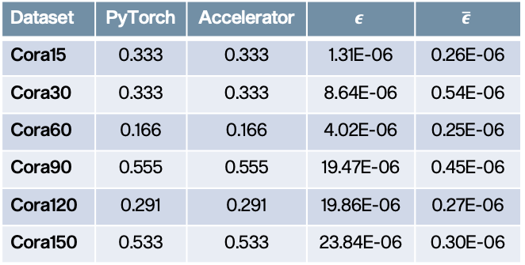

Model accuracy
- understandably low accuracy
- synthesis has not impacted the
accuracy of the model
- the average error is stable even
for increasing graph sizes
- very low probability of
misclassification even when
dealing with large dataset
Dataset | PyTorch | Accelerator | $$ε$$ | $$\overline{ε}$$
Cora15 | 0.333 | 0.333 | 1.31E-06 | 0.26E-06
Cora30 | 0.333 | 0.333 | 8.64E-06 | 0.54E-06
Cora60 | 0.166 | 0.166 | 4.02E-06 | 0.25E-06
Cora90 | 0.555 | 0.555 | 19.47E-06 | 0.45E-06
Cora120 | 0.291 | 0.291 | 19.86E-06 | 0.27E-06
Cora150 | 0.533 | 0.533 | 23.84E-06 | 0.30E-06
Accuracy comparison between PyTorch and Accelerator. 𝝐=total error; $\overline{ε}$=average error.
17

