Slide 1
An FPGA toolchain for
Graph Neural Network
acceleration using
High-Level Synthesis
ADVISOR
FABRIZIO FERRANDI
AUTHOR
DEMASI GIOVANNI
CO-ADVISORS
SERENA CURZEL, MICHELE FIORITO

Slide 2
Contents
01
02
03
Introduction
Solution
Conclusion
motivations
objectives
background
toolchain
experiments
matrix mul acceleration
GCN accelerator
model accuracy
solution analysis and comparison
toolchain future developments
02

Slide 3
Thesis motivations and objectives
A comprehensive toolchain for Graph Neural Network inference acceleration on FPGA architectures
Identify customized optimizations designed to finely enhance model performance
Enhancing the capabilities of the toolchain’s elements to make them compatible
Identify the models bottlenecks and accelerate the heaviest computational operations
Usage of the toolchain for the generation of a GNN inference accelerator
Growing popularity of Graph Neural Networks in past years on Google Scholar.
03

Slide 4
Graph Neural Networks
Deep learning techniques that operate on graph-structured data to solve prediction tasks:
Graph Neural Networks consist of multiple interconnected layers and typically encompasses three main stages:
pre-processing
Iterative updates
readout
transforming
the input data
edge and vertex feature vectors update
aggregates embeddings
in a global feature vector
04

Slide 5
Design of the toolchain
PyTorch
Popular framework for neural network implementations.
Torch-MLIR
enables the generation of
the MLIR IR.
Synthesizer
The MLIR representation serves as input for the synthesizer. Frontend optimizations are applied, then the refined version proceeds to the backend, where the actual GNN accelerator is effectively produced.
FPGA Toolchain for Graph Neural Network Acceleration
05

Slide 6
Toolchain inputs
Cora dataset
GCN model
scientific publications
multiclass classification
Name | Nodes | Words | Links | Classes
Cora | 2708 | 1433 | 5429 | 7
Cora15 | 15 | 15 | 3 | 7
Cora30 | 30 | 30 | 4 | 7
Cora60 | 60 | 60 | 8 | 7
Cora90 | 90 | 90 | 18 | 7
Cora120 | 120 | 120 | 22 | 7
Cora150 | 150 | 150 | 37 | 7
Implemented in PyTorch
Two convolutional layers
Convolutional layers made of two matrix multiplications
Task is node classification
Datasets used for experiments; subsets of Cora dataset
06

Slide 7
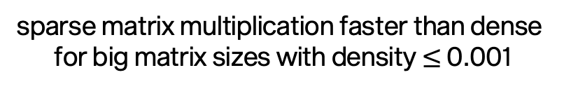
Performance analysis
PyTorch matrix multiplication analysis
Model analysis
Name | %
aten::mm | 50.25%
aten::addmm | 36.30%
aten::add | 4.64%
aten::mm=matrix multiplication; aten::add=
matrix sum; aten::addmm=matrix
multiplication plus matrix sum
>50% of the computational
time used by matrix
multiplication
sparse matrix multiplication faster than dense
for big matrix sizes with density $≤$ 0.001
07

Slide 8
From PyTorch to MLIR
Torch script is an intermediate representation used to generate serializable and optimizable models directly from PyTorch code; it represents the bridge between PyTorch and Torch-MLIR.
The model has been adapted to Torch Script, then
it has been compiled using Torch-MLIR to obtain its
MLIR representation.
PyTorch model
implementation
Adapt model
to Torch Script
Model training
torch_mlir.compile
MLIR
MLIR IR
A novel approach to construct reusable and extensible compiler infrastructure.
From PyTorch model implementation to MLIR IR flow
08

Slide 9
Synthesis
SODA-OPT
PandA-Bambu
HLS
MLIR representation
Low-Level IR
C/C++
Outline kernel function
Low level optimizations
HLS tool
High level optimizations
RTL IR
VHDL/Verilog
Low-Level IR
Accelerator
high level optimization
subset of MLIR optimization passes
output represents the input of Panda-Bambu
low level optimizations
output is the final accelerator
simplified hardware development
reduces design time and effort
09

Slide 10
FPGA-accelerated matrix multiplication
PyTorch
Intel Core i9, 8
cores, 2.3 GHz
Accelerators
AMD Virtex UltraScale+ (Alveo U280) FPGA.
Analysis about model performance to identify the computational bottlenecks
The baseline accelerator is faster than PyTorch when matrices are relatively small. The reasons behind this behaviour may lie in the fact that:
the generated accelerator assumes that all data is available in BRAM
PyTorch times have been measured using all available threads on the machine, exploiting more parallelism with respect to the accelerator
Comparative analysis between PyTorch matrix multiplication operation and the baseline accelerator performance.
10

Slide 11
Synthesis optimizations
Loop unrolling
Parallel memory access
data
read
before
after
for i in range(0,4){
code
}
for i in range(0,2){
code
code
}
1 | 3 | 0
2 | 8 | 3
3 | 2 | 6
increasing the number of memory channels
better exploitation of available parallelism
more parallel memory accesses but more cycles due to external memory
expanding completely or partially the loop
unroll factor parameter to decide the number of loop iterations to unroll
more chances of parallelization
11

Slide 12
Optimized matrix multiplication accelerator
Low available parallelization: two channels and storing all memory objects in BRAMs
High available parallelization: thirty-two channels with external memory
Two channels with external memory is the least favourable choice
External memory beneficial when large volume of data can be simultaneously loaded and stored to offset the additional cycles required for external memory
Cycles comparison between configurations with different number of channels with BRAM/external memory.
12

Slide 13

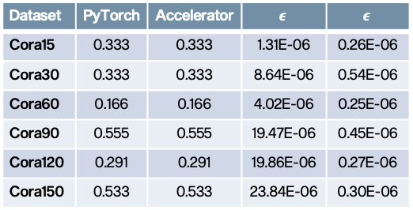
GCN accelerator
optimized accelerator uses two channels with on-chip BRAMs and one full unroll
synthesis has not impacted the accuracy of the model
Accelerator outperforms PyTorch
Advantage maintained with increasing dataset sizes
Dataset | PyTorch | Accelerator | $$ε$$ | $$\overline{ε}$$
Cora15 | 0.333 | 0.333 | 1.31E-06 | 0.26E-06
Cora30 | 0.333 | 0.333 | 8.64E-06 | 0.54E-06
Cora60 | 0.166 | 0.166 | 4.02E-06 | 0.25E-06
Cora90 | 0.555 | 0.555 | 19.47E-06 | 0.45E-06
Cora120 | 0.291 | 0.291 | 19.86E-06 | 0.27E-06
Cora150 | 0.533 | 0.533 | 23.84E-06 | 0.30E-06
Graph Convolutional Network inference time comparison between PyTorch and FPGA implementations for different sizes of the dataset.
Accuracy comparison between PyTorch and Accelerator. 𝝐=total error; $\overline{ε}$=average error.
13

Slide 14
GCN accelerators comparison
analysis to show how the accelerator has been affected by the loop unrolling technique with respect to the baseline performance
optimized accelerator uses two channels and one full unrolling of the innermost loop
the speedup increases as the size of the dataset increases
trade-off between performance and area
Graph Convolutional Network number of cycles comparison between baseline and optimized accelerators for different sizes of the dataset.
14

Slide 15
Proposed solution analysis
Characteristic | State of the art | FlowGNN | Toolchain
Supported models | mostly focused on a specific model, only some solutions are generalizable | Set of implementations in C++ that can be modified | All models that can be implemented in PyTorch
Customization | mostly not customizable, only few propose some settable parameters | Four configurable parallelization parameters | Optimization during synthesis, fine-tuning of model performance
Hardware design | mostly required, only one solution uses HLS tools | Use of HLS, no need of low-level programming | Use of HLS, no need of low-level programming
About FlowGNN
FlowGNN is the only state of the art solution using High-Level Synthesis
New model and features should be implemented in C++, for significative changes it can represent a possible blocking factor
Limited possibility of customization to specific needs, only four parallelization parameters
15

Slide 16
Conclusions and future developments
Accomplishments
FPGA toolchain for GNN inference acceleration
Enhanced compatibility of toolchain elements
General set of rules to make models compatible with torch script
Support of constant of tuple Type in Torch-MLIR
Identification of area of improvements for PyTorch Geometric support
Matrix multiplication and GNN accelerators with customized optimizations to finely enhance their performance
Future developments
Support of PyTorch Geometric
Support of sparse tensor operations, possible solution is PyTaco
Possible future developments to the proposed toolchain
16

Slide 17
Thanks for your
attention
GIOVANNI DEMASI, 2023

Slide 18
State of the art GNN accelerators
Unified
architecture
Tiled
architecture
Hybrid
architecture
SW-HW
Co-design
AWB-GCN
ENG
Auten et al.
HyGCN
GRIP
Zhang et al.
GCoD
High-Level Synthesis based
C++ models
FlowGNN is a GNN acceleration framework utilizing
High-Level Synthesis.
C++ model implementations ready to be synthesized.
FlowGNN
Accelerator
06

Slide 19
MLIR and High-Level Synthesis
MLIR
High-Level Synthesis
C/C++
input design
HLS tool
VHDL/Verilog
output RTL
- A novel approach to construct
reusable and extensible compiler
infrastructure
- Reduces the effort to build
domain-specific compilers.
- Simplified hardware development
- Reduces design time and effort
- Final implementation’s functionality
independent of hardware design
knowledge
05

Slide 20
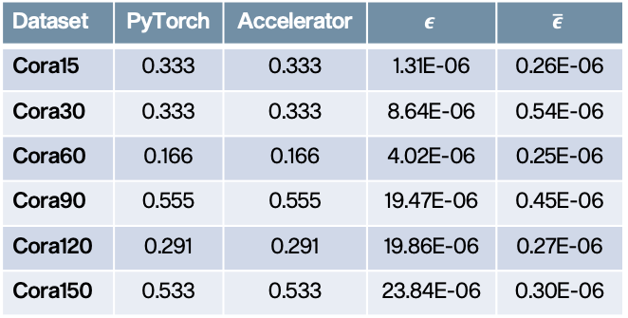

Model accuracy
- understandably low accuracy
- synthesis has not impacted the
accuracy of the model
- the average error is stable even
for increasing graph sizes
- very low probability of
misclassification even when
dealing with large dataset
Dataset | PyTorch | Accelerator | $$ε$$ | $$\overline{ε}$$
Cora15 | 0.333 | 0.333 | 1.31E-06 | 0.26E-06
Cora30 | 0.333 | 0.333 | 8.64E-06 | 0.54E-06
Cora60 | 0.166 | 0.166 | 4.02E-06 | 0.25E-06
Cora90 | 0.555 | 0.555 | 19.47E-06 | 0.45E-06
Cora120 | 0.291 | 0.291 | 19.86E-06 | 0.27E-06
Cora150 | 0.533 | 0.533 | 23.84E-06 | 0.30E-06
Accuracy comparison between PyTorch and Accelerator. 𝝐=total error; $\overline{ε}$=average error.
17

