Slide 1
단머스 2기 두번째 미팅!
2019.8

Slide 2
변수 목록
TransactionID, isFraud, TransactionDT, TransactionAmt, ProductCD,
DeviceType, DeviceInfo
card1, card2, card3, card4, card5, card6,
addr1, addr2, dist1, dist2, P_emaildomain, R_emaildomain,
C1, C2, C3, C4, C5, C6, C7, C8, C9, C10, C11, C12, C13, C14,
D1, D2, D3, D4, D5, D6, D7, D8, D9, D10, D11, D12, D13, D14, D15,
M1, M2, M3, M4, M5, M6, M7, M8, M9,
V1, V2, V3, V4, V5, V6, V7, V8, V9, V10, V11, V12, V13, V14, V15, V16, V17, V18, V19, V20, V21, V22, V23, V24, V25, V26, V27, V28, V29, V30, V31, V32, V33, V34, V35, V36, V37, V38, V39, V40, V41, V42, V43, V44, V45, V46, V47, V48, V49, V50, V51, V52, V53, V54, V55, V56, V57, V58, V59, V60, V61, V62, V63, V64, V65, V66, V67, V68, V69, V70, V71, V72, V73, V74, V75, V76, V77, V78, V79, V80, V81, V82, V83, V84, V85, V86, V87, V88, V89, V90, V91, V92, V93, V94, V95

Slide 3
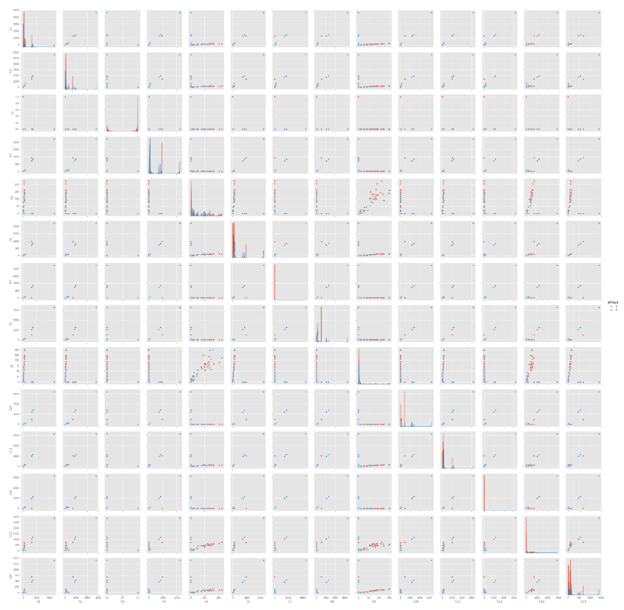
C1 ~ C14 : counting, such as how many addresses are found to be associated with the payment card, etc.
C1
C2
C3
C4
C5
C6
C7
C8
C9
C10
C11
C12
C13
C14
C1
C2
C3
C4
C5
C6
C7
C8
C9
C10
C11
C12
C13
C14

Slide 4
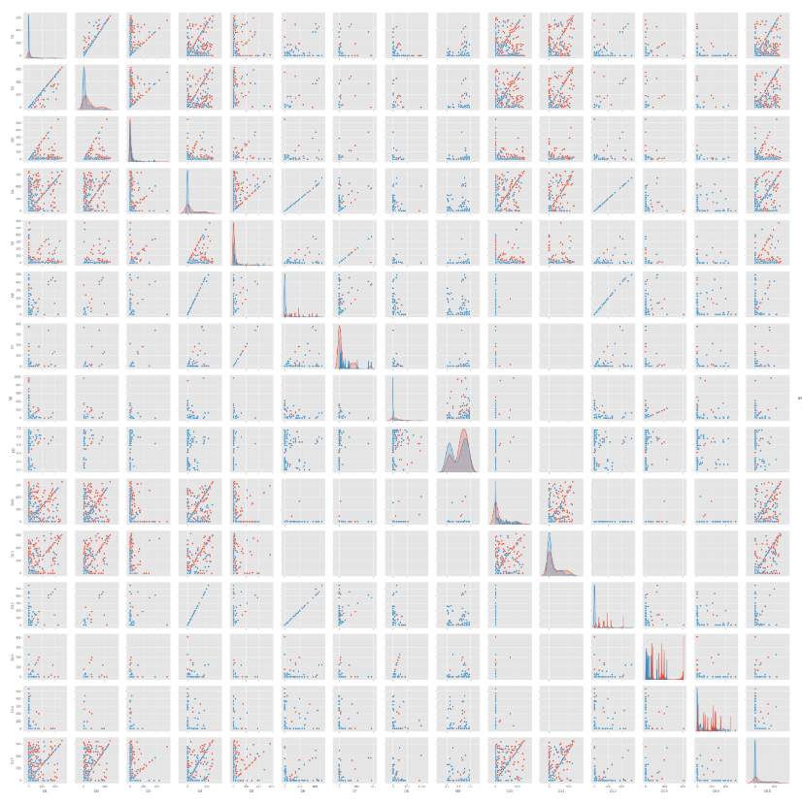
D1 ~ D15 : timedelta, such as days between previous transaction, etc.

Slide 5
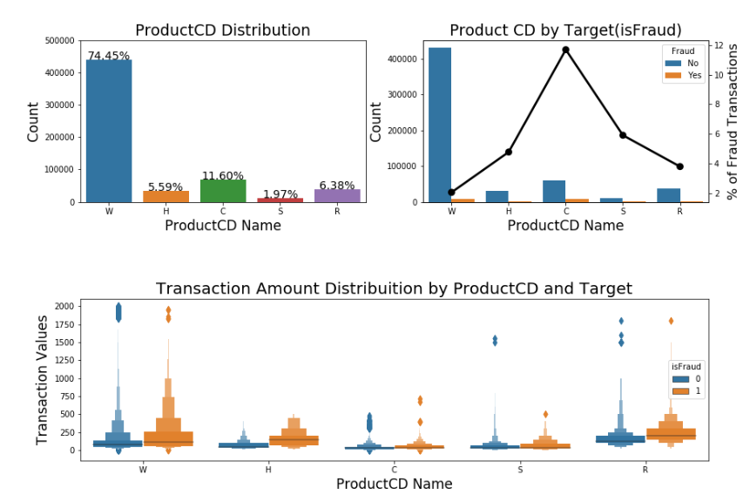
W, H and R the distribution of Fraud values are slightly higher than the Non-Fraud Transactions

