Slide 1

CSE5335 WEB DATA MANAGEMENT PROJECT PRESENTATION
TEAM - 3
MOHANA VENKATA SAI RAM KALYAN DEVISETTY (1002176707)
MUNI SAI KALYAN TEJA DUDI (1002104402)
SAI GOPALA SWAMY GADDE – (1002157726)
VENKATA ARUN KRISHNA GANUGAPATI – (1002059174)
SAI MAHINDHARA NAGA VAMSI GATTE – (1002140926)
Section: 5335-001
SPRING 2024

Slide 2
INTRODUCTION
Welcome to the Volunteer Application Project! This project aims to create a user-friendly web application to manage volunteer programs for MS graduates in Computer Science.
This website gives a good opportunity for graduate students to Volunteer under professor until student finds a job.

Slide 3

PHASE 4 DEMO
PAGES BEFORE LOGIN

Slide 4
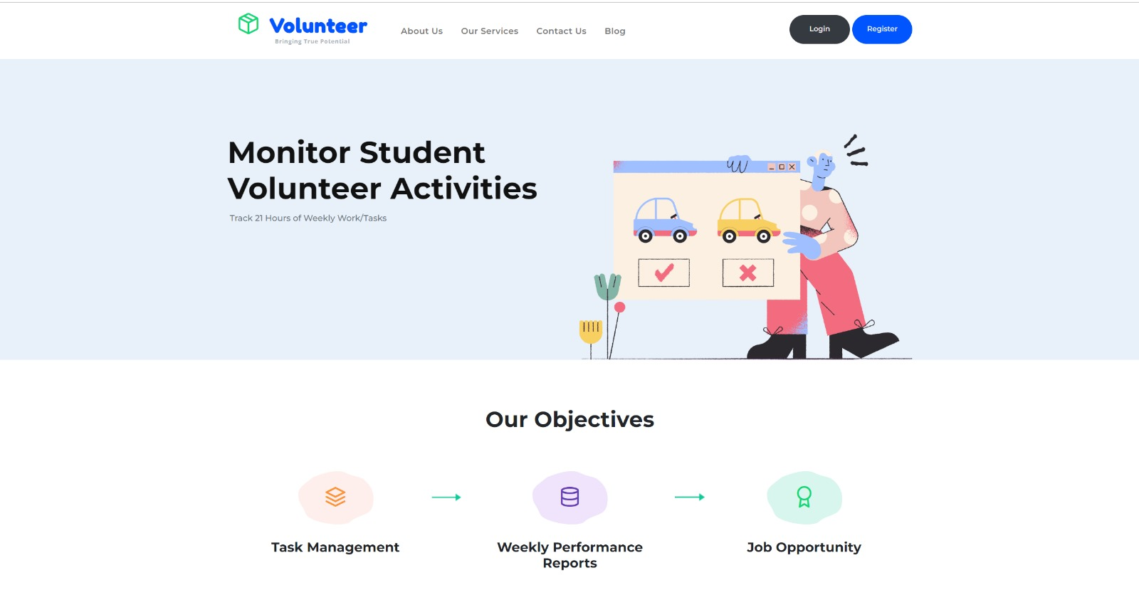
HOME PAGE :
This Home page of our website acts as an introduction to the site. The Page is simple & it gives overall elements in the project.

Slide 5
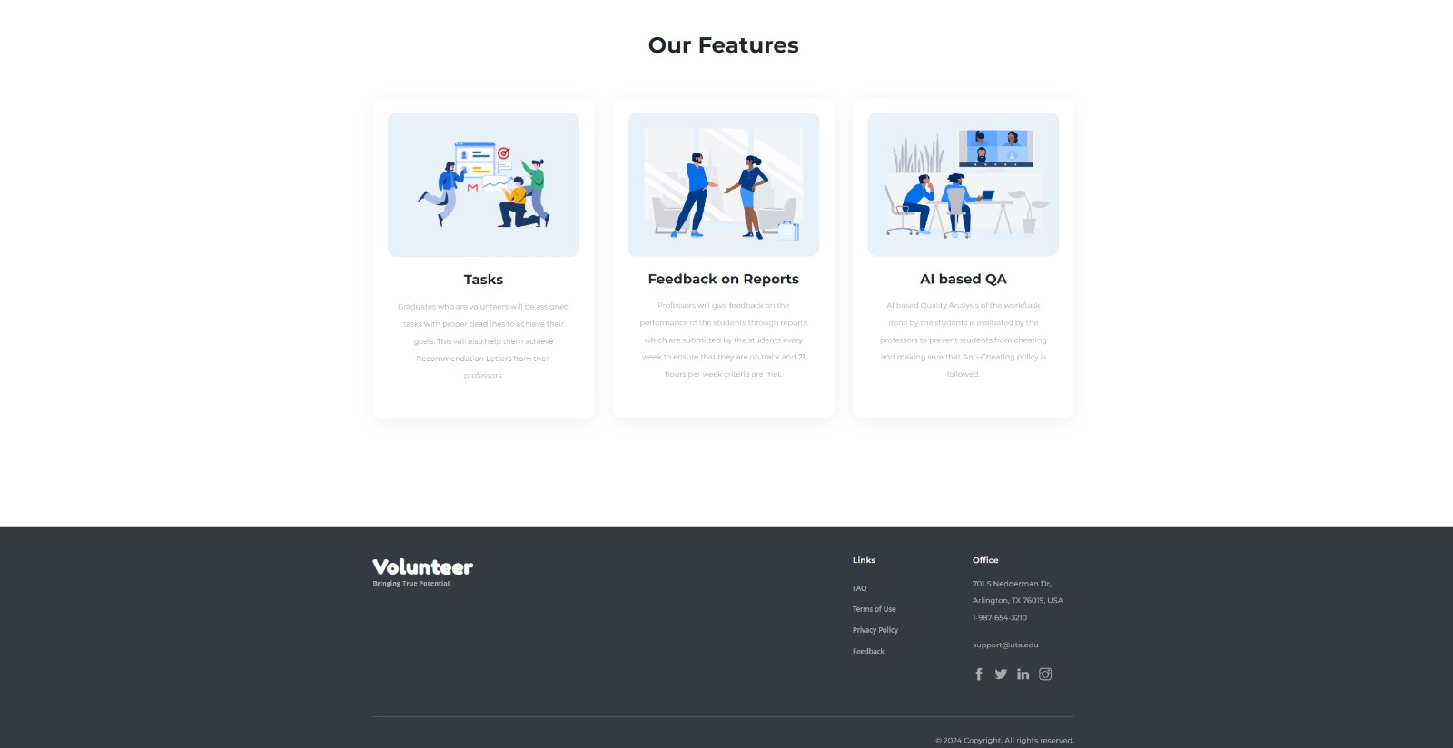

Slide 6
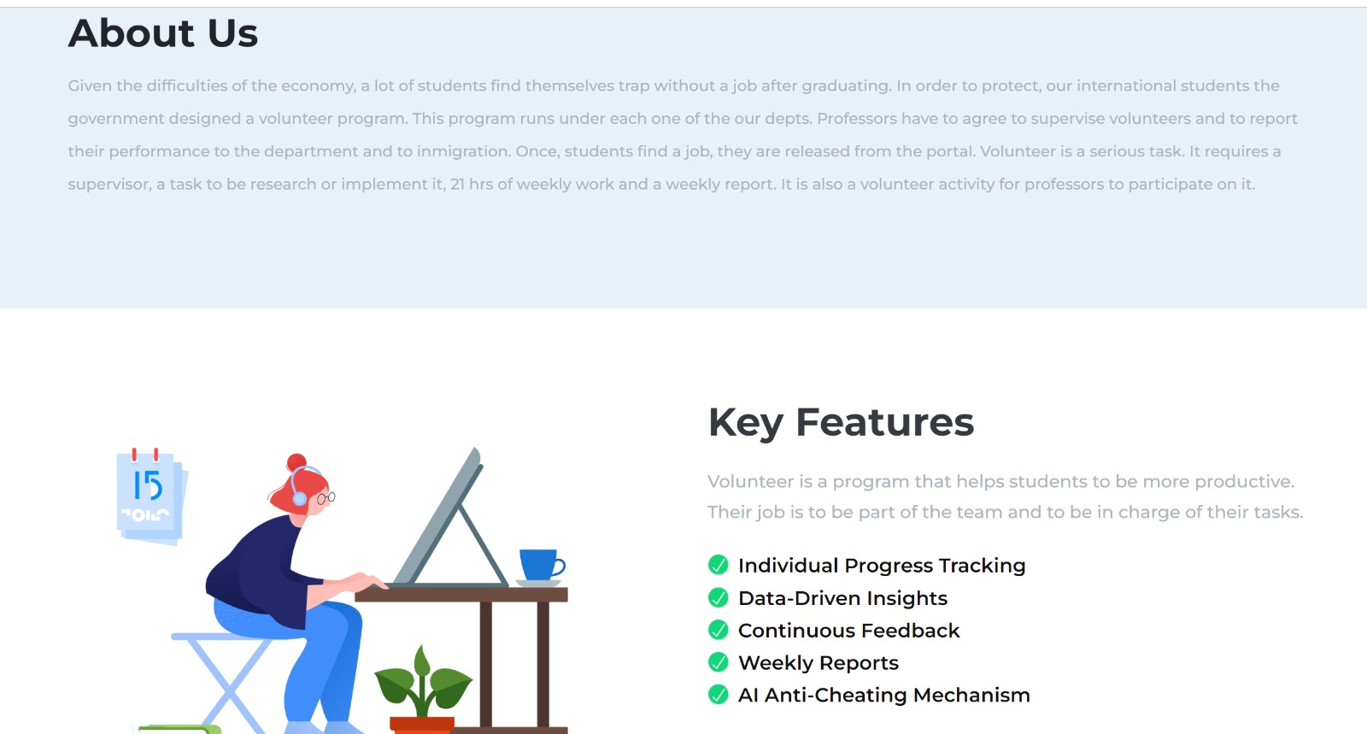
ABOUT PAGE:
This page provides the vision and objective of the application with key features.

Slide 7
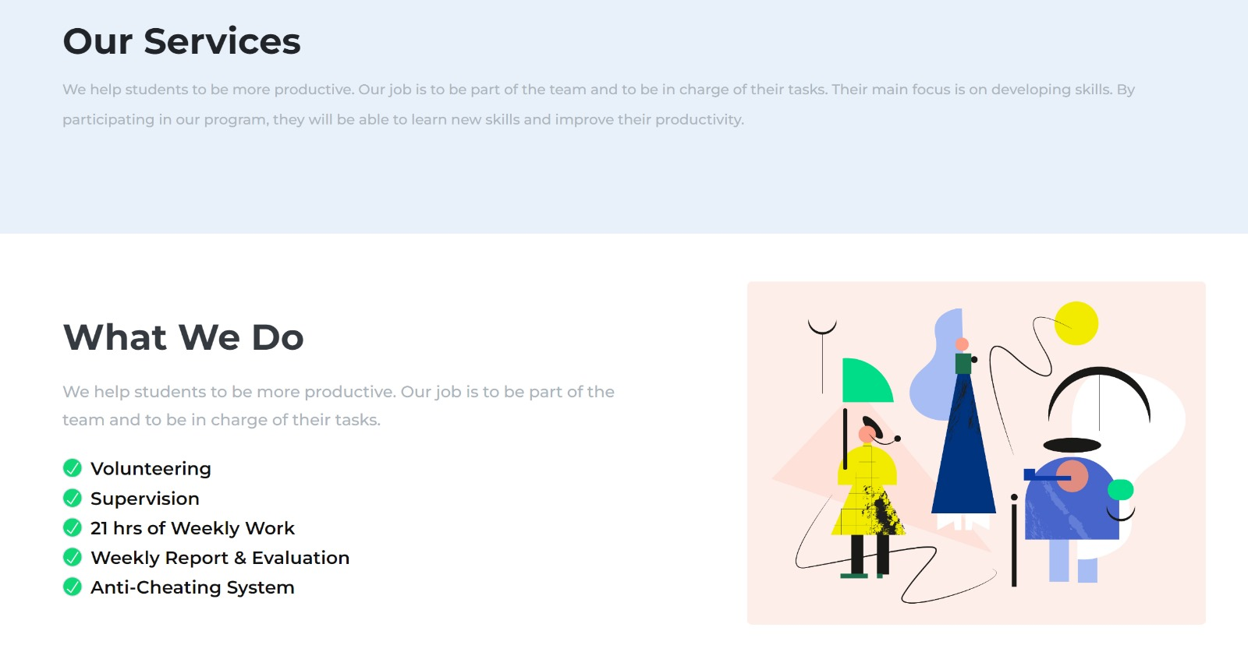
SERVICE PAGE:
This page provides details about the range of services available to graduate students. It offers productive information on the various services offered.

Slide 8
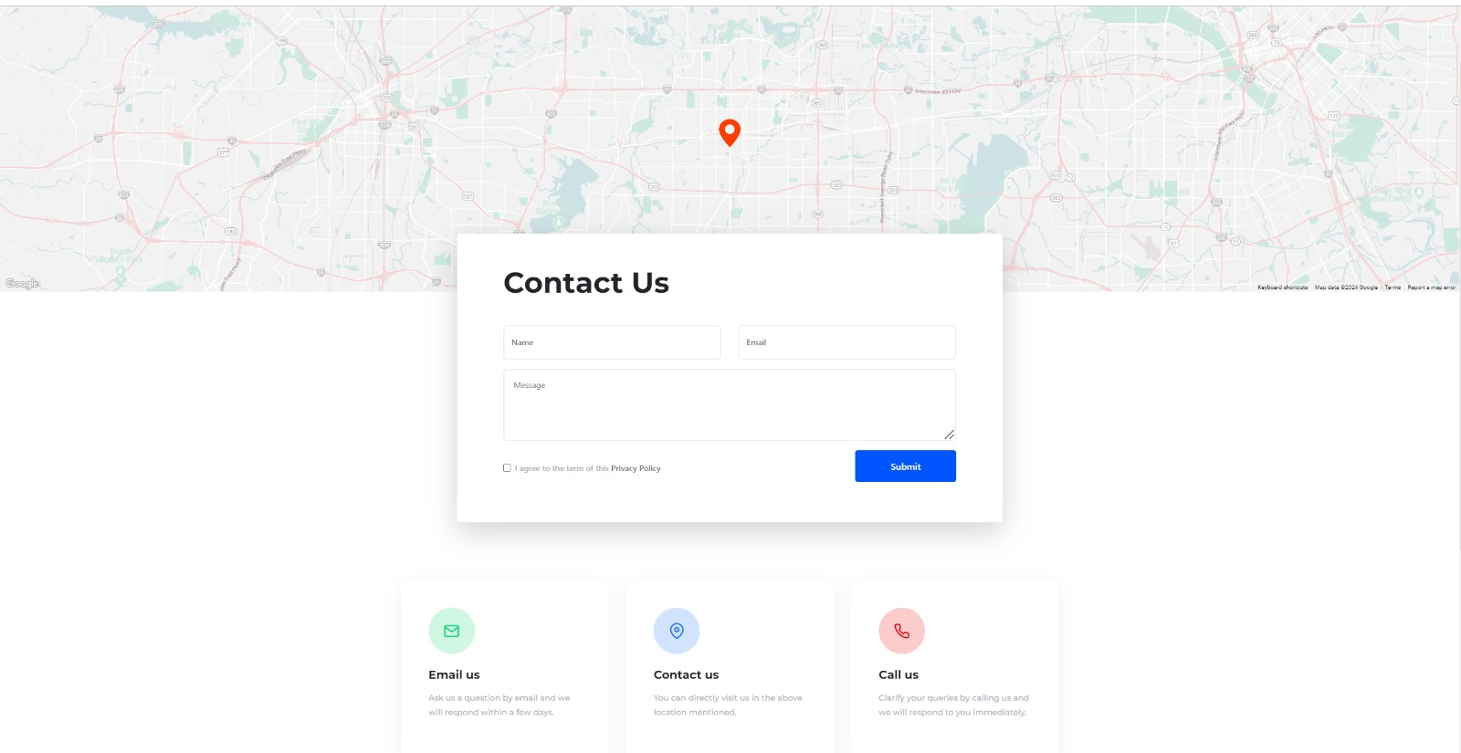
CONTACT US:
If any person, user or non-user has any query regarding the services offered or the query regarding the program, they can provide their name and contact details and they will get more information regarding the program.

Slide 9
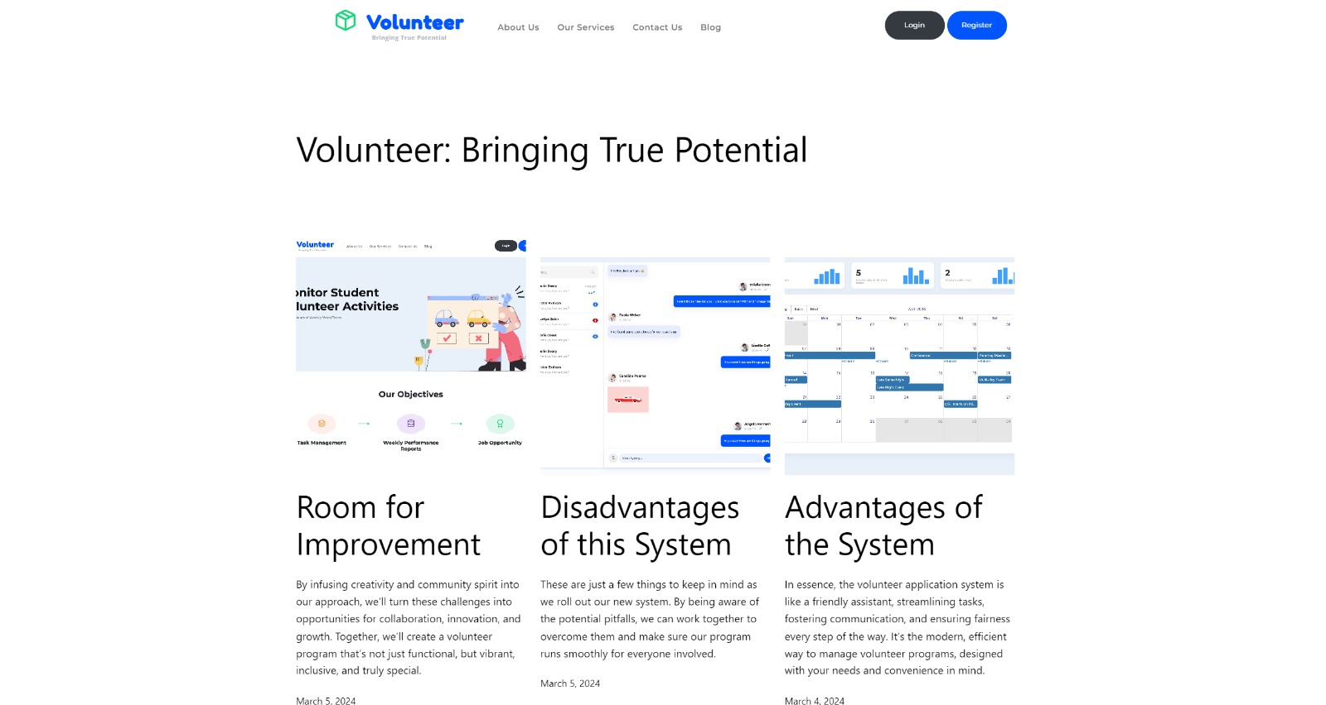
BLOG PAGE :
The blog is developed using WordPress. The blog contains improvement of room, Advantages and Disadvantages of the system.

Slide 10
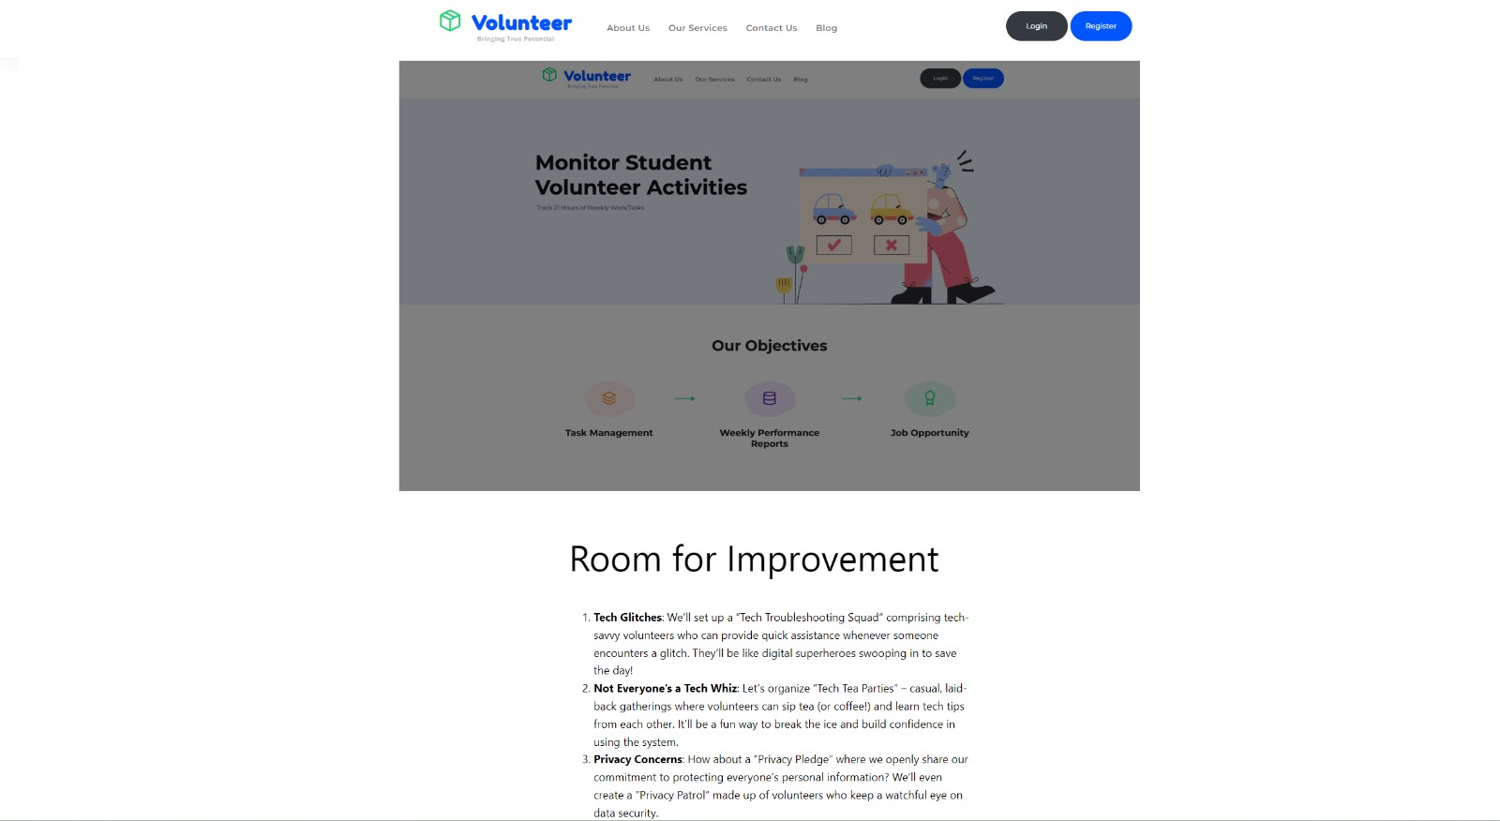
BLOG PAGE:

Slide 11
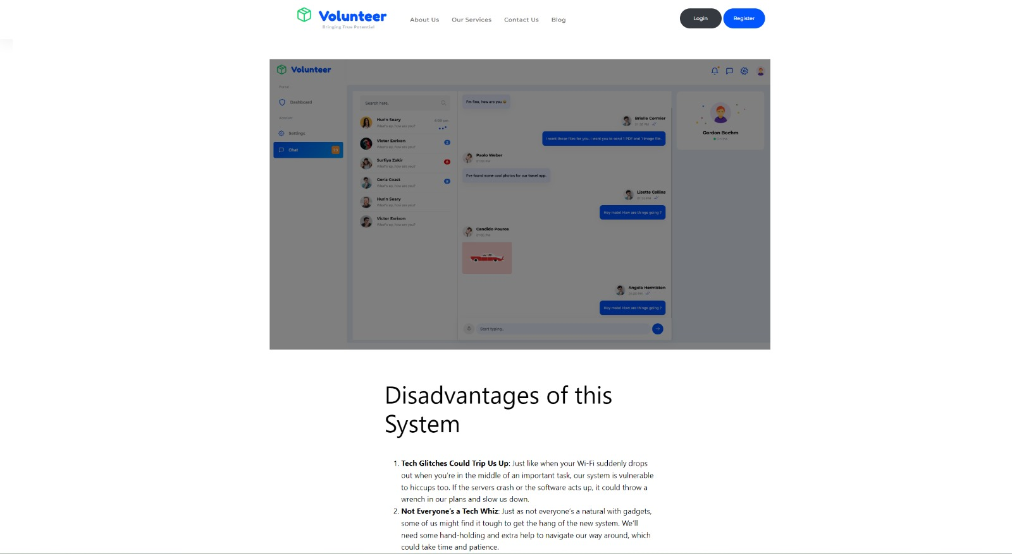
BLOG PAGE:

Slide 12
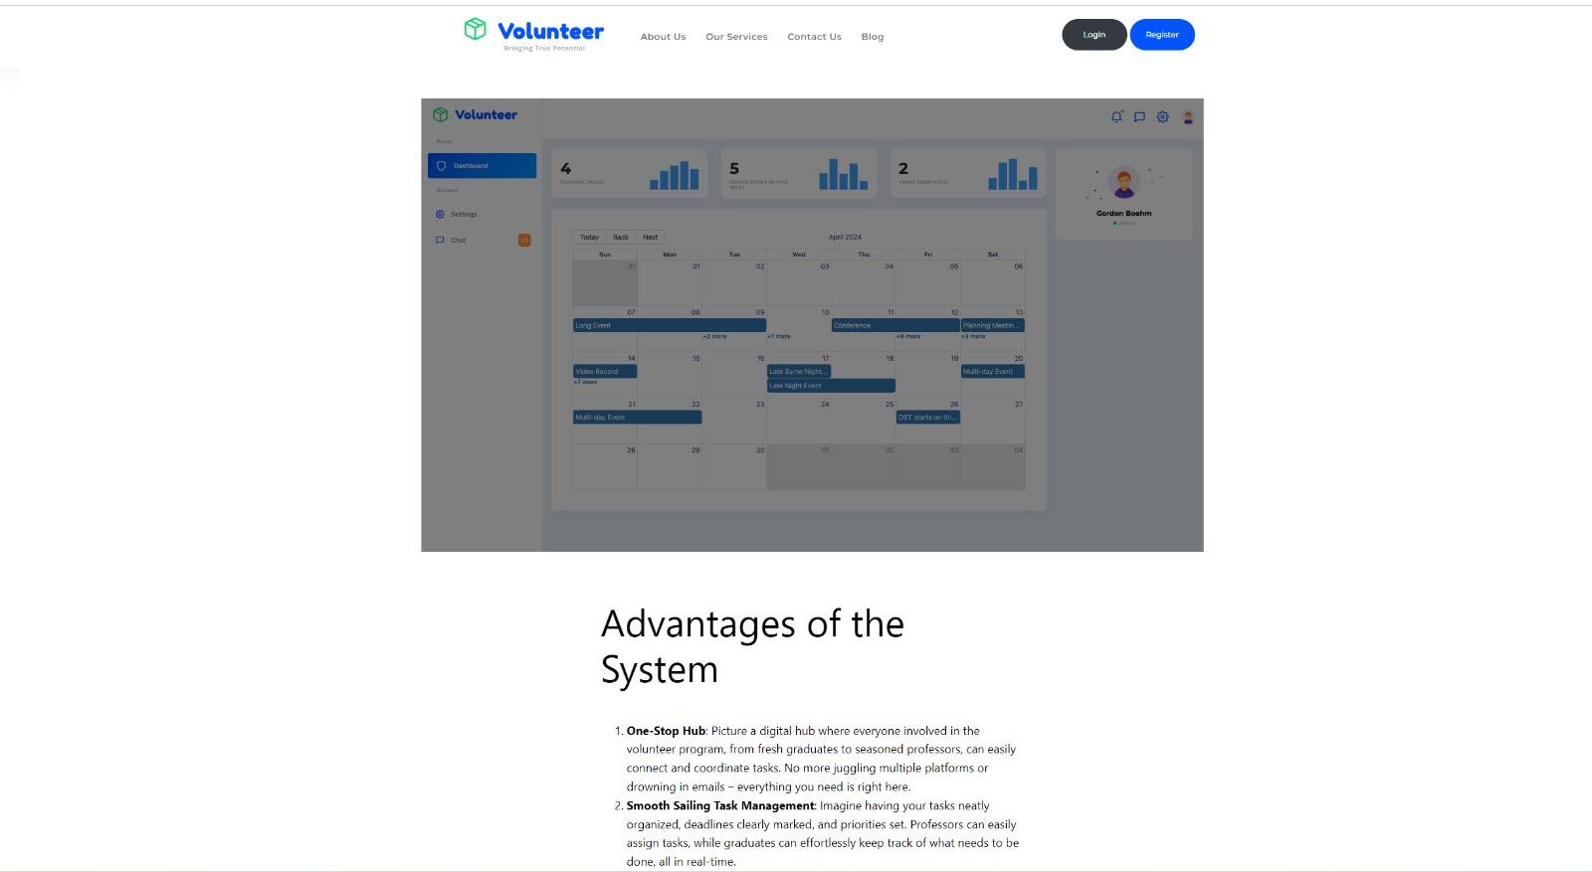
BLOG PAGE:

Slide 13
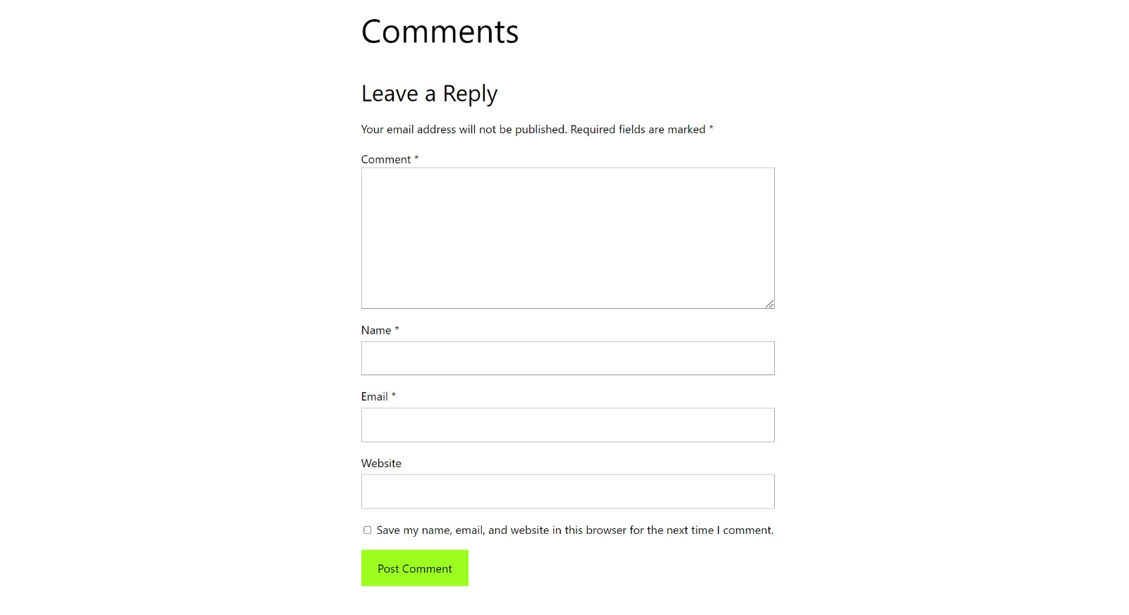
Comment section for blog in each page!!

Slide 14
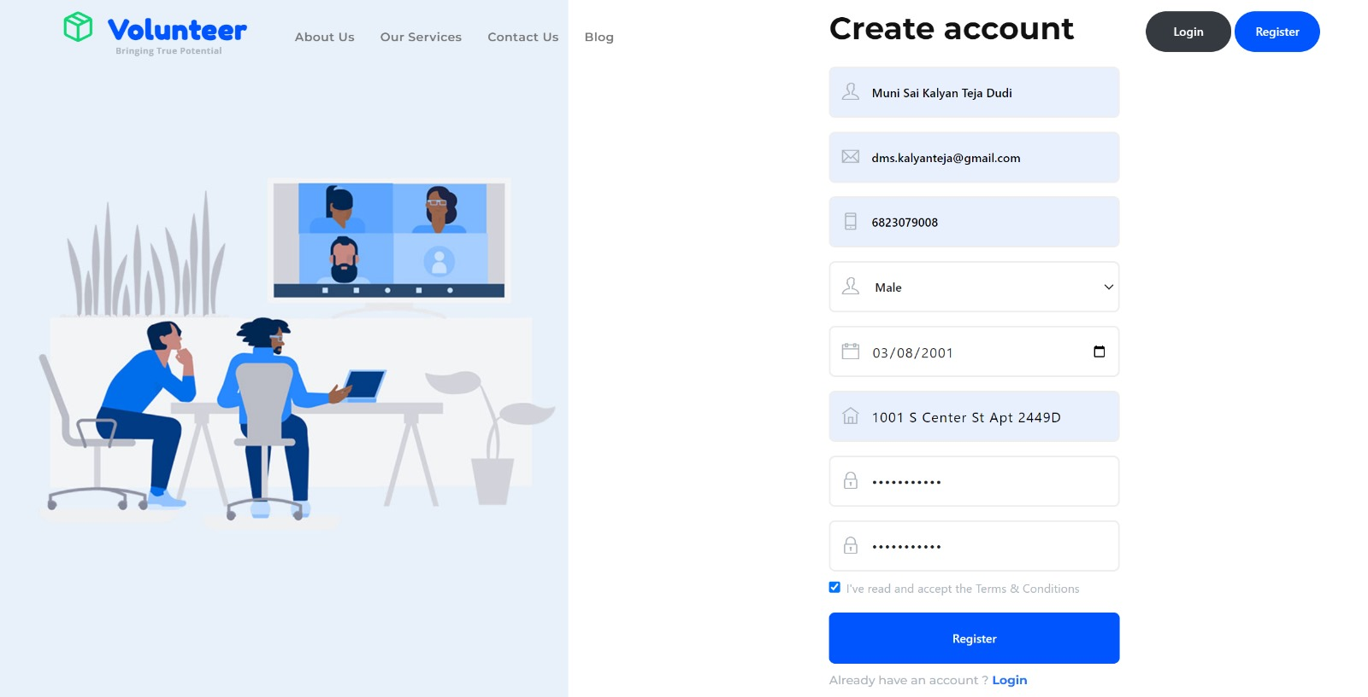
USER REGISTRATION & AUTHENTICATION:
This provides functionality for a new user to register. Here new user will be the student, professor will be added by the admin. Graduate student must provide his/her full name, email (university mail), phone number, date of birth, gender, address and password (must be 8 char long). Validation will be done through Email verification. Upon registration student can login.

Slide 15
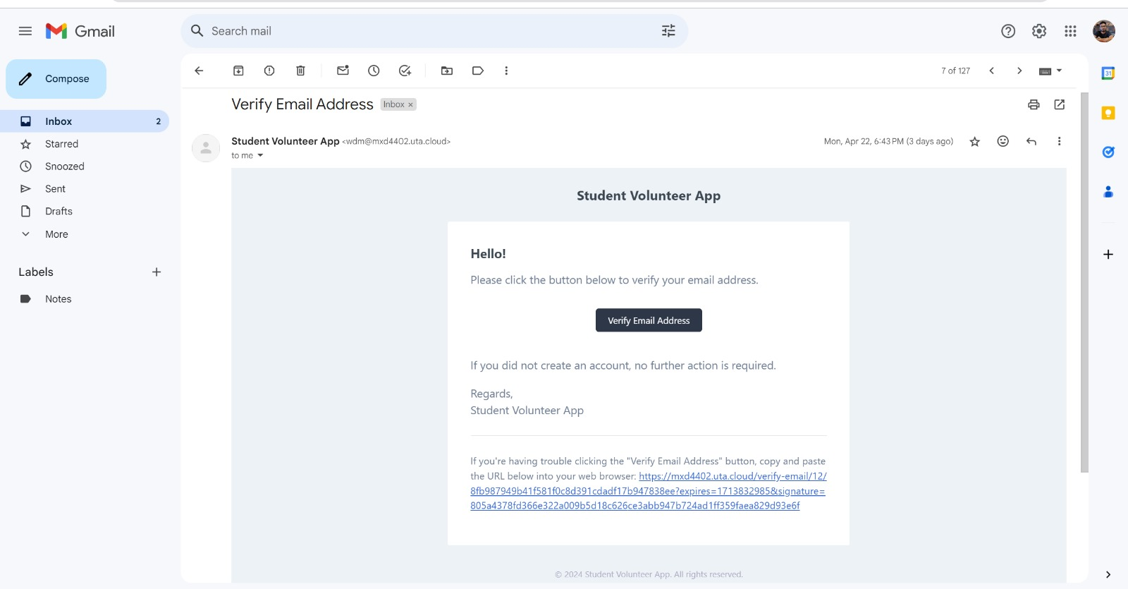
E-Mail Verification

Slide 16
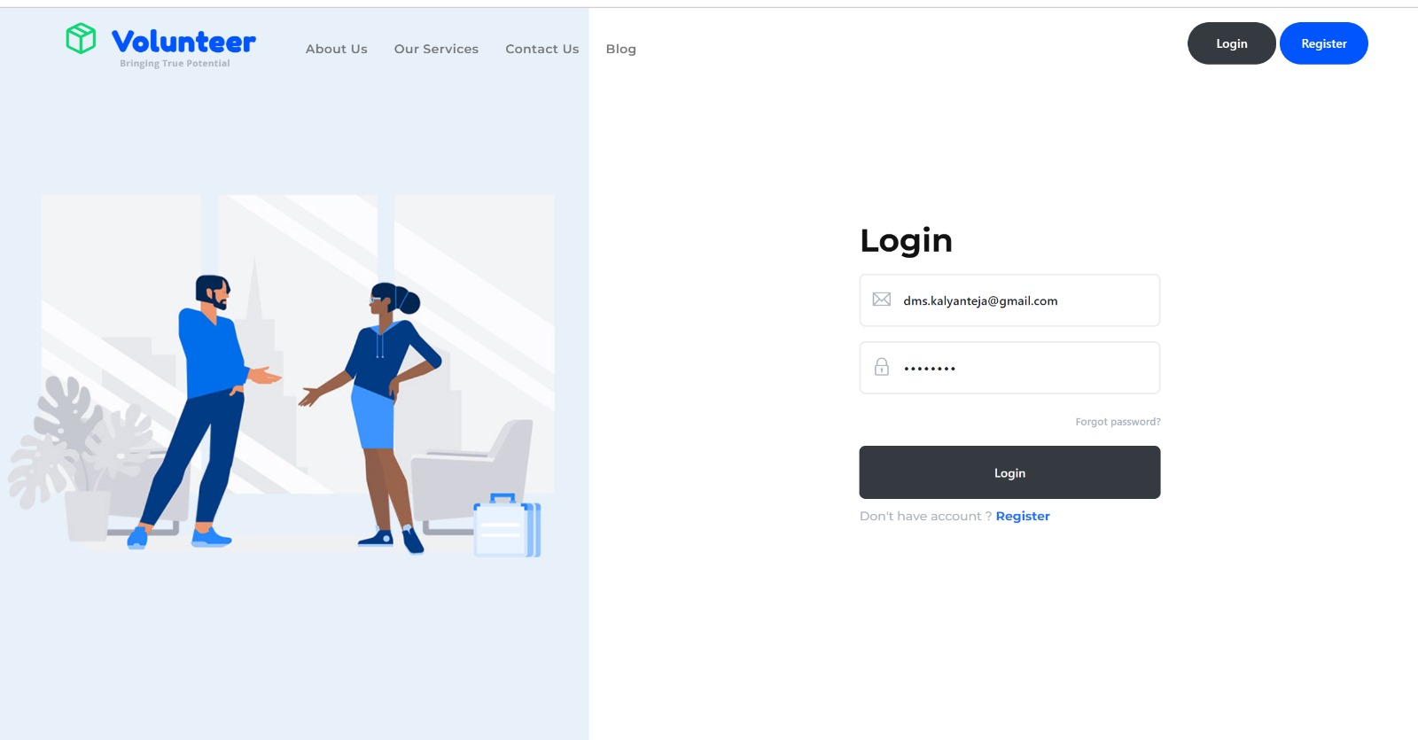
LOGIN PAGE:
This page asks if you are a member or not. Enter your login and password to access the data validation page. Email and password recorded in the database are used to verify the user. The user is directed to the dashboard after logging in.

Slide 17
PHASE 4 DEMO
PAGES AFTER LOGIN

Slide 18
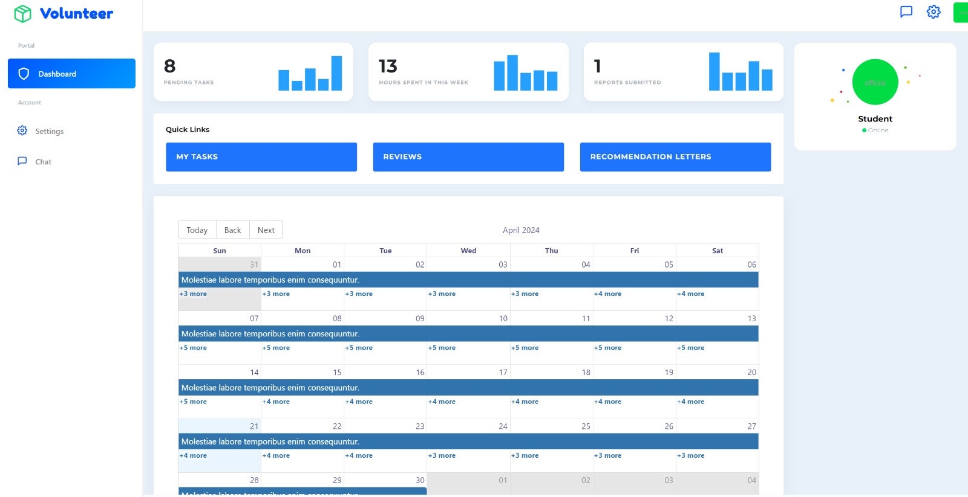
GRADUATE DASHBOARD:
This page consists of graduate student dashboard which displays his/her assigned tasks & pending tasks, hours of works spent in the week, reports submitted/ to be submitted, graduate student can see reviews and recommendation letters if professor provides. Underneath calendar that shows deadline of tasks. Additionally chat facility is available to communicate with professors, admin & other graduate students.

Slide 19
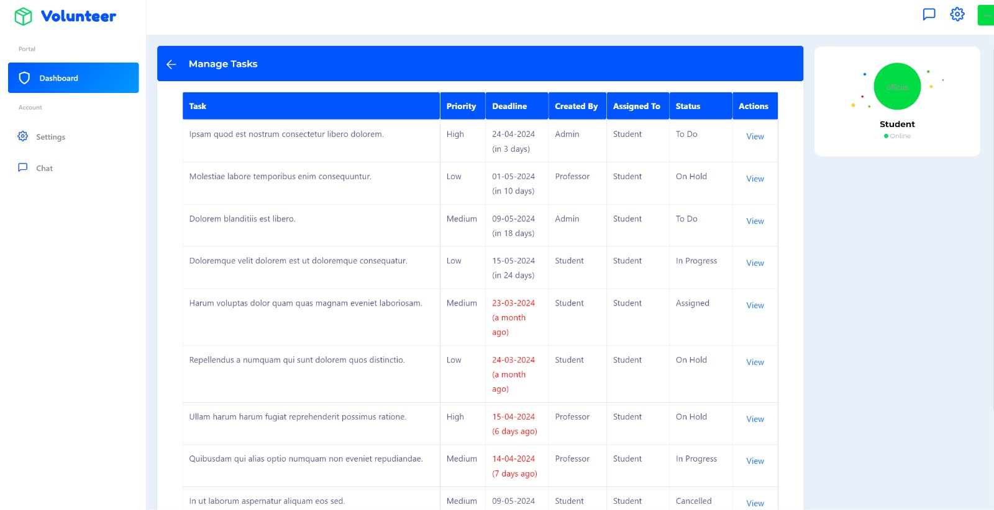
This page shows the tasks and the deadlines

Slide 20
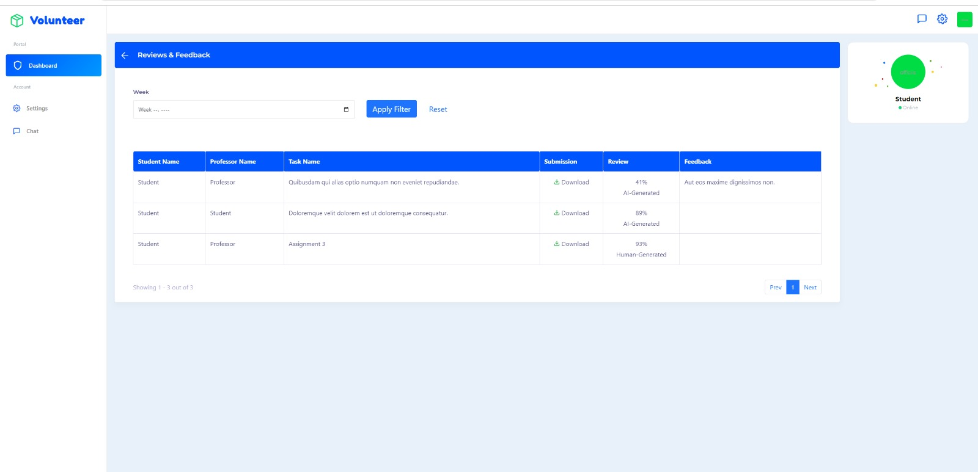
This page is review and feedback section where we can see the feedback from the professor once after professor reviews the task.

Slide 21
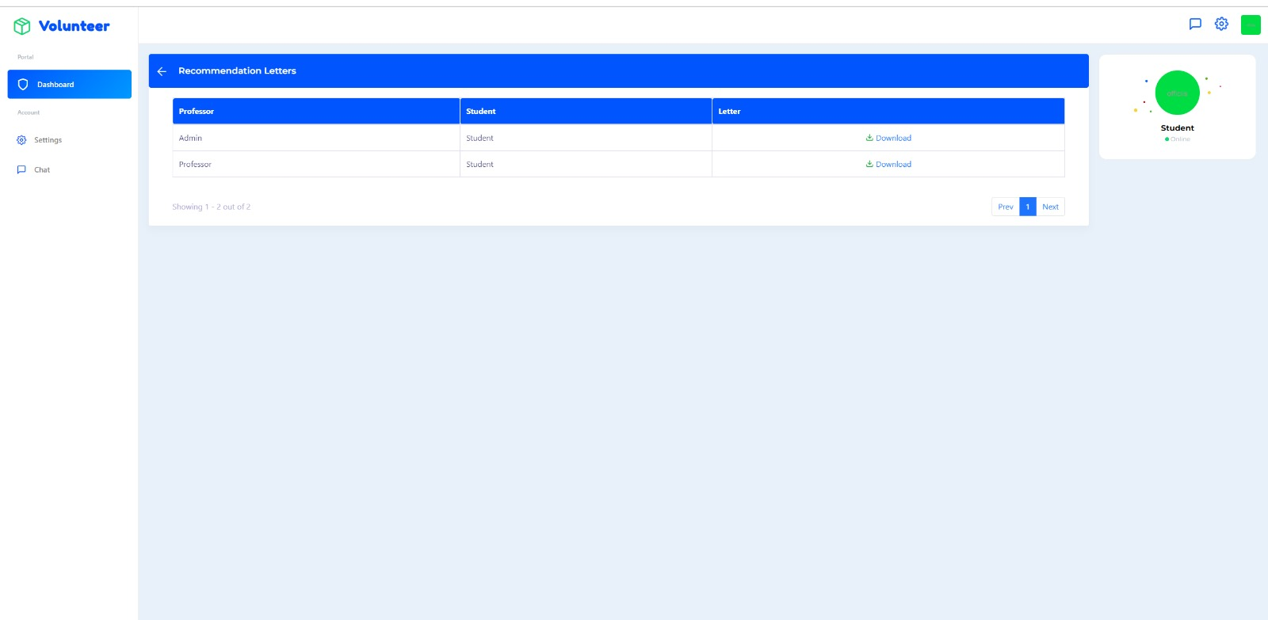
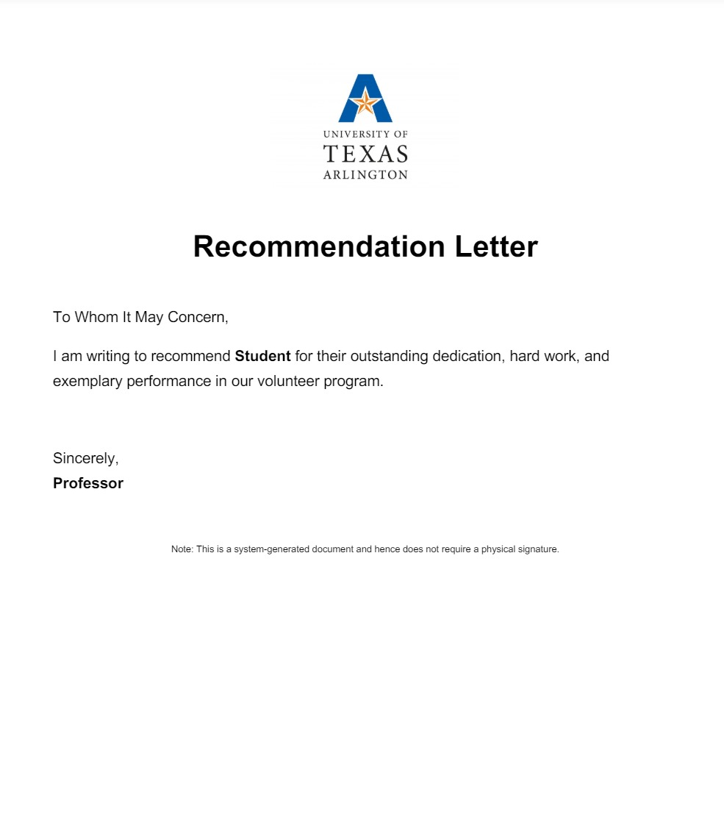
This page is the recommendation letter page where graduate student can see the letter of recommendation if professor generates.

Slide 22
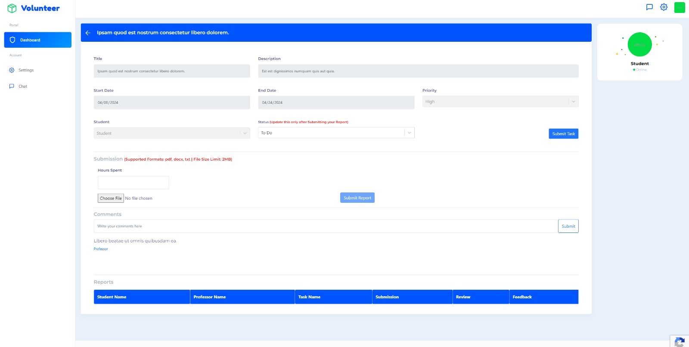
Submission page for weekly reports

Slide 23
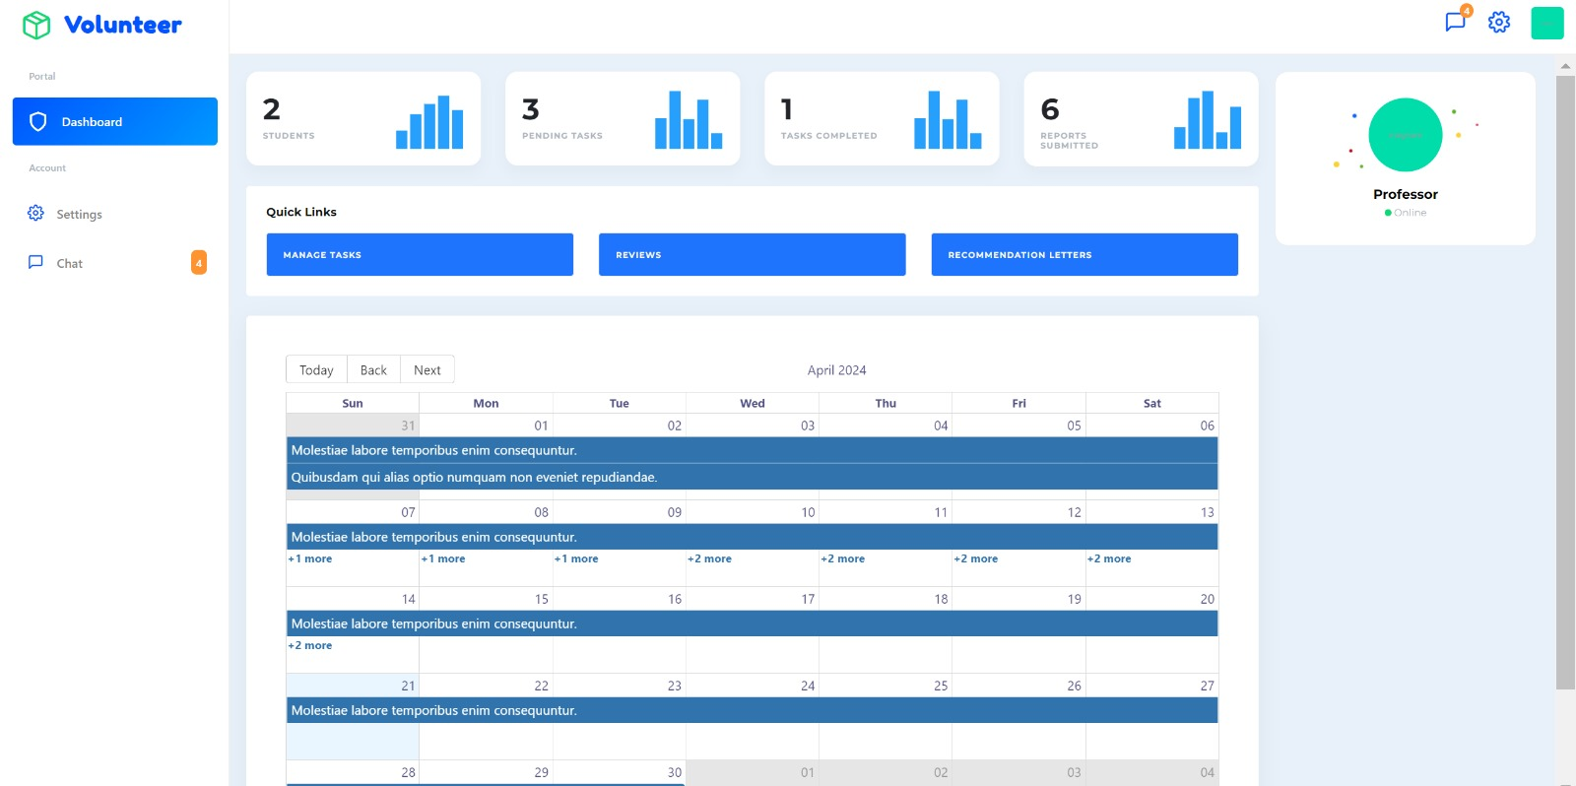
PROFESSOR DASHBOARD:
Professor can create task and assign for graduate students from manage task and review the work of graduate students and give feedback for the task, recommendation letters which professor might offer to his/her desired graduate students. Underneath calendar that shows deadline of tasks. Additionally chat facility is available to communicate with other professors, admin & graduate students.

Slide 24
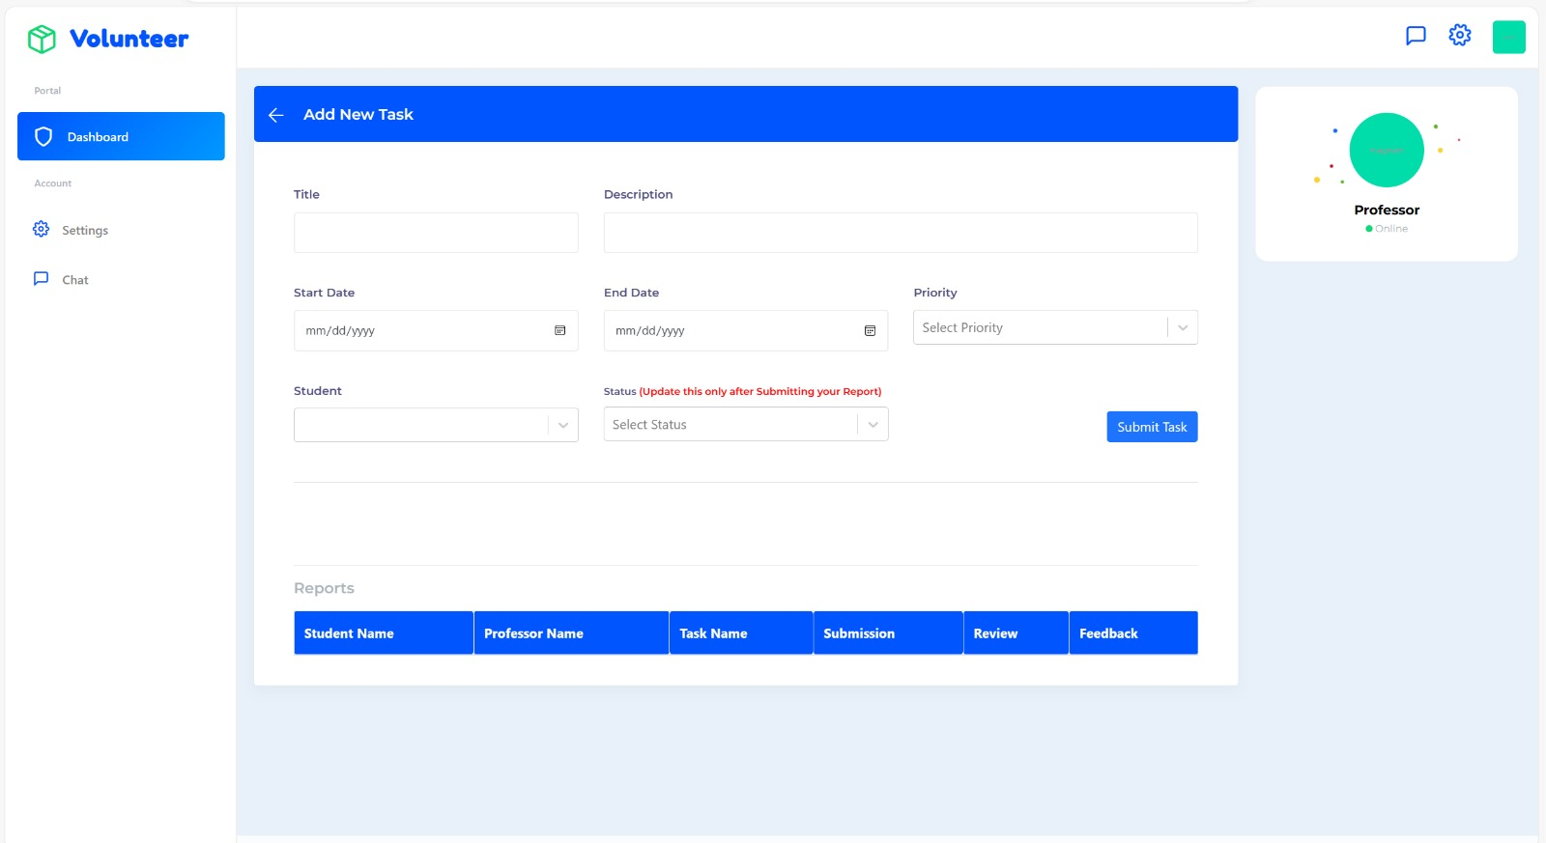
This page is adding for a new task

Slide 25
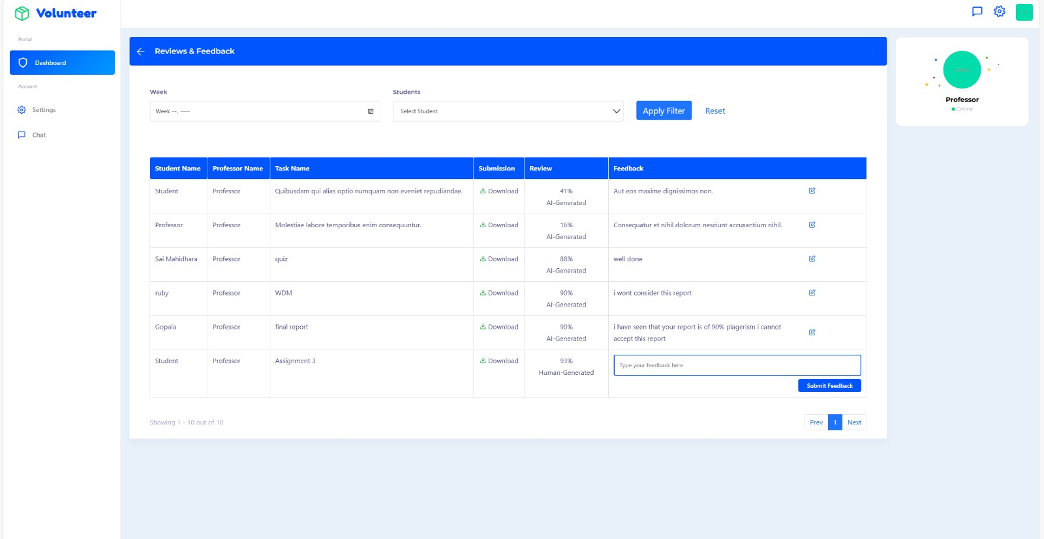
This page is where professor can see graduate student work and give feedback to the work done by the graduate.

Slide 26
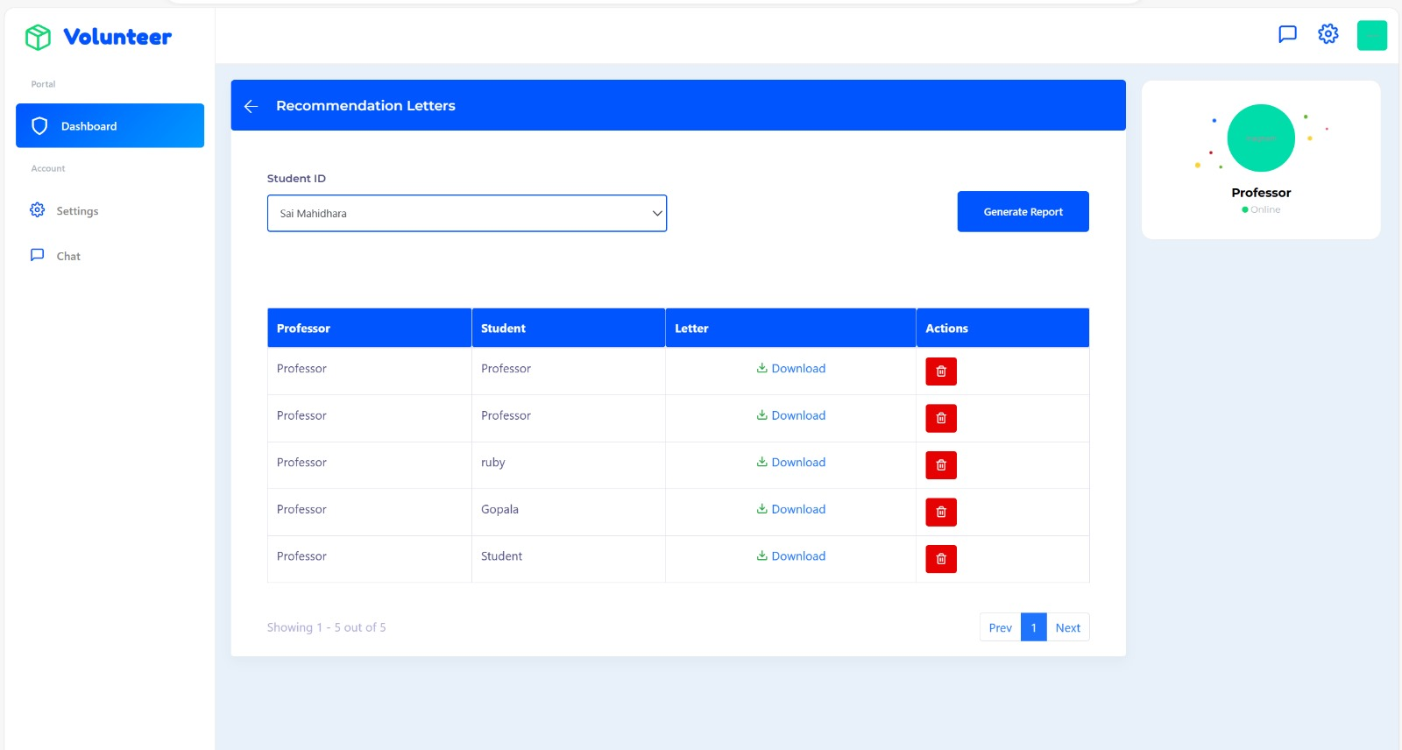
This page is the recommendation letter page where professor can generate recommendation letter for student that professor wish to provide.

Slide 27
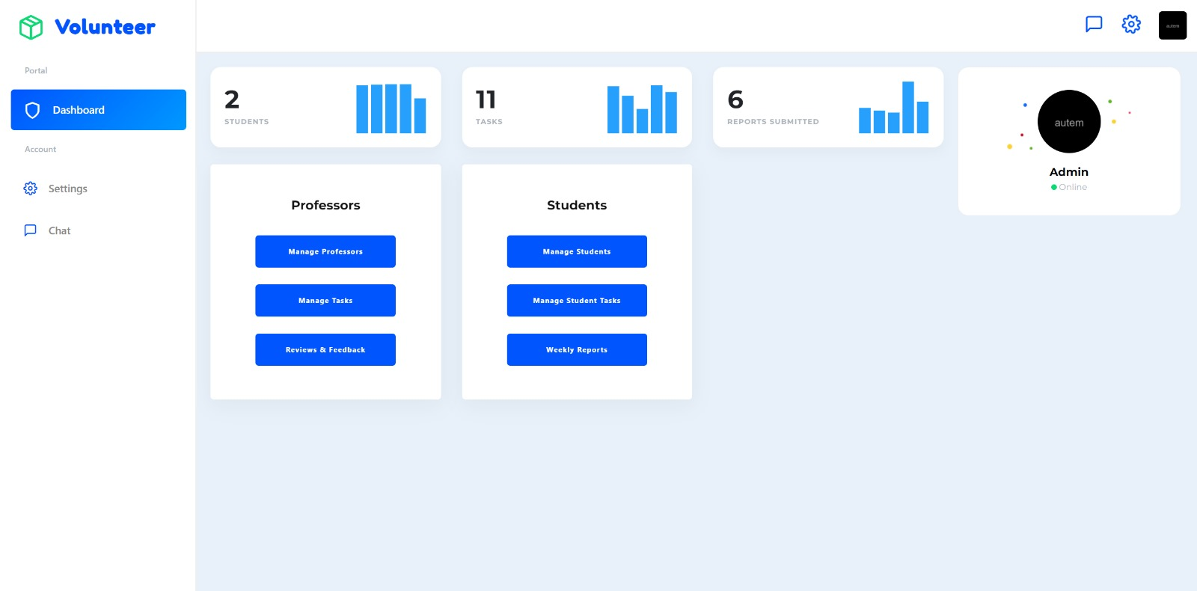
ADMIN PAGE:
This Page provides a centralized platform for overseeing both student and professor dashboard. Efficiently manage professor, students, Navigate through tasks, weekly reports, reviews & Feedback, and chat facility to communicate.

Slide 28
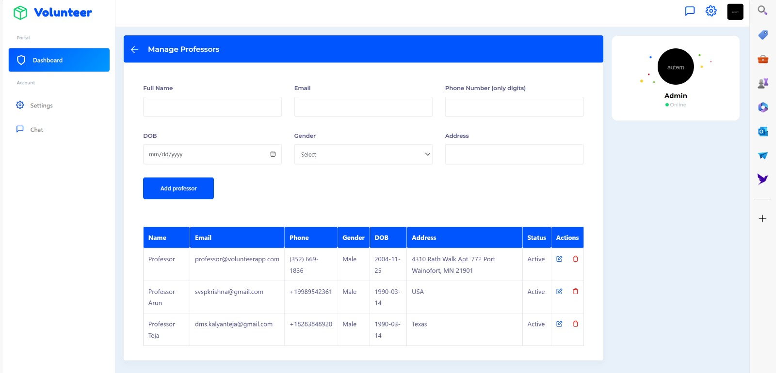
Admin can do and see everything that professor and graduates performs and additionally manage professor and students too.
View of all professors from admin page

Slide 29
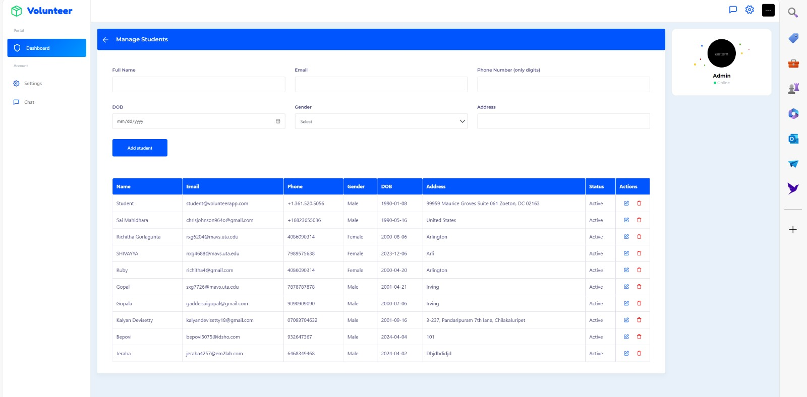
View of all graduates from admin page

Slide 30
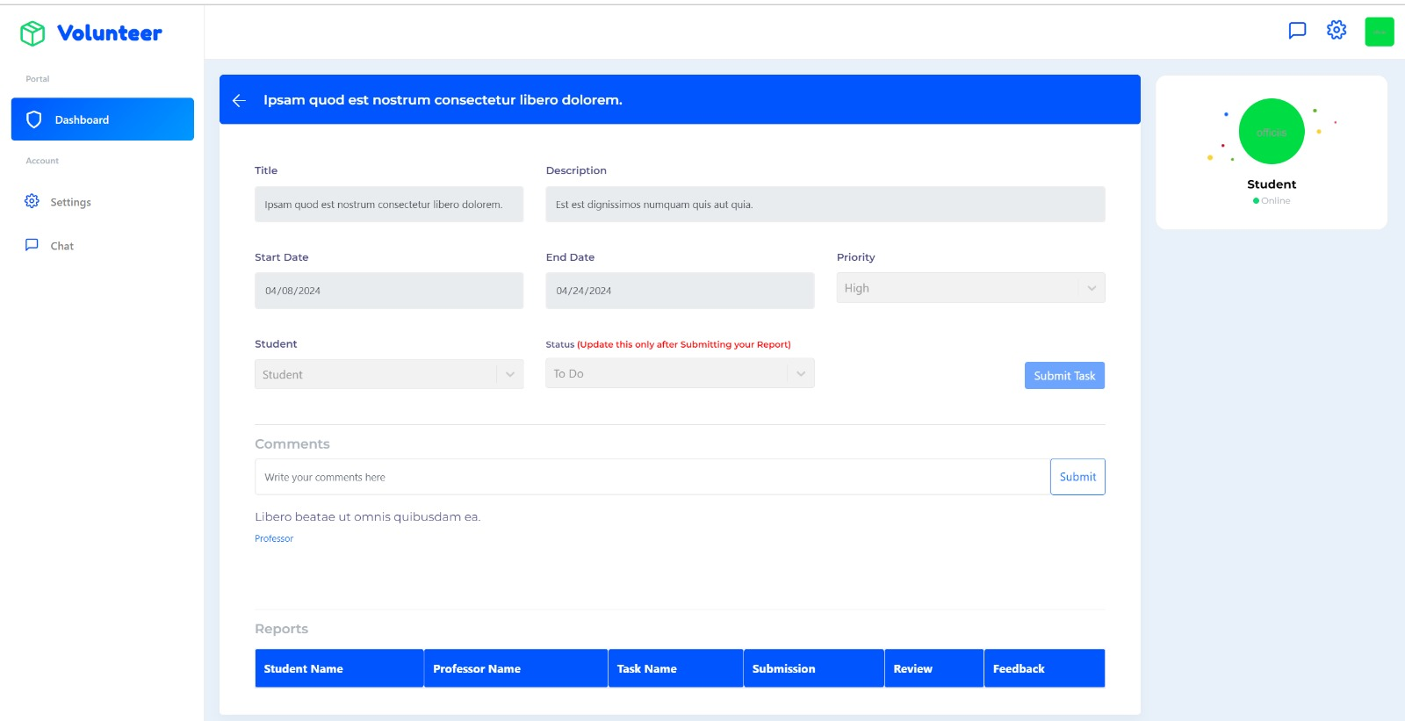
TASK MANAGEMENT:
In this page graduate student can view tasks that are assigned. Each task details are displayed in detail like deadlines & priorities are shown. And graduates can also update the status of work.

Slide 31
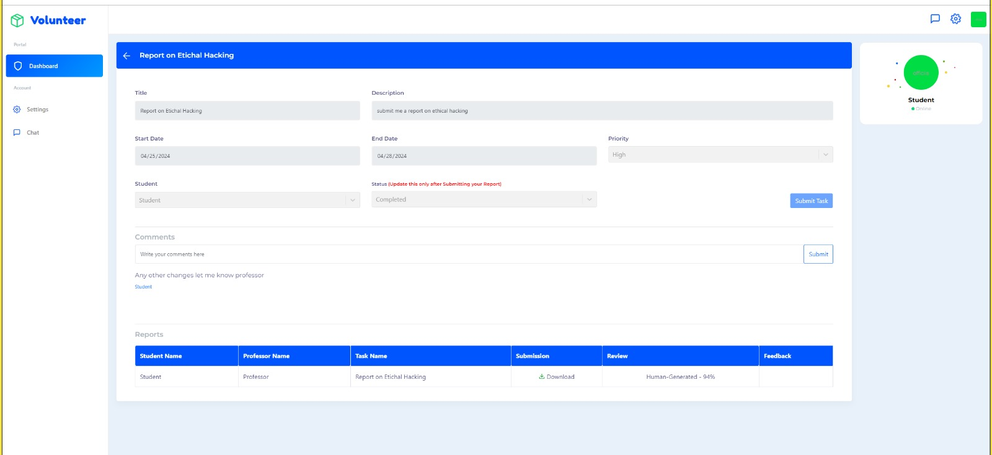
Human generated

Slide 32
WEEKLY REPORTS & AI CHEATING MECHANISM:
In this page graduate student can submit corresponding weekly reports with summary of work with & text input for justifying 21 hours, can upload relevant attachments. Implemented Anti Cheating measures to prevent from using AI agents for the work.

Slide 33
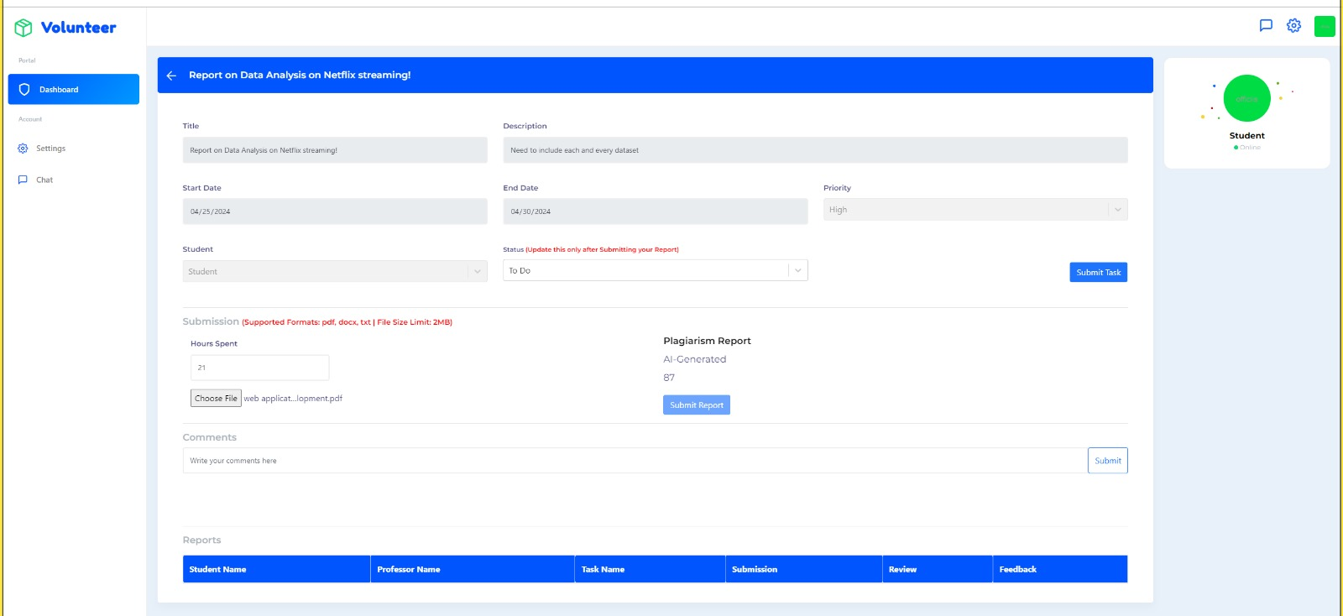
AI generated

Slide 34
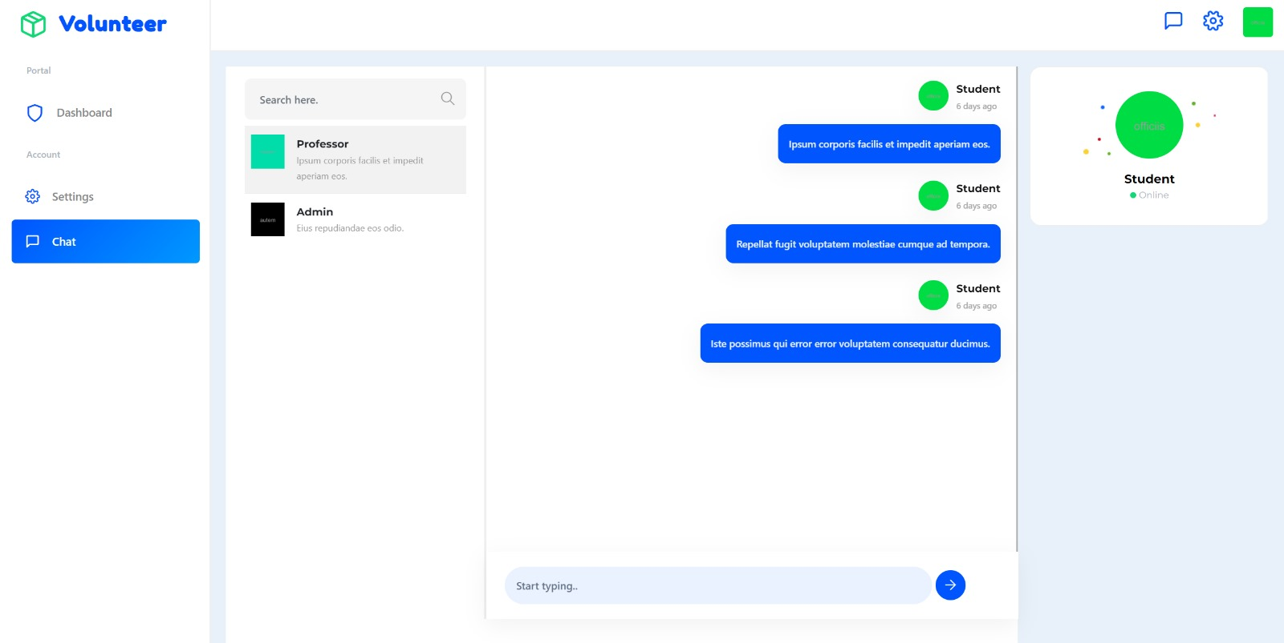
Using chat functionality, graduate students, instructors, admin coordinator can interact with each other for any queries, and they will get response.
CHAT PAGE:

Slide 35
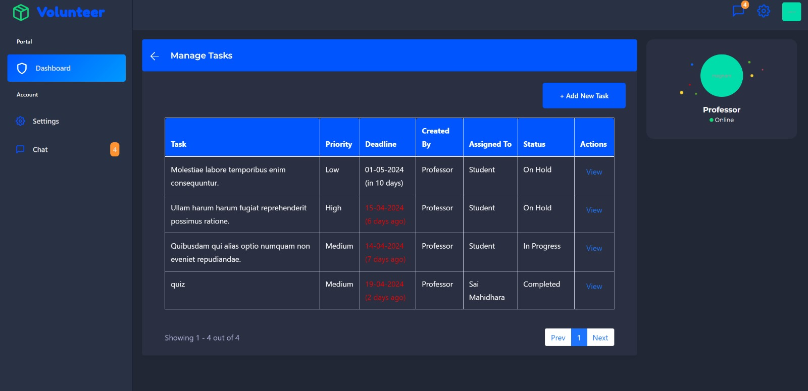
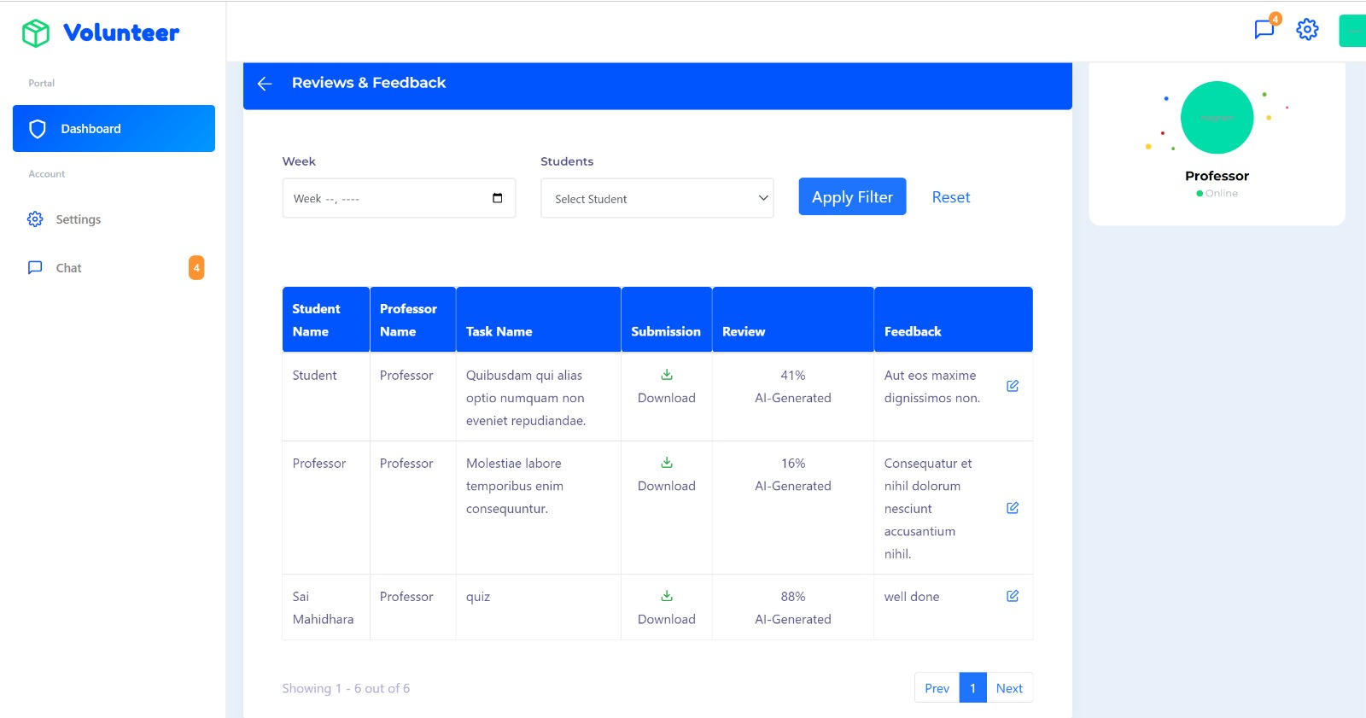
CSS IMPROVEMENT: DARK MODE & LIGHT MODE

Slide 36
RELEVANCE FROM THE CLASS LECTURES
Styling HTML elements with the CSS selectors
Structuring different HTML elements such as headers, Paragraph, Media elements, list elements, Hyperlinks etc.
Data representation with Tables and submission with Forms
Database connection with PHP (Laravel) code
Database design and development
Node architecture

Slide 37
CHALLENGES FACED
Laravel is completely new for us, We faced extreme difficulty understanding the concept and implementing it.
Email Verification
Anti Cheating measure implementation.
Improvement:
Despite facing many difficulties, we were able to implement all the functionalities.

Slide 38
FUTURE ENHANCEMENTS
Real-time Chat: Implement real-time messaging functionality using WebSockets or a similar technology to enable instant communication between volunteers and supervisors.
Mobile App: Develop a mobile application version of the chat application to allow users to access it conveniently from their smartphones.
Security Enhancements: Regularly update security measures to protect user data and prevent unauthorized access or breaches.

Slide 39

THANK YOU

