Slide 1
Java Executor Framework
Overview
Task creation and submit
Return result value from task
Exception handling
Task cancelation
ForkJoin pool

Slide 2
Disadvantages of unbounded thread creation
1. Thread life cycle overhead.
Thread creation and teardown are not free and takes time, introducing latency into request processing, and requires some processing activity by the JVM and OS.
2. Resource consumption.
  2.1 Active threads consume system resources, especially memory.
  2.2 When there are more runnable threads than available processors, threads sit idle. Having many idle threads can tie up a lot of memory, putting pressure on the garbage collector.
3. Stability.
There is a limit on how many threads can be created. The limit varies by platform and is affected by factors including JVM invocation parameters, the requested stack size in the Thread constructor, and limits on threads placed by the underlying operating system. When you hit this limit, the most likely result is an OutOfMemoryError.

Slide 3
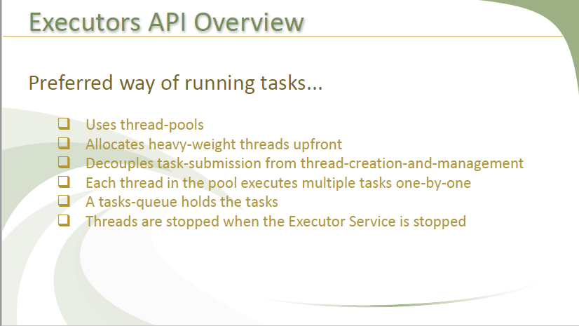

Slide 4
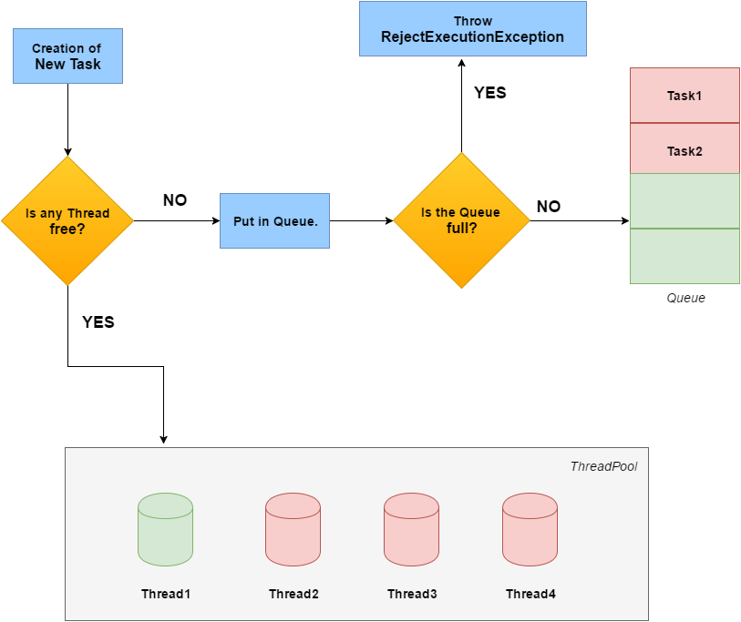

Slide 5
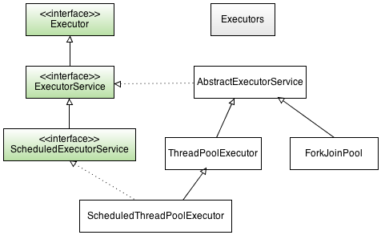

Slide 6
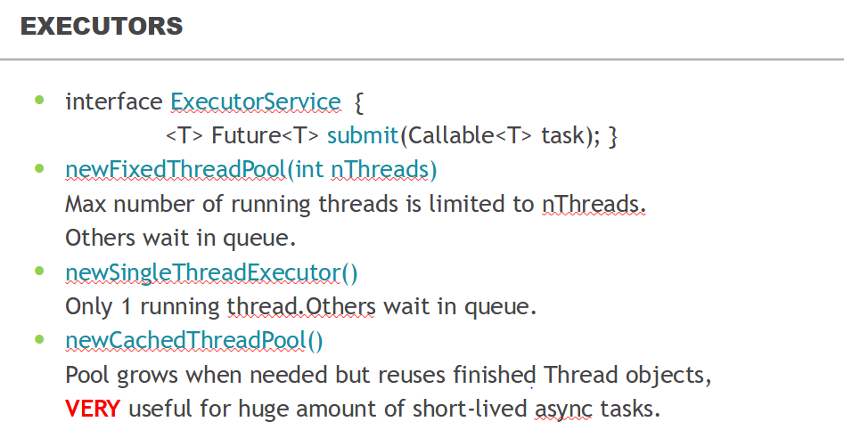

Slide 7
- corePoolSize - the minimum number of workers to keep alive.
- maximumPoolSize - Maximum pool size.
- keepAliveTime - Timeout in nanoseconds for idle threads waiting for work.
If the pool currently has more than corePoolSize threads, excess threads will be terminated if they have been idle for more than the keepAliveTime.
By default, the keep-alive policy applies only when there are more than corePoolSize threads,
but method allowCoreThreadTimeOut(boolean) can be used to apply this time-out policy to core threads
- workQueue - The queue used for holding tasks and handing off to worker threads.
1. If fewer than corePoolSize threads are running, the Executor always prefers adding a new thread rather than queuing.
2. If corePoolSize or more threads are running, the Executor always prefers queuing a request rather than adding a new thread.
3. If a request cannot be queued, a new thread is created unless this would exceed maximumPoolSize, in which case, the task will be rejected.
- threadFactory - All threads are created using this factory (via method addWorker).
Using large queues and small pools minimizes CPU usage, OS resources, and context-switching overhead, but can lead to artificially low throughput.
Hook methods
- beforeExecute(Thread, Runnable)
- afterExecute(Runnable, Throwable)
- terminated()

Slide 8
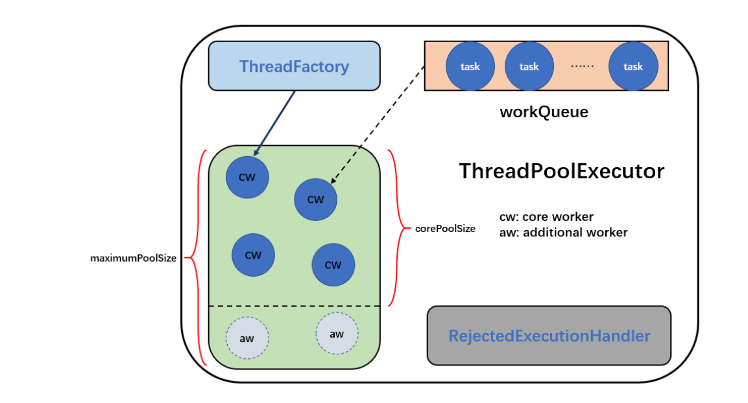

Slide 9
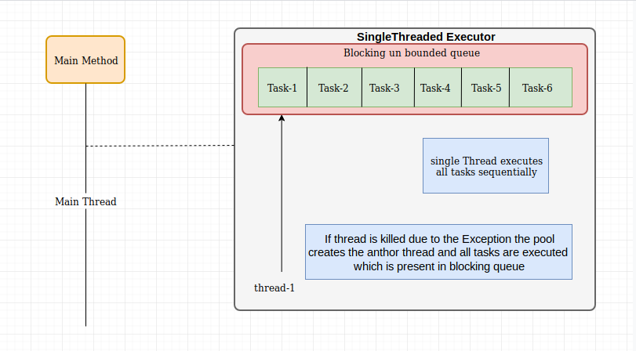

Slide 10
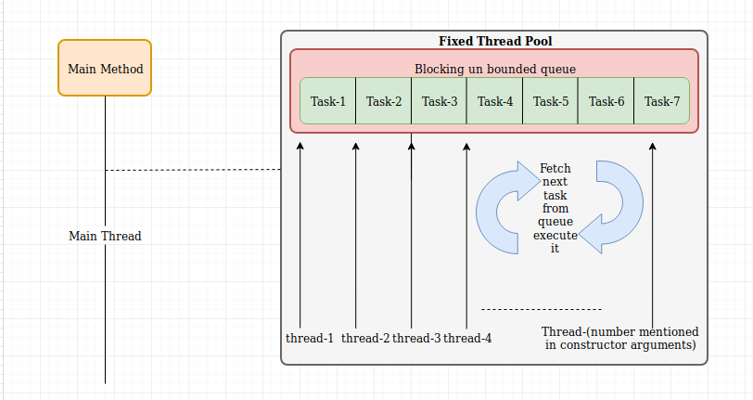

Slide 11
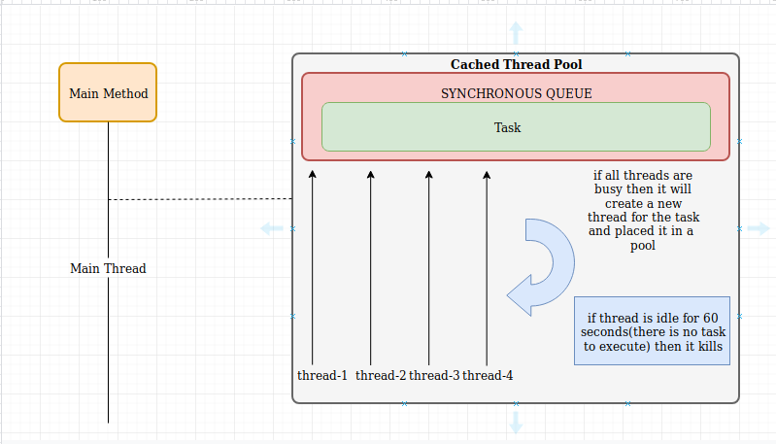

Slide 12
A cached thread pool is useful when tasks submitted for processing should not wait and needs to be addressed as soon as submitted.
To satisfy this requirement, Java creates a new thread for the submitted task if there are no thread in the pool to address the task.
- We should avoid this thread pool when the execution time is unpredictable, like IO-bound tasks.
There are basically two (related) problems with it:
- It's unbounded, which means that you're opening the door for anyone to cripple your JVM by simply injecting more work into the service (DoS attack).
- Each new task will create a new thread if all existing threads are busy. This is generally a bad strategy for server code. When the CPU gets saturated, existing tasks take longer to finish, so tasks take longer and longer to complete.

Slide 13
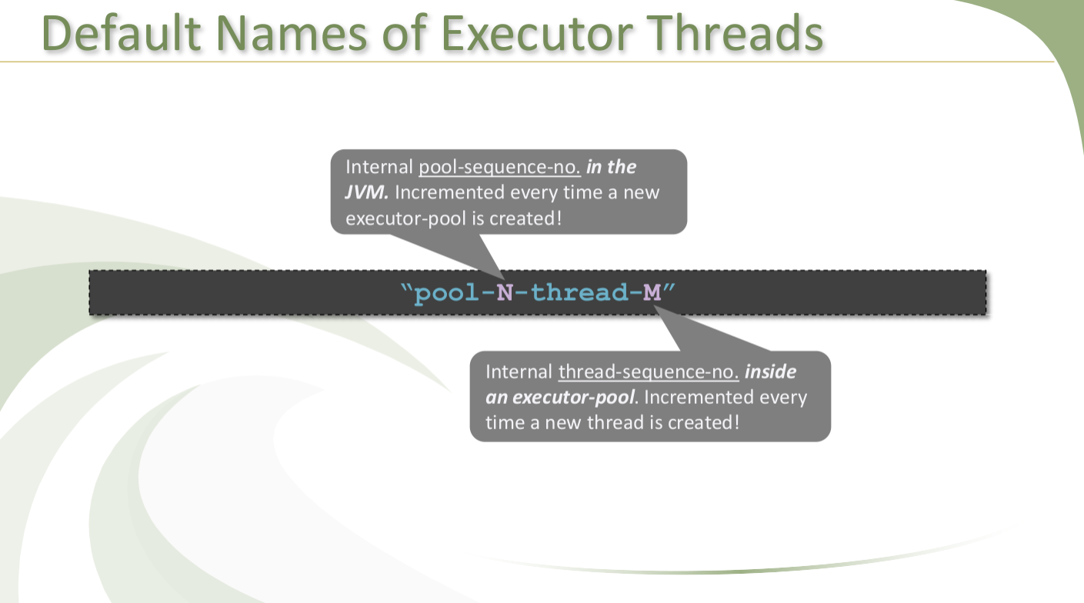

Slide 14
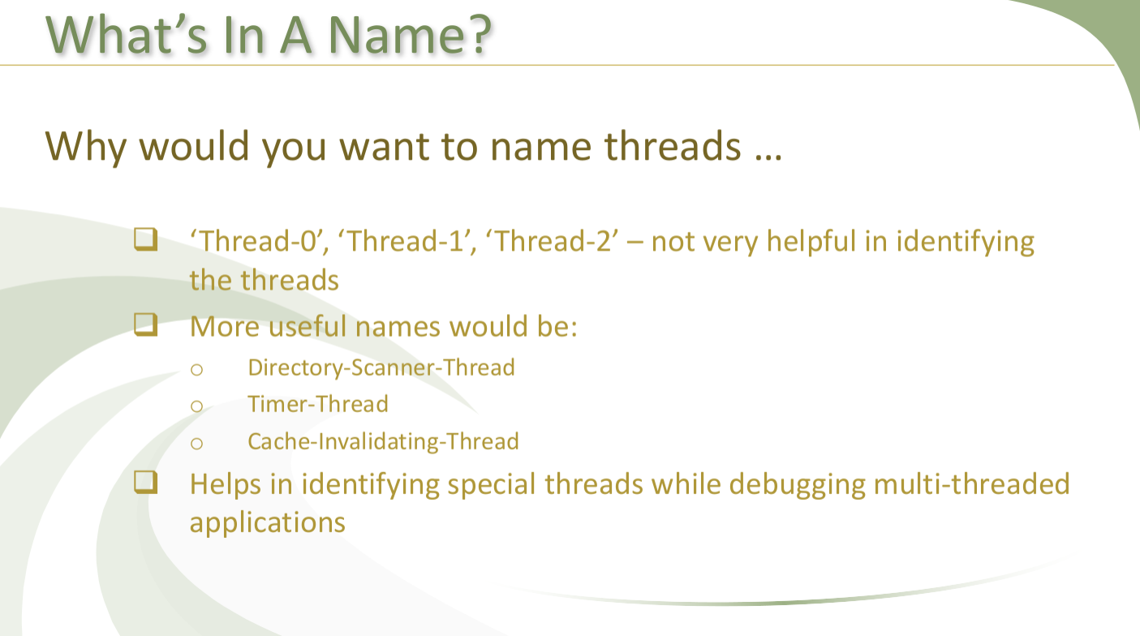

Slide 15
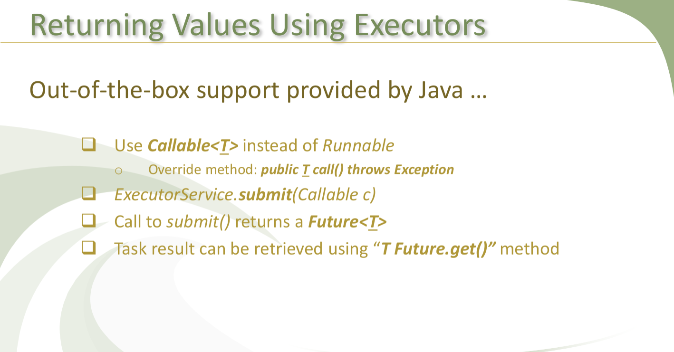

Slide 16
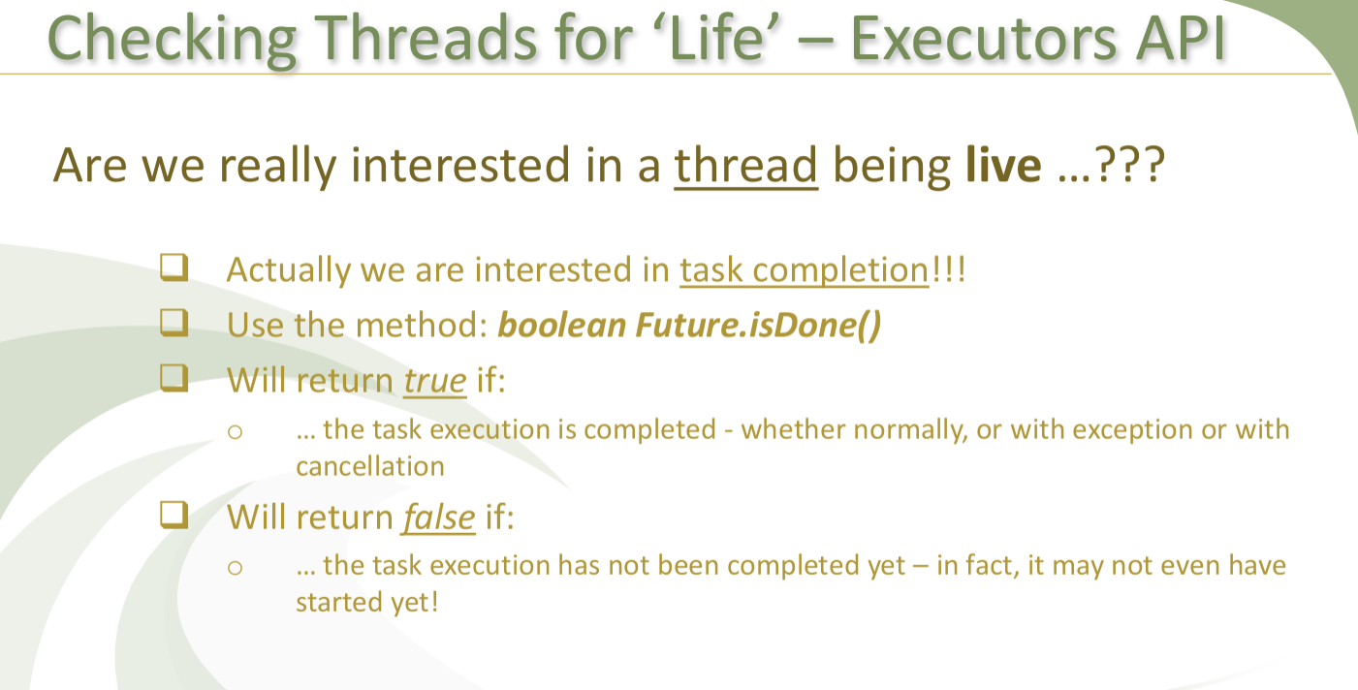

Slide 17
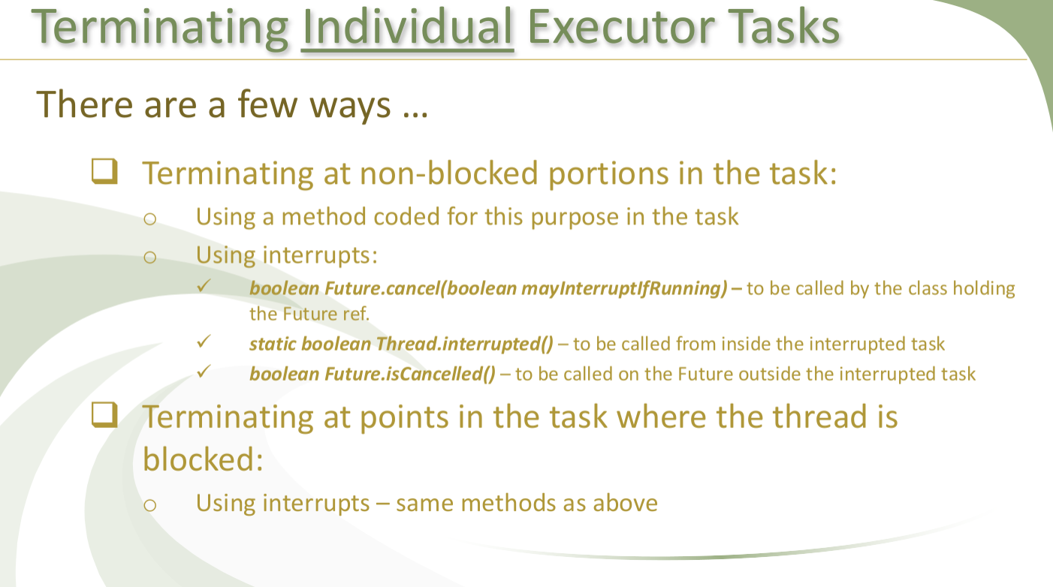

Slide 18
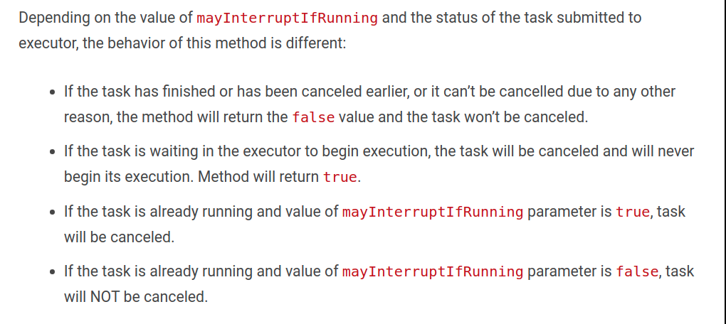

Slide 19
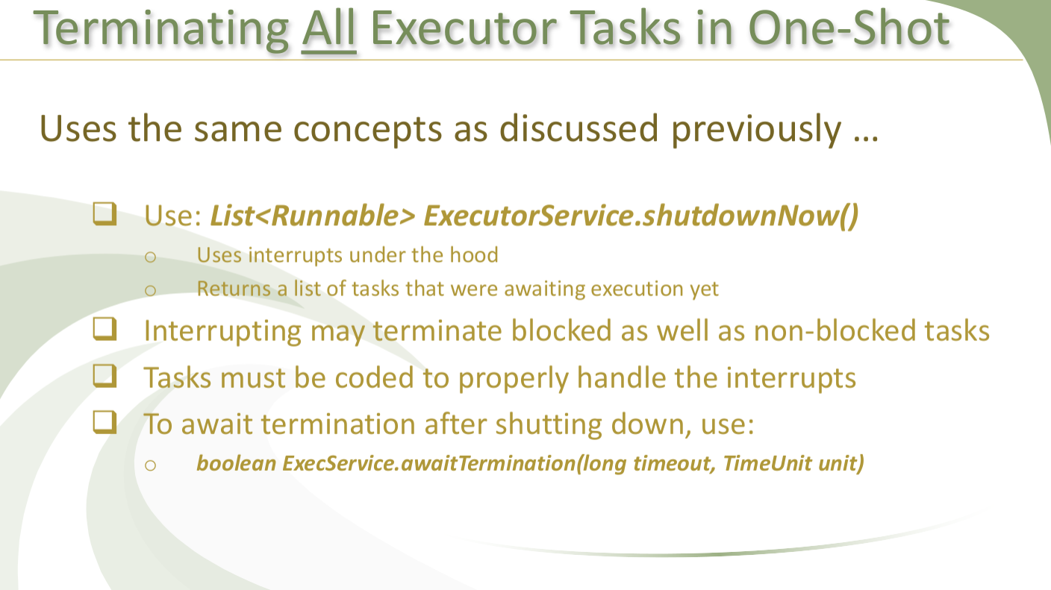

Slide 20
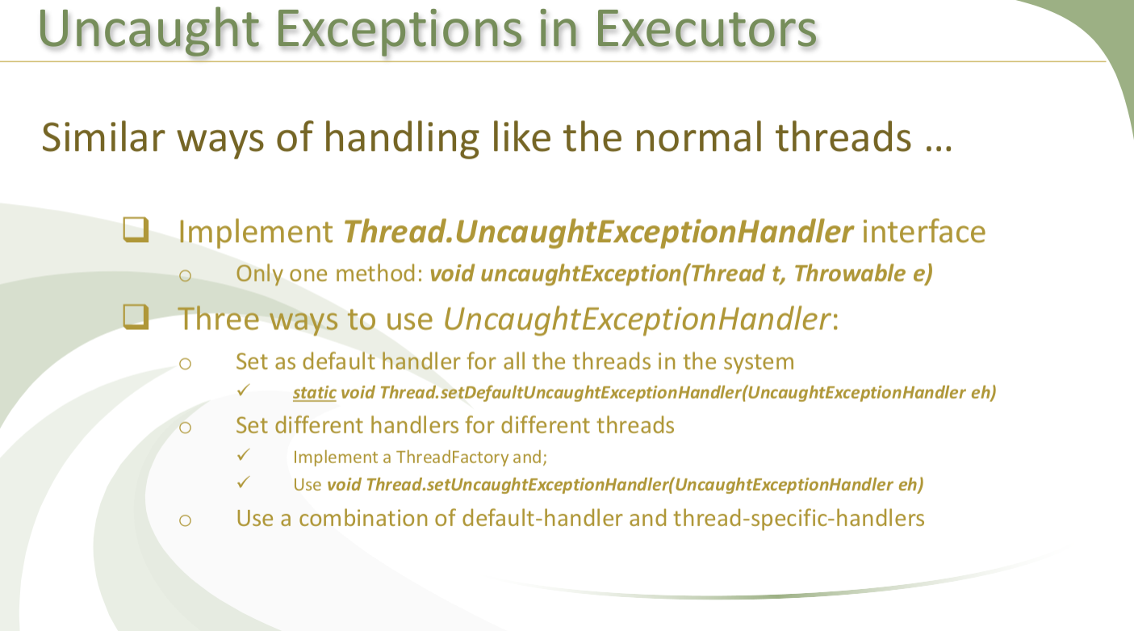

Slide 21
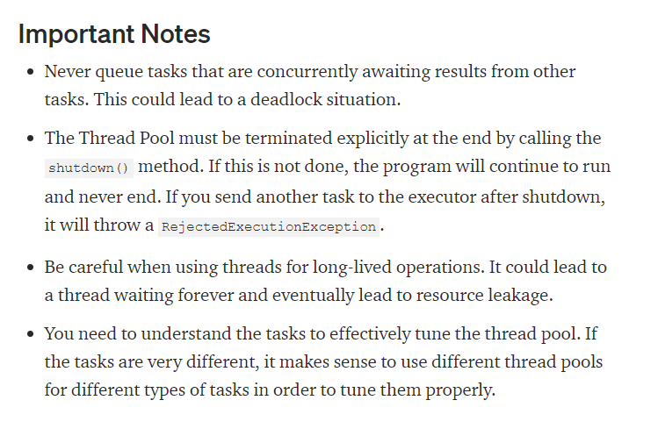

Slide 22
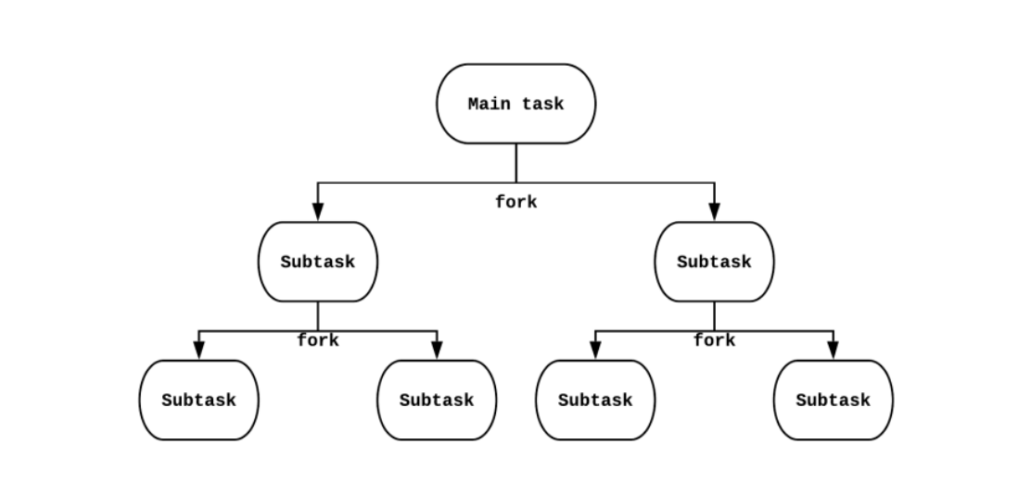

Slide 23
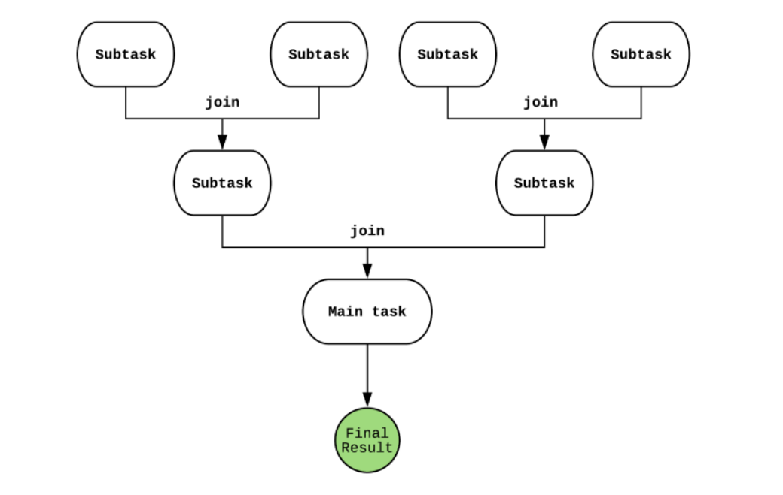

Slide 24
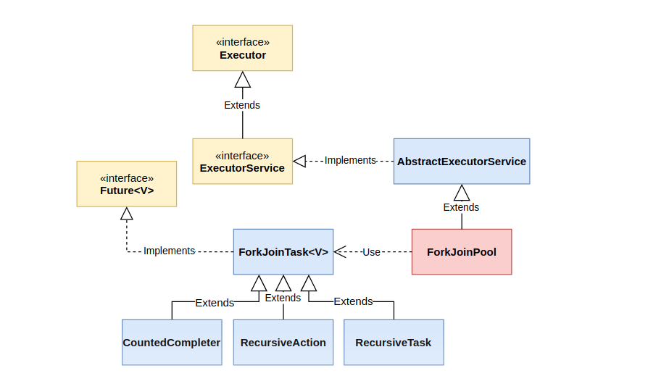

Slide 25
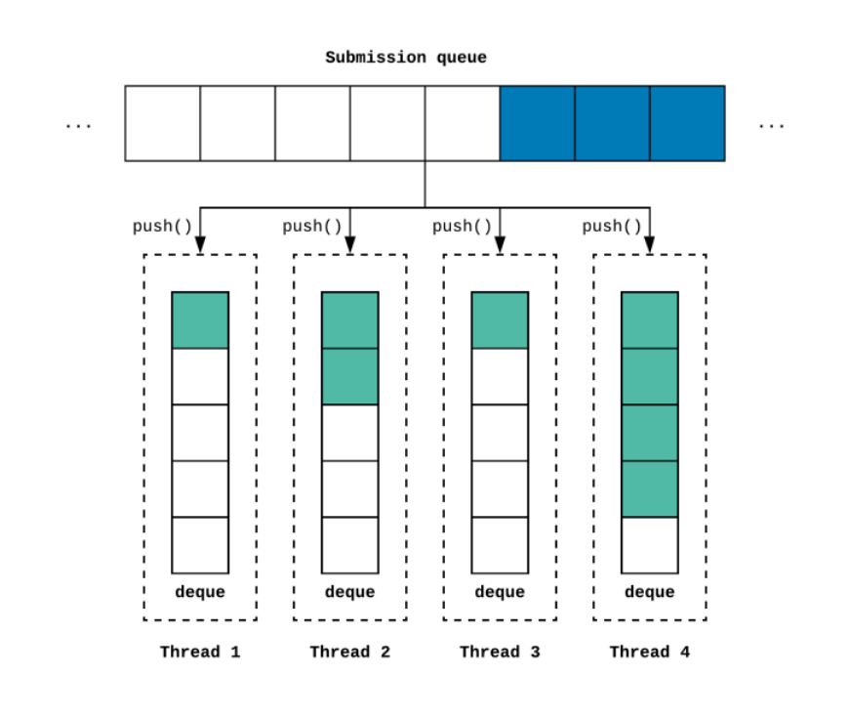

Slide 26
- A producer-consumer design has one shared work queue for all consumers;
- in a work stealing design, every consumer has its own deque. If a consumer exhausts the work in its own deque, it can steal work from the tail of someone else's deque. Work stealing can be more scalable than a traditional producer-consumer
design because workers don't contend for a shared work queue;
- most of the time they access only their own deque, reducing contention. When a worker has to access another's queue, it does so from the tail rather than the head, further reducing contention.
- asyncMode concerns the order in which each worker takes forked tasks that are never joined from its work queue.
Workers in a ForkJoinPool in async mode process such tasks in FIFO (first in, first out) order. By default, ForkJoinPools process such tasks in LIFO (last in, first out) order.

Slide 27
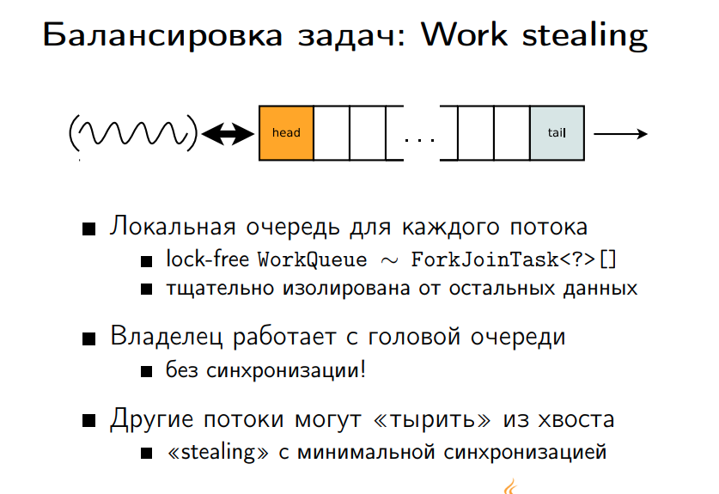

Slide 28
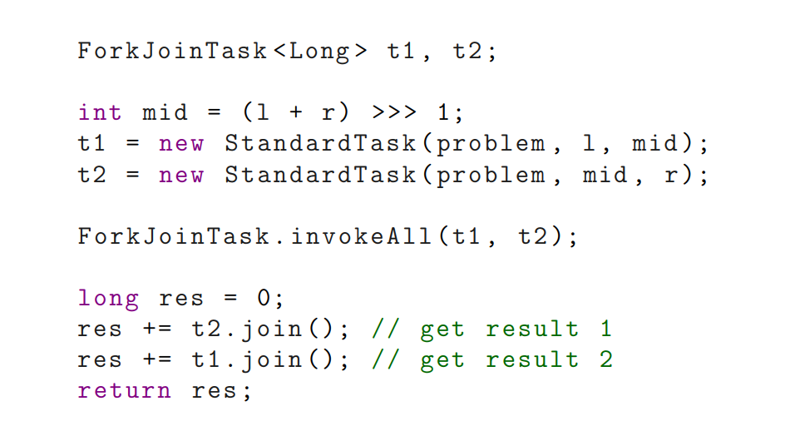

Slide 29
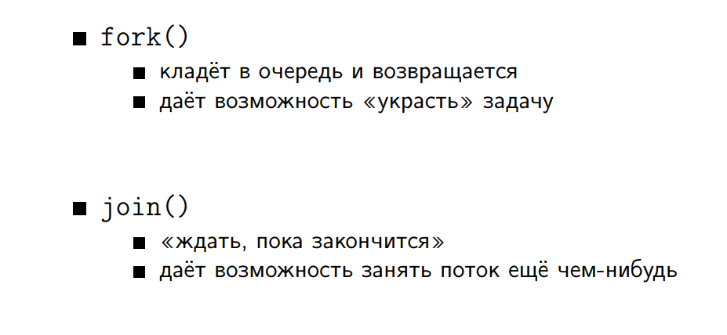

Slide 30
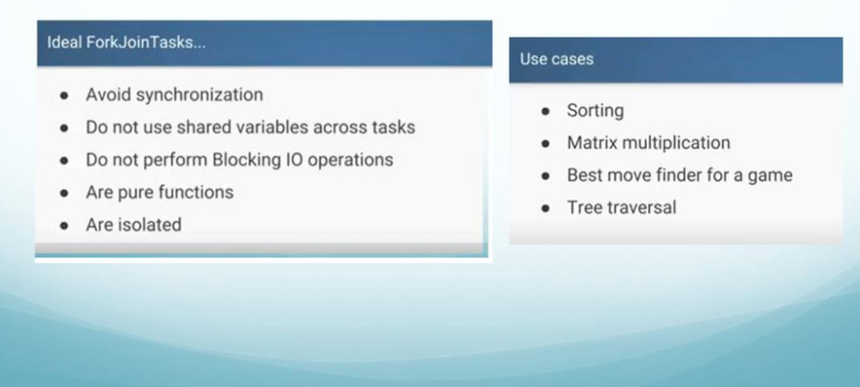

Slide 31
