Slide 1
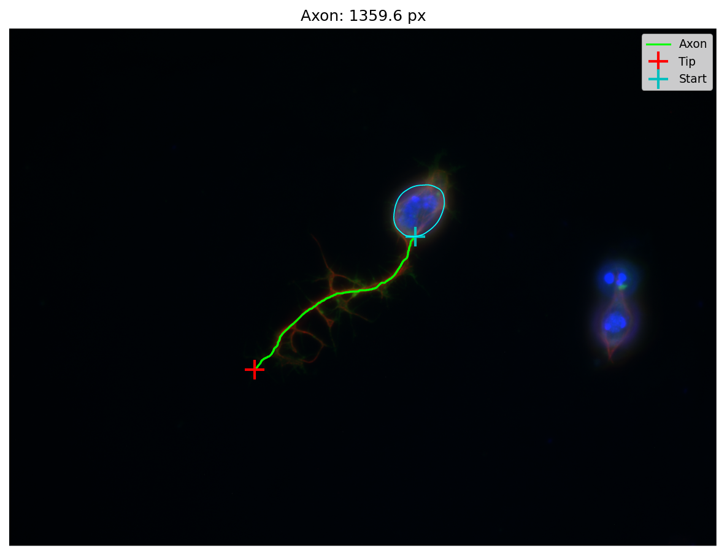
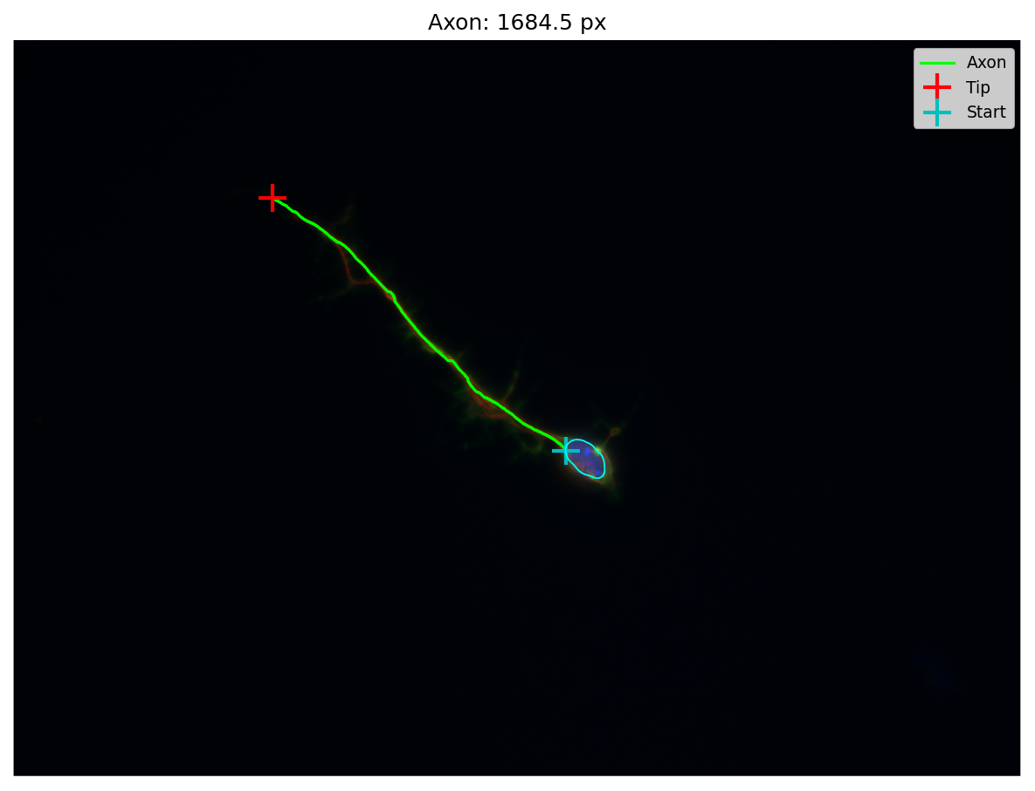
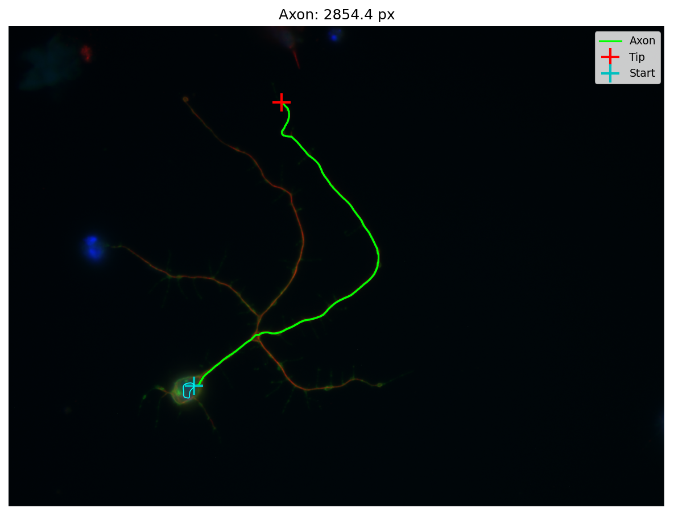
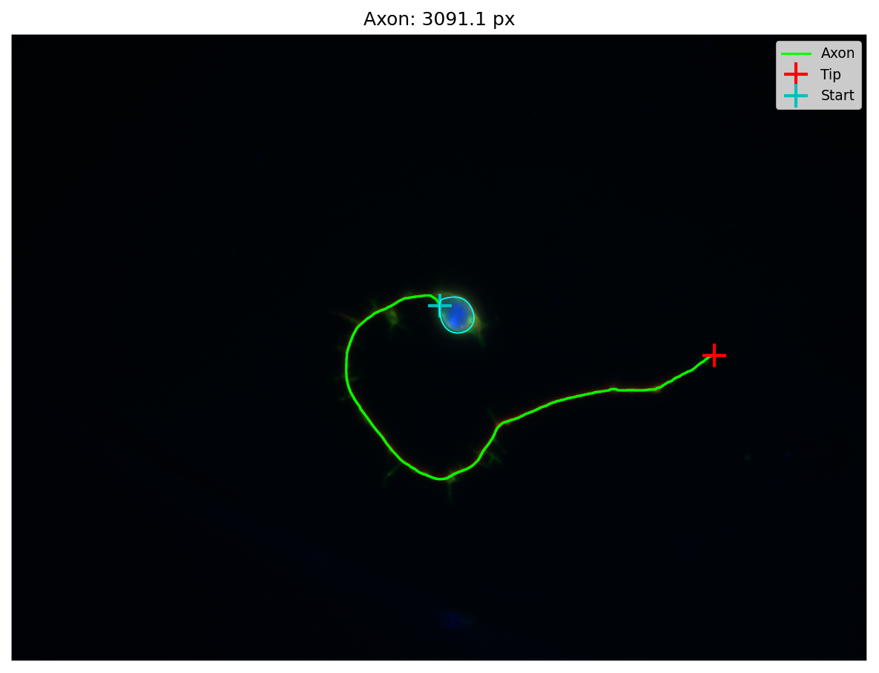
Works well for simple neuron shapes

Slide 2
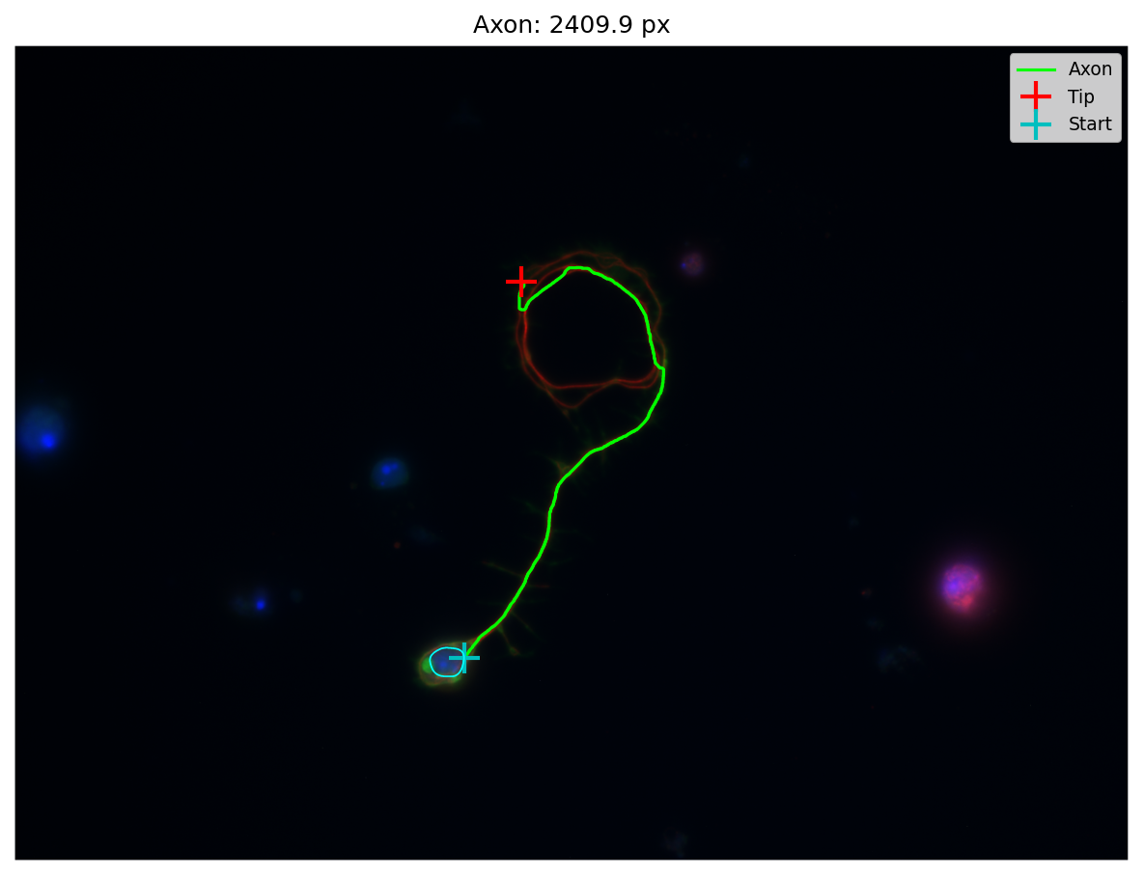
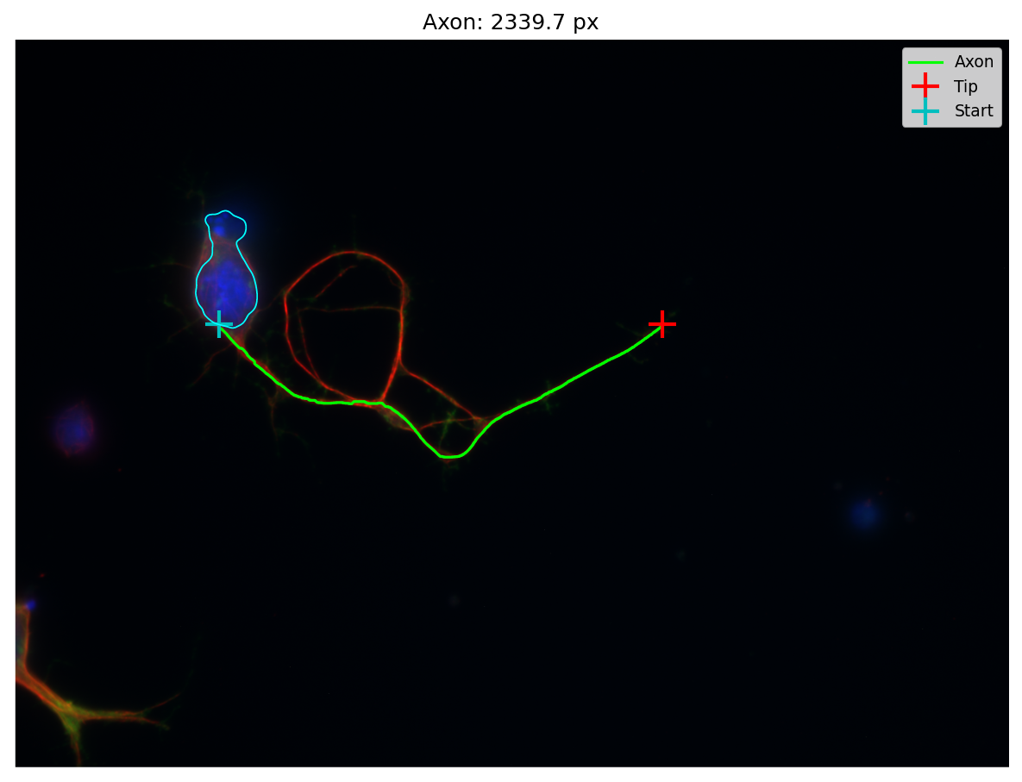
Not so well for complex circular/ overlaps

Slide 3
How it works
1. Nucleus Detection
Extract blue (DAPI) channel from RGB image
Gaussian blur to smooth internal chromatin variation
Otsu threshold to create binary mask of bright nuclei
Connected component labelling — each separate blob = one nucleus
Filter: discard nuclei without green (HRP) signal nearby — removes non-neuronal DAPI
3. Neuron Filtering (discard non-neurons)
Seed intensity: skip if no bright tubulin signal near the nucleus
Mask too small: discard masks below a minimum pixel count
Mask too large: discard masks covering >15% of image (noise/artefact)
Border exclusion: skip nuclei near image edges (white border artefact)
Geodesic reach: tubulin must extend at least 2× nucleus radius from the centroid, measured along the mask — removes blobs without neurite-like projections
2. Neuron Tracing
For each nucleus centroid, region-grow on the red (tubulin) channel
Flood-fill includes all connected pixels above an intensity threshold
Keeps only the connected component containing the seed point
4. Axon Measurement
Identify axon tip: geodesic distance (path through the mask) from nucleus centroid — the furthest reachable point = axon tip
Trace axon path: intensity-weighted Dijkstra from tip toward nucleus — path follows the brightest tubulin signal (centre of the axon)
Terminate path: stop when the trace reaches within a set distance of the nucleus mask — prevents looping around the soma
Axon length = summed pixel-by-pixel distance along the traced path

Slide 4
Next steps
I don’t see a reliable way to include the complex overlapping neurons in this analysis. If I begin tweaking parameters to try and do this, I fear it may open up a can of worms with respect to non neuronal signals.
I suggest that after this system batch processes a panel, manual review of all results (ill build a little viewing system to count or discount neurons before it saves everything into csv formats). Perhaps these discounted neurons could be manually labelled or just ignored.
Some tweaking needed but automated axon measurements is basically done.
Just need to work on MDI now – next week

