Slide 1
Evaluation of C++ Applications
Student: Dumitrița Munteanu, Master An II, IVA

Slide 2
Software Performance
Performance only meters when you don’t have enough of it
„It runs slow”
Symptom vs root cause
Performance profiling – activity that helps us discover something we didn’t anticipate

Slide 3
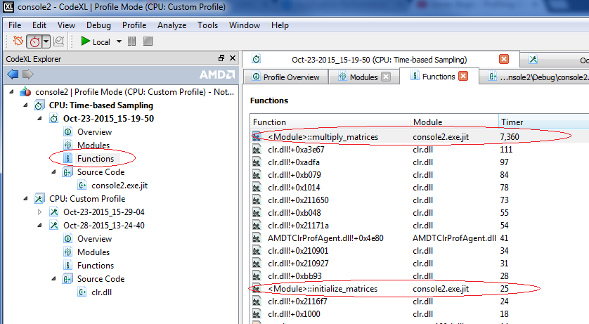
1. Identify Hot Spots
Good start for performance analysis : identify the hot spots.
    Which are the slowest functions?
Run a use case and observe profiling data

Slide 4
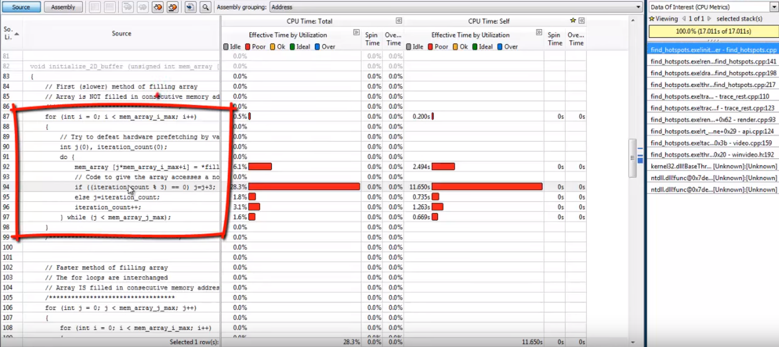
Focus Optimization Efforts on Hotspots
Highlight the line code that are being called the most

Slide 5
2. Number of Calls
Some performance bottlenecks do not show up on the Top 10 slowest functions.
Examine your loops and expensive calls.
Take a look at the Hit Count.
When you look at time, you get the Hit Count as well, but number of calls is something you can also do when you do Code Coverage profiling.
Code Coverage Profiler will tell you what was run and how many times and most importantly what you still didn’t test.

Slide 6
3. Excessive Object Allocation
“Too much of a good thing” may not be so great.
Run Memory Allocation Profiler
Look at the objects that are dynamically allocated in heap memory
Find how many and what type of objects are in memory at a given point of time.
How much memory do they take as you run the application in a given scenario?
See if you can maybe reduce the size of the memory that is being used.
Find Memory Leaks

Slide 7
3. Excessive Object Allocation
Allocation Profiler is used to find memory leaks in applications.
It allows to determine whether the allocated memory blocks or objects remain in memory after the application execution is over.
Reference Count Profiler tracks the creation and deletion of references to objects and allows to pinpoint unreleased references.
Resource Profiler is used to find resource leaks and resource errors in applications.

Slide 8
Allocation Profiler
Each class has a live count value, which if it is not zero, means that some of the objects that where created were not destroyed when the application was closed.
Find out where these instances were created and determine why they were not released.
For each leak detected, the allocation profiler collects information on the call stack i.e. the hierarchy of functions that led to the creation of the objects that was not released.
Once you find the function, you can look at it’s source code and find the place in which the allocated memory can be released.

Slide 9
3. OS Resource Usage
The size of code and data your program can declare and use under a certain OS is as well important.
Use OS Resource Usage Profiler in order to detect the unused handlers.
There are three kinds of memory limits:
Static code and data - this is all the compiled code plus all static data. In C or C++, static data is generally created by variables and structs declared at "file scope", outside of a procedure.
Dynamic data - this is memory that is allocated during program execution. In or C or C++ this is usually done with malloc or new;
Stack data - this is memory that is allocated as a procedure is entered and deallocated when the procedure exits. In C or C++, most routine local variables and variables declared inside blocks are allocated on the stack.

Slide 10
Memory Limits for Applications on Windows
32-bit
  Static data - 2GB
  Dynamic data - 2GB
  Stack data - 1GB (the stack size is set by the linker, the default is 1MB. This can be increased using the Linker property System > Stack Reserve Size)
  Note that on 32-bit Windows, the sum of all types of data must be 2GB or less. The practical limit is about 1.75GB due to space used by Windows itself
64-bit
  Static data - 2GB
  Dynamic data - 8TB
  Stack data - 1GB (the stack size is set by the linker, the default is 1MB. This can be increased using the Linker property System > Stack Reserve Size)

Slide 11
4. Database and Third Party Calls
Connection to DB and third party calls could be a source of bottlenecks.
Data transfer and calls to third party functions can be time intensive.
Observe the timings on the line level.
See how much time was taken to execute a particular call.
Optimize application design around bottlenecks that you can’t eliminate directly.

Slide 12
5. Eliminate Unused Code
Dead application code and unused modules may accumulate access weight over time.
Reduce the footprint of the application.
Use a Code Coverage profiler for cleaner and leaner code.
Code Coverage profiler can help to identify unused libraries so that they can be removed.

Slide 13
Conclusion
Use Profiler Tools to find
  Hotspots
  Excessive functions calls
  Excessive object allocation
  Unnecessary OS resources in use
  Bottlenecks in SQL statements and third party calls
  Unused Code
Profiles Tools
  AMD Code XL / Code Analyst
  VTune Intel
  AQTime
  Glow Code / Very Sleepy

