Slide 1


Value Alignment
Dan Webber, PHD

Slide 2


Wait, who’s this “Dan” guy?
Postdoc, HAI and EIS at Stanford
Embedding ethics into CS courses like this one!
PhD in Philosophy, University of Pittsburgh
Dissertation on moral theory
Basically, trying to think systematically about value
BA in Computer Science, Amherst College
Plus a few years as a software developer in fintech and e-commerce

Slide 3

Value (mis)alignment: an example
Paperclip AI (Bostrom 2016): “An AI, designed to manage production in a factory, is given the final goal of maximizing the manufacture of paperclips…”
“… and proceeds by converting first the Earth and then increasingly large chunks of the observable universe into paperclips.”
Even a less powerful AI might pursue this goal in surprising ways.
Notes:
E.g., recycling the factory’s plumbing for raw materials, locking out humans who might interrupt the AI’s processes, etc.

Slide 4
Value alignment: the problem
How do we design AI agents that will do what we really want?
What we really want is often much more nuanced than what we say we want. Humans work with many background assumptions that are (1) hard to formalize and (2) easy to take for granted.
It’s hard to solve this problem just by giving better instructions!
Compare the difficulty in manually specifying reward functions.
Even worse for AI that takes instructions from non-expert users!

Slide 5
Precisifying the problem
There are several ways of interpreting “what we really want”!
First, value alignment might be the problem of designing AI agents that do what we really intend for them to do.
If this is right, Paperclip AI is an example of value misalignment because the AI failed to derive the user’s true intention (maximize production subject to certain constraints) from their instruction (maximize production).

Slide 6
Aligning to user intentions
The solution, then, would be to design AI systems that successfully translate from underspecified instructions to fully specified intentions (incl. unspoken constraints, conditions, etc.)
“This is a significant challenge. To really grasp the intention behind instructions, AI may require a complete model of human language and interaction, including an understanding of the culture, institutions, and practices that allow people to understand the implied meaning of terms.” (Gabriel 2020)
Notes:
When I say “maximize paperclip production,” the AI correctly interprets that as “maximize paperclip production within the confines of the factory, using the usual materials, not destroying people or property, etc. etc.”
How well has this quote aged? (Could LLMs help translate? How would well could we verify that they were translating well, if we don’t always know a good translation when we see it?)

Slide 7
Aligning to user intentions
A philosophical problem: our intentions don’t always track what we really want.
Classic cases: incomplete information, imperfect rationality
Suppose I intend for the AI to maximize paperclip production (subject to constraints) because I want to maximize return on my investment in the factory. If the AI knows that I would get a better return by producing something else, has it given me what I really want if it does what I intend?

Slide 8
Aligning to revealed preferences
Second interpretation: AI agent is value-aligned if it does what the user prefers.
Paperclip AI is misaligned because I prefer it not destroy the world!
Problem: How can the AI know what the user prefers when that differs from the intentions expressed by the user?
Solution: The AI could infer the user’s preferences from the user’s behavior or feedback.

Slide 9
Aligning to revealed preferences
Technical challenges:
Requires agent to train on observation of user or from user feedback
Infinitely many preference/reward functions consistent with finite behavior/feedback
Hard to infer preferences about unexpected situations (e.g., emergencies)
Philosophical problem:
Just as my intentions can diverge from my preferences, my preferences can diverge from what is actually good for me.
Notes:
Lots of people prefer to smoke, even though it’s not really good for them. I might prefer to maximize profit on my paperclip factory at all costs, even if it would be better for me to be less focused on money and spend more time with my family, etc.

Slide 10
Aligning to user’s best interests
Third interpretation: AI agent is value-aligned if it does what is in the user’s best interests, objectively speaking.
Paperclip AI is misaligned because it is objectively bad for me for the world to be destroyed.
Technical/philosophical problem: Unlike the intended meaning of my instruction or my revealed preferences, my objective best interests can’t be determined empirically. What’s objectively good for me is a philosophical question, not a scientific one.

Slide 11
Aligning to user’s best interests
The bad news is that philosophers disagree about what’s objectively good for a person:
Is it just the person’s own pleasure or happiness?
… or the satisfaction of the person’s desires or preferences?
… or are things like health, safety, knowledge, relationships, etc. objectively good for us even if we don’t enjoy or prefer them?
The good news is that there’s a lot of agreement:
Health, safety, liberty, knowledge, social relationships, purpose, dignity, happiness… almost everyone agrees that these things are at least usually good for the person who has them
Notes:
By “almost everyone,” I mean philosophers and non-philosophers alike.
Even philosophers who think only pleasure or happiness is ultimately good will think that these things are generally good insofar as they generally lead to happiness.

Slide 12
Aligning to user’s best interests
One thing that is widely thought to be good for a person is autonomy: the ability to choose for yourself how to live your life, even if you don’t always make the best choice.
We want to avoid paternalism: choosing what you think is best for someone rather than letting her choose for herself.
Even if we align to users’ best interests, then, users’ interests in autonomy might give us reason to consider their intentions or preferences, even when these conflict with their other interests.

Slide 13
Part-way recap
Value alignment is the problem of designing AI agents that will do what we really want them to do.
This could mean doing what we really intend, or what we really prefer, or what would really be in our best interest.
These are not always the same thing, and each option poses unique technical and philosophical problems for alignment.

Slide 14
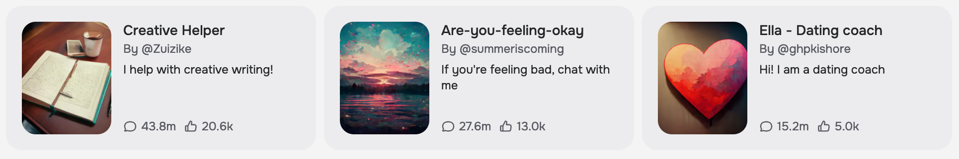

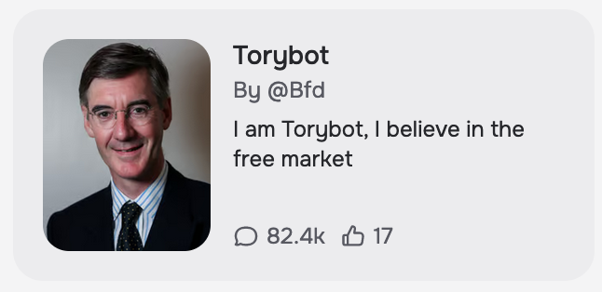



Case study: LLM chatbot personalization
Everyone who talks to ChatGPT is talking to the same chatbot. But many chatbot providers now offer a wide range of different chatbots with different personas. Often these personas are crafted by users:
Notes:
Ignore the fact that there’s GPT 3.5, GPT 4, etc.
From character.ai, “Personalized AI for every moment of your day”

Slide 15
Case study: LLM chatbot personalization
Imagine you are building an LLM chatbot to serve as a source of news for users.
In what ways might you make the chatbot personalizable if you wanted to align to users’ preferences?
In what ways might you make the chatbot personalizable if you wanted to align to users’ best interests?
What would be the pros and cons of each approach?
Discuss!
Notes:
Hint: think about what it might be like to get your news from the chatbot personas we saw on the last slide.
Might be in your best interest to get unbiased news, to be exposed to a variety of opinions and arguments, etc.

Slide 16

What’s been missing from our discussion so far?

Slide 17

People other than the user!
Notes:
The user isn’t the only person in the world who matters!

Slide 18
Aligning to morality
Fourth interpretation: AI agent is value-aligned if it does what is morally right.
Paperclip AI is misaligned because it’s bad for everyone if the world is destroyed!
This interpretation emphasizes the we in “what we really want.”
What the user intends, prefers, or even what’s in her interest might be bad for others!
Notes:
Paperclip AI probably isn’t value-aligned if it maximizes production by exploiting slave labor, even if I, the user, have no qualms about that.

Slide 19
Aligning to morality
But it wasn’t just a waste of time to start by focusing on the user!
Even though we want to align to morality, we also want to align to what the user wants when what the user wants is morally acceptable.
So it still matters how we think about what the user really wants, even if we need to think about it in the larger moral context.

Slide 20
Aligning to morality
A philosophical problem: Which things really are morally right?
There’s a lot of disagreement on this one too!
Is it right to lie to spare someone’s feelings?
Is it right to pirate copyrighted material?
Is it right to buy luxuries when you could donate to charity instead?
Is it right to kill one person to save five?
… a thousand?
… a million?
Notes:
Again, among both philosophers and people more generally.

Slide 21
Aligning to the best moral theory
A moral theory is a systematic account of morality that aims to answer questions like these.
For example, consequentialism says that an act is right iff it produces the greatest net good of any act available.
Is it right to lie to spare someone’s feelings? It could be, if you can get away with it!
Idea: align AI agents to the correct or best moral theory.
If that theory were consequentialism, value alignment would be about training AI agents to do what they can to maximize net good.
Notes:
You may have heard of utilitarianism, which is basically consequentialism plus a theory of the good where happiness is the only ultimate good. So utilitarianism says maximize happiness.

Slide 22
Aligning to the best moral theory
A now familiar problem: philosophers disagree about what the best moral theory is, or even if there is one!
Prioritarianism: Produce the greatest weighted sum of good, with the interests of those who are worse off given more weight.
Maximin: Make things as good as possible for the worst off.

Slide 23
Aligning to the best moral theory
Satisficing: Produce a sufficiently great (weighted) sum of good.
Deontology: Even acts with good consequences can be wrong if they violate certain moral rules or rights.
Common deontological rules: don’t murder anyone, don’t steal, don’t lie, keep your promises, etc.
Rules/rights themselves might be justified by their consequences!

Slide 24
Aligning to the best moral theory
Another problem: even if we knew the best moral theory, it might be bad to design AI agents to act on moral values that their users don’t share.
This might be bad for moral reasons (avoiding paternalism) or more practical ones (users might not trust AI agent, might try to oppose it, etc.)

Slide 25
Aligning to common-sense morality
There’s lots of moral disagreement, but also a lot of agreement.
Idea #2: align AI agents to what we might call common-sense morality: the common-sense moral ideas that most people agree on.
Instead of trying to make AI morally perfect, we just try to make it make moral decisions like a regular person would.
This probably ends up being pretty deontological and satisficing!
Notes:
Most of us think that you shouldn’t kill someone even if you could accomplish a lot of good by doing so; most of us think that as long as you respect others’ rights, keep your promises, are generally a decent person, etc., then you aren’t morally required to do the most good you possibly can. It’s fine to do less, to prioritize yourself over others, etc.

Slide 26
Common-sense morality and predictability
One advantage of aligning to common-sense morality rather than a particular moral theory is that moral theories often have surprising implications.
Can you think of a surprising implication of the consequentialist requirement to maximize net good?
How about a deontological rule against lying?
An AI agent aligned to a particular moral theory might act on surprising implications we haven’t even noticed yet!

Slide 27
Common-sense morality and predictability
By contrast, an AI agent aligned to common-sense morality would behave more predictably, making moral decisions like a regular human.
But it might be unpredictable in edge cases, where common sense arguably runs out.
Would an AI aligned to common-sense morality kill one person to save a million?
Is it bad if the AI is unsure about cases we’re also unsure about?

Slide 28
Recap
Value alignment is the problem of designing AI agents that will do what we really want them to do.
This could mean doing what we really intend, or what we really prefer, or what would really be in our best interest.
We saw what the difference might look like in chatbot development.
It definitely means doing what’s morally right.
But this could mean doing what’s morally right in theory, or just abiding by the common-sense morality that most people share.

Slide 29

Want to talk more about ethics?
Dan Webber webberdf@stanford.edu
Email to set up a meeting!

