Slide 1






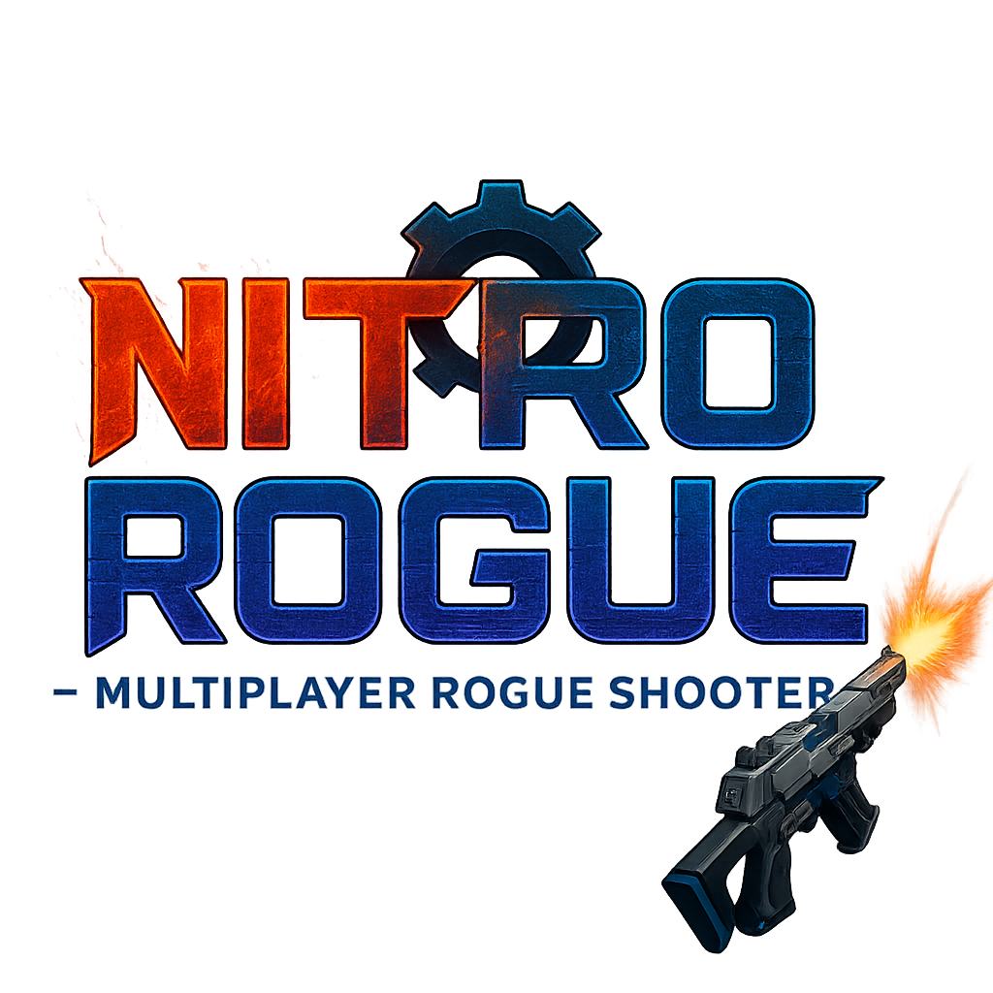


AI 기반 집필 및 협업 지원 E-Book 에디터 Lunavel
동양미래대학교 컴퓨터소프트웨어공학과 YD반 니트로글리세린팀
김동환, 이성민, 김민준, 황서진
지도교수 : 이희진
Background
Results
This project details the development of a dedicated-server-based cooperative multiplayer action game, leveraging the Unity engine and Mirror networking framework. The game is implemented as a 4-player cooperative battle system requiring player collaboration to defeat AI-controlled enemies.
Departing from traditional peer-to-peer models, this project employs a dedicated server architecture to enhance fairness, stability, and scalability. The dedicated server oversees critical functions such as room creation, synchronization, and enemy spawning, while each client is responsible for player control, combat logic, and UI rendering.
Through this architecture, the game facilitates consistent real-time communication and mitigates common issues such as desynchronization or host advantage. The development process also emphasized cross-platform compatibility and deploy ability on Linux-based Azure servers, validating how a dedicated server structure can be effectively integrated into modern multiplayer environments.
Achieved stable 4-player synchronization without desync or delay. Implemented dynamic room creation and removal based on player count. Integrated mission and spectate systems with synchronized result panels. Server-client separation improved network stability and security. When deployed on a Linux-based Azure virtual machine, the dedicated server maintained smooth performance even with three or more concurrent players, showing stable gameplay under real-world conditions. However, minor player flickering issues were occasionally observed during synchronization updates. Gained strong understanding of Mirror’s dedicated server workflow and debugging.
1
2
3
4
Objectives
Build a stable 4-player cooperative environment using a dedicated server structure.
Implement real-time synchronization for movement, combat, and item systems.
Develop matchmaking and room management for smooth session handling.
Ensure server authority logic to prevent desync or client-side cheating.
Client connects
Match list request
Room creation/join
Server sync
Connects to dedicated server and starts session.
Requests available rooms from the server.
Creates or joins a 4-player match room.
Syncs all player and monster data in real time.
Table 1. Comparison of network architectures and performance in multiplayer environments.
Methods
Feature | Peer-to-Peer | Dedicated Server
Stability | Medium | High
Fairness | Low (host advantage) | High (neutral server)
Scalability | Limited | Expandable
Server Control | Client-based | Centralized
Engine / Network: Unity 6 + Mirror API
Database: Firebase for user data
Sync Mechanism: Sync Var, Target RPC, Network Transform (Reliable)
Game Logic: Player Stats (HP, EXP, Level), Enemy Base (AI & combat)
UI: Room UI Manager (room info), Game UI (HUD & player status)
Hosting: Azure Linux VM + Telepathy / KCP
Structure and presentation style
Conclusions
The following diagram illustrates the evolution of the network architecture used in this project. It shows how the system transitioned from a basic peer-to-peer model to a dedicated server and finally to an Azure cloud deployment, improving stability, scalability, and fairness at each stage.
This project demonstrates the performance and reliability benefits of the dedicated-server architecture in Unity multiplayer environments.
It achieved real-time synchronization, scalability, and improved fairness.
Future work includes:
(A)
Peer-to-Peer Model Host acts as the server — unstable when host leaves..
(B)
Dedicated Server Model Server manages syncs — stable and fair gameplay.
(C)
Azure VM Deployment Linux-based server runs smoothly with multiplayers.
01
Cross-region server deployment – Expanding the infrastructure to multiple geographic regions for lower latency and improved global connectivity.
02
Additional game modes – Introducing competitive, cooperative, and survival modes to increase replay value and gameplay diversity.
2025
2035
2045
2055
2025
2035
2045
2055
2025
2035
2045
2055
03
Multi-platform integration – Expanding client compatibility across PC, mobile, and console platforms to enable cross-play through unified account synchronization.
Fig.1. Comparison of multiplayer network architectures and deployment performance. Each stage shows improvements in stability, fairness, and scalability, with the Azure-based dedicated server providing the most reliable performance during multiplayer testing.
04
AI-driven match management – Applying AI to optimize matchmaking balance, player skill grouping, and automated server load distribution.
REFERENCES
Unity Technologies, Unity Engine Manual.
Mirror Networking, Official Mirror Documentation.
Microsoft Azure, Azure Virtual Machines Documentation.
Telepathy Transport for Mirror, GitHub Repository.

