Slide 1








+
$$BatchNorm$$
$$ReLU$$
+
$$k×k Conv$$
$$BatchNorm$$
$$1×1 Conv$$
$$ReLU$$
$$k×k Conv$$
$$x$$

Slide 2


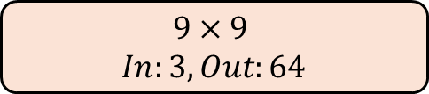
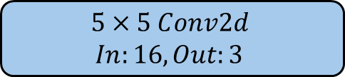
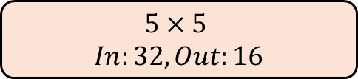
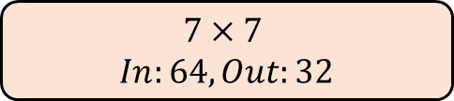
+
$$5×5 Conv2d$$
$In:16, Out:3$
$$5×5$$
$In:32, Out:16$
$$7×7$$
$In:64, Out:32$
$$9×9$$
$In:3, Out:64$
$$Upsample 2x$$
$$x$$

Slide 3

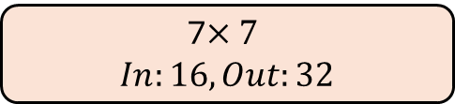
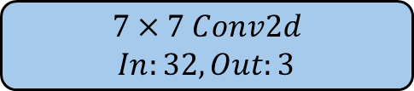
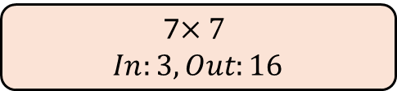

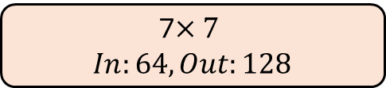
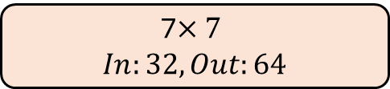

+
$$7×7 Conv2d$$
$In:32, Out:3$
$$Pixel Shuffle (r=2)$$
7$×7$
$In:64, Out:128$
$$Upsample 2x$$
7$×7$
$In:32, Out:64$
7$×7$
$In:16, Out:32$
7$×7$
$In:3, Out:16$
$$x$$

Slide 4
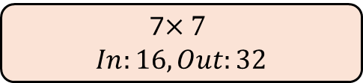
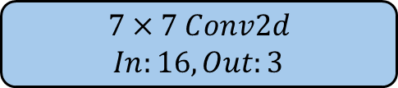



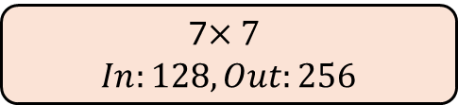
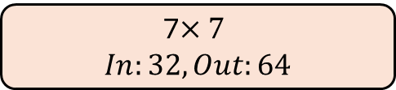
+
$$7×7 Conv2d$$
$In:16, Out:3$
$$Pixel Shuffle (r=4)$$
7$×7$
$In:128, Out:256$
7$×7$
$In:64, Out:128$
$$Upsample 2x$$
7$×7$
$In:32, Out:64$
7$×7$
$In:16, Out:32$
7$×7$
$In:3, Out:16$
$$x$$

Slide 5
High Resolution Image
Generator Loss
Upscaled Image
Super Resolution CNN
Low Resolution Image

Slide 6
High Resolution Image
Critic
Generator Loss
Critic Loss
Upscaled Image
Super Resolution CNN
Low Resolution Image

Slide 7
Generator Loss
Critic Loss
Critic
Critic
Upscaled Image
High Resolution Image
Super Resolution CNN
Low Resolution Image

Slide 8




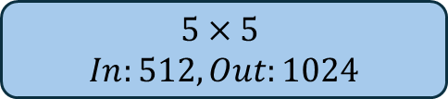








$$x$$
$$9×9$$
$In:3, Out:32$
$$5×5$$
$In:128, Out:256$
$$Leaky ReLU$$
$$Leaky ReLU$$
$$5×5$$
$In:32, Out:64$
$$5×5$$
$In:256, Out:512$
$$Leaky ReLU$$
$$Leaky ReLU$$
$$5×5$$
$In:64, Out:128$
$$5×5$$
$In:512, Out:1024$
$$Leaky ReLU$$
$$Leaky ReLU$$
4x4
Average Pooling
1024x1
Linear

