Slide 1
Version Control for Game Developers
Benjamin Kenwright
Short Introduction

Slide 2
Roadmap
How do you manage your data?
What is Version Control?
Why do we use Version Control?
Advantages and Applications
How Version Control Works
Conclusion/Discussion

Slide 3
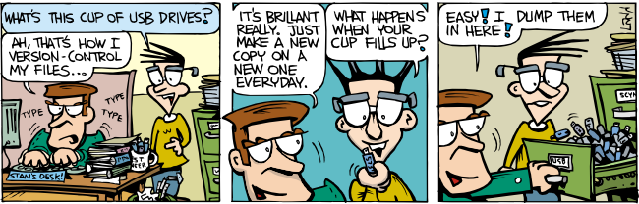
Example….
How do we backup our work?
USB/Hard-drive/email
Revisions – file_v1.txt, file_v2.txt, file_v3.txt (date/times)
Two people working on the same file keep track of changes?

Slide 4
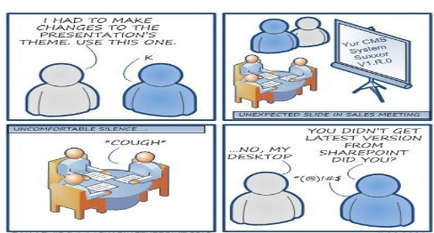

Slide 5

So what is Version Control?
Also referred to as:
Version control systems (VCS)
Software Configuration Management
Revision Control
Source Control

Slide 6
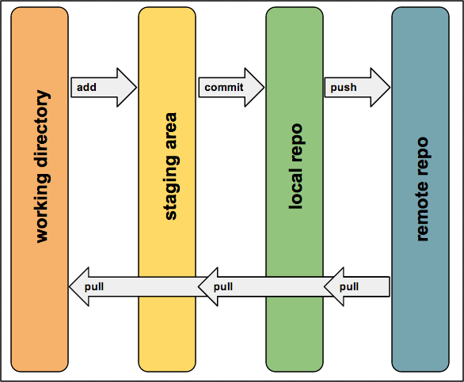
“
Version control (also known as Revision Control) is the management of multiple revisions of the same information

Slide 7
`What’
Tool for managing changes to a set of files
Each set of changes is saved as a new revision of the file
Allows users to recover old revisions reliably
Helps manage conflicting changes made by different users
Backup/security system

Slide 8
Why should we use Version Control?
Works like a `save as’ function
Enables parallel development
Brings collaboration between developers
Maintains history of the whole project
Enables reversibility

Slide 9
Is it important?

Slide 10






Is it important?
YES! - Lots of people use it (i.e., industry standard)

Slide 11
Is it expensive and difficult to setup?

Slide 12
Is it expensive and difficult to setup?
NO
Lots of types:
Git, svn, hg
Lots of free software with GUIs and online articles/tutorials
Lots of free resources:
Bitbucket*, github, sourceforge

Slide 13
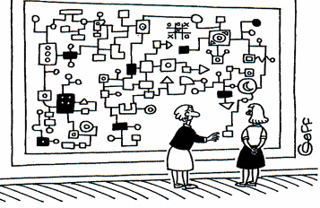
Why doesn’t everyone use Version Control?
Intimidating
Think it’s too complex
Bad experience

Slide 14

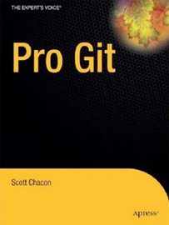
Resources/Further Information
Massive amount of information online
Lots online books/pdfs
Books on amazon

Slide 15
Much more than just a `file’ backup system
Collaboration
Detailed History
Better Deployment
Backup/Security
Additional features
File portability
Keyword substitution
Locking
Externals
Network model
Hooks (Automation)
…

Slide 16
Conclusion
Get started (create a `test’ repository)
Experiment (don’t be afraid)
Get into the `habit’ of using Version Control Early

