Slide 1

BUMTV from the TV-Bums
A comprehensive movie and tv show tracker

Slide 2
Team members
Trevor Cardoza - Design and Implementation leader
Mahim Choudhury - Security leader
Zhe Huang - QA leader
David Mulvihill - Configuration leader
Delaney Sullivan - Requirement leader

Slide 3
Mission Statement
At BUMTV, our mission is to provide a reliable and user-friendly platform for movie and TV show enthusiasts. We aim to offer a secure, accessible, and efficient solution that simplifies the way users track and engage with their favorite content. By prioritizing a seamless user experience and secured browsing, we strive to become a trusted companion for entertainment tracking, ensuring that BUMTV remains a valuable tool for users to manage and explore their cinematic and TV interests.

Slide 4
Key features
User Registration and Authentication: Allows users to create accounts, securely log in, and enjoy their BUMTV experience in a secured environment.
Comprehensive Search: Effortlessly find your favorite movies and TV shows using our intuitive search feature, ensuring you never miss out on the latest entertainment.
Personalized Watchlists: Curate your entertainment journey by adding titles to your watchlist, making it easy to track what you want to watch next (STRETCH GOAL: notify changes to Movie/TV Show).
Where to Watch: Discover where your chosen titles are available for streaming or rental, making it simple to find and access content across different platforms.
Data-Rich Information: Access in-depth information, reviews, and ratings for movies and TV shows, enriching your viewing decisions with detailed insights.

Slide 5
Initial requirements
As a | I want to | So that
User | Be able to track shows I’ve watched through a watch list | I can see my historical information
User | Be able to create an account | I can gain access to BUMTV
User | Be able to access reviews | I can collect information on shows and movies
Website | Be able to have users only access their account | Their data is secure
Website Administrator | Be able to add data | So that the website stays relevant
User | Be able to search over all shows/ movies | I can find ones I want to watch
User | Be able to login to my account | I can login to my BUMTV account

Slide 6
Tech stacks and configuration tools
Amazon Web Services (AWS)
Elastic Container Service (ECS)
Elastic Container Registry (ECR)
Application Load Balancer (ALB)
Virtual Private Cloud (VPC)
DocumentDB (with MongoDB compatibility)
Secrets Manager
Amazon Certificate Manager (ACM)
Key Management Service (KMS)
Terraform for deploying infrastructure to AWS
GitHub for code and documentation repository
Git for version control
GitHub Actions for implementing CI/CD

Slide 7
SPPP Risk Management
Assessing risks under the following categories
Personnel
Communication
Requirements
Management
Technology competence
Design and implementation
Testing
Integration and deployment
Security

Slide 8
SDD - Software Design Document
The BUMTV Web Application is a sophisticated movie and TV show tracker web application that adheres to industry-standard design procedures and best practices. This Software Design Document outlines the architectural and design considerations that underpin the development of BUMTV, emphasizing modularity, security, and quality.

Slide 9
SDD - Software Design Document
Frontend Module
Description: The frontend module handles the presentation layer of the BUMTV web application.
Interfaces: Exposes a user interface for interaction with the application.
Dependencies: Communicates with the Backend API for data retrieval and updates.
Backend API
Description: The Backend API serves as the core of the application, handling business logic, data retrieval, and user authentication.
Interfaces: Provides RESTful APIs for user account management, movie and TV show tracking, and streaming information retrieval.
Dependencies: Relies on the Database Service for data storage and retrieval.
Database Service (Amazon RDS)
Description: Amazon RDS is used for managing the database to store user accounts, tracked content, and streaming information.
Interfaces: Provides a SQL interface for CRUD operations on user data and content tracking.
Dependencies: None.
Docker Containers
Description: Docker containers encapsulate individual components for improved modularity and portability.
Interfaces: Containerized components interact via APIs and HTTP requests.
Dependencies: None.

Slide 10
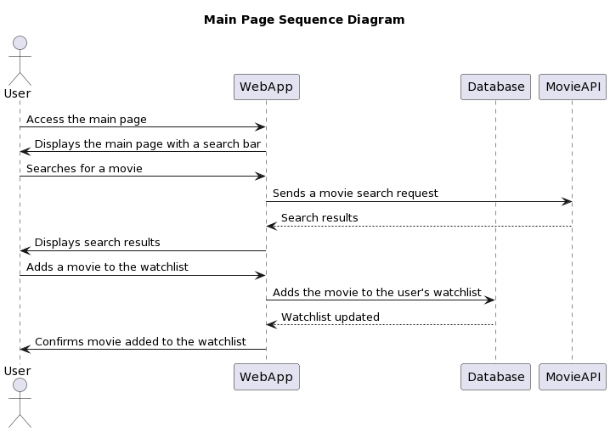
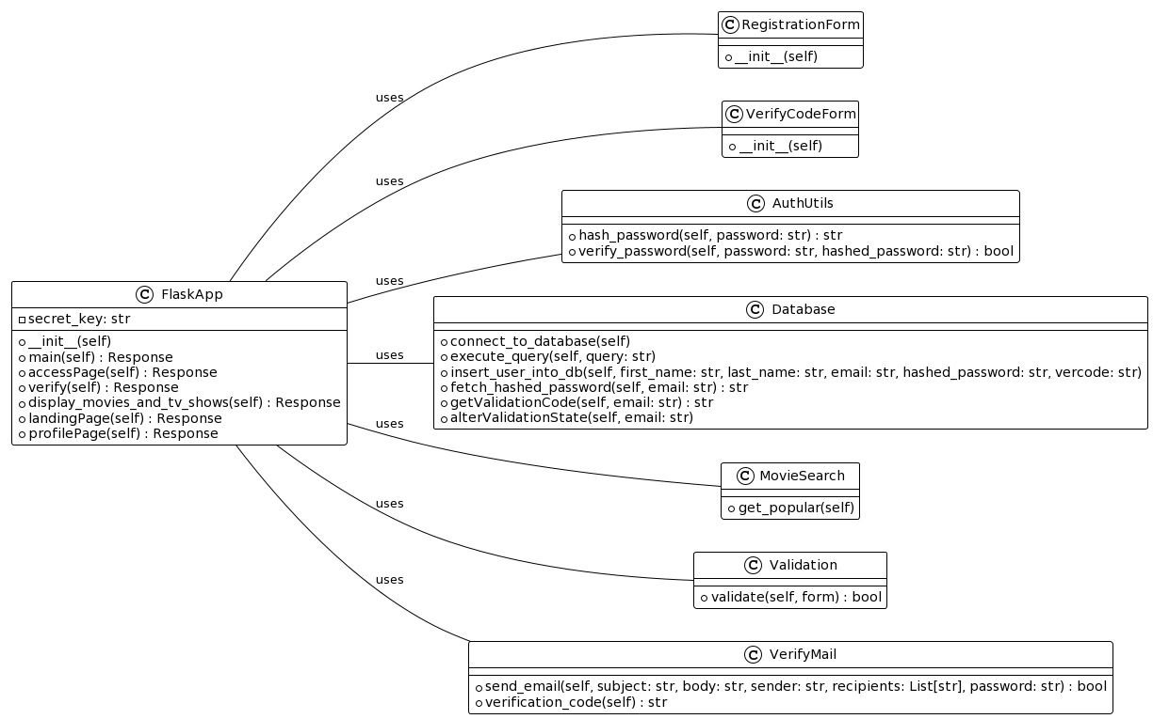
New SDD Diagrams

Slide 11
STD - Software Testing Documentation
We will test the following features of bumtv,
User registration/email validation
Test the form validation, registration success/failure, email verification success/failure
User Login
Test the user login success/failure
Movie search
Test the movie/tv show search capabilities
Routing
Test different routes for success/failure
Add to watchlist
Test add to watch list feature connected to a user
DB connectivity
Test many db connectivity,insertion, and update features
Multiple unit, integration, and automated tests were completed and documented in the STD document. We plan to continue to do further tests in the last iteration.

