Slide 1

BUMTV from the TV-Bums
A comprehensive movie and tv show tracker

Slide 2
Team members
Trevor Cardoza - Design and Implementation leader
Mahim Choudhury - Security leader
Zhe Huang - QA leader
David Mulvihill - Configuration leader
Delaney Sullivan - Requirement leader
Code repo: https://github.com/BUMETCS673/project-team-4

Slide 3
Mission Statement
At BUMTV, our mission is to provide a reliable and user-friendly platform for movie and TV show enthusiasts. We aim to offer a secure, accessible, and efficient solution that simplifies the way users track and engage with their favorite content. By prioritizing a seamless user experience and secured browsing, we strive to become a trusted companion for entertainment tracking, ensuring that BUMTV remains a valuable tool for users to manage and explore their cinematic and TV interests.

Slide 4
Key features
User Registration and Authentication: Allows users to create accounts, securely log in, and enjoy their BUMTV experience in a secured environment.
Comprehensive Search: Effortlessly find your favorite movies and TV shows using our intuitive search feature, ensuring you never miss out on the latest entertainment.
Personalized Watchlists: Curate your entertainment journey by adding titles to your watchlist, making it easy to track what you want to watch next (STRETCH GOAL: notify changes to Movie/TV Show).
Data-Rich Information: Access in-depth information, reviews, and ratings for movies and TV shows, enriching your viewing decisions with detailed insights.

Slide 5
Initial requirements
As a | I want to | So that
User | Be able to track shows I’ve watched through a watch list | I can see my historical information
User | Be able to create an account | I can gain access to BUMTV
User | Be able to access reviews | I can collect information on shows and movies
Website | Be able to have users only access their account | Their data is secure
Website Administrator | Be able to add data | So that the website stays relevant
User | Be able to search over all shows/ movies | I can find ones I want to watch
User | Be able to login to my account | I can login to my BUMTV account

Slide 6
SPPP Risk Management
Assessing risks under the following categories
Personnel
Communication
Requirements
Management
Technology competence
Design and implementation
Testing
Integration and deployment
Security

Slide 7
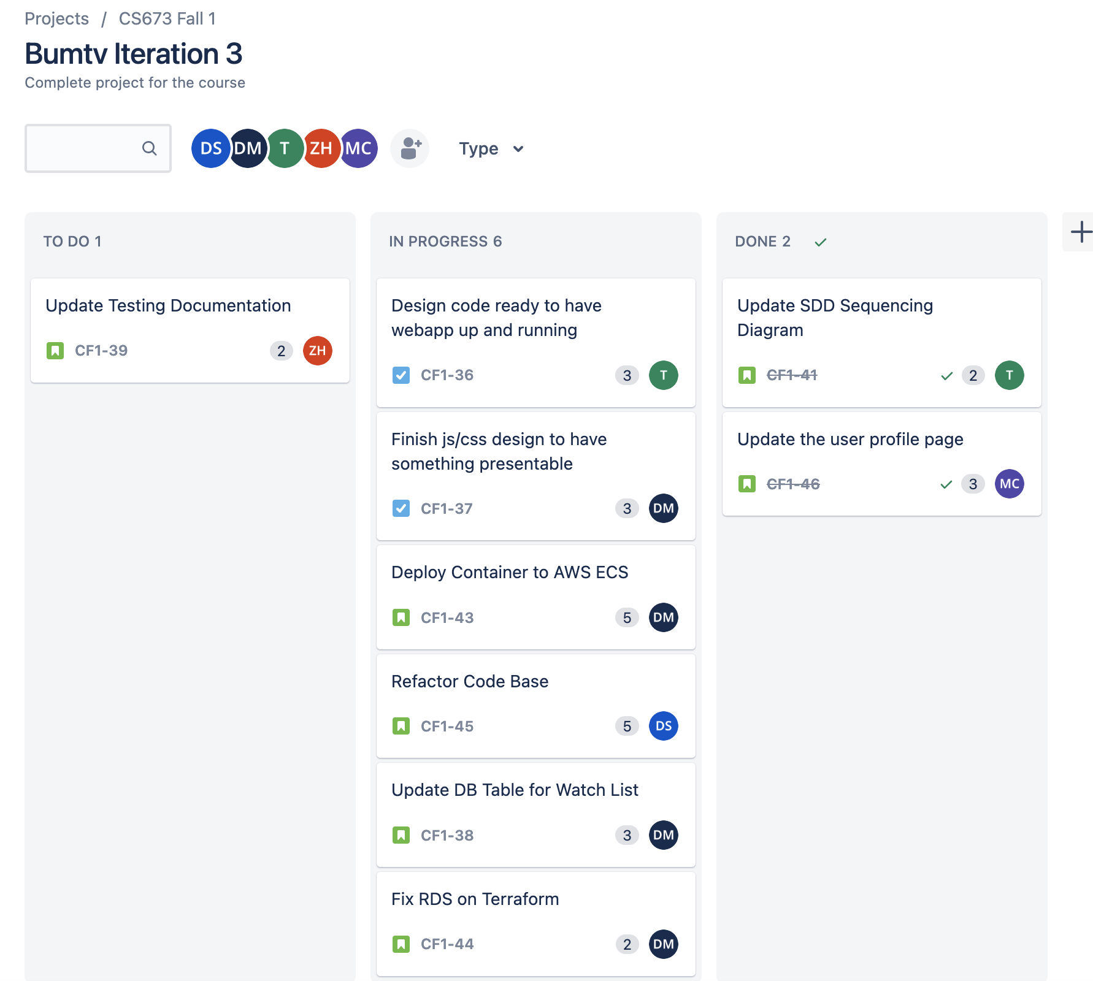
Jira Management

Slide 8
Process Improvement -Pull Request Process
Team member makes changes on their branch
Once code is ready, they make a pull request
One team member must approve the pull request in order to merge into main
Team member would run the code to ensure no breakage to the main branch

Slide 9
Tech stacks and configuration tools
Amazon Web Services (AWS)
Elastic Container Service (ECS)
Elastic Container Registry (ECR)
Application Load Balancer (ALB)
Virtual Private Cloud (VPC)
RDS Mysql
Secrets Manager
Amazon Certificate Manager (ACM)
Terraform for deploying infrastructure to AWS
GitHub for code and documentation repository
Git for version control
GitHub Actions for implementing CI/CD

Slide 10
Configuration Management Overview
Project Repo:
Directory Structure
GitHub Actions
Releases
Terraform Code:
Review Terraform and resources
Dockerfile/Container build
Review container build components
Database (Amazon RDS)
Review schema
Review MySQL Workbench View
AWS Resources
Review AWS deployed resources
CSS
Highlight CSS

Slide 11
Security
Authentication Security: Usage of strong cryptographic password hashing with salt combination. Email verification was also added as an extra method of authentication.
Secure Communication (SSL): Deployment of the webapp in the aws cloud server and the usage of load balancer aided the security of the data transfer in the webapp. AWS provided the signed certificate through the load balancer that is used to configure the ssl.
Static Application Security Testing (SAST): Another important security tool used to ensure the integrity of the code base used for the webapp when it comes to security. It automatically scans the code and provide a detailed report
Database SQL Injection Prevention: One of the most fundamental security requirements of the modern day application. We made sure we tackled the issue by writing proper sql code and test.

Slide 12
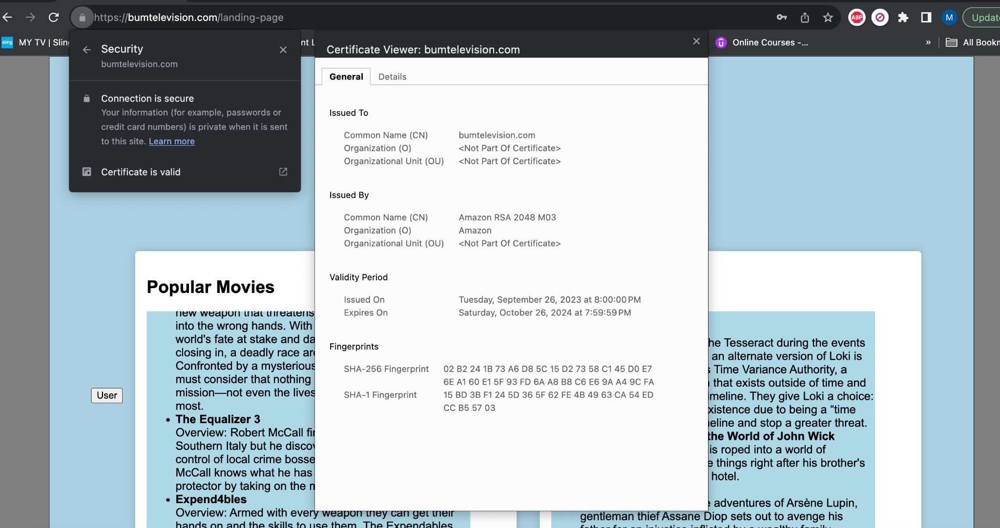

Slide 13
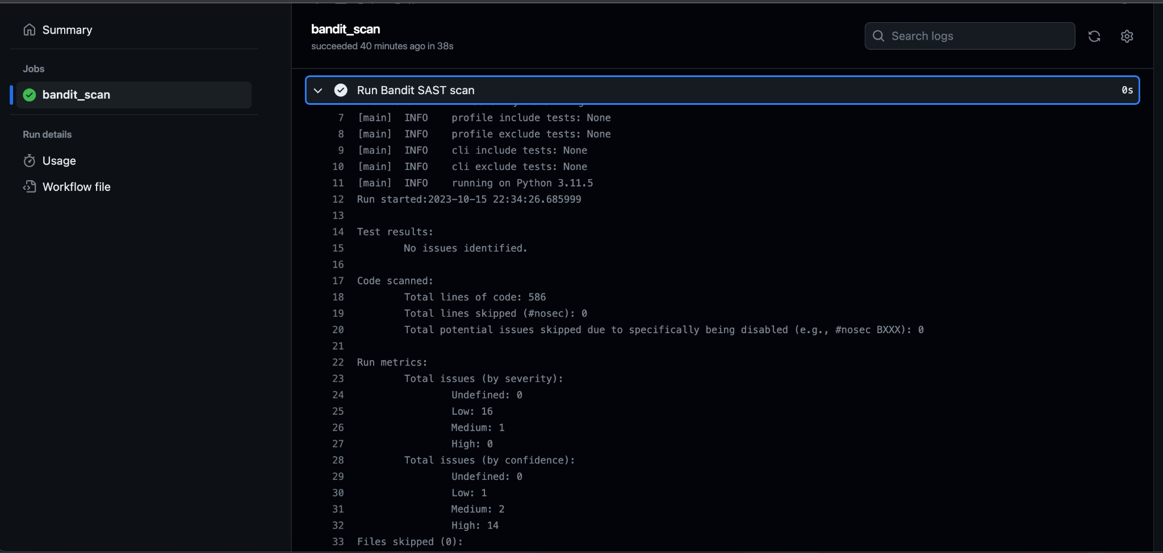

Slide 14
SDD - Software Design Document
The BUMTV Web Application is a sophisticated movie and TV show tracker web application that adheres to industry-standard design procedures and best practices. This Software Design Document outlines the architectural and design considerations that underpin the development of BUMTV, emphasizing modularity, security, and quality.

Slide 15
SDD - Software Design Document
Frontend Module
Description: The frontend module handles the presentation layer of the BUMTV web application.
Interfaces: Exposes a user interface for interaction with the application.
Dependencies: Communicates with the Backend API for data retrieval and updates.
Backend API
Description: The Backend API serves as the core of the application, handling business logic, data retrieval, and user authentication.
Interfaces: Provides RESTful APIs for user account management, movie and TV show tracking, and streaming information retrieval.
Dependencies: Relies on the Database Service for data storage and retrieval.
Database Service (Amazon RDS)
Description: Amazon RDS is used for managing the database to store user accounts, tracked content, and streaming information.
Interfaces: Provides a SQL interface for CRUD operations on user data and content tracking.
Dependencies: None.
Docker Containers
Description: Docker containers encapsulate individual components for improved modularity and portability.
Interfaces: Containerized components interact via APIs and HTTP requests.
Dependencies: None.

Slide 16
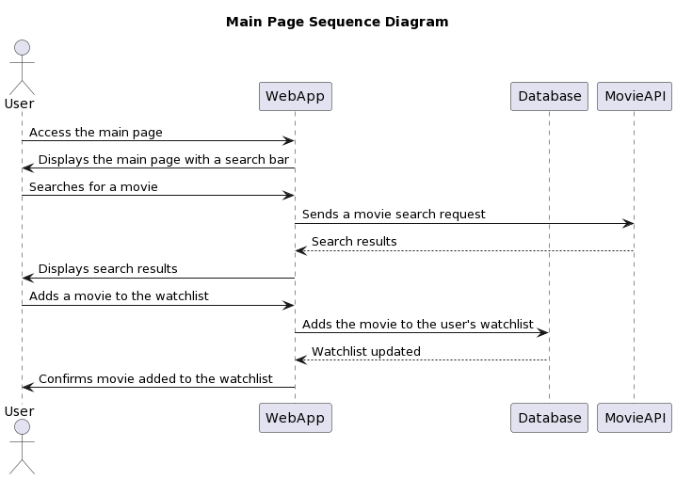
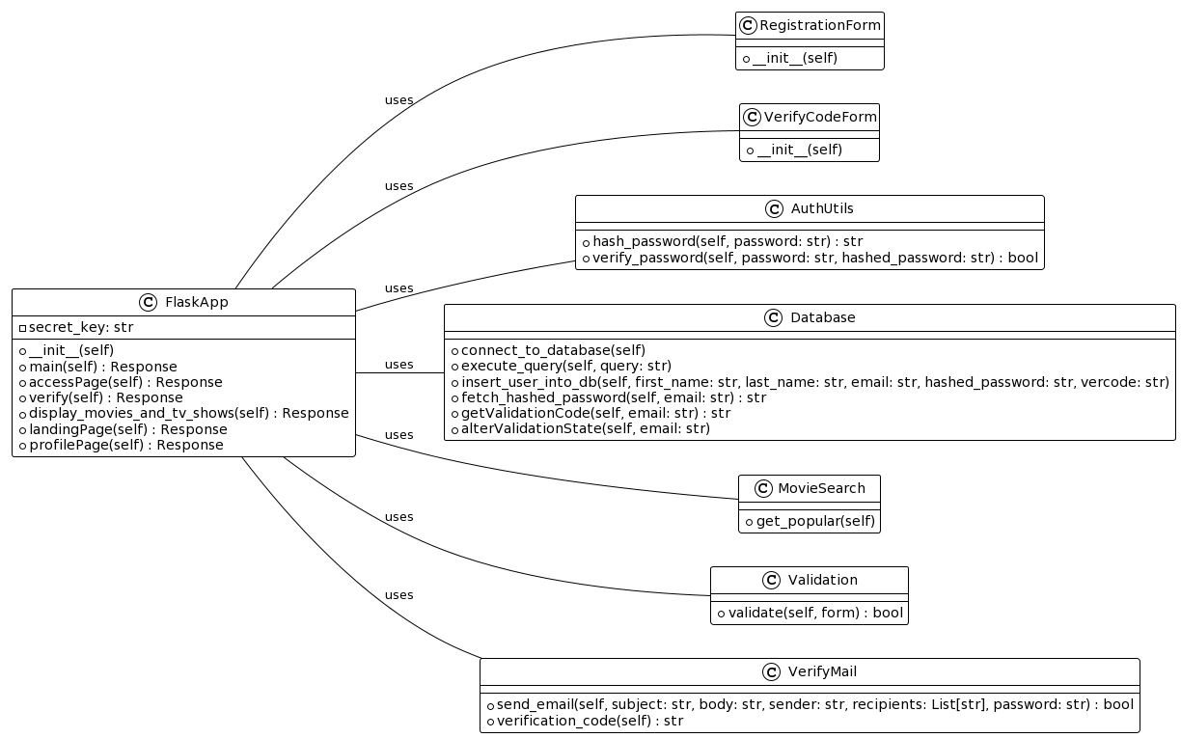

Slide 17
STD - Software Testing Documentation
We will test the following features of bumtv,
User registration/email validation
Test the form validation, registration success/failure, email verification success/failure
User Login
Test the user login success/failure （auto）
Movie search
Test the movie/tv show search capabilities
Routing
Test different routes for success/failure
Add to watchlist
Test add to watch list feature connected to a user
DB connectivity
Test many db connectivity,insertion, and update features (auto)
Multiple unit, integration, and automated tests were completed and documented in the STD document. We plan to continue to do further tests in the last iteration.

