Slide 1
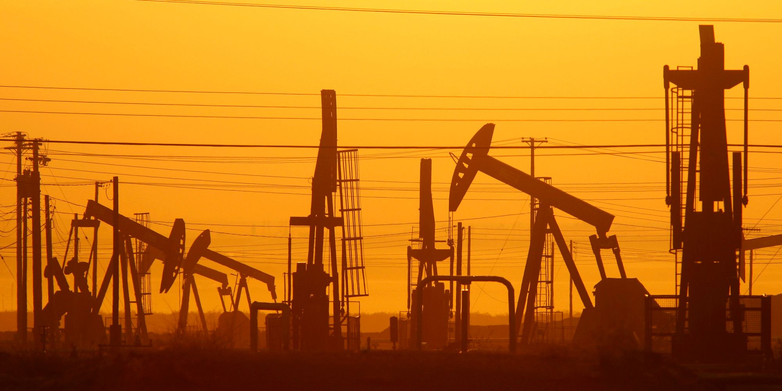
Hydraulic fracturing
Dylan Mumm

Slide 2
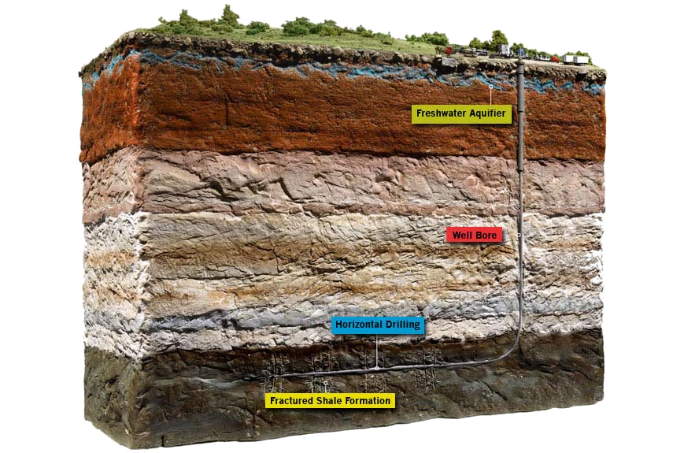
What is fracking?
Hydraulic fracturing, or hydrofracturing, or fracking, is a method of well stimulation in which rock is fractured by a high-pressure liquid stream
Historically, its been used for getting the last bit of oil out of a mostly-extracted well
The first experimental oil fracking was done in 1947, and it was first commercialized in 1949.
As of more recently, it has been used very successfully to acquire methane, or natural gas from shale rock

Slide 3
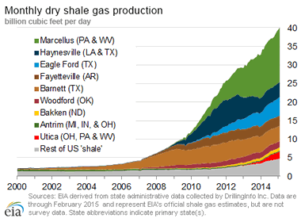
Rise
Throughout the last decade, fracking has seen huge growth. Once an obscure extraction method, it has become a hugely important and controversial cornerstone of US energy
2% of US oil output in 2000, 50% in 2016
Increased natural gas production by 50% since 2005

Slide 4
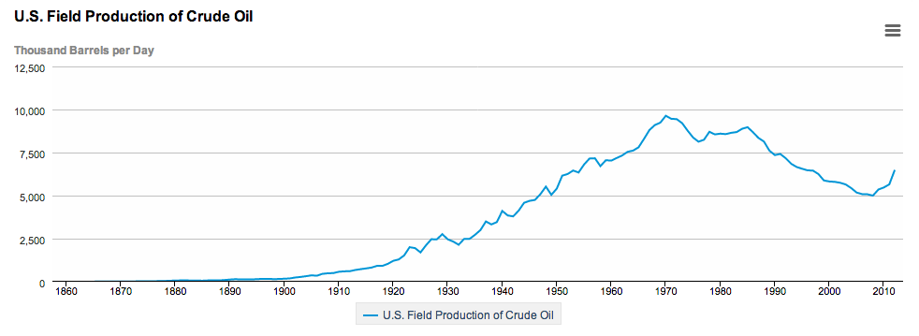

Slide 5
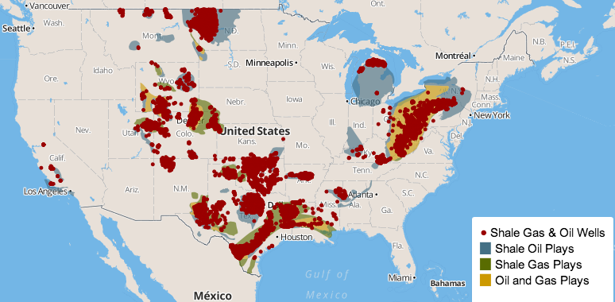

Slide 6
Implications
Pros
Benefits to consumers
Decrease of reliance on foreign oil and methane
Given proper infrastructure, natural gas is more climate friendly than coal
Cons
Potential to pollute nearby drinking water
Major fresh water consumption
Possibly linked to rise in Magnitude 3 and larger Earthquakes
With improper infrastructure, natural gas is no better for the climate than coal

Slide 7
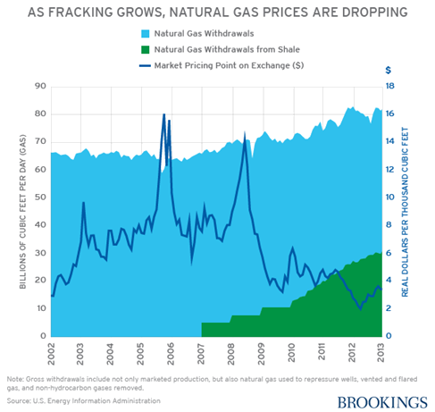
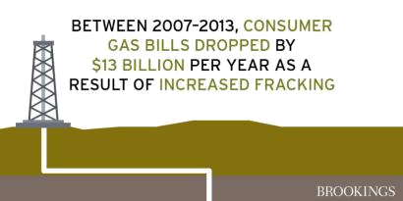
Economic Benefit
While economic benefits are more heavily focused near fracking-heavy regions, the average consumer saves ~$150 a year from hydraulic fracturing

Slide 8
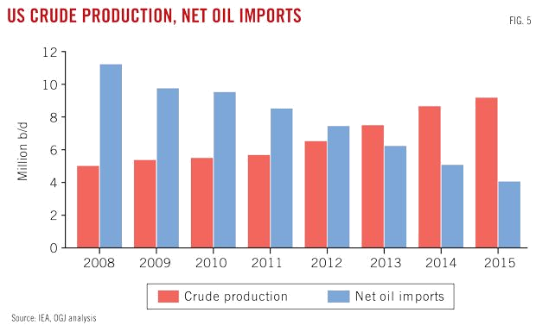
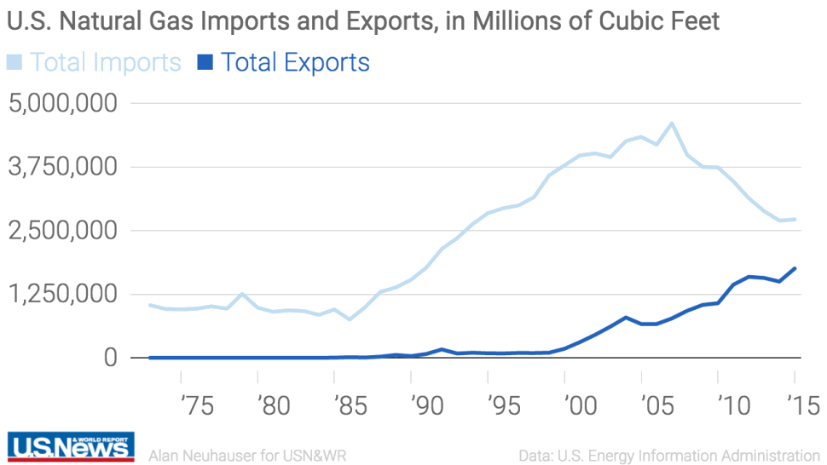
Help towards US Energy Independence
Fracking of natural gas and crude oil has helped to heavily increase in American energy production, lessening our reliance on foreign oil and natural gas. This gives the US more geopolitical power.

Slide 9
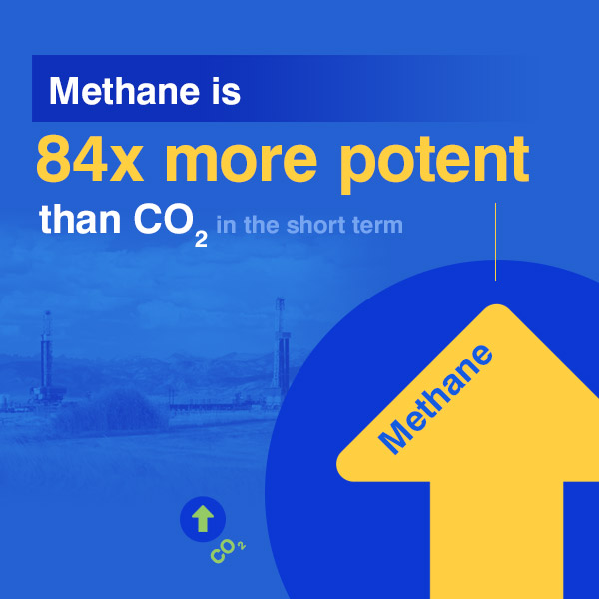
Nat Gas and Climate Change
While natural gas has a much smaller carbon footprint than coal and other fossil fuels, suboptimal infrastructure can lead to high methane leakage during storage and transportation
About 25% of current climate change is from methane
While the Obama administration has tried to address these concerns, much more regulation is needed

Slide 10
Water contamination
Earlier this year, the EPA released an incredibly comprehensive review of potential contamination.
The EPA concluded there are many above and below ground mechanisms which have the potential to impact water resources
While they found some individual examples, they found no evidence of widespread impacts.

Slide 11
Earthquakes
While fracking does commonly create seismic activity, they are unnoticeable and do not cause damage, only to be seen using instruments
Many minor 3.0+ magnitude earthquakes have been linked to fracking the last few years, but there is not clear consensus fracking was the culprit
There is no evidence as of now indicating that fracking can cause a dangerous earthquake, but that may change

Slide 13
References
http://frack.mixplex.com/content/hydraulic-fracturing-history-enduring-technology
http://www.popularmechanics.com/science/energy/g161/top-10-myths-about-natural-gas-drilling-6386593/
http://www.eia.gov/dnav/pet/hist/LeafHandler.ashx?n=pet&s=mcrfpus2&f=m
http://shalebubble.org/dbd-map/
https://www.brookings.edu/blog/brookings-now/2015/03/23/the-economic-benefits-of-fracking/
http://www.ogj.com/articles/print/volume-113/issue-1/special-report-forecast-review/imbalances-weakening-oil-prices-remain-in-place-at-start-of-2015.html
http://www.usnews.com/news/articles/2016-05-15/us-gas-exports-poised-to-surpass-imports-for-first-time-since-1957
https://www.edf.org/climate/methanemaps/leaks-problem
https://www.edf.org/climate/methane-studies
http://www.forbes.com/sites/matthewfrancis/2015/06/18/oil-byproduct-practices-to-blame-for-oklahoma-earthquakes/#15191d233a66

