Slide 1
Freedom of Speech & Censorship
Dylan Mumm

Slide 2
1st Amendment
“Congress shall make no law … prohibiting the free exercise thereof; or abridging the freedom of speech, or of the press”
Restriction on the power of government, not individuals or private businesses
Written precisely to protect controversial speech and ideas
Does not protect libel and direct, specific threats
Does protect offensive speech, whether pornographic art, fascist political ideology, or just plain hate speech

Slide 3
restrictions of speech in democratic countries
US an outlier when it comes to protection of hate speech
Most other countries are more strict on speech perceived as potentially inciting of violence, such as general hate speech towards disenfranchised groups
Examples:
Australia: No explicit right to free speech
Germany: While freedom of expression is declared a right, “Insult”, “Hate speech”, “Disparagement” and many other actions punishable
United Kingdom: Abusive words or behavior excluded from protections

Slide 4
restrictions of speech in oppressive countries
Some countries, with an interest in controlling dissent or perceived immoral conduct, heavily restrict freedom of expression
Content providers often comply and aid with this censorship as to not lose on their markets
Examples:
Great Firewall of China
Saudi Arabia restricts content perceived as sinful, in accordance with their fundamental Salafist Islam

Slide 5
regulating media
With mass media becoming more and more important, regulatory agencies focused on these issues have been given more and more power.
Additionally, the constitution was not written with this communication invented, making legal understanding murkier.

Slide 6
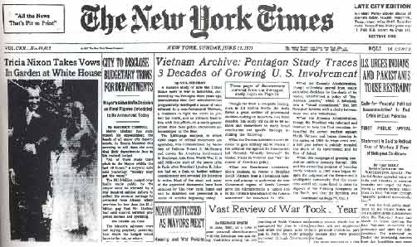
print media
Strongest constitutional protections, partly due to centuries of litigation ruling in its favor
The New York Times v United States

Slide 7

broadcast media
Required for broadcasters to acquire licenses that must meet a minimal standard of merit
Has been used to effectively ban sexually oriented broadcasts, cigarette advertisements, “indecency”, and much more
These powers have been upheld by the Supreme Court, despite no such power existing over print media

Slide 8
“common carriers”
Providers of communication mediums, such as telephone providers and the postal service
As they tend to have regional monopolies, they were prohibited from controlling content on the medium
Additionally, as they have no control over the information, they have no legal responsibility for illegal content

Slide 9
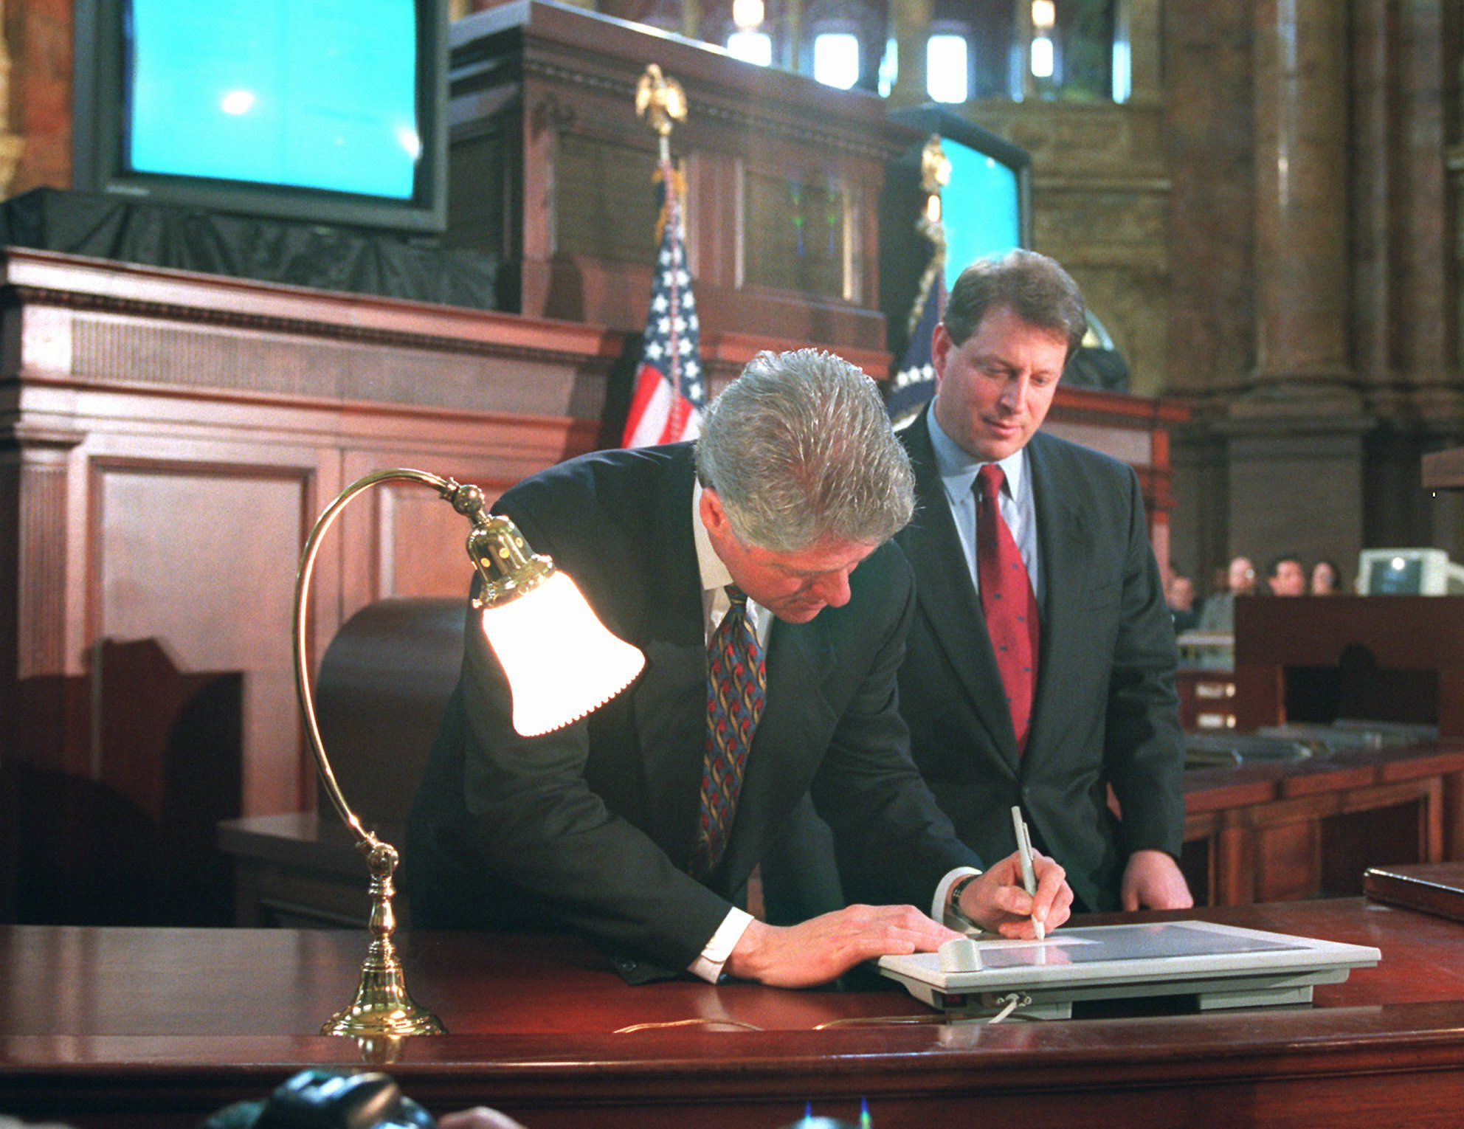
internet
Before the Telecommunications Act of 1996, providers feared legal liability for content posted by subscribers, and actively removed content, partially because of several suits brought against them for content
This act protected providers from liability, encouraging a growth in user-created content
To coincide with these protections for providers, the Communications Decency Act of 1996 regulated pornographic material
In Reno v. ACLU, the Supreme Court struck down censorship provisions

Slide 10
content censorship
To replace the Communications Indecency Act, Congress passed the Child Online Protection Act in 1998
Struck down in 2009, this law made it a federal crime for commercial sites to publish content “harmful to minors”
Passed in 2000, the Children’s Internet Protection Act was passed, blocking federal funding to public schools and libraries if they do not implement internet filters strict enough to the government’s liking.
A target of censorship since their initial boom, governments have been seeking to regulate sexual or violent games

Slide 11
more examples
In response to terrorism threats, Congress passed a law mandating 20 years in prison for disseminating bomb-making information with the intent for it to be used in crimes
Despite incidents of people using online guides to construct and use bombs, no one has been tried under this law
Currently, all sexually explicit content of minors is illegal under federal law
The significant increase in “sexting” has put these laws under pressure

Slide 12
more examples
Due to growing presence of predatory spam, combined with well funded corporate lobbying efforts, anti-spam laws have been passed to censor fraudulent mail
But as these spam senders care little about breaking the law, spam persists
Governments, wanting to prevent spread of sensitive information, outlaw confidential information holders from publishing said info
Due to inherent third party interest in the release of this info, either by whistleblowing or hacking, public and private parties face a conundrum on how best to censor this info
Additionally, should websites such as Google prevent access to these?

Slide 13
private sector censorship
1st Amendment does not apply to non-governmental power
However, it does not protect from service providers acting as gatekeepers on information
While there is currently bans on providers doing so, these regulations are weak
If, for instance, Spectrum, a company significantly benefiting from regional monopoly power, partially empowered through municipal regulations, were to throttle, if not ban, access to satellite internet information, to what extent is this a violation of freedom of speech?
Google has an overarching commitment to social inclusion and is actively against exclusive institutions
Is it right for them to be able to limit these groups voice?

Slide 14
recap
Freedom of Speech is a commonly shared negative right, but different countries have different magnitudes of exceptions to this rule
The US Constitution tends to project even the most vulgar speech, only limiting it when deemed directly dangerous
Congress has been interested in regulating communications for most of its history, and is often rebuffed in the courts
Digital communication makes enforcement of censorship both more requested and simpler

Slide 15
Questions?

