Slide 1

Analysis of Tactile Map Reading
Tablet, Visual and Signal Teams
for CIS 423/510

Slide 2
Who is this Tool for and Why?
For analysts like Amy Lobben who research how visually-impaired users navigate tactile maps.
Provide a tool capable of:
  tracking finger movements over a tactile map overlay
  visualizing the data received during tracking

Slide 3
Overview
First Prototype:
A foundation for new requirements, design and implementation details
Accomplishments:
  Established feasibility of tracking multiple fingers with video
  Established feasibility of tracking a finger with tablet
  Combined video and finger tracking data
  Created one example data display (heat map)
    began discussion of what kinds of analysis and display methods are useful
  Built a "baseline" implementation of all components
    allows future teams to pick individual components to enhance or replace

Slide 4
Teams
Tablet Team:
  Tracks a single finger using a tablet and pen device
Visual Team:
  Tracks multiple fingers from a video source
Signal Team:
  Visualizes data received from Visual and Tablet Team into graphs representing finger movements

Slide 5
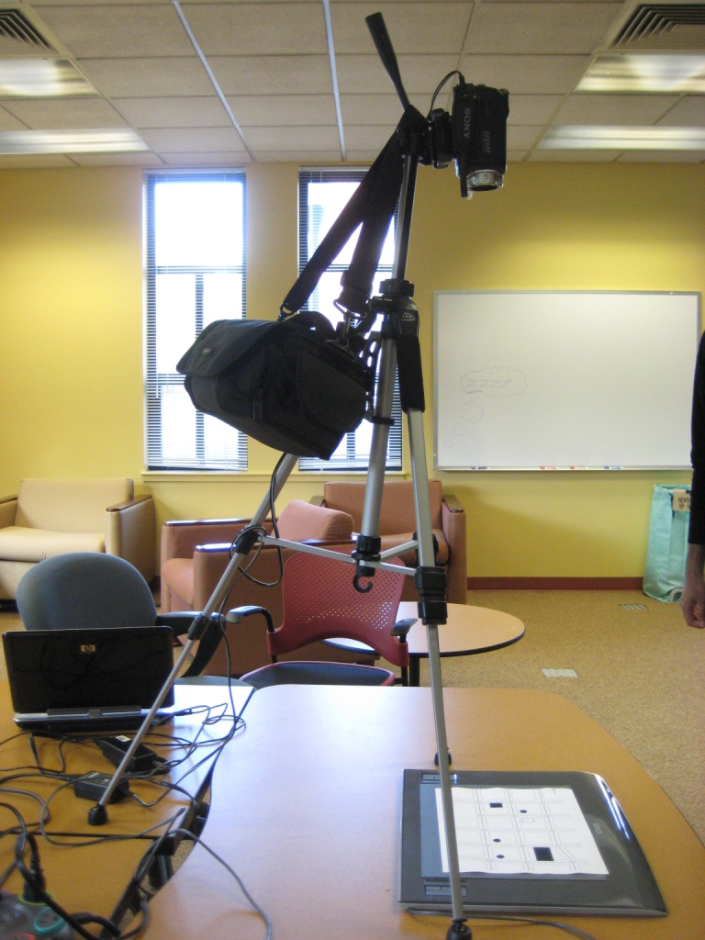
Presentation
Overview
Tablet Team Presentation
Visual Team Presentation
Signal Team Presentation
Live Demonstration
Questions and Feedback
(will follow each presentation)
Setup during combined Visual and Tablet Team testing

