Slide 1

Analysis of Tactile Map Reading
Signal Team
Abdul Binrasheed, Duheng Deng, Zach Moser, Nick Stradling, and Anthony Wittig

Slide 2
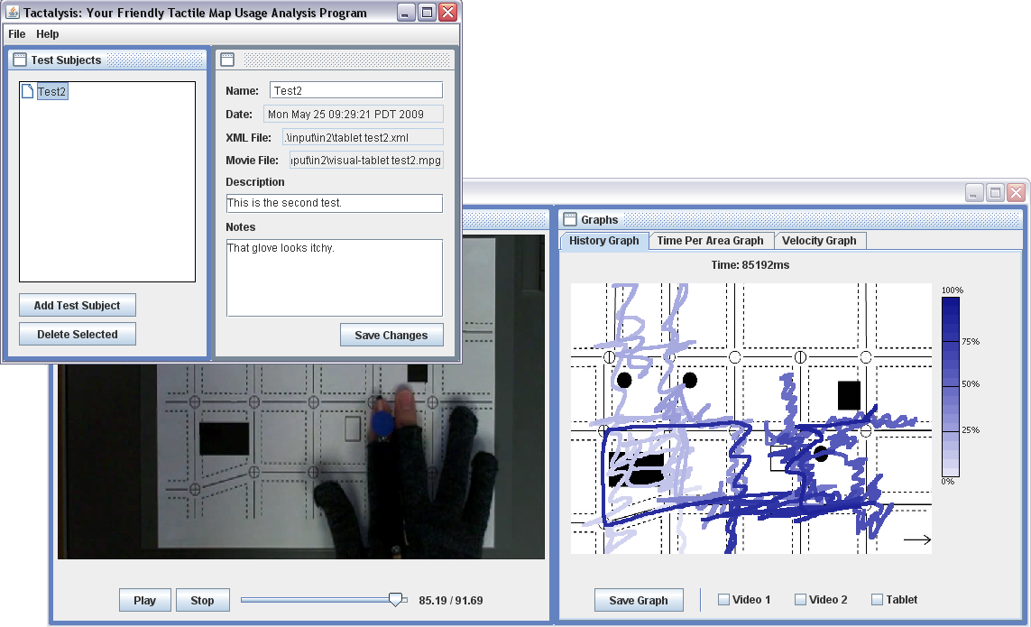
Output Program
Takes video and finger tracking data from testing.
View the data.
View the video.

Slide 3
Features
Add, delete, and select test subjects.
Watch the test video.
Take and save notes.
Generates graphs from test data.
Save the graphs as images.

Slide 4
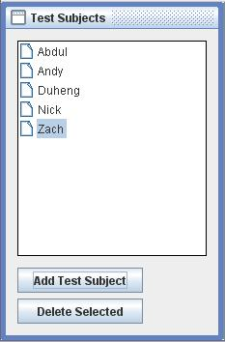
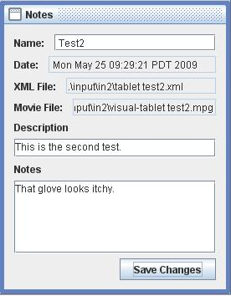
List
Stores and provides access to all of the test subjects.
Allows for changing of notes and description.

Slide 5
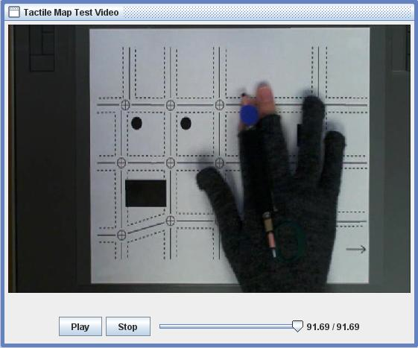
Video
Play, stop, and navigate the video.
The navigator bar affects the graphs.

Slide 6
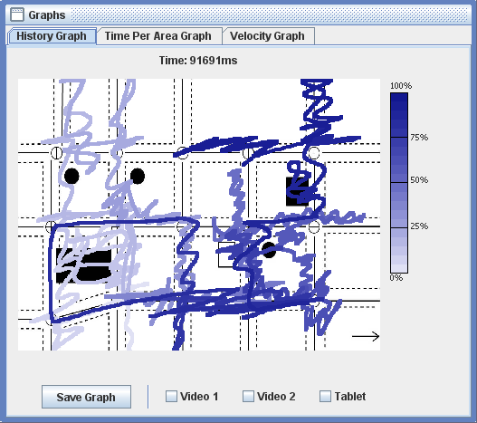
Graphs
Currently draws three graphs.
  History Graph
  Time Per Area Graph
  Velocity Graph
Ability to save graph.

Slide 7
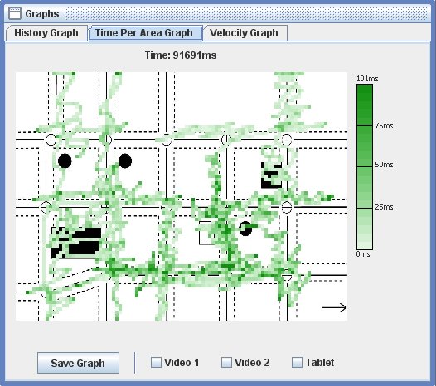
Graphs
Currently draws three graphs.
  History Graph
  Time Per Area Graph
  Velocity Graph
Ability to save graph.

Slide 8
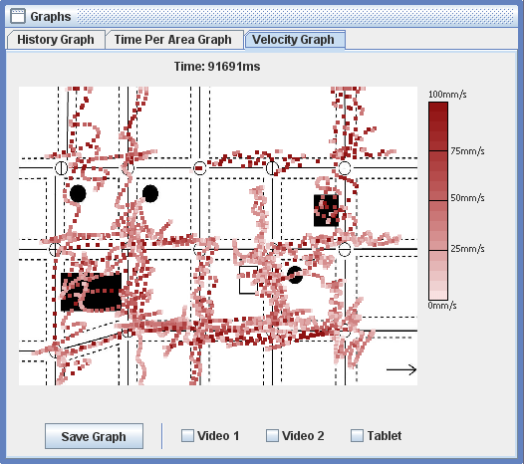
Graphs
Currently draws three graphs.
  History Graph
  Time Per Area Graph
  Velocity Graph
Ability to save graph.

Slide 9
Issues
List usability.
Video format support.
Video loading time.
Delay between video and graph data.
Graph background not scaled properly.
Data length.

Slide 10
Future Features
Extensive usability testing.
Ability to create groups.
Second slider for video.
Additional graphs.
Multiple finger tracking.
MAC support.
Saving the project.

