Slide 1

Analysis of Tactile Map Reading
Tablet Team:
for CIS 423/510
Andrew Munkres
Craig Gardner
Daniel Mundra
Justin McCraw
Tican Chang

Slide 2
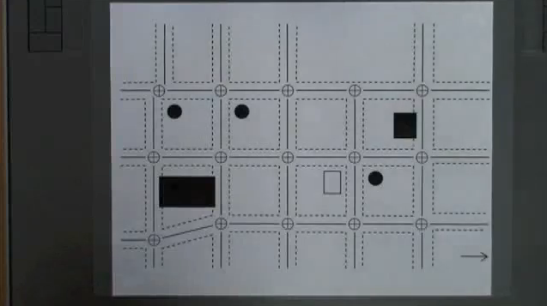
Overview - Tablet Team
  Focus on tracking finger movements using a tablet
  One-finger tracking with possible expansion
Tablet with a printed replica tactile map overlay.

Slide 3
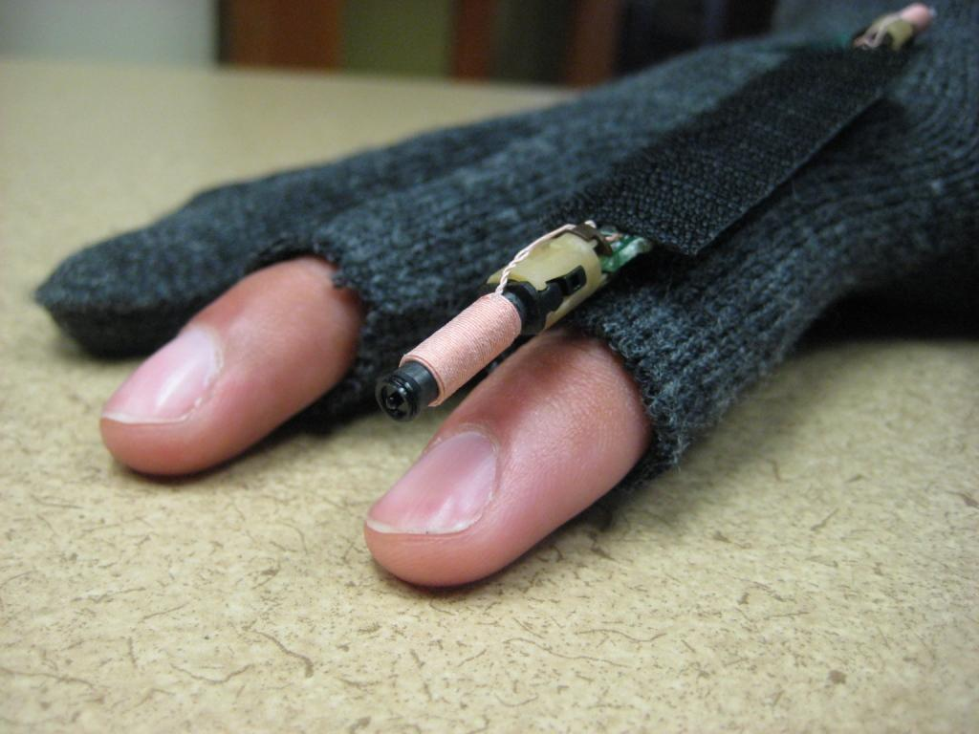
Hardware
Tablet:
We used the Wacom Intuous 3.
Can use any tablet that:
  allows proximity stylus detection
  does not contain pressure sensitivity
  allows the tablet to be mapped to particular screen coordinates
Prototype Pen:
  Used to track finger movements on the tablet
  Exposed the circuit to enhance finger mobility
  Attached to the Prototype Glove
Prototype glove and pen being worn by a testing participant.

Slide 4
Software
Java Program:
  Tracks finger using the Prototype Pen
  Outputs to an intermediate XML data file
Open Source Shout-out:
  Jpen driver library
<http://sourceforge.net/projects/jpen/>
  Batik SVG library
<http://xmlgraphics.apache.org/batik/>

Slide 5
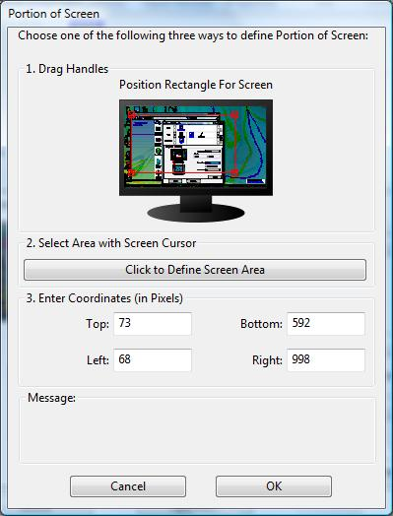
Program Features
  Tracks finger movement through the Prototype Pen
  Displays an SVG image of the map for the operator
  Provides data necessary to map tablet to program window
Data received from the Track Motion program can be used to specify exact coordinates for mapping the program window to the tablet using the tablet's driver software (image).

Slide 6
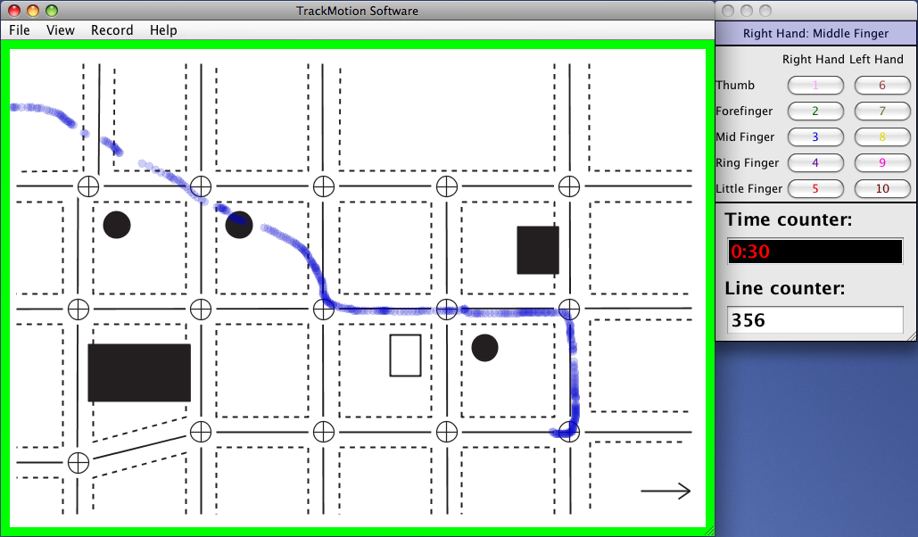
Program Features
  Allows operator to designate fingers
  Provides time and line counter
  Displays visual cues for operator:
    start/pause recording
    finger track colors
    background map
Right Hand Middle Finger being tracked (blue path) during recording (green outline) while the time and line counter are displayed under the finger selection screen.

Slide 7
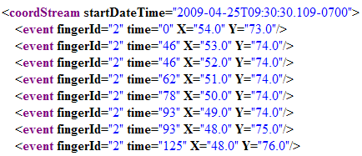
Test Details
Several successful tests:
  Combined Visual/Tablet Team test
  40 min. stress test
Example data from our project's customized-XML format

Slide 8
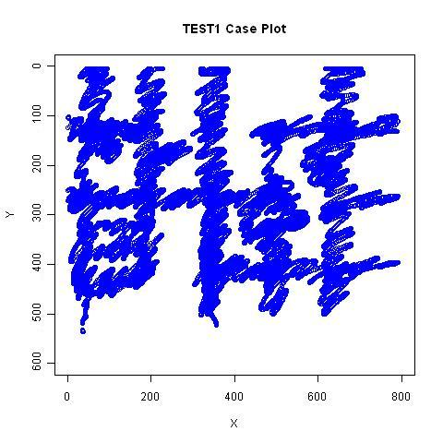
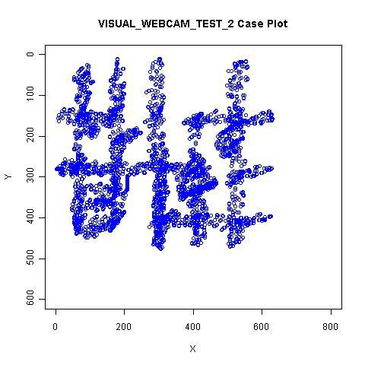
Test Details
Combined Visual/Tablet Testing:
  Simultaneously tracked finger(s) using both recorded video and the tablet
  Analyzed both sets of XML data (below image)
  Noticed a trade-off
    Tablet tracking provides a higher resolution
    Video tracking is capable of multi-finger tracking
Tablet XML data (left) plotted using the R statistical analysis language. Visual XML data (right) plotted using the same program.

Slide 9
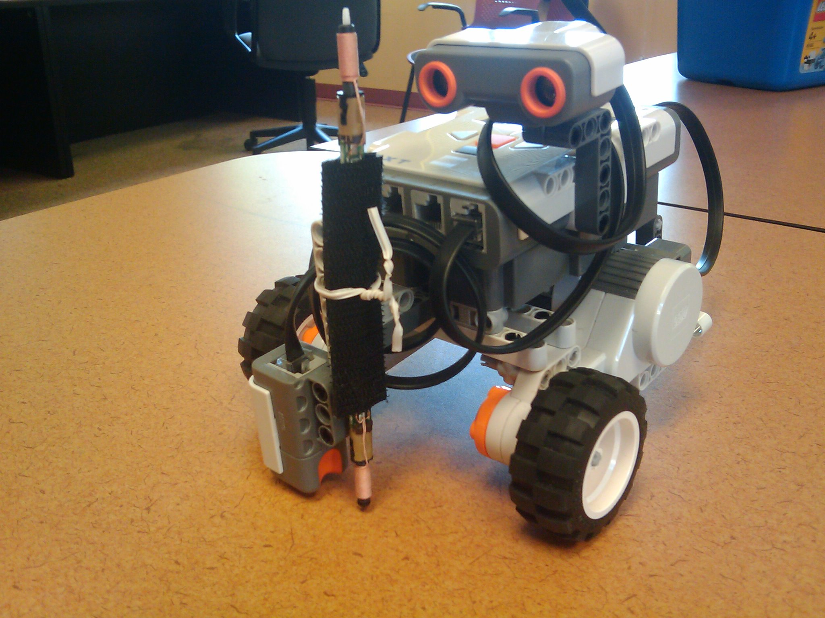
Test Details
40 Minute Stress Test:
  Used Lego Mindstorm Robot
  Received no errors during test
(Threshold probably beyond requirements)
Custom-built Lego Mindstorm robot for use with stress testing the TrackMotion Tablet Team program.
Robot Stress Test

Slide 10
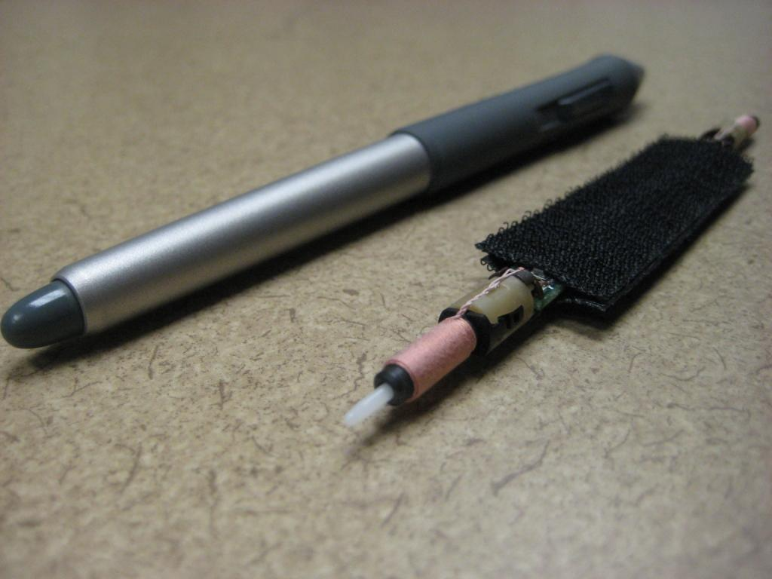
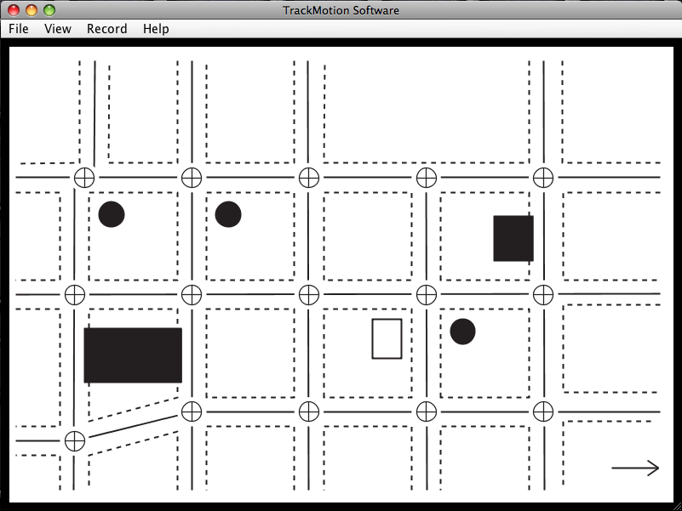
Questions and Feedback
Left: Intuous 3 tablet pen (left) compared to our prototype pen (right).
Right: Main window of the TrackMotion program. The black border indicates the system is uninitialized.

