Slide 1

Analysis of Tactile Map Reading
Visual Team
Peter Maricle, Raihan Masud, Kristy Thomas, Kyle Vessey and Fan Wang
Notes:
06/01/09

Slide 2
Outline
Goal
Problem Space
Solution
Open Problems
Notes:
06/01/09

Slide 3
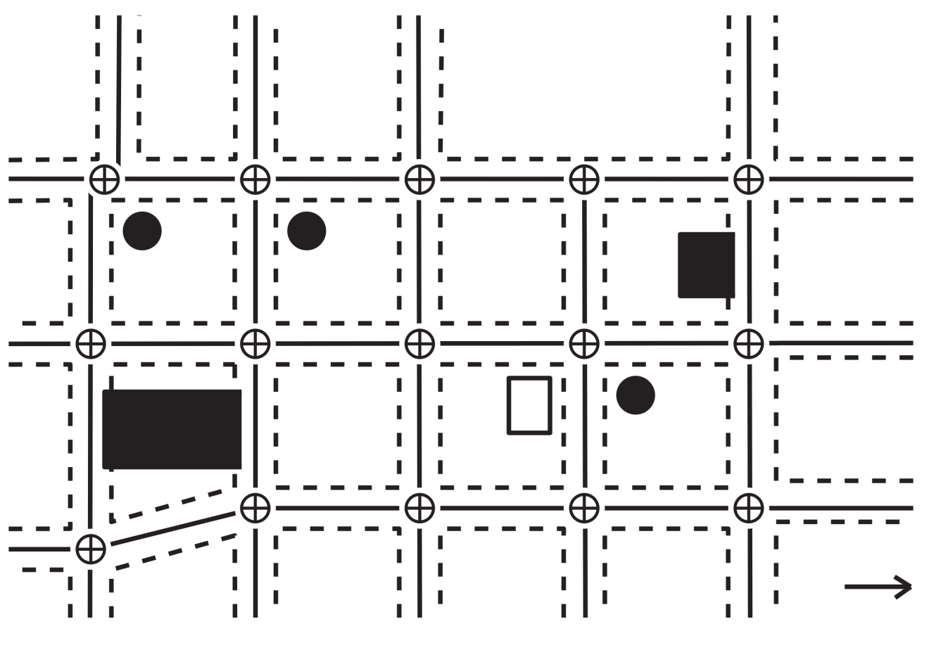
Goal
- To create a tool to aid research in tactile map reading.
- Specifically, to gather data from video that allows for more than one input to be tracked.
Notes:
06/01/09

Slide 4
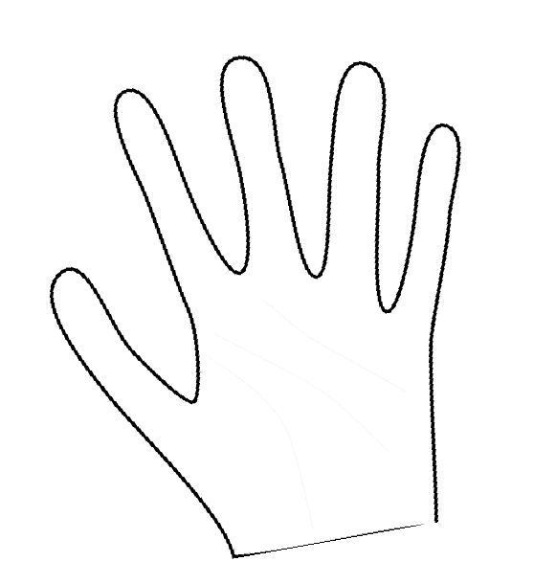
Problem Space
Video Input
  Camera Setup
  Map Orientation
  Lighting
Extract Fingertips
  Marked or unmarked fingers?
  -Identifying fingers
Data Output
  Matching project standard
Notes:
06/01/09

Slide 5
Solution
Color Fingers
Track RGB
Threshold
ImageJ
Speed Up
Color Updating
Notes:
06/01/09

Slide 6
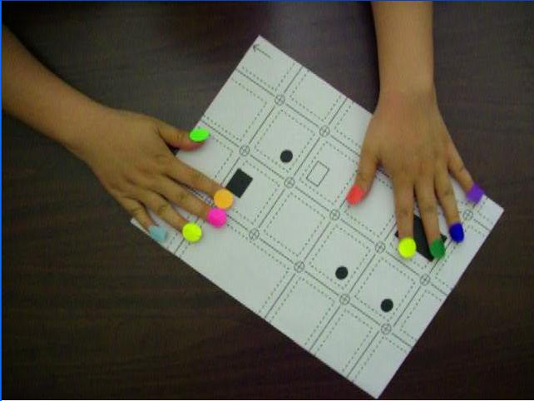
Solution
Putting color stickers on fingers
Notes:
06/01/09

Slide 7
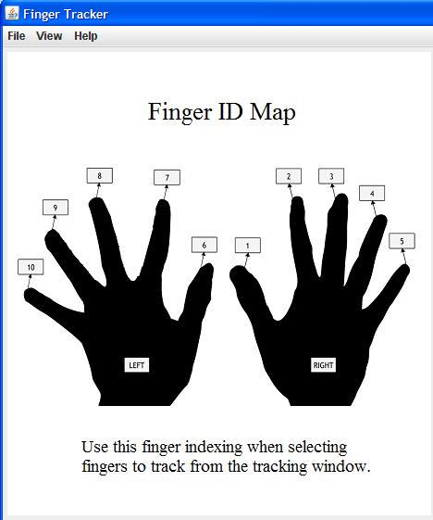
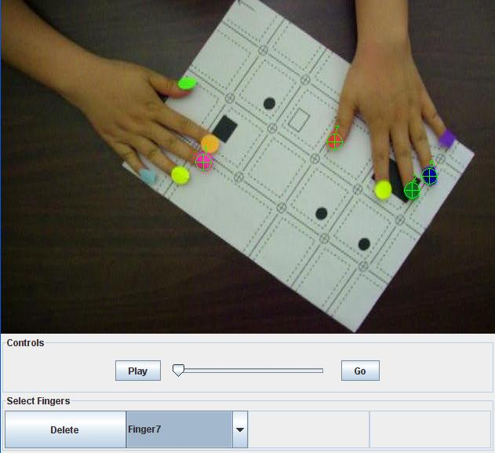
Solution
Selecting finger tips and finger IDs
Notes:
06/01/09

Slide 8
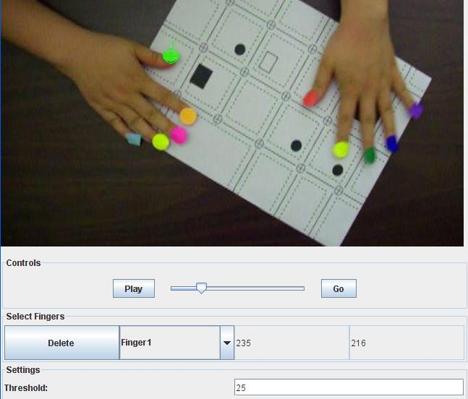
Solution
Setting threshold to Track RGB
Notes:
06/01/09

Slide 9
Solution
1: Get pixels from frame.
2: Find pixels that match each tracking color.
3: Calculate centroid and save.
4: Start over with the next frame.
Notes:
06/01/09

Slide 10
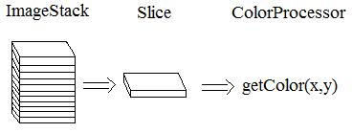
Getting pixels from frame.
During creation of the TrackingWindow, ImageJ is used to get an ImageStack of all the frames in the movie.
Pull out pixel information from the desired “slice” in the ImageStack.
Notes:
06/01/09

Slide 11
What pixels to get?
For efficiency only pull out a small subset of the pixels if we can.
If all centers where found for the previous frame
Then only grab the pixels from a small box around each center.
Else if any center was not found previously
Then grab all the pixels from the frame (since we do not know where to look for the center of one ore more finger).
Notes:
06/01/09

Slide 12
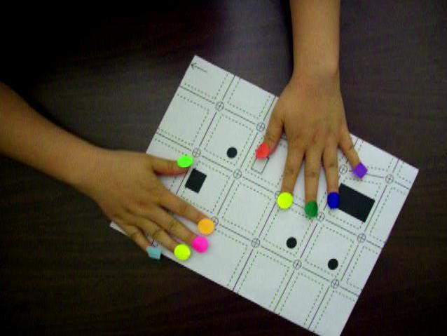
All pixels
Notes:
06/01/09

Slide 13
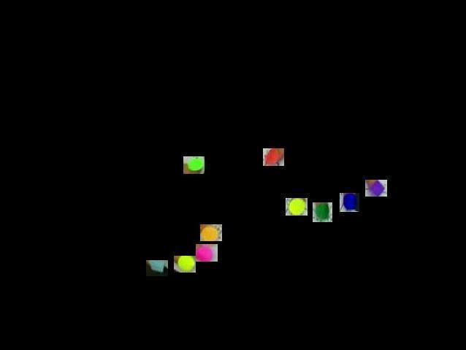
Subset
Notes:
06/01/09

Slide 14
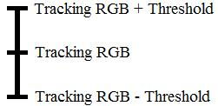

Find pixels that “match” the tracking finger color.
For all pixels grabbed earlier
If pixels red component ≈ tracking color red ± threshold value
If pixels green component ≈ tracking color green ± threshold
If pixels blue component ≈ tracking color blue ± threshold
Then update the running tally with the information from that pixel.
Three running tallies to keep track of for each finger to track.
x_total
y_total
count
Notes:
06/01/09

Slide 15
Calculate centroid and save.
For each tracking finger.
Center x for that finger = x_total / count
Center y for that finger = y_total / count
For each frame the color being tracked can be updated if there are lighting issues in the video. For example if there are a lot of shadows in the video the RGB values can change drastically.
Notes:
06/01/09

Slide 16
Open Problems
Image Registration
Non-RGB tracking
Video Formats
Video Setup
Notes:
06/01/09

Slide 17
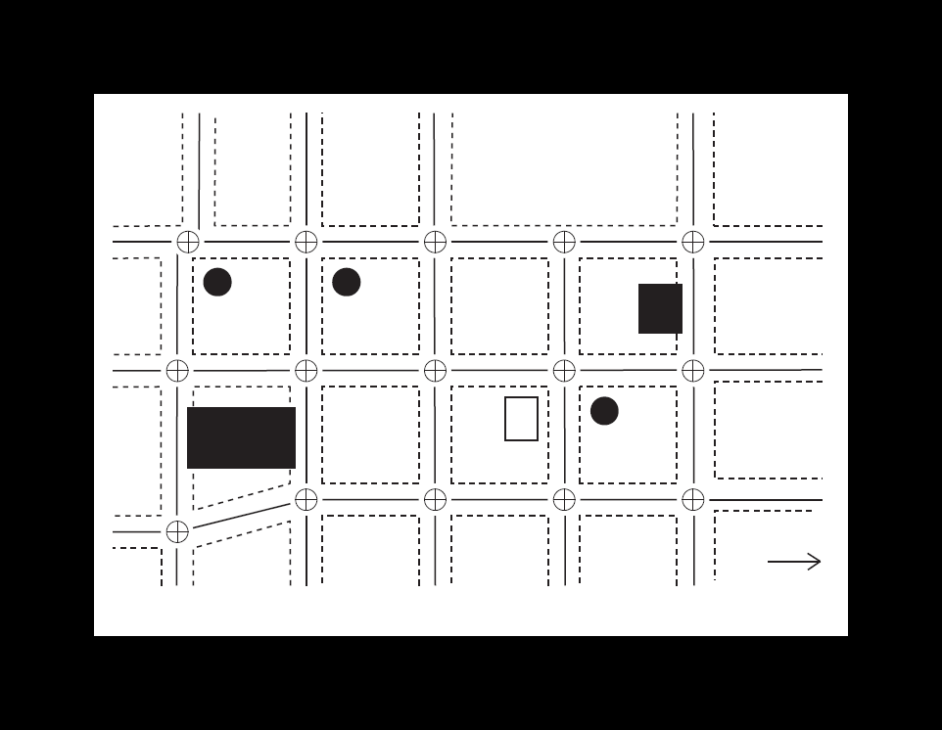
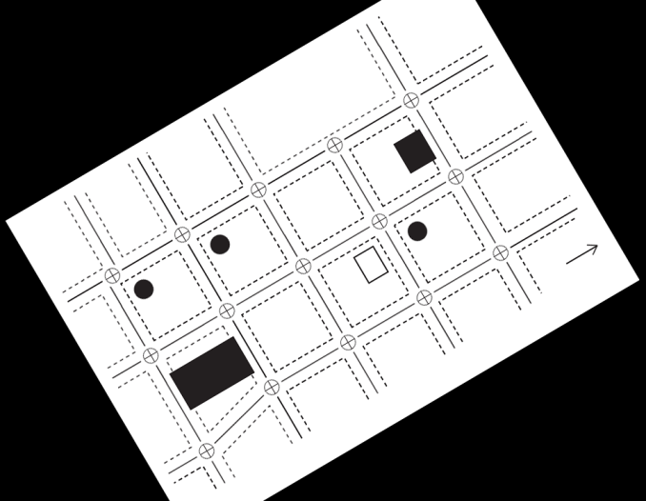
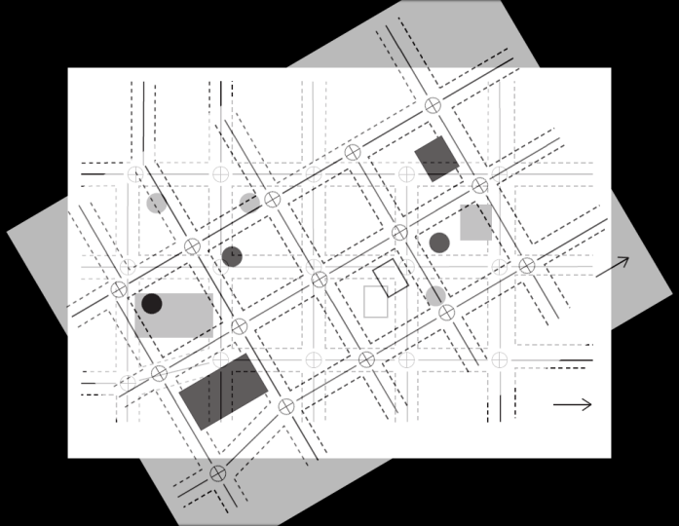
Open Problems
Image Registration
What happens when the user is allowed to move the map?
Notes:
06/01/09

Slide 18
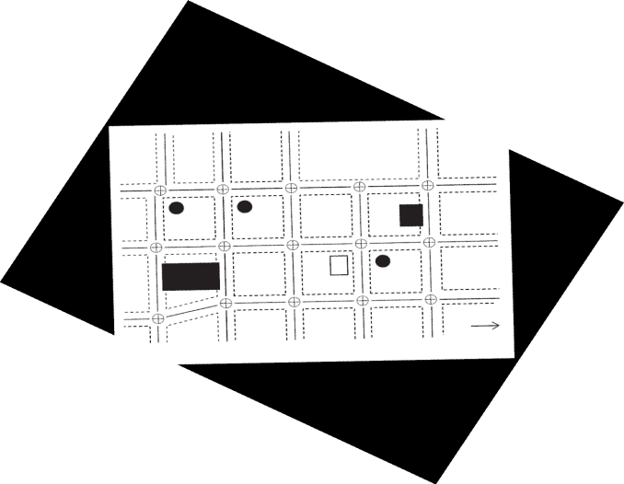
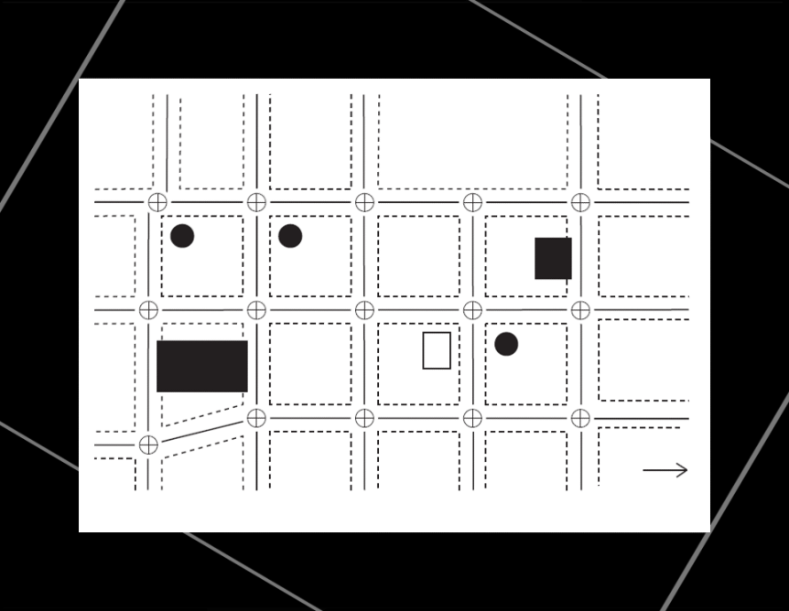
Open Problems
Image Registration
StackReg and TurboReg, ImageJ plug-ins, were used with permission by Philippe Thévenaz.
Notes:
06/01/09

Slide 19
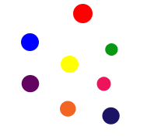
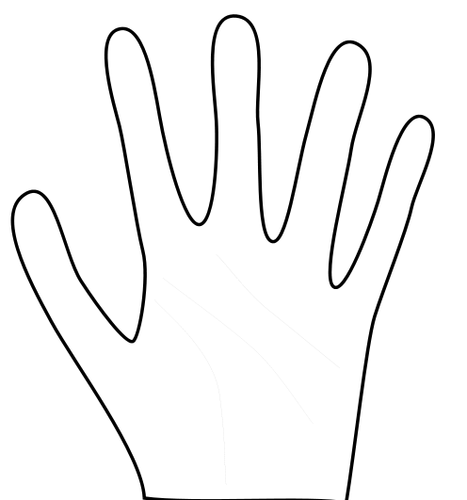
Open Problems
Finger Tracking
Color vs. Shape
Notes:
06/01/09

Slide 20

Open Problems
Video Format
Image J
Any
Other
Format
uncompressed avi
mjpeg avi
Notes:
06/01/09

Slide 21
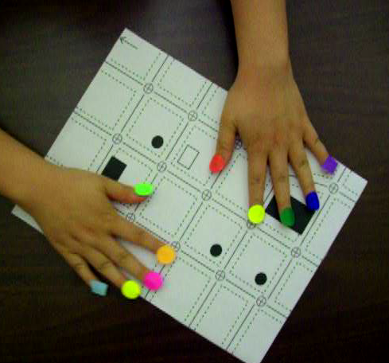
Open Problems
Video taking technique
The accuracy of processing depends on the quality of video:
Lighting (most important)‏
Distinguishable Label Colors
Camera
Actual Color
Notes:
06/01/09

Slide 22
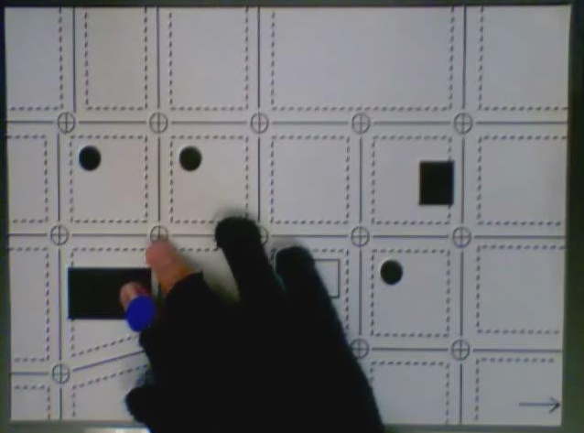
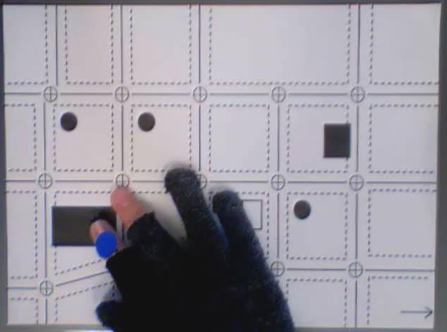
Open Problems
Video taking technique
The accuracy of processing depends on the quality of video:
next
frame
If the light changes drastically, the labelled color will change too.
Notes:
06/01/09

Slide 23
Conclusion
Thanks for coming.
Questions?
Notes:
06/01/09

