Slide 1


Slide 2

Caching in the Air:
Exploiting D2D Content Caching for 5G Systems
Presented by:
David Ungar
Rene Midouin

Slide 3
OVERVIEW
Significance of the problem
Existing approaches
Contribution
Results achieved
Conclusion and future work

Slide 4
Significance of the problem
1
High demand of rich multimedia services

Slide 5
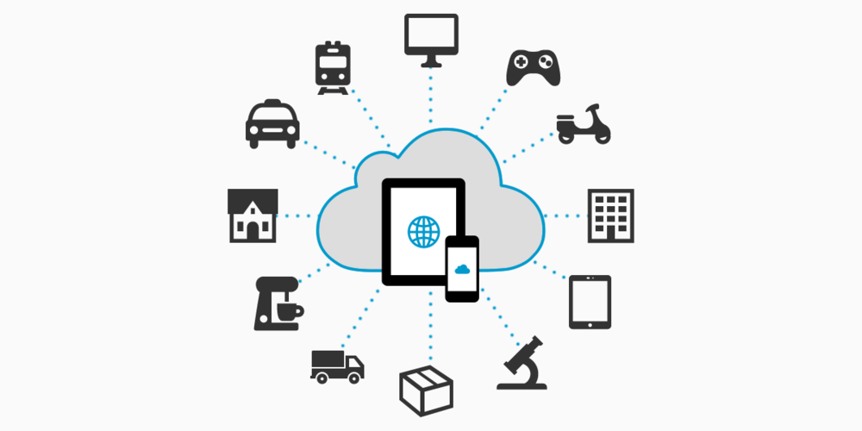
50B connected things by 2020.

Slide 6
Existing approaches
2
Caching at EPC: web caching, redundancy elimination; caching at RAN

Slide 7
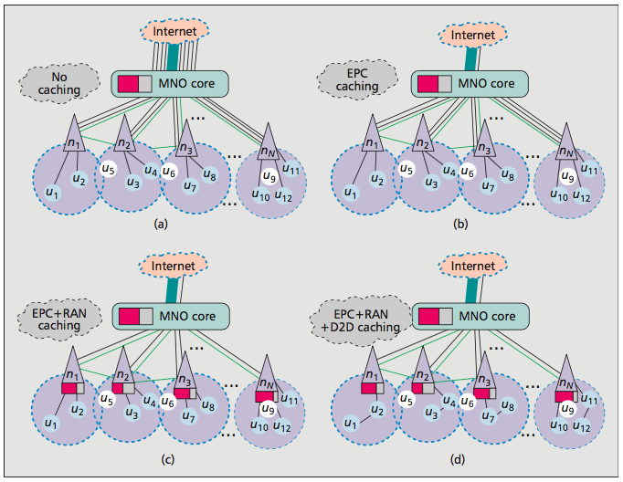
EXISTING APPROACHES

Slide 8
EXISTING APPROACHES – Caching within EPC
1. Web Caching
URL-Based Web Caching (same-different, different-same, one-time use)
Prefix-Based Web Caching (check N-bytes and content-length. N is vital)
2. Redundancy Elimination (RE)
Chunk-Level RE (solve url issue, lacks awareness of content, no coop-caching)
TCP-Level RE (TCP flow, overhead)
Packet-Level RE (IP packet chunk, upstream remove redundant, downstream reconstruct, explode index size)

Slide 9
EXISTING APPROACHES – Caching at RAN
Caching at network edge, reduce network traffic and improve QOS.
eNBs tunnels between users and EPC packetize contents using GTP, making it difficult to carry object-oriented or content-aware caching.
Use byte caching technique at network layer, cache common sequence of data, cache repetitive portion of an object
Penetrate into byte string, cache often used byte, and eliminate redundant ones
Caching space at eNBs is small
Intelligent caching resource allocation strategies and cooperative caching policies among (neighboring) eNBs is mandatory for efficient RAN caching.

Slide 10
Contribution
3
Caching with D2D – Improved Caching Policy

Slide 11

Contribution
INTERNET
A
20ms
EPC
20ms
B
RAN
5-10ms
C

Slide 12
Contribution
Flowchart of Code
For Lots of Times
For Each User
Request a Random File
Check if the File is in Cache
YES
NO
-Access -Update Delay, etc.
-Access -Update -Cache (LRU)

Slide 13
Results Achieved
4
Improved latency using D2D

Slide 14
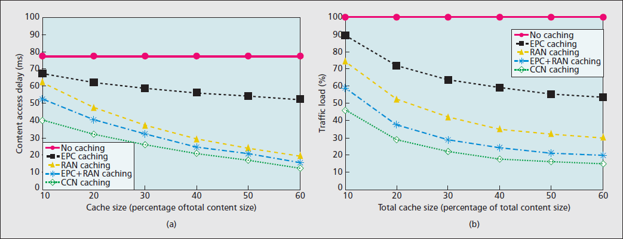
RESULS ACHIEVED

Slide 15
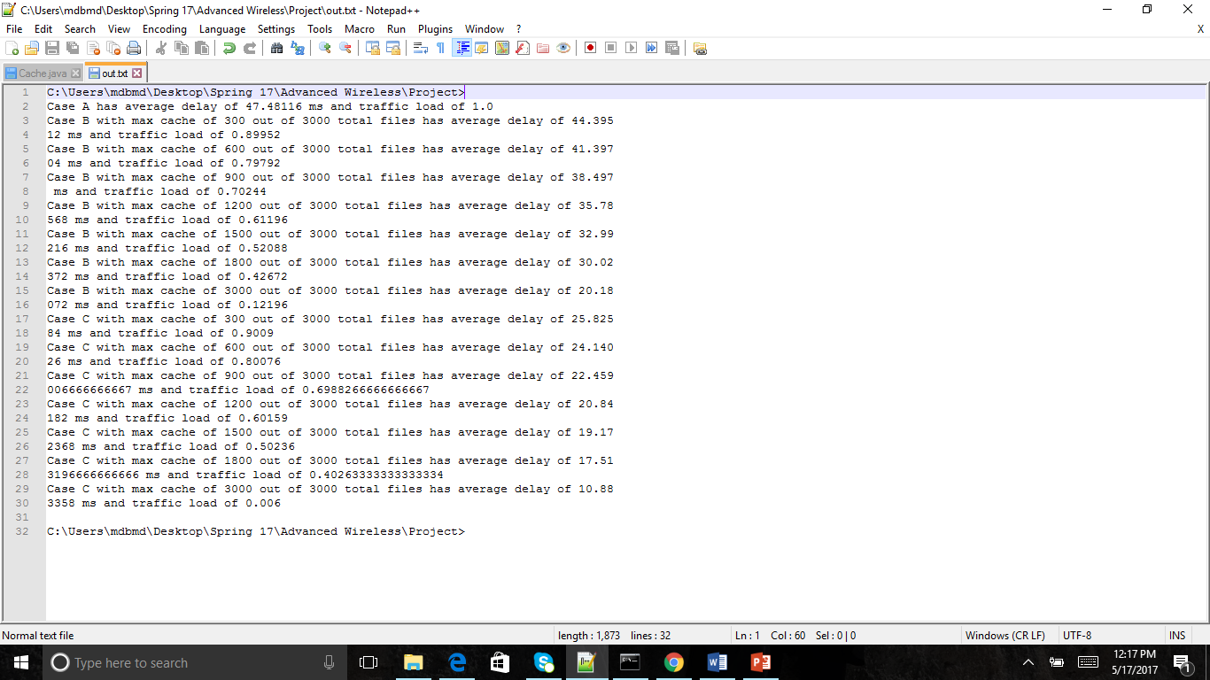
RESULS ACHIEVED

Slide 16
RESULS ACHIEVED

Slide 17
RESULS ACHIEVED

Slide 18
Conclusion and future work
5
Cooperative caching policy

Slide 19
CONCLUSION AND FUTURE WORK
Caching with Device-to-Device:
Local caching and sharing techniques such as device-to-device (D2D) will drastically improve Wireless Communication
Has the potential to contribute significantly to 5G latency goals
Main Challenges (future research potential):
Cooperative caching policy
Complex caching algorithm for D2D
Security, Privacy, and Legal concerns

Slide 20

CONCLUSION AND FUTURE WORK

Slide 21
Thanks!
ANY QUESTIONS?
You can find us at
David Ungar: davidungar87@gmail.com
Rene Midouin: renemidouin@gmail.com

